Slide 1
Unclaimed Support: Changes in the Take-Up of Means-tested Benefits in the UK since 2008
Daria Popova ª, Melchior Vella ª , Lavinia Mitton ^{b} and Matteo Richiardi ª
ª ISER, University of Essex
^{b} University of Kent
Workshop “New Evidence on Benefit Take-Up: Determinants, Measurement, and Policy Implications” May 19, 2026

Slide 2
Motivation
Many households do not claim benefits they are entitled to receive.
International evidence shows that benefit non take-up is widespread across different types of programmes and persistent over time.
This matters because non take-up:
  reduces the effectiveness of social policy in alleviating poverty;
  leaves some vulnerable households without support;
  but may also reflect deliberate non claiming among relatively better-off eligible households.
Why This Study Is Needed
In the UK, official take-up statistics are limited and no regular estimates are published for important benefits such as Universal Credit.
Existing UK academic studies are:
  often dated;
  focused on individual benefits;
  based on aggregate data;
  unable to track longer-term trends.

Slide 3
Objectives
First comprehensive assessment of benefit take-up trends in the UK, 2008 to 2023
Estimate take-up rates for the three main UK means-tested programmes:
  Child Benefit
  Universal Credit and legacy benefits
  Pension Credit
Use a transparent microsimulation approach based on the Family Resources Survey and UKMOD, similar to the approach used by the Department for Work and Pensions.
Identify which eligible households are least likely to claim.
Assess whether changes in take-up are driven by:
  changes in the characteristics of eligible households,
  or changes in behaviour, policy design, and claiming incentives.

Slide 4
Why Do Eligible Households Not Claim?
Two types of allocation errors
  Inclusion errors: benefits are paid to people who are not eligible.
  Exclusion errors: eligible people do not receive benefits.
  Benefit non take-up is a form of exclusion error.
Main drivers of non take-up
  Costs of claiming: time, paperwork, stigma, and uncertainty may outweigh the expected gain.
  Programme design: complex rules and burdensome application processes reduce participation.
  Conditionality and sanctions: increase the perceived cost of claiming.
  Benefit size: smaller entitlements are less likely to be claimed.
  Past claiming experience: households that have claimed before are more likely to claim again.
Implications
  Low take-up does not necessarily imply weak need. It may indicate that the system is too complex or difficult to navigate.
  Persistent non take-up among better-off eligible households may reflect self-screening rather than policy failure.
  Who does not claim matters as much as the overall take-up rate.

Slide 5
Measuring non take-up
Notes:
Numerator errors: Means tested benefits are particularly prone to underreporting; the FRS is known to under sample benefit recipients.
Denominator errors: Errors in simulating eligibility are possible due to imperfect survey data (e.g. short observation window, no contribution history data, etc.)
As both numerator and denominator come from the same data source, some of these distortions offset each other in the ratio. In the worst case, take up estimates are biased downward and should be viewed as a lower bound.
We cannot account for implementation issues may also reduce observed take up: delays, administrative mistakes, and miscommunication can prevent eligible individuals from receiving benefits even when eligibility is correctly simulated.
Error rate helps us assess the robustness of take-up estimates.

Slide 6
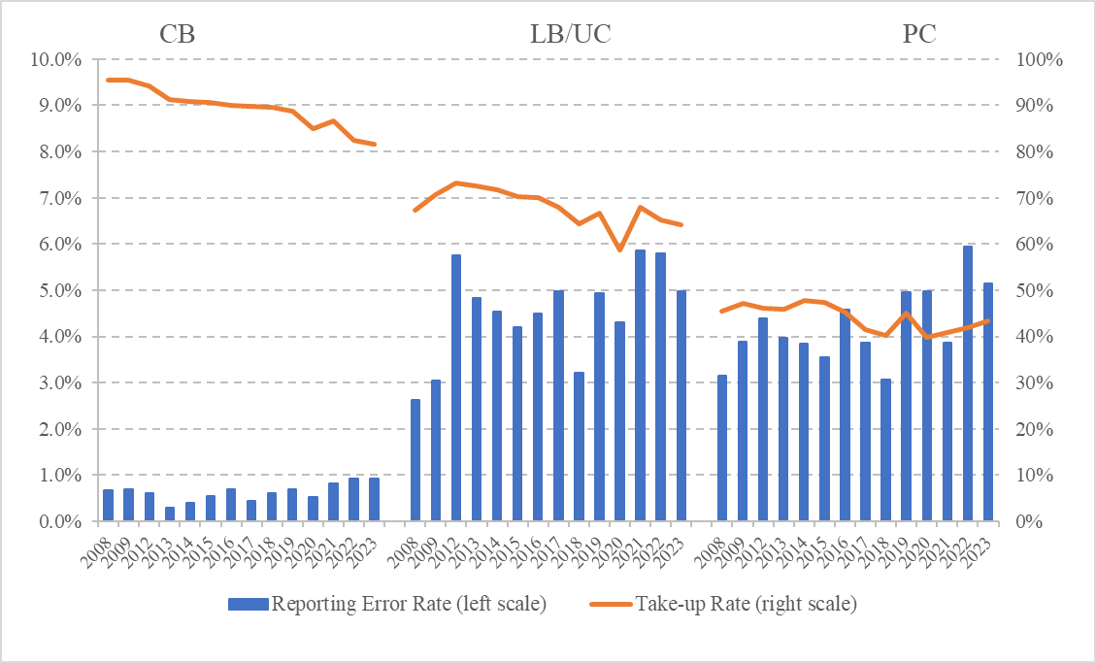
Take-up and Error rates (at BU level)
Notes:
CB take up is highest but has declined from about 90 percent in 2008 to about 80 percent in 2023, likely due to the HICBC introduced in 2013.
One limitation: UKMOD is only able to assess joint eligibility for UC and legacy benefits (LB) during the UC roll-out period, which spans years 2015-2023.
LB/UC dropped from 70 to 60 percent by 2023. A temporary rise in 2021-22 following the pandemic.
PC remains persistently low, fluctuating between 40 and 50 percent with no lasting improvement.

Slide 7
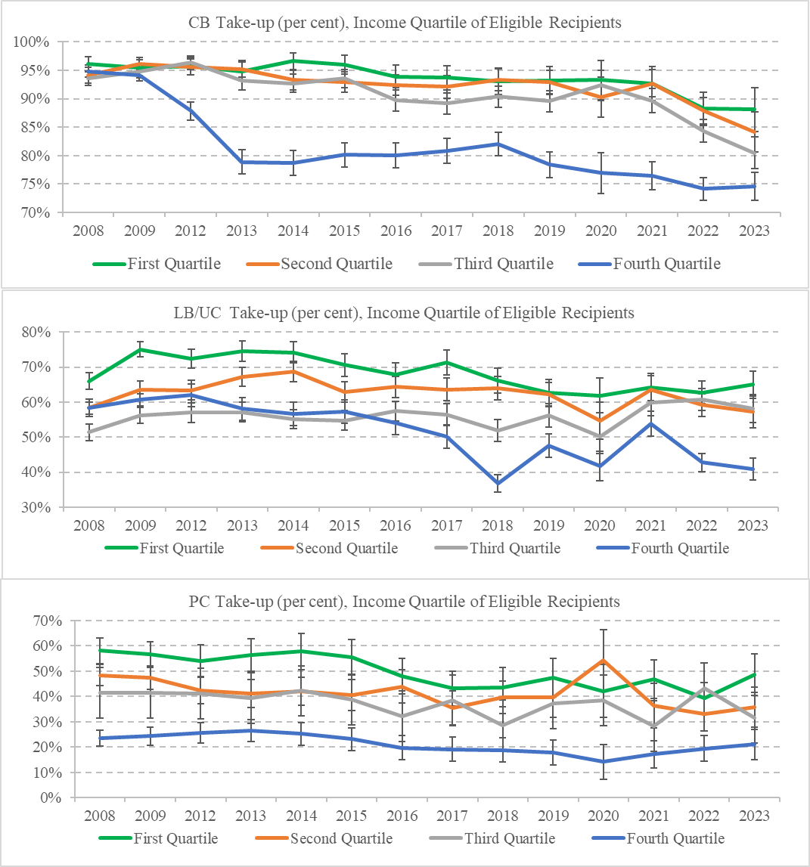
Heterogeneity in Take-Up: by income quartiles
CB: Sharp & persistent drop in the top quartile after 2013
LB/UC: Quartile differences more modest, but a clear decline emerges in the top quartile from 2017 onward, with the temporary convergence in 2021.
PC: Strongest income gradient, with the widest gap in rates between low and high income groups (28pp)
Very similar results by education

Slide 8
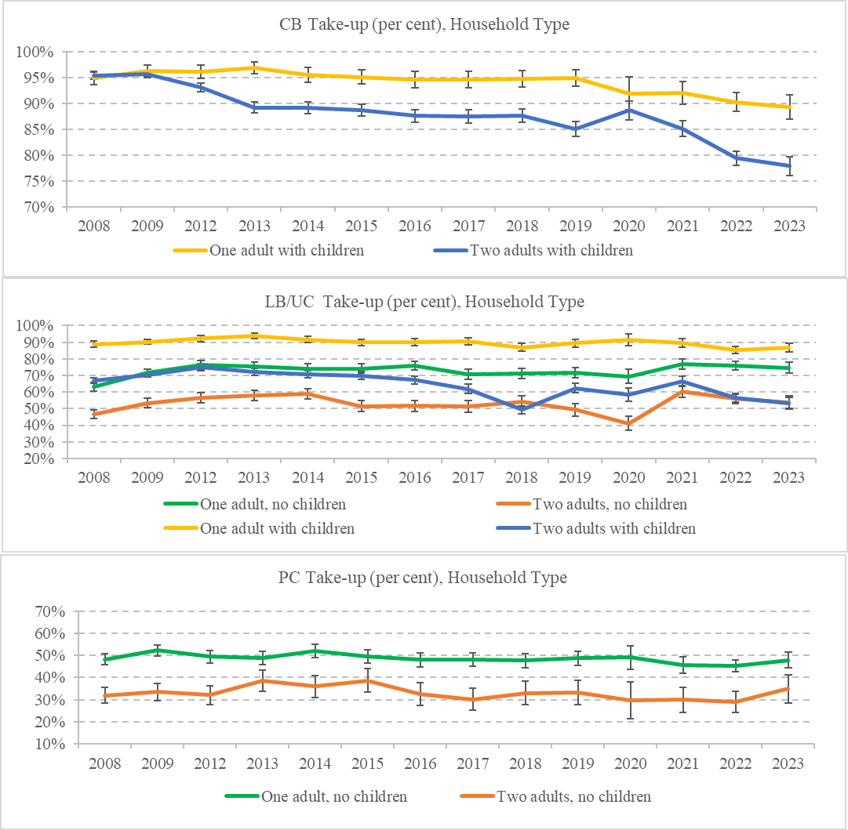
Heterogeneity in Take-Up: by household type
Lone parents stand out with consistently high take-up of both CB and LB/UC, although their take-up rates have declined somewhat since 2020 after remaining close to universal.
For PC, single pensioners are more likely than couples to claim.

Slide 9
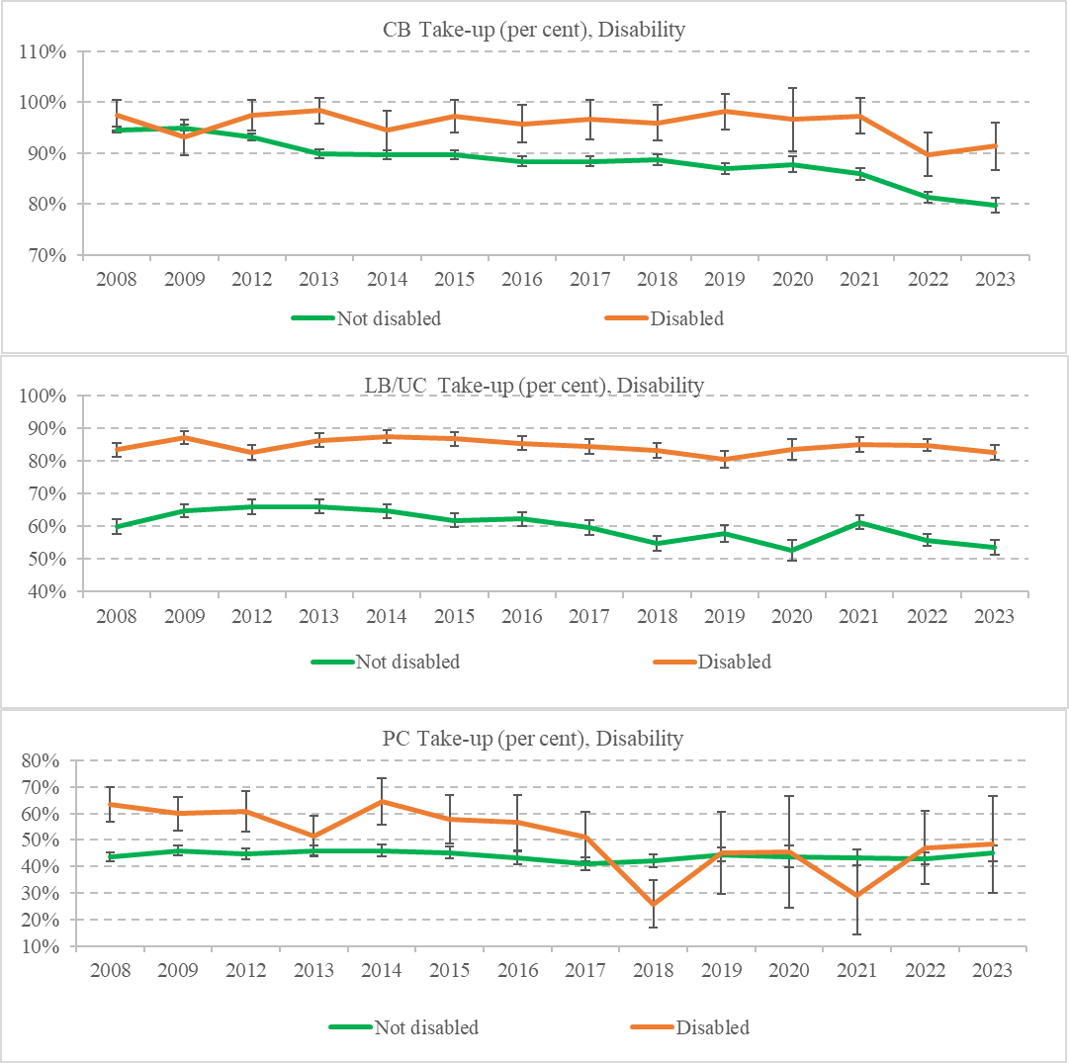
Heterogeneity in Take-Up: by disability status
CB: Gap emerges after 2013 as non-disabled take-up falls.
UC/LB: Stable and sizeable gap, A brief rise for non-disabled appears in 2021.
PC: Higher take-up for disabled individuals, but rates converge after 2016

Slide 10
What Drives Changes in Benefit Take-Up?
Composition Effect or Changes in Who Is Eligible, e.g.:
  More eligible households are pensioners
  More are in work
  Average entitlement amounts are larger or smaller
  The regional distribution shifts.
Behaviour/Policy Effect or the combined impact of policy reforms and behavioural responses, e.g.
  Benefit rules become simpler or more complex
  Administrative barriers increase or decrease
  Awareness improves
  Stigma changes
  Conditionality and sanctions change
Interaction Effect, part of the change reflects both forces operating together, for example when the composition of eligible households changes at the same time as claiming behaviour changes.
This approach allows us to answer a simple policy question: Did take-up change because (1) the eligible population changed, or because (2) the system became more or less effective at converting entitlement into receipt?
Empirical Implementation: We compare take-up in 2008 with each subsequent year up to 2023 for households eligible for CB, UC/LB and PC. The analysis controls for: Income, Employment status, Household composition, Presence of children, Disability, Region and Simulated benefit amount.

Slide 11
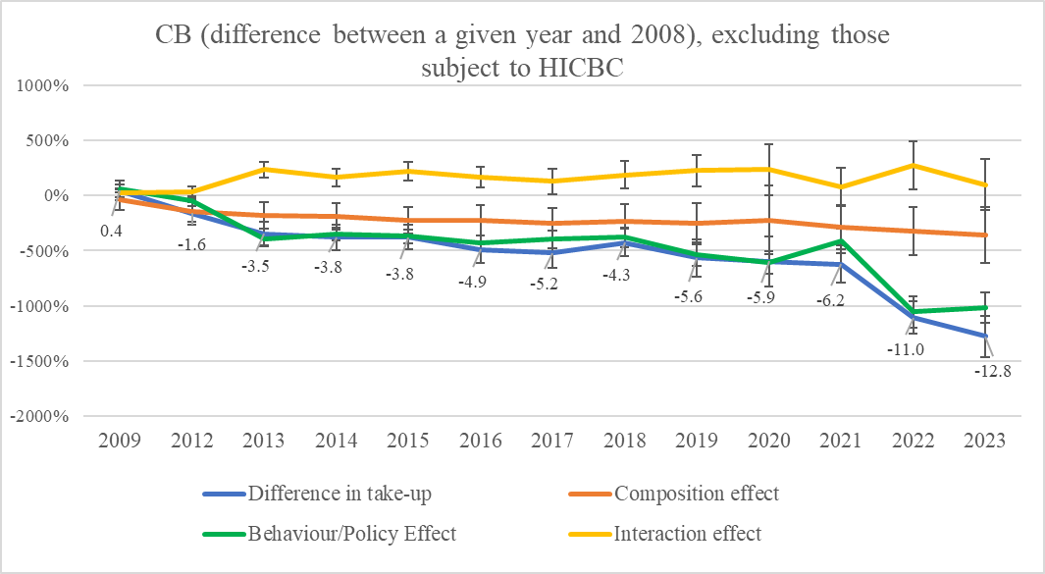
Decomposition of Changes in Take-up: CB
The fall in CB take-up relative to 2008 is overwhelmingly explained by Behavior/Policy effect,
not by changes in who is eligible
Notes:
Claimants affected by the High Income Child Benefit Charge are excluded.
Take-up fell steadily, reaching around 13 percentage points below the 2008 level by 2023. The shift begins around 2013, coinciding with the introduction of the HICBC.
Changes in the composition of eligible families explain very little of this decline.
The main driver is the coefficient effect, indicating a change in claiming behaviour.

Slide 12
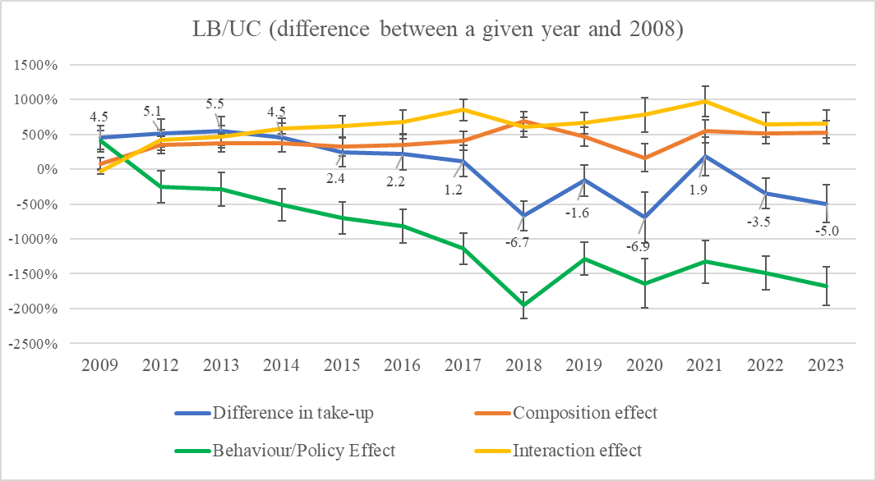
Decomposition of Changes in Take-up: LB/UC
The decline in take-up relative to 2008 is driven almost entirely by Behavior/Policy effect, while Composition changes should have increased take-up.
Notes:
Take-up was above the 2008 level in the early 2010s, but fell to around 5 percentage points below baseline by 2023.
Changes in the characteristics of eligible households would have increased take-up over time.
The interaction effect is also positive and reinforces this pattern.
These positive effects are more than offset by a large negative coefficient effect.
This suggests that the main driver of declining take-up is a change in claiming behaviour, rather than changes in the eligible population.
The timing is consistent with the rollout of Universal Credit and associated uncertainty and conditionality.

Slide 13
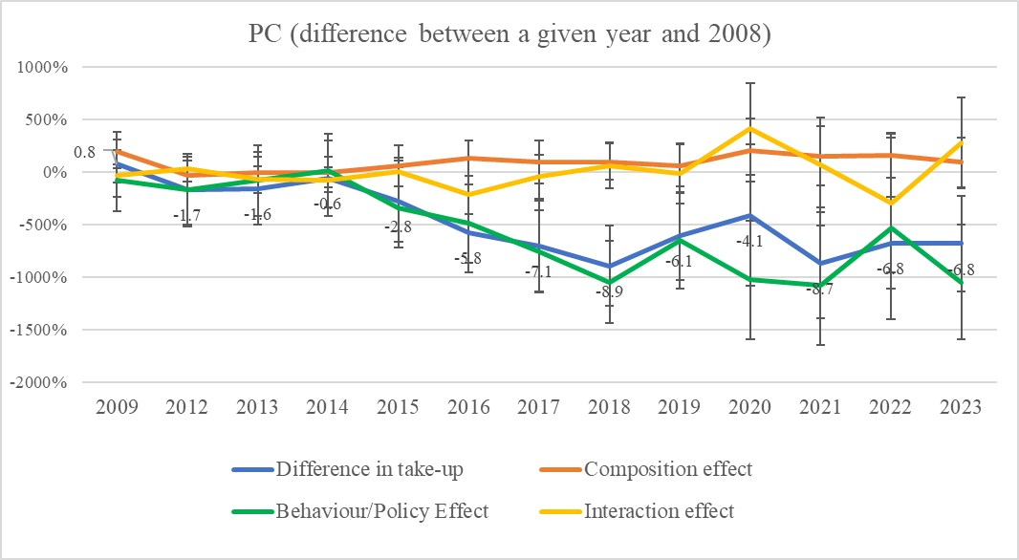
Decomposition of Changes in Take-up: PC
Strongly negative Behavior/Policy effect since 2016 explains the decline in take-up, outweighing small Compositional shifts.
Notes:
Take-up remained close to the 2008 level until around 2015, then fell by about 7-9 percentage points.
Changes in the characteristics of eligible pensioners explain very little of this decline.
The interaction effect is small and unstable.
The coefficient effect is the main driver, becoming increasingly negative from 2015 onwards.
This suggests that declining take-up is primarily due to changes in claiming behaviour.

Slide 14
Discussion and Conclusions
Take-up has declined over time, most notably for Child Benefit.
Non take-up is more common among eligible households with higher incomes and higher education.
More disadvantaged groups, including lone parents, disabled individuals, and single pensioners, are more likely to claim.
Decomposition results show that declining take-up is driven mainly by behavioural/institutional changes rather than shifts in the characteristics of eligible households.
Ongoing research by CEMPA examines the long-term consequences of non take-up for poverty, employment, and health using longitudinal data.

Slide 15
Full report:
Unclaimed Support: Changes in the Take-Up of Means-tested Benefits in the UK since 2008. CeMPA Working Paper 6/26
dpopova@essex.ac.uk

Slide 16
Additional Slides

Slide 17
Means-tested benefits included
 | CB | LB/UC | PC
Type | Universal until but withdrawn at high income from 2013 | Means-tested (income and asset-dependent) | Means-tested (income and asset dependent)
Complexity | Near-universal for families with dependent children, simple application, automatic for most births; few updates | Complex and fragmented eligibility rules across multiple programmes, frequent reassessments and onerous reporting requirements for changes in income, work status, or household composition | Complex income/asset rules, application process can be complex for older adults
Payment regularity | Predictable, stable. Paid every 4 weeks (weekly option for single parents or low-income households) | Amount depends on assessment, LB paid on different schedules, UC paid monthly in arrears | Predictable, stable. Paid every 4 weeks or quarterly; depends on individual choice and banking arrangements.
Interaction with employment | Affected by earnings (if above HICBC) | Strongly interacts with earnings and hours worked | Not affected by employment
Conditions attached to receipt | None | Work-related conditions (e.g. job-seeking, work preparation), reporting requirements, sanctions possible | None
Coverage, percent of all benefit units, 2023 | 8.1 percent | 8.1 percent | 1.6 percent
Average monthly amount in BU, 2023 | £160 | £910 | £494

Slide 18
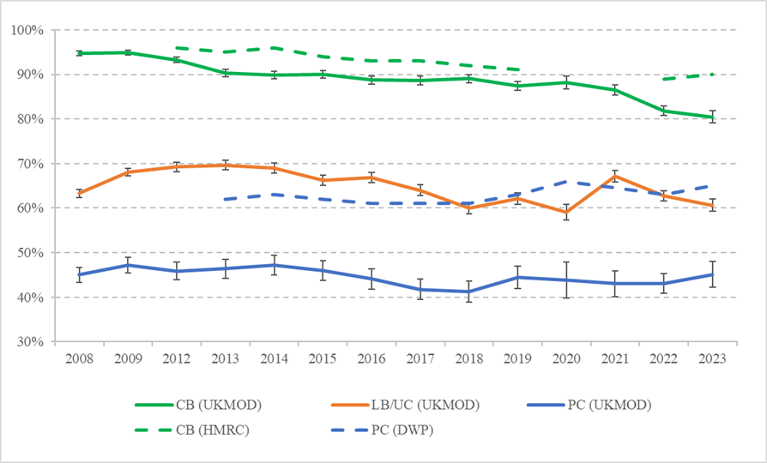
Take-Up Rates in UKMOD-FRS vs DWP
Notes:
Good match for CB
No Stats for UC/LB
Big mismatch for PC (may be due to the FRS sample bias or problems with our simulated eligibility)

