Slide 1
Trends in child benefit take-up in the UK since 2008
Evidence from UKMOD and the Family Resources Survey, 2008–2023
Lavinia Mitton (University of Kent)
Melchior Vella, Daria Popova and Matteo Richiardi (ISER, University of Essex)
L.Mitton@kent.ac.uk

Slide 2
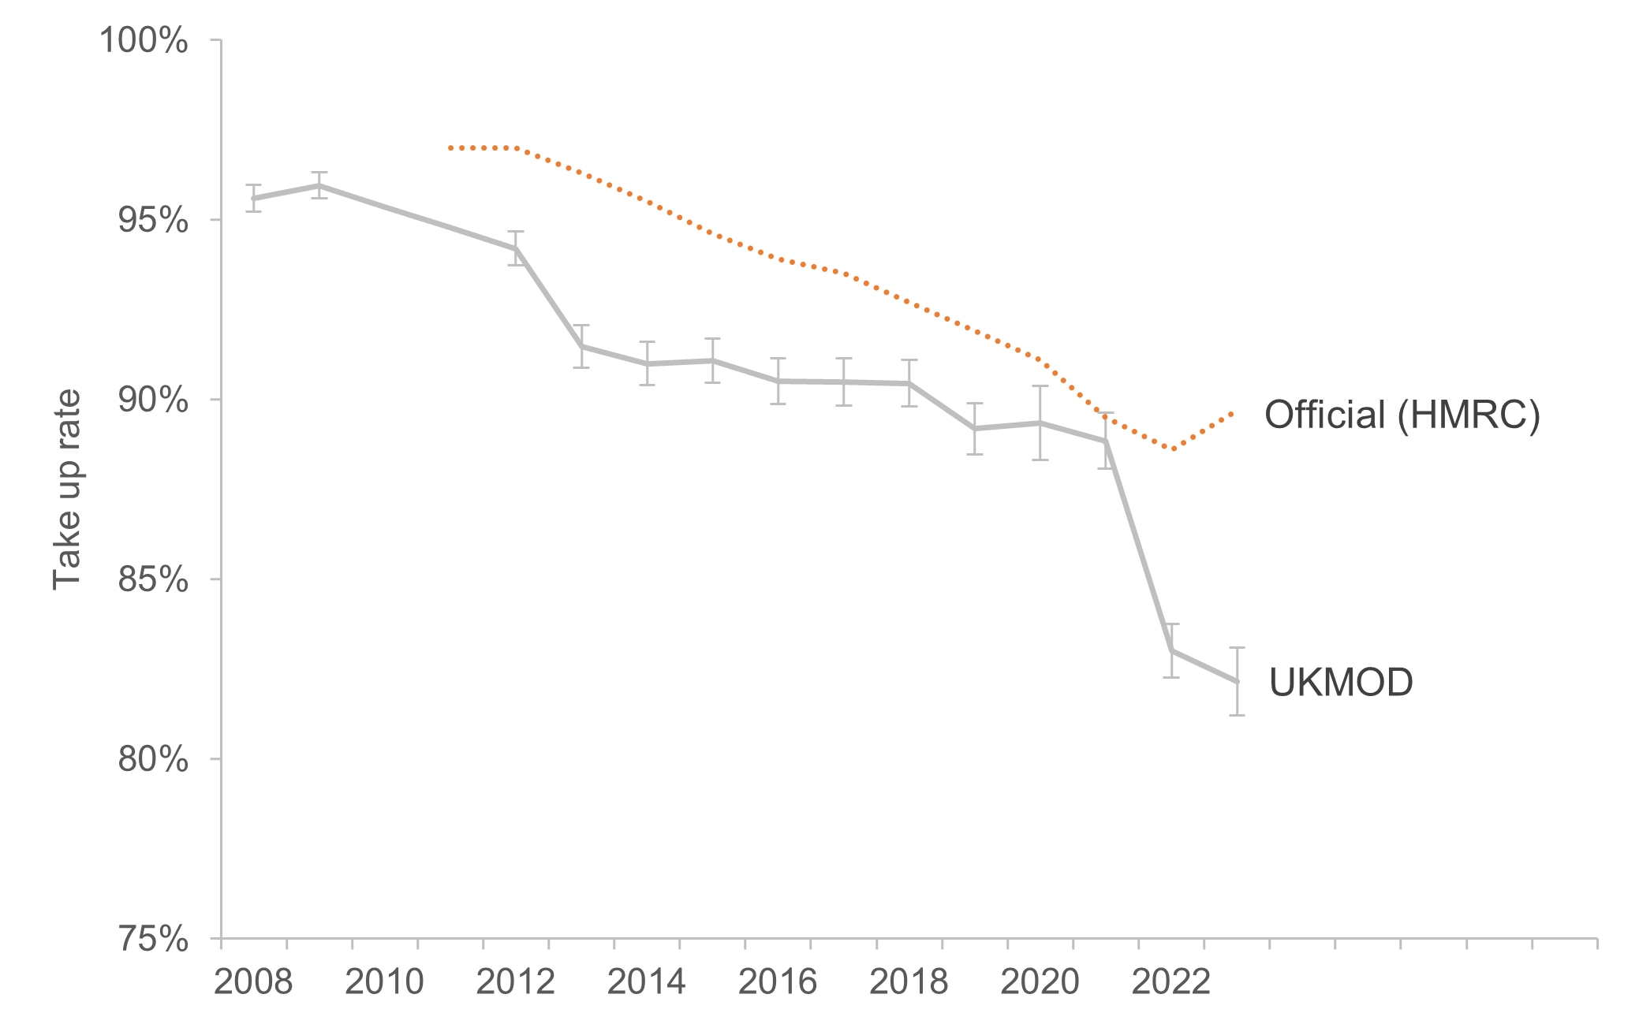
Child Benefit take up rates, UK, 2008-2024
Child Benefit take-up fell from around 96% to 81%
Notes:
Good morning. Today I’m going to present new evidence on trends in Child Benefit take-up in the UK since 2008.

Slide 3
Why Child Benefit matters
Paid to 6.9 million families
Historically near-universal
Important for family incomes and child poverty
Even modest declines in take-up can translate into substantial income losses.
Notes:
Child Benefit remains one of the UK’s largest family benefits, reaching nearly seven million families.
Although it is relatively modest in value, it matters because of its scale and because it reaches families with children across the income distribution.

Slide 4
Complexity of application process | Low: Simple online form or paper application; automatic for most births
Who Is Eligible | All parents/guardians with qualifying children (under 16 or under 20 in education)
Frequency of Payment Changes | Infrequent: Fixed monthly/weekly rates; affected only by policy uprating or HICBC
Payment Frequency | Every 4 weeks (weekly option for single parents or low-income households)
Conditions Attached to Receipt | None (unless affected by HICBC; even then, opt-out is voluntary)

Slide 5
The policy change
Before 2013 → Universal
After 2013 → Targeted through tax system
Earnings | Percentage to be repaid | Benefit charge for one child to be repaid | Benefit charge for two children to be repaid
£60,000 | 0% | £ - | £ -
£65,000 | 25% | £338 | £562
£70,000 | 50% | £677 | £1125
£75,000 | 75% | £1015 | £1688
£80,000 | 100% | £1354 | £2251
Notes:
Families above the threshold faced new administrative burdens and self-assessment requirements.

Slide 6
What happened to Child Benefit take-up after the High Income Child Benefit Charge?
Notes:
Child Benefit is interesting because it gives us something close to a natural experiment. Before 2013 it was essentially universal; after the introduction of the High Income Child Benefit Charge, it became partially targeted.

Slide 7
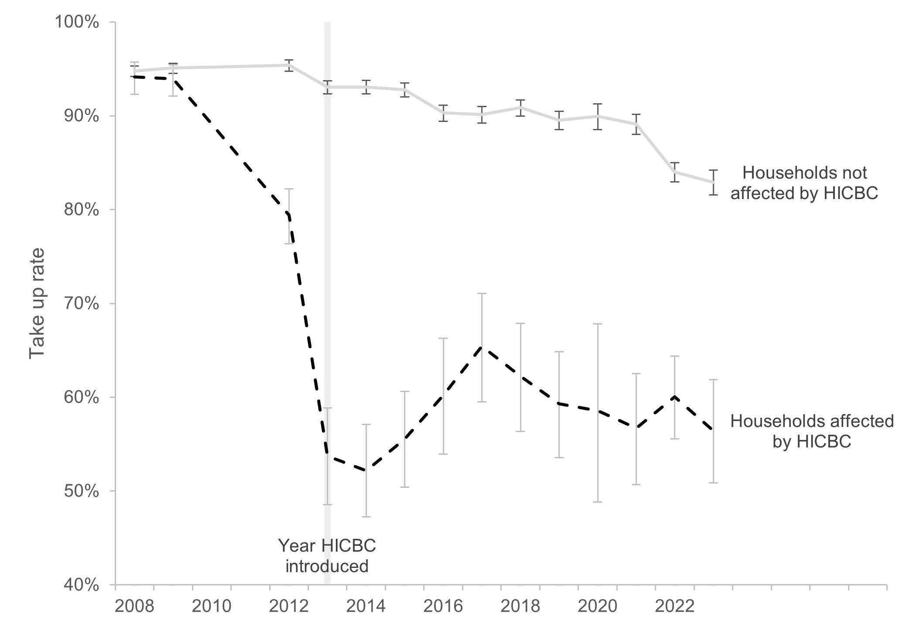
Child Benefit take up rates
Declines in take-up extending beyond families directly affected by the HICBC
Notes:
From a take-up perspective, it is also unusually useful analytically because the institutional design changed quite sharply in 2013.
The headline finding is straightforward: take-up has fallen substantially — from around 96% to 81% — but importantly, the decline is not confined to higher-income households affected by the reform.
This is the main trend.
Child Benefit take-up was extremely high prior to 2013 — consistently around 96%.
Following HICBC, we see an immediate drop, followed by a continued downward trend through to 2023.
The timing strongly suggests that the reform mattered, although I should stress this is not a causal identification paper.
The decline was not only among higher-income families
What I think is the most policy-relevant finding is here.
As expected, take-up fell sharply among families directly affected by HICBC.
But what surprised us was that take-up also declined among families not subject to the charge — families fully entitled to receive Child Benefit payments.
That suggests spillover effects. A targeted reform to Child Benefit appears to have reduced take-up not only among higher-income households, but also among families fully entitled to receive payments.
Something about the reform appears to have changed claiming behaviour more broadly.
Put simply: targeting one group may have unintentionally discouraged claiming in another.

Slide 8
Money left unclaimed
Around £1.77 billion in Child Benefit went unclaimed in 2023.
Largest absolute losses: two-child families
Biggest proportional decline: smaller households
Family size | Take-up rate | Unclaimed CB
1 Child | 80% | £627.9m
2 Children | 85% | £698.1m
3+ Children | 88% | £442.2m
Notes:
Why should policymakers care?
Because incomplete take-up means families are not receiving support they are entitled to.
We estimate roughly £1.8 billion in Child Benefit went unclaimed in 2023 alone.
In a period of rising child poverty concerns, that is not trivial.

Slide 9
Why might this have happened?
Extra confusion “I earn too much”
Extra complexity Self-assessment burden
Reduced salience Lower real value of benefit
Notes:
We think three mechanisms are plausible.
First, confusion. HMRC qualitative work shows many families misunderstood eligibility and assumed they earned too much to claim.
Second, transaction costs. Self-assessment created hassle and fear of getting things wrong.
Third, reduced salience. The real value of Child Benefit declined over time, reducing incentives to claim.
Our interpretation is behavioural rather than purely financial: policy complexity seems to matter.

Slide 10
Conclusion
Benefit design affects take-up Targeting may reduce coverage.
Complexity matters Administrative burden changes behaviour.
Policy reforms can have spillovers Even unaffected groups may respond.
Notes:
To conclude, our evidence suggests that the HICBC may have had wider consequences than intended.
The reform appears associated not only with lower take-up among higher-income households, but also among families fully eligible for support.
More broadly, this raises an important question for social policy:
How do we design targeted benefits without reducing visibility, simplicity

Slide 11
Thank you.

