Slide 1
Analysis of Trends in Benefit Take-Up in Greater London Presentation for the University of Essex Policy Workshop
19 May 2026

Slide 2
Purpose
INSIGHTS
Overview of key data insights on benefit take-up rates in London
POLICY
Discuss policy applications of the data by the GLA
LESSONS
Reflect on existing challenges and the way forward

Slide 3
Key insights

Slide 4
Context: Why benefit take-up rates matter
Direct impact
Individuals and households can miss out on important income
Particularly important during periods of cost-of-living pressure
Indirect impact
Eligibility for some services and support can also depend on receipt of benefits
Funding allocations for services may partly reflect local benefit receipts levels

Slide 5
Missing Out 2025: Assumed take-up rates for three key benefits
Missing Out dataset (Policy in Practice, PiP): Regarded by DWP as the best publicly available source of benefit take-up estimates - it compiles assumed take-up rates for 12 benefits using government data sources. It provides estimates of the number and value of unclaimed benefits at local authority level. Crucially, it assumes that benefit take-up rates are constant across local authorities.
Universal Credit (UC)
77% caseload take-up
86% expenditure take-up
Based on official DWP estimates of legacy benefit take-up.
PiP groups UC recipients into four categories (based on work status and claim type) and match them to corresponding legacy benefit take-up rates.
Pension Credit (PC)
62% caseload take-up
71% expenditure take-up
Based on official DWP estimates of Pension Credit take-up.
Estimates are based on matching DWP admin data with modelled FRS data on non-take-up.
Child Benefit (CB)
90% caseload take-up
Uses HMRC estimates of Child Benefit take-up.
Based on comparisons between caseload data and ONS population estimates.*
Notes: caseload and expenditure take-up rates measure different aspects of benefit receipt. Estimates are based on administrative and survey data sources. *For 17–19-year-olds, Child Benefit population estimates are adjusted using full-time education participation rates from the LFS.
Notes:
For all three benefits, caseload take-up rates are applied to local authority claimant counts to estimate total eligible population.
For UC and PC, expenditure take-up rates are then used to estimate the value of unclaimed support, applying the expenditure take-up rate to the total eligible population
For CB*, unclaimed support in each LA is estimated by grouping the existing caseload by number of children and finding the sum of each group's weekly award rate

Slide 6
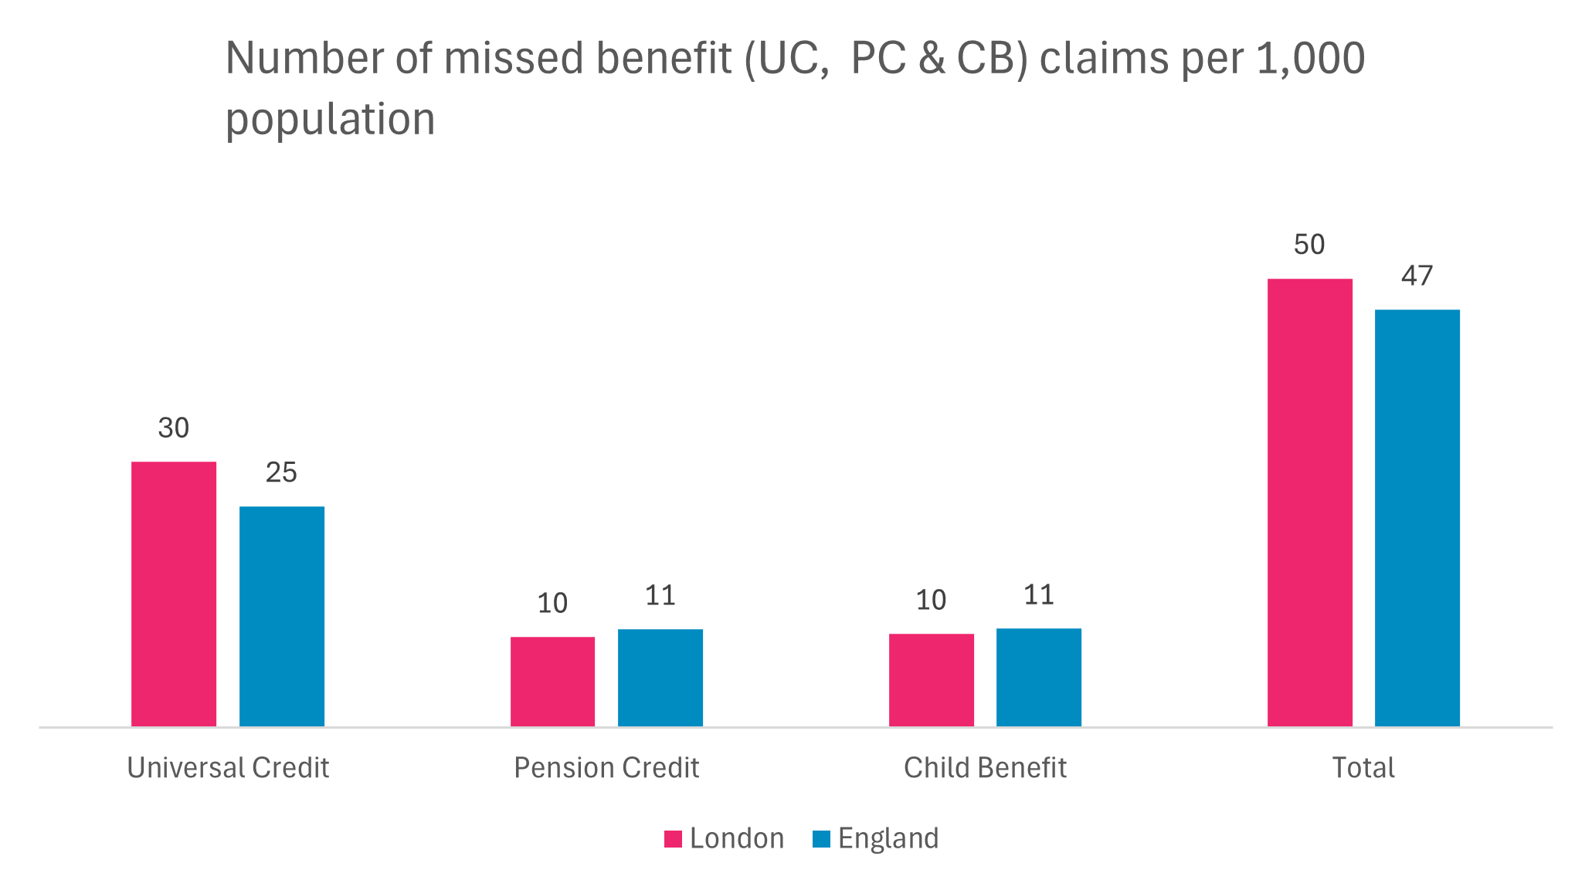
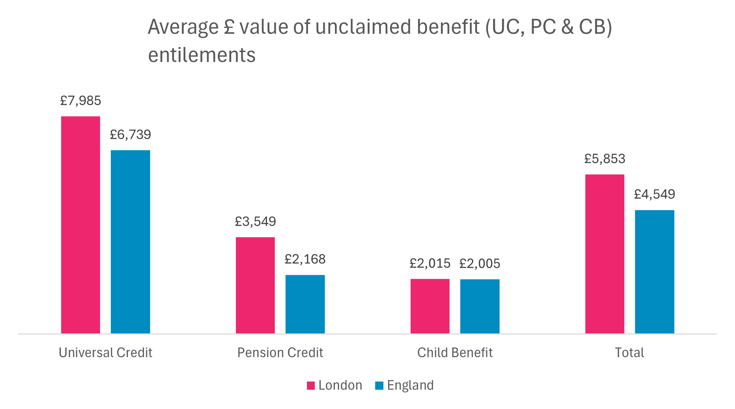
Missing Out 2025: Unclaimed financial support in London and the UK
Slightly more missed claims in London, except for PC, where trend is reversed.
Average value of unclaimed entitlements is also slightly higher in London, around £1,000 pa relative to England.
Since take-up rates are constant, these differences reflect the fact that a higher proportion of Londoners receive benefits (except for PC).

Slide 7
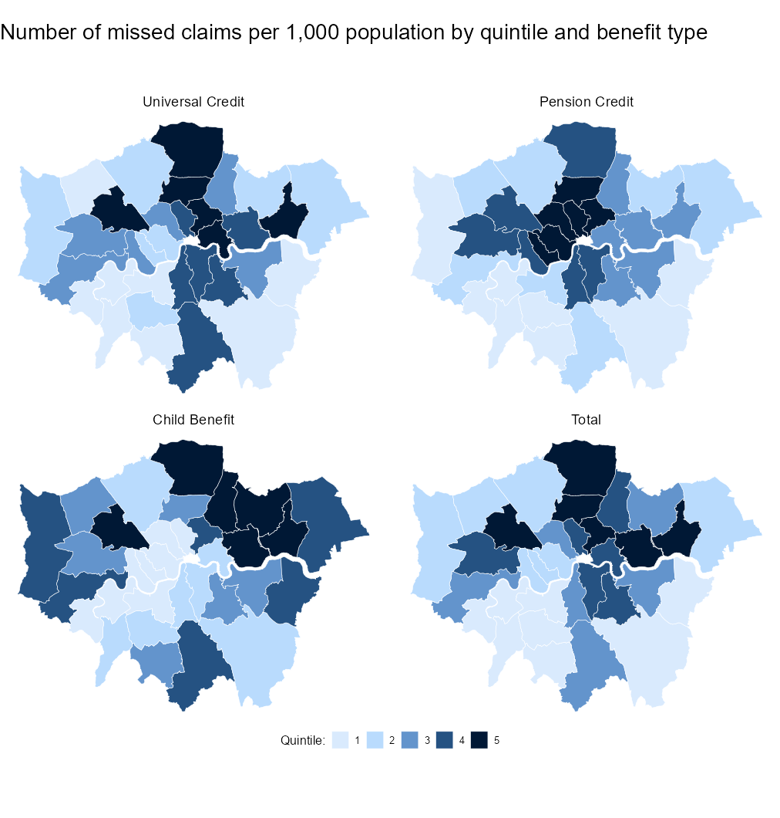
Missing Out 2025: Unclaimed financial support in London by borough
Inner London has a substantially higher share of missed benefit claims than Outer London, except for Child Benefit (more families in Outer London)
This Inner versus Outer London divide is the same pattern observed in data on poverty and deprivation and London.
Again, since take-up rates are constant, variation within London is entirely a function of the fact that a higher proportion of individuals living in Inner London receive benefits.
The data does not capture geographic variation in the demographic determinants of non-take-up.

Slide 8
Policy applications

Slide 9
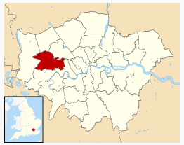
Example 1: Pension Credit in Ealing
Missing Out data showed that £325m of Pension Credit goes unclaimed across London, with approximately 91,000 households missing out on support averaging just over £2,000 per year.
Policy in Practice used Ealing’s local administrative data to identify low-income households of State Pension age who were likely to be eligible but not claiming, with 2,042 households identified.
Using these insights, Ealing sent identified households with letters, outlining potential eligibility and providing guidance on how to claim.
Household financial gains tracked across three phases of campaign activity in Ealing:
510 submitted a claim for Pension Credit
25% conversion rate achieved
£2.5m in annual Pension Credit secured for Ealing residents
Pension Credit also acts as a gateway to additional support (e.g. social tariffs), potentially increasing total financial gains by up to £10,000 per year, if all additional benefits and tariffs are claimed.
According to DWP data, London Boroughs that participated in the Pension Credit campaigns saw an average of 430 claims per local authority compared to 170 in non-participating boroughs – a 150% increase.

Slide 10
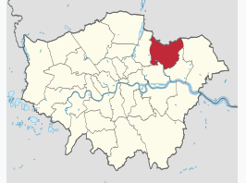
Example 2: Healthy Start vouchers in Redbridge
Missing Out data showed that £7.5m of Healthy Start vouchers go unclaimed in London with 28,000 families missing out on an average of £273 annually.
Policy in Practice used Redbridge’s local data to identify 1,908 low-income families thought to be eligible but not claiming.
Using these insights, Redbridge sent identified households letters, outlining potential eligibility and providing guidance on how to claim.
Household financial gains tracked across two phases of campaign activity in Redbridge:
181 families applied for Healthy Start vouchers
9% conversion rate achieved
£21,517 in annual Healthy Start vouchers secured for families to support the purchase of essential food for children, including milk and fruit
Participating boroughs saw Healthy Start uptake grow by 5.4% following the campaign, compared to a 0.7% decrease in other boroughs during the same time period

Slide 11
Lessons learnt from a policy perspective
Data-informed approaches: Missing Out data helps quantify the scale of underclaimed benefits, strengthening the case for investment in take-up activity at a (sub)regional level and identifying areas of focus.
More effective targeting: Using local authority level data enables a shift from general, mass campaigns to more precise household, cohort, or benefit-specific interventions. This improves cost-effectiveness by reducing unnecessary contact with those already claiming or ineligible.
Prioritisation: data can identify households with the greatest potential entitlement that are not currently claiming, enabling priority contact with those who stand to gain the most.
Tailored communications: GLA-funded Pension Credit letters achieved almost 30% take-up on average, exceeding the 3-4% usually seen from mass marketing. Including personalised messages such as estimated entitlements e.g. “we think you are eligible for £380–£400 per month” and information on passported benefits, further increase response rates.
More effective monitoring: Data enables clear measurement of the return on investment of public spending (e.g. £ claimed per £ spent) at a (sub)regional level and household financial gains are tracked through national and local level data
Impact on take up rates: Household gains are reflected in improved benefit take-up rates in the Missing Out data, for example, a 5% increase in Healthy Start take up in participating London boroughs
Data limitations
For benefits that rely on an individual assessment (such as Personal Independence Payment), eligibility cannot be predicted as precisely as for benefits determined by clearer criteria, such as income or age. The GLA is currently delivering a disability benefits pilot across six boroughs to test approaches in this area.
It is not possible to attribute increases in benefit take-up solely to GLA activity

Slide 12
The way forward

Slide 13
Limitations of PiP's Missing out Data
Take-up rates are applied uniformly across all LAs
Research shows that benefit take-up is highly contingent on demographic characteristics such as income, age, family type, tenure type and ethnicity.
These demographic characteristics vary considerably both within London and between London and rest of the UK.
The use of a range of take-up rates calibrated to the demographic composition of a given LA would allow for more robust estimates of benefit take-up in London, capturing more than just variation in existing caseload.
Take-up estimates draw on a range of different datasets and methodologies
The take-up estimates used to model each benefit in the Missing Out data are produced separately by different government departments, as well as PiP, at different points in time using different data.
Variation in data and method raises questions about the internal consistency of the Missing Out data, limiting comparison of take-up between different benefits and the robustness of combined non-take-up figures.
We would have more confidence if the methods used to produce take-up rates for each benefit were internally consistent, produced on the same data using the same model (where appropriate) and at the same point in time.
Notes:
(including differentTBMs and publication lags)

Slide 14
Limitations with existing GLA policy levers
Engagement: delivery is dependent on borough participation, which can vary due to competing priorities, capacity constraints, and local issues. Borough buy-in is critical, as they hold administrative data needed to support delivery. The current Pension Credit campaign operates in 23 of 32 boroughs and changing participation over time makes it challenging to scale more consistently.
Funding: long-term funding uncertainty across both the GLA and boroughs means campaigns are typically reliant on short-term (12 months or less) pilot funding and time-limited grants. This limits the ability to develop and sustain long-term, strategic approaches to benefit take-up across London. Funding packages also tend not to include dedicated delivery capacity, creating additional barriers for boroughs already facing resource constraints.
Systems: the GLA does not control the benefits system, which is largely administered by DWP. While campaigns can raise awareness and help reduce stigma, they cannot fully address these issues or overcome wider structural barriers, including the complexity of applications.

Slide 15
Other important issues to consider
“Matter” beats “Mind”: we need better demographic data resolution at regional level
London’s unemployment and health-related illness rates as predictors of persistent claims
Spatial inequality in London presents a ‘take-up’ paradox
The introduction of HICBC (2013) likely to have disproportionately affected Londoners more
Non-take-up as a driver of high child and pensioner poverty in London
Freezes, below-inflation uprating, and other changes to benefit design affect Londoners more by virtue of higher living costs

Slide 16
Potential ways to address these challenges
Better coordinate existing benefit programmes to boost take-up rates
How to address data shortcomings (PiP, DWP, etc.)?
UKMOD as a stepping stone and increased academic/policy interaction
Flawed programme design affecting general take-up and aggravating spatial inequalities

