Slide 1

In-depth Analysis plugin
Online training course

Slide 2
Acknowledgement
The InDepth Analysis plugin is the result of the joint effort of the Greek Council of Economic Advisors (SOE), the Directorate General for Structural Reform Support (DG REFORM) , ISER University of Essex and the Joint Research Centre (JRC).
We would especially like to thank the contribution of Christine Lietz , Chrysa Leventi, Eirini Andriopoulou, Kostas Manios and Lazaros Dimitriadis.

Slide 3
Outline of the session
Presentation of the tool
Presentation of examples
Q&A

Slide 4
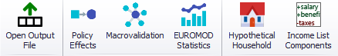
Overview
EUROMOD Applications : Two plugins to obtain summary statistics
Statistics Presenter
Descriptive statistics of income and population
Predefined tables for budgetary and distributional impact
In-depth Analysis
Customized tables for budgetary and distributional impact of reforms

Slide 5
In-depth Analysis plugin: overview
Three categories:
Fiscal (4 tables) ➔ full disaggregation of taxes and benefits: totals and taxpayers/beneficiaries for each
Distributional (8 tables) ➔ totals, means, taxpayers/beneficiaries and winners/losers, by selected breakdown variable(s) and target population
Inequality and poverty (6 tables) ➔ inequality, progressivity, redistribution and AROP rates and gaps
Fully customizable table templates (parameters and titles)
Results shown on screen and exportable to Excel

Slide 6
Main dialog box
Set/load set of parameters
Customisation of parameters
Selection of tables to be displayed
Selection of baseline(s)/reform(s) and labels
Selection of benchmark
Run!
Option for saving merged dataset (variable names starting with b_* for baseline, r1*_for reform1, etc.)

Slide 7
Fiscal tables
Fully customisable tables, same logic as 1.1 and 1.2
Title of the group
Titles of the tables
Reset to default values
Level of analysis
Criterion for identifying benefit receivers
Criterion for identifying other cases

Slide 8
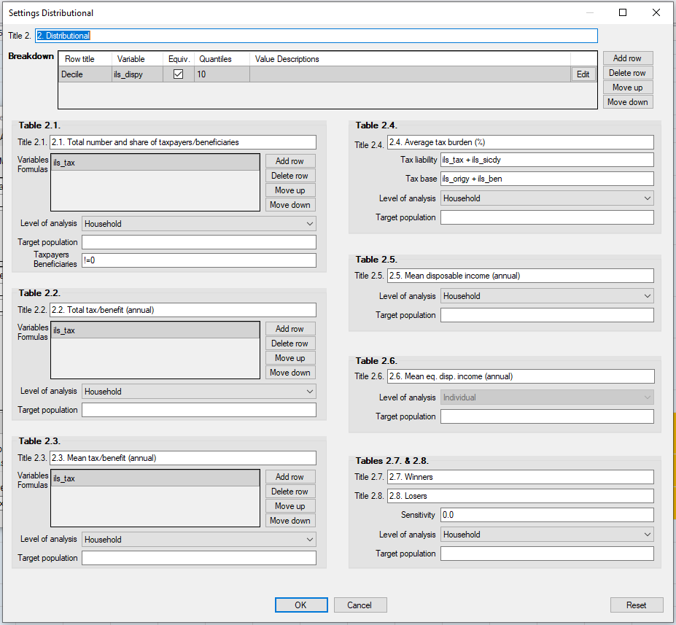
Distributional tables
Breakdown variables for tables 2.x (categorical or quantiles)
Variables for tax burden (or any other ratio)
(Equivalised) disposable income
Variables for number of payers/receivers, totals and means
Sensitivity for identifying winners or losers
Definition of target population (optional)

Slide 9
Inequality and poverty tables
Variables for Kakwani decomposition
Parameters for quantile and inter-decile shares and Atkinson inequality aversion
Population categories for poverty indicators
Definition of poverty lines
Income definitions for inequality and poverty indicators
Type of poverty gap measure

Slide 10
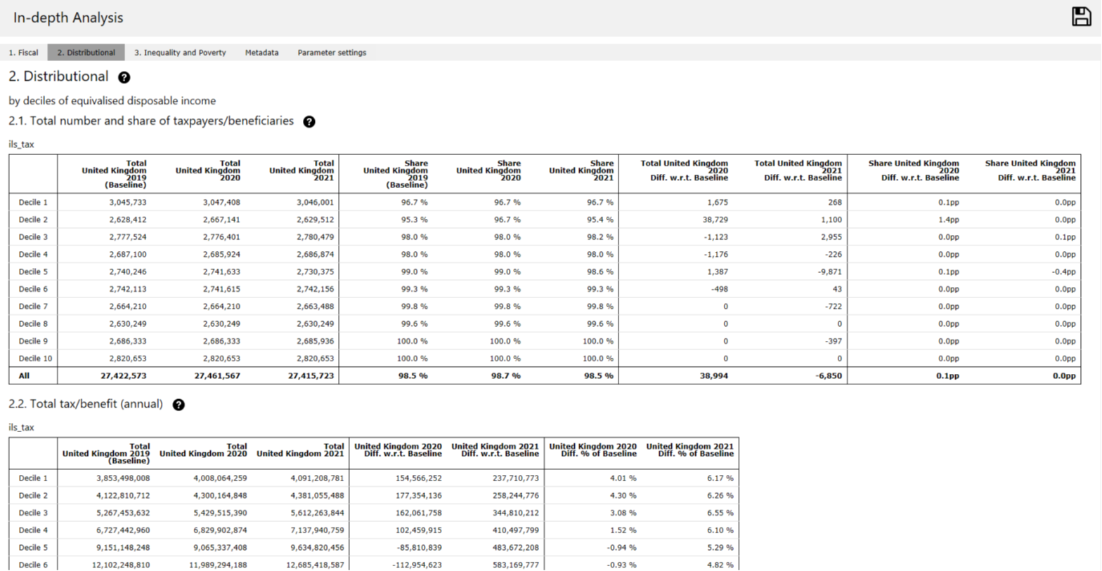
Output tables

Slide 11
Parameters used in the simulations

Slide 12
Merged dataset

Slide 13

Questions

Slide 14
Examples
1. Remove HICBC in 2025
a) customized fiscal tables
b) changes in mean income by number of earners and region
c) poverty reduction by number of earners and region
2. Uprate income tax thresholds with inflation in 2025
a) customized fiscal tables
b) average tax burden by income decile
c) inequality, redistributive impact and Kakwani

Slide 15
Final remarks
Think carefully about what you want to calculate
Always check help and metadata
Don’t delete the EM logs
Send us feedback through the UKMOD user forum

Slide 16
Thank you

