Slide 1


UKMOD Fest 2025
20 October 2025
Online event

Slide 2
Welcome!
Welcome to the 4th UKMOD Fest, the annual gathering of the UKMOD community bringing together users and developers
UKMOD is unique in the UK tax-benefit modelling landscape:
The only open-source, fully transparent and documented model for the UK and its constituent nations
Truly accessible to everyone with both the model and the underlying data are available free of charge
Developed and maintained over more than 20 years
Combines academic rigor and policy impact
Relies on the EUROMOD simulation engine
Follows standard modelling practices and conventions adopted by dozens of countries in the EU and worldwide

Slide 3
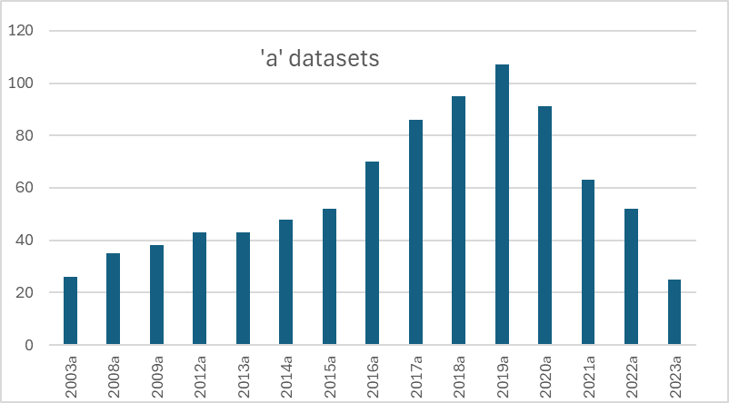
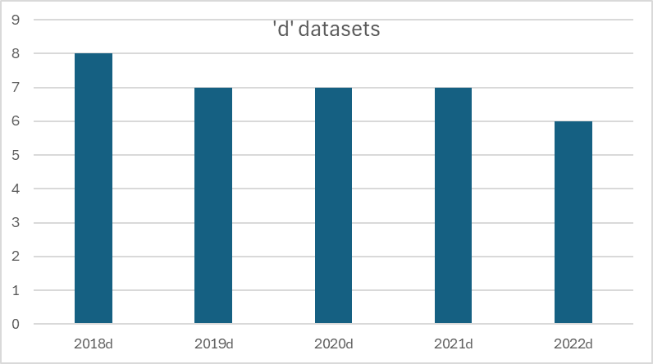
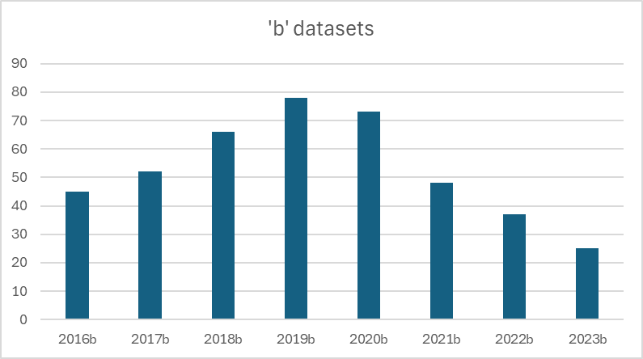
UKMOD in numbers

Slide 4
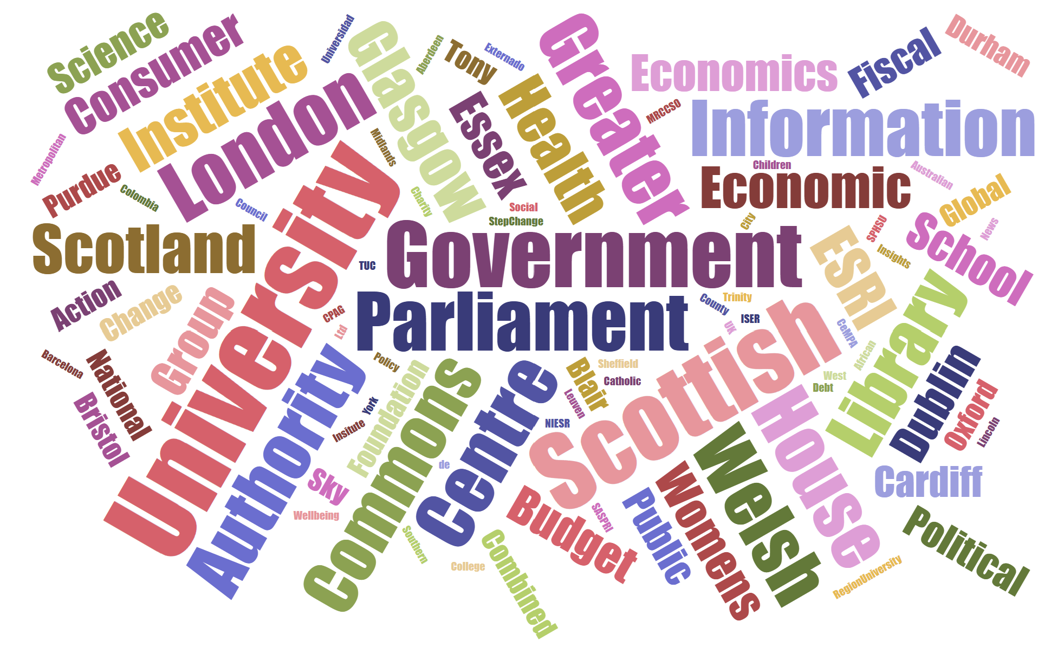
The UKMOD community
Researchers and analysts from more than 150 institutions

Slide 5
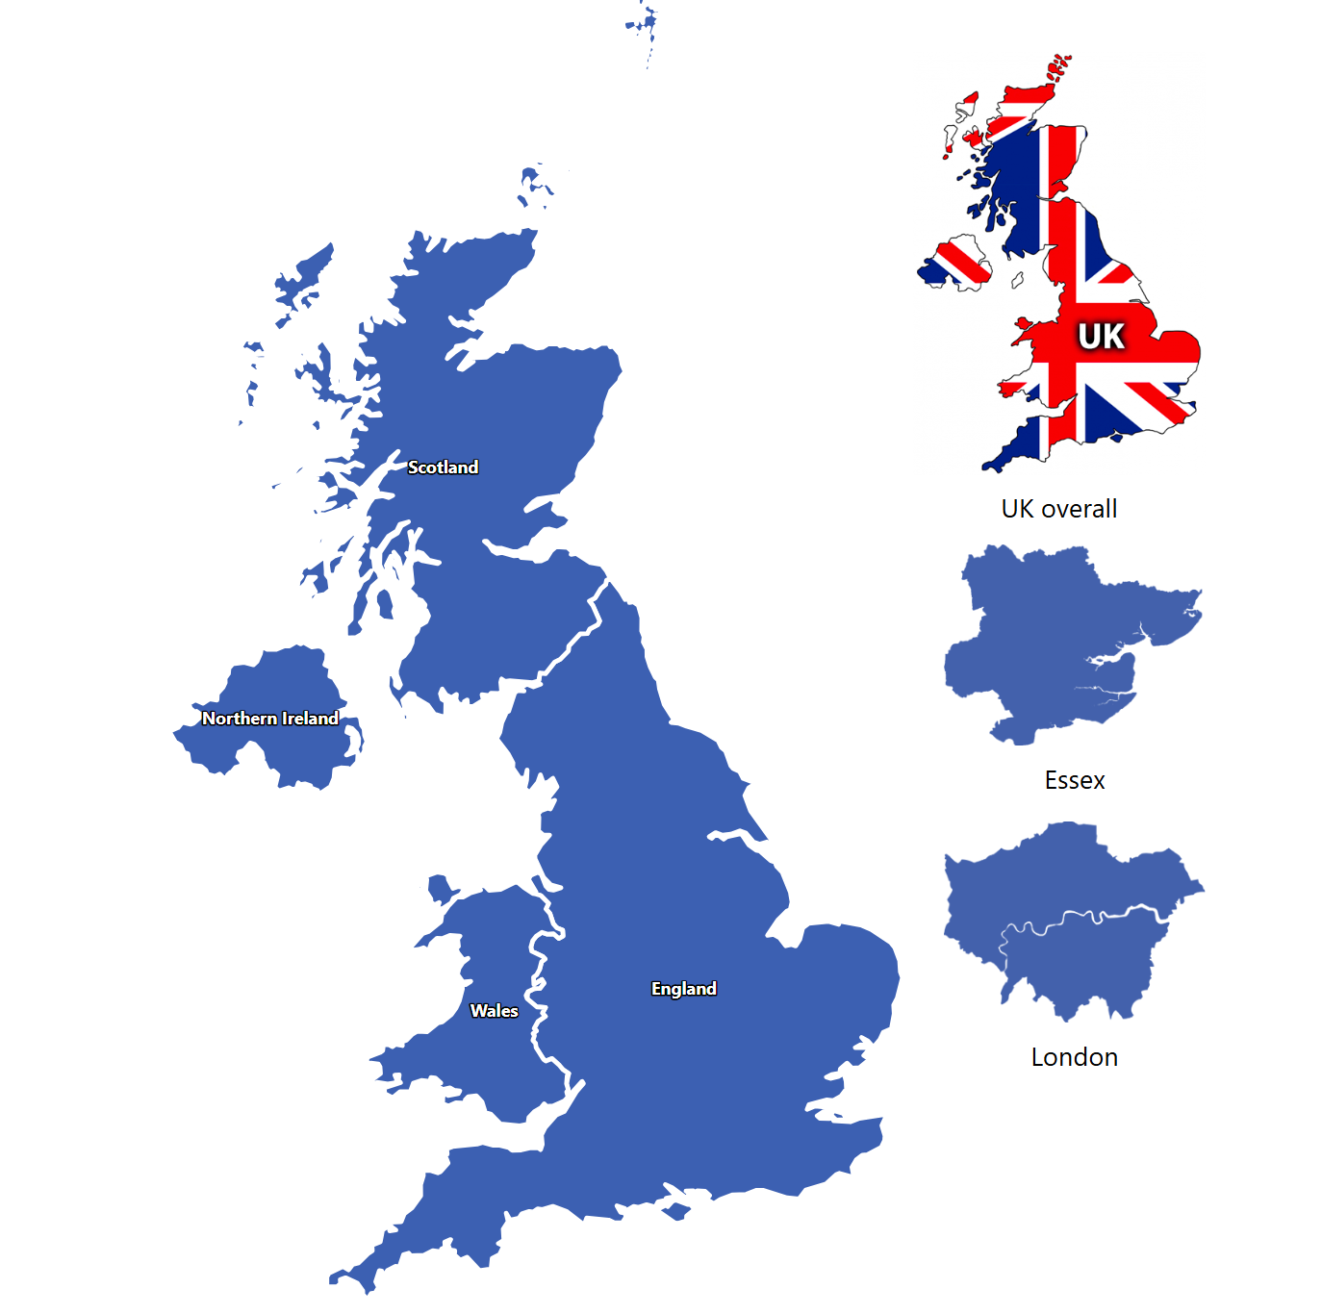
An expanding family of models

Slide 6
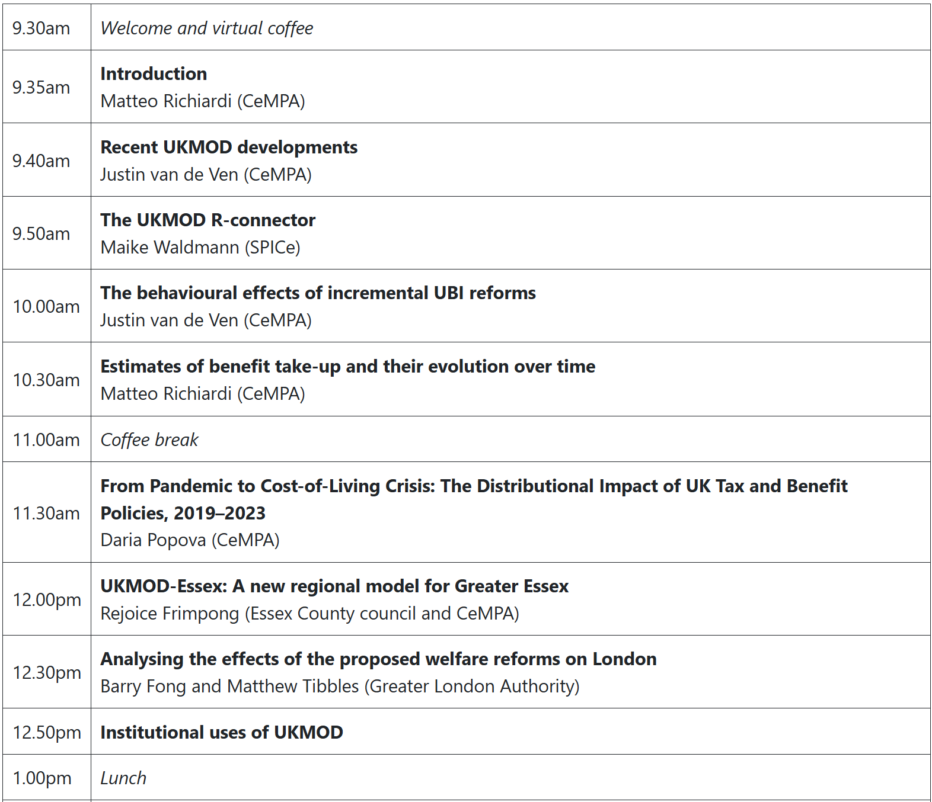
Today’s program: Morning

Slide 7
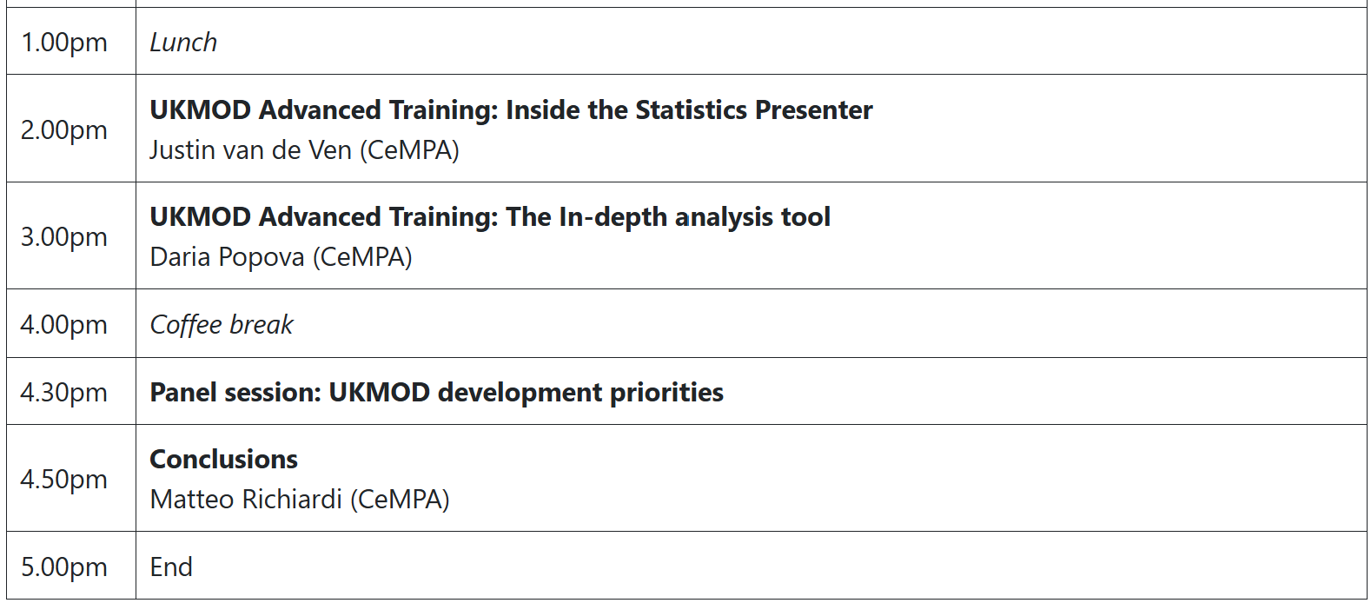
Today’s program: Afternoon

