Slide 1

Aligning Socioeconomic Datasets Using Random Forests / Gradient Boosted Machines for Proximity Matching, Inverse Probability weighting and Raking : A Case Study of UKMOD and Experian Data
Centre for
Microsimulation
and Policy Analysis
Rejoice Frimpong^{1,2}, Matteo Richiardi²
¹ Essex County Council
² Centre for Microsimulation and Policy Analysis, University of Essex

Slide 2
How can we model the effects of national tax-benefit policies at a local level?
Application: UKMOD (UK variant of EUROMOD) and Essex.
UKMOD is built on FRS and designed for UK-wide analysis at the Government Office Regions (GORs) level.
But what if we want results at the regional or sub-regional level?
That’s the challenge we’re addressing, in our case, using Essex as the example.
What avenues are available for adapting UKMOD to produce meaningful local estimates?

Slide 3
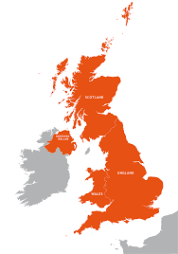
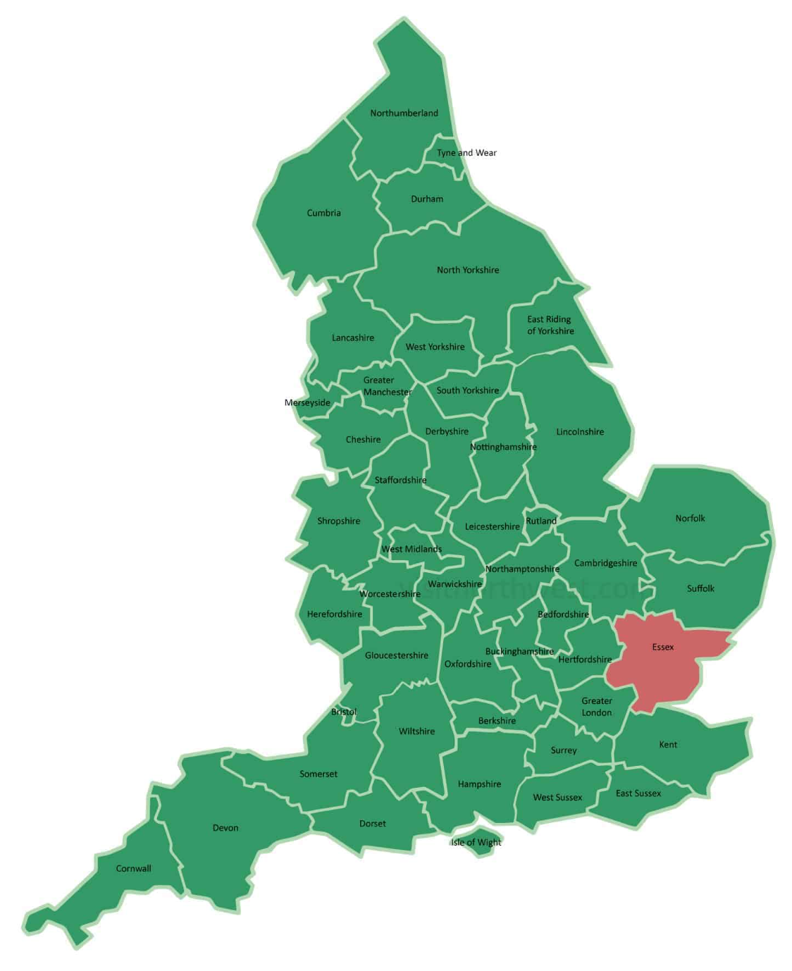
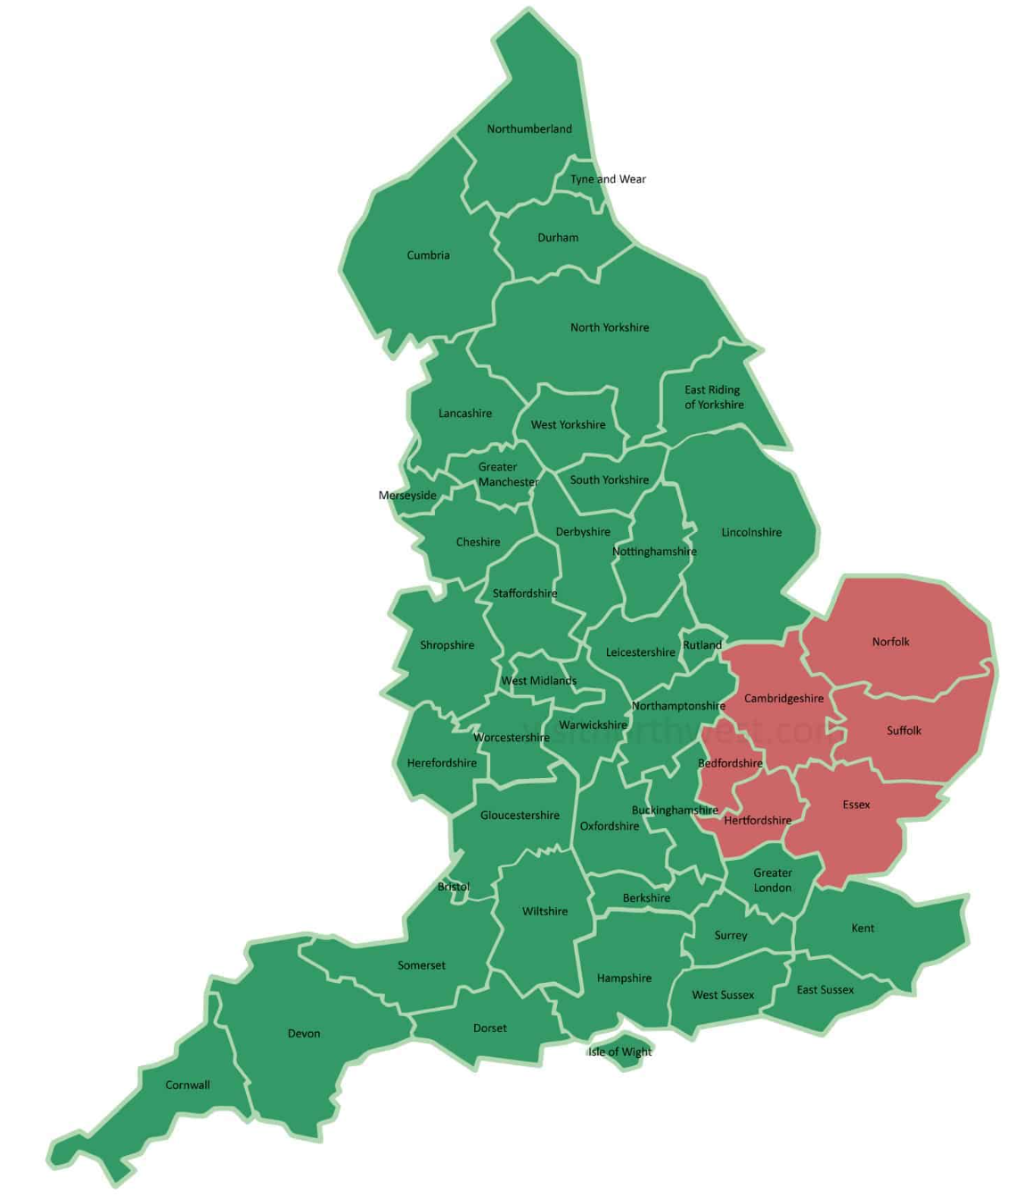
How can we model the effects of national tax-benefit policies at a local level?
UK:
OBS: 53,577
England: OBS: 42,380
East of
England:
OBS: 5,158
Essex

Slide 4
Strategies
Use secure version of FRS with more regional disaggregation. > Sample size becomes too small to model reliably. > Also, more difficult to share input data with external users.
Focus on a wider aggregate available in the existing input data (e.g. East of England), and adjust outcomes to focus on area of interest (e.g. Essex) based on simple rules (e.g. population or income shares) > Sample size still small (~ 5,000 households for the East of England) > Simple rules likely to miss relevant features of the area of interest
Use marginal distributions from the Census or external sources to calibrate the input data to the local area > Allows adjustments by age, household size, etc., but detailed breakdowns are often unavailable or unreliable.

Slide 5
When local micro-data is available…
New input data for the tax-benefit model could be produced from local microdata (e.g. Experian).
Experian offers small-area, household-level data for Greater Essex (proprietary, commercially distributed).
Experian data is statistically synthetic, built using imputation, model-based estimation, and constrained optimisation.
It draws on sources like the Census, ONS, admin data, and commercial inputs, but it’s not derived from actual households.
> Sounds ideal, but this datasets does not contain all the variables UKMOD needs for simulation.

Slide 6
Our Approach - Calibrate UKMOD Toward Local Reality
We adjust UKMOD so that it mimics the joint distribution of variables available in Experian.
But since Experian might not fully represent Greater Essex, we also apply final adjustments to match external aggregates (e.g. ONS).
Why is this necessary?
UKMOD (UK-wide) ≠ Experian (Greater Essex)
And Experian (while calibrated) ≠ ONS, especially on a margins like income which are essential for policy simulations

Slide 7
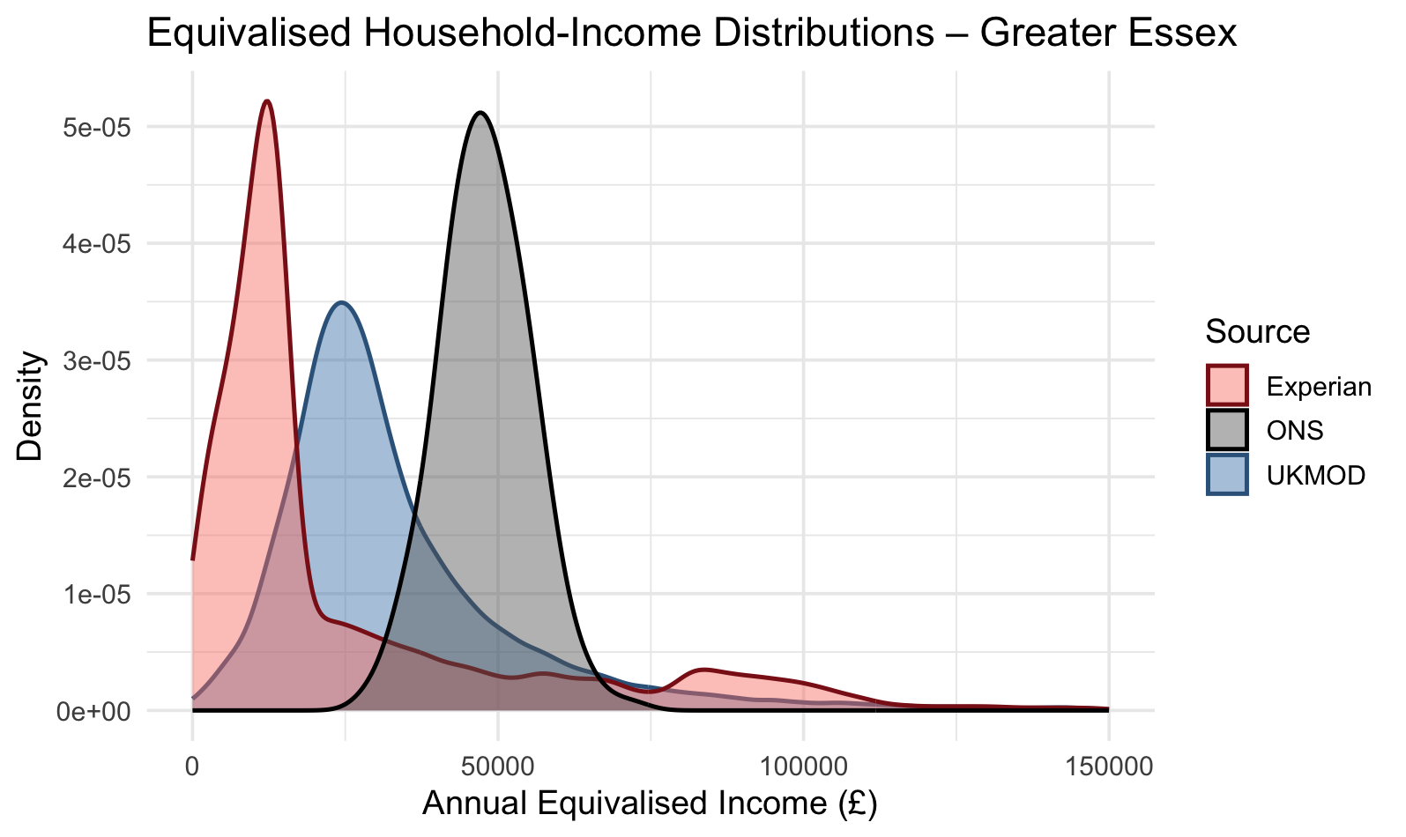
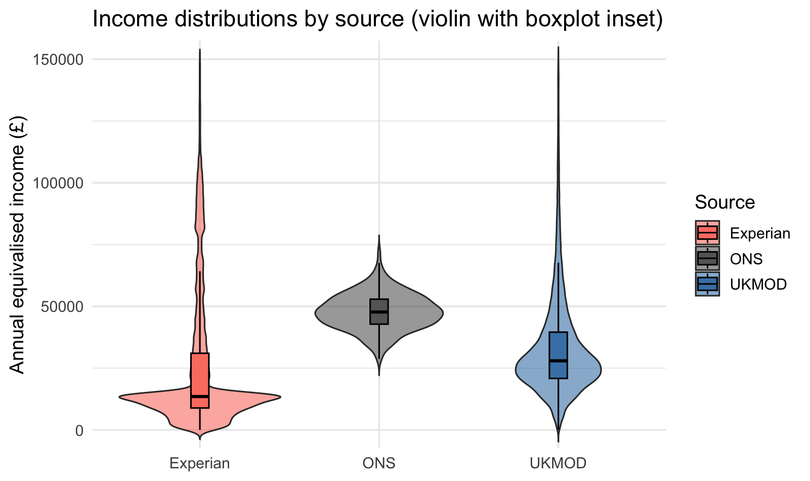
Pre-Calibration Income Distributions Across UKMOD, Experian, and ONS
Our approach:
Use GBM-based calibration to align UKMOD with Experian
Then apply raking to match key margins (e.g. income, household size)

Slide 8
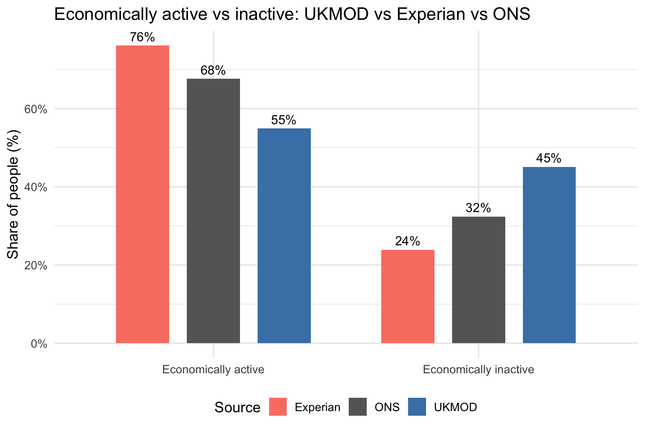
Pre-Calibration Economic Activity Distributions Across UKMOD, Experian, and ONS
Substantial variation across sources highlights the need for calibration.
UKMOD underestimates economic activity, while Experian overestimates it.
Our approach:
Use GBM-based calibration to align UKMOD with Experian
Then apply raking to match key margins (e.g. income, household size)

Slide 9
Aligning UKMOD to Local Microdata - Method Overview
Goal: Adjust UKMOD so it statistically resembles Experian’s population structure at the household level.
Match on observed covariates between Experian and UKMOD.
Use a machine learning model to estimate propensity scores (probability of being in Experian vs. UKMOD).
Derive inverse-probability weights to adjust UKMOD.
Post matching raking to external margins.
Ensure multivariate covariate balance post-weighting.
Validate through diagnostics and visualizations.

Slide 10
Matching Design
Unit of analysis: Household
Covariates for matching: (Household size, Number of children, Age groups, Economic status indicators: Retired, Student/Unemployed, Employed Full-Time, Part-time/Housewife, Housing tenure, income)
Interaction terms used:
Age × Retired
Household Size × Number of Children
Age × Household Size
Household Size × Part-time / Housewife
Sampling approach: Balanced subsample of Experian drawn to mirror UKMOD’s employment composition to ensure fairer comparison prior to matching

Slide 11
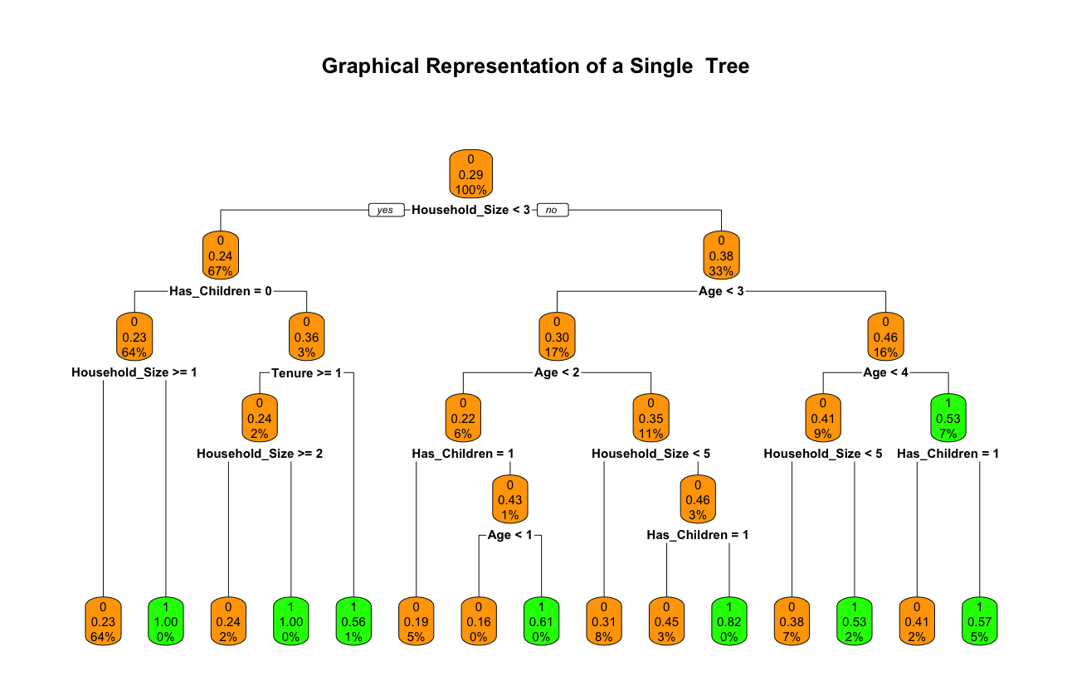
Propensity Score Estimation - Initial Model
Models tested: Random Forest (initial model)
Ensemble of decision trees trained on random data subsets
Captures non-linear relationships and variable interactions
Robust to overfitting and works well with high-dimensional
data
Used as initial model for estimating propensity scores
Good baseline, but less flexible in capturing fine-grained patterns
Diagram shows a single tree from the ensemble, splitting on household size, age, and children in households, typical of how Random Forest identifies structure

Slide 12
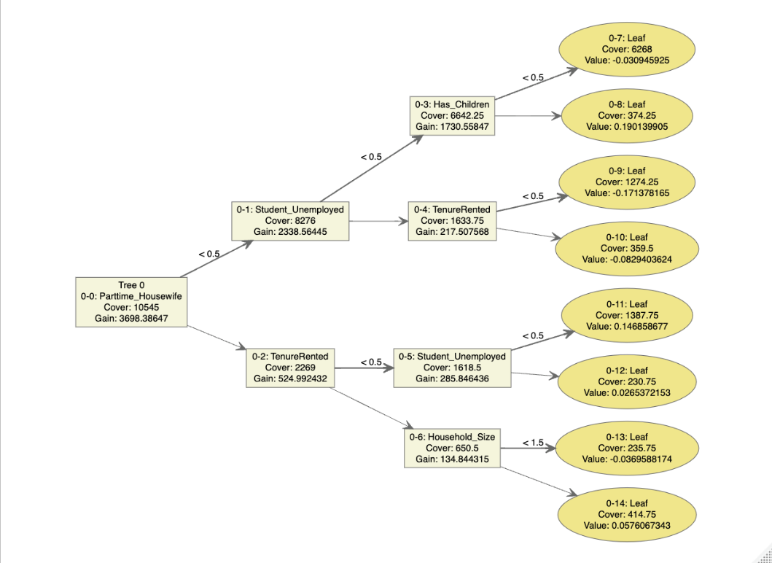
Propensity Score Estimation - Final Model
Model used: Gradient Boosting Machines (GBM) — XGBoost
Sequential tree model: each new tree learns from previous residuals
Captures non-linearities and high-order interactions
Tuned via cross-validation (tree depth, learning rate, number of trees)
Delivered better covariate balance and more stable IP weights
Final model used to generate propensity scores for UKMOD reweighting

Slide 13
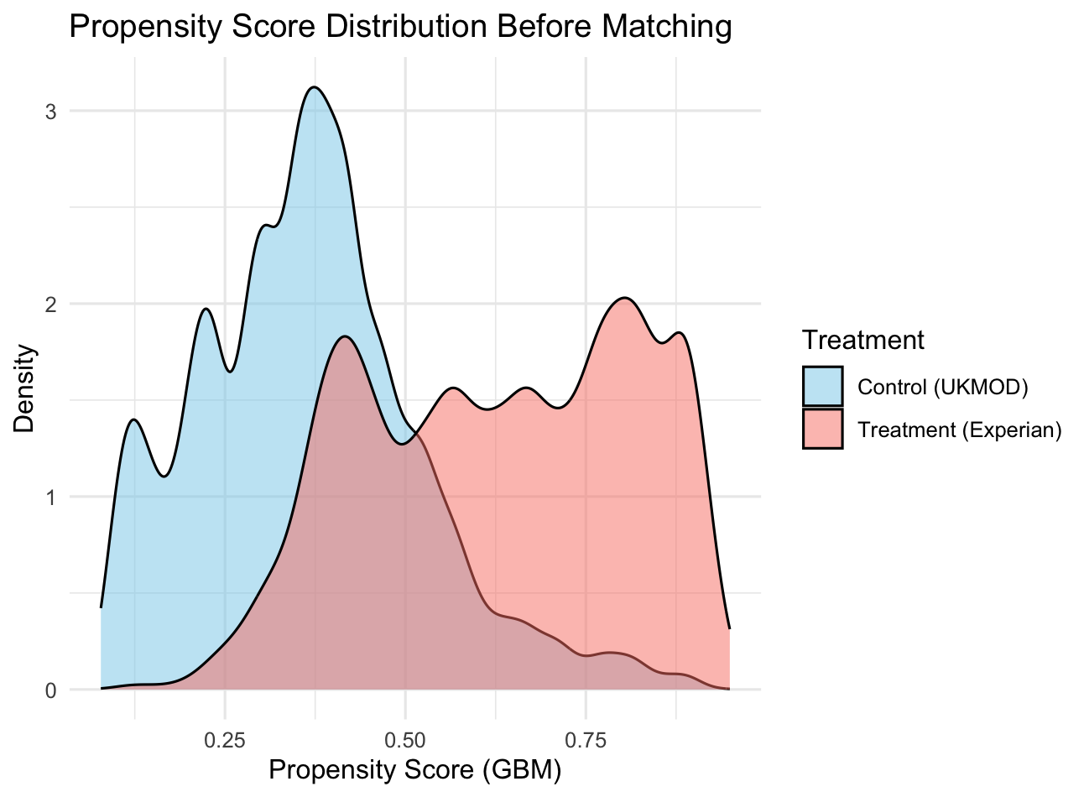
Weighting Procedure
Applied inverse probability weights (IPW) to UKMOD households to align with Experian’s population structure
Weights were stabilized, top 1% trimmed, and normalized to maintain sample size integrity
Based on propensity scores from the GBM model; plot shows clear separation between UKMOD and Experian before weighting

Slide 14
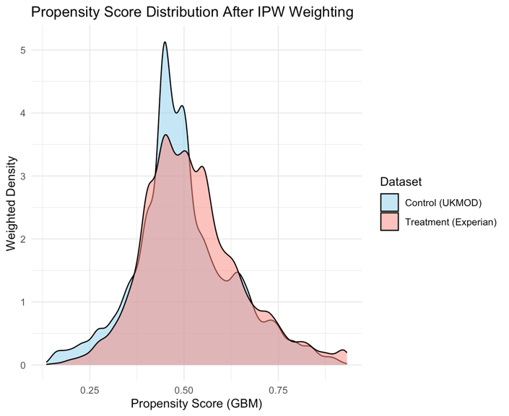
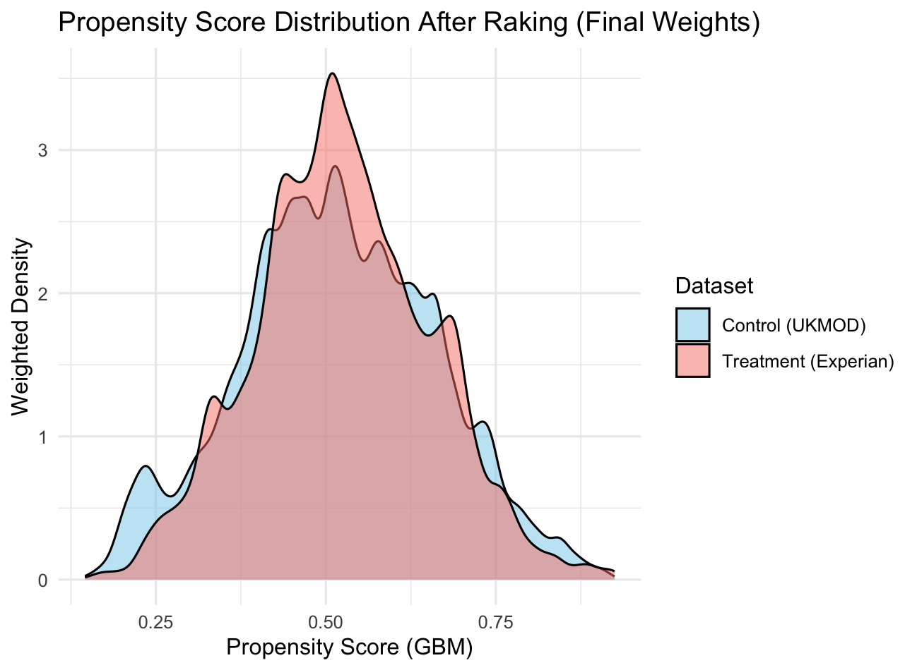
Post - IPW Calibration via Raking
Goal: Refine weighted UKMOD sample to match known population margins
Raked margins:
Age group (0–18 to 66+), Employment status (employed = full or part-time),
Presence of children in household, Housing tenure (Owned, Mortgaged, Rented)
Final weights capped at 99th percentile and renormalized to population total (1.9 million)
Plots show improved alignment in propensity scores after raking (bottom plot) compared to after IPW only (top plot)

Slide 15
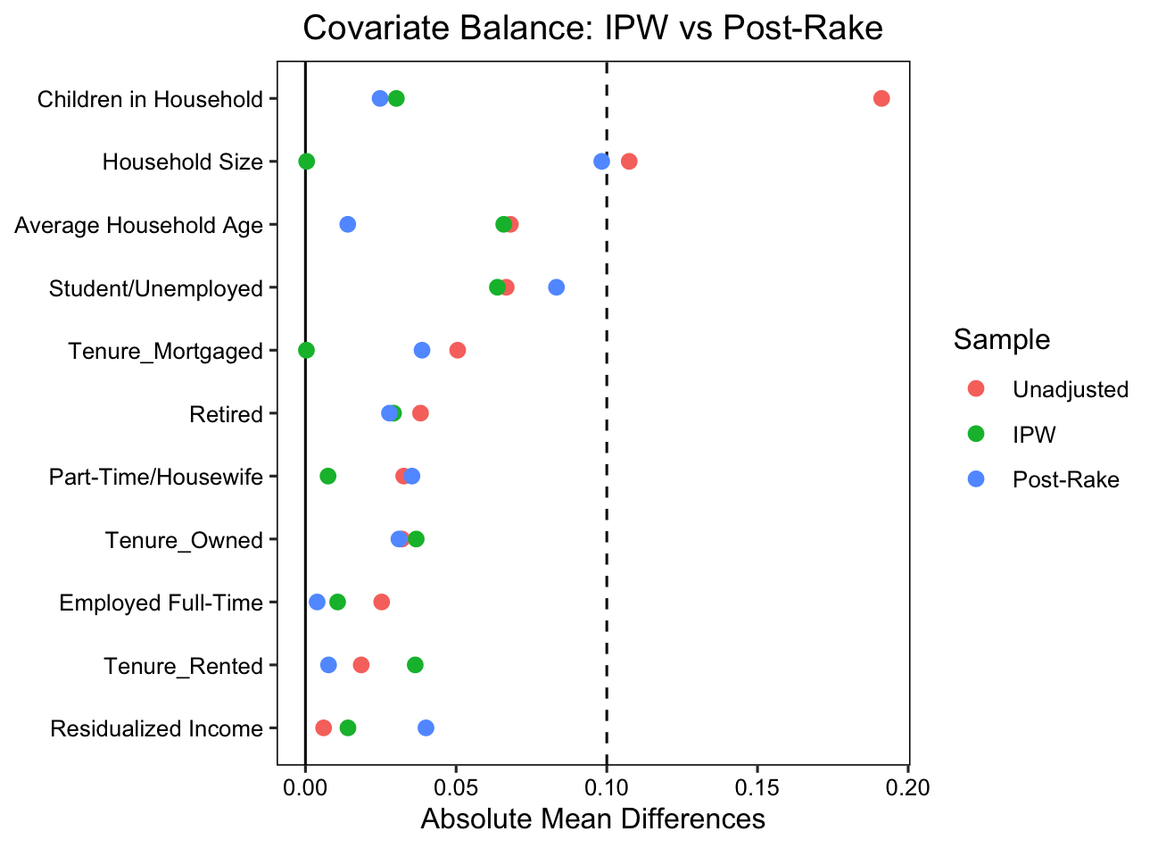
Evaluation
Metric used: Standardized Mean Difference (SMD) to assess covariate balance pre/post-weighting
Diagnostic: Love plots and weighted propensity score density curves (UKMOD vs Experian)
Target Threshold: SMD < 0.1 across all key variables including Tenure, Retired, Student/Unemployed, and Residualised Income
Results: Post-raking weights improved balance over IPW alone; ESS and district-level counts confirmed representativeness

Slide 16
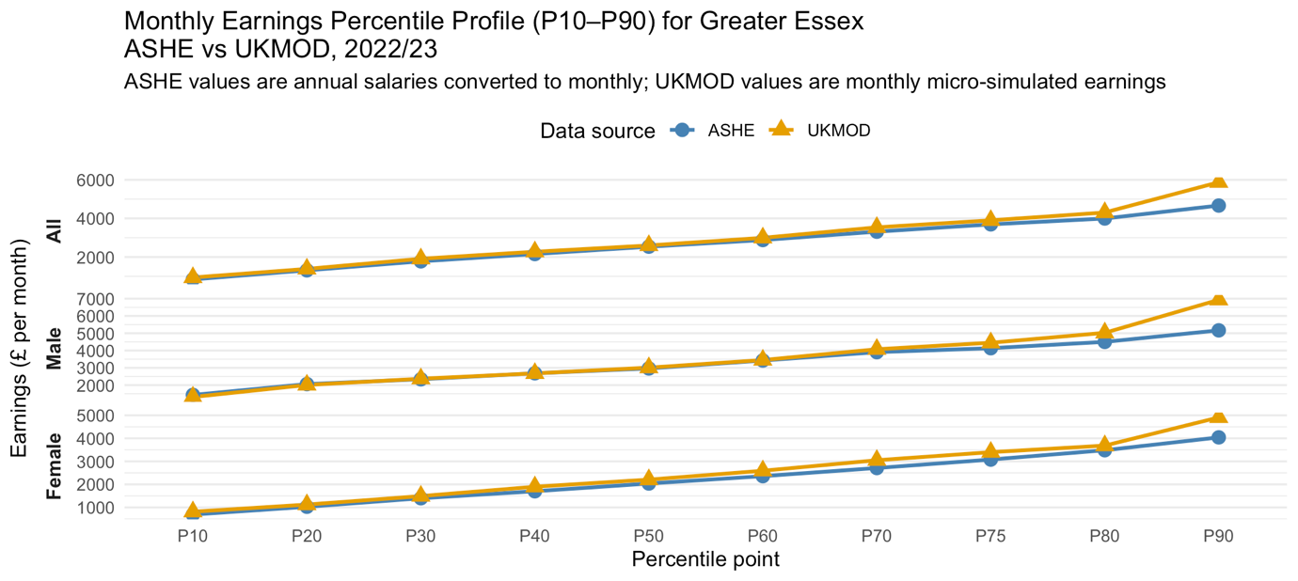
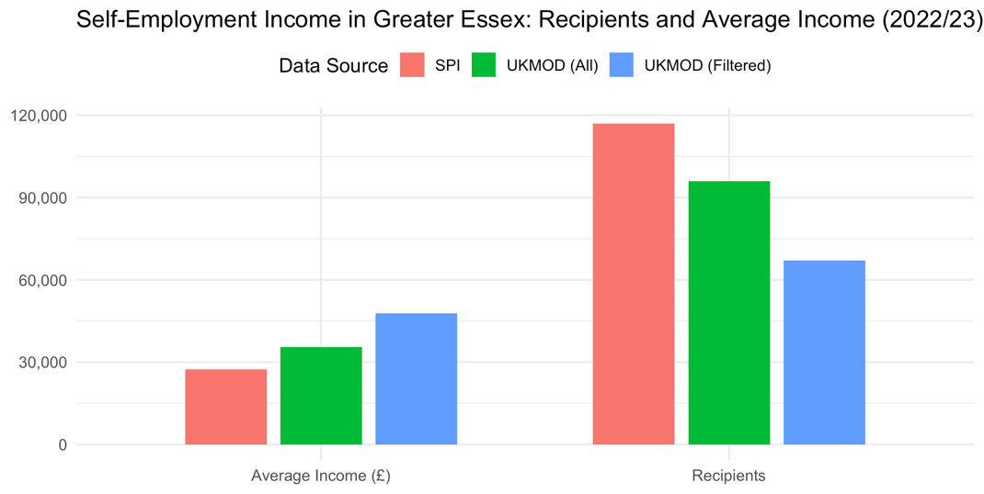
Validations

Slide 17
Alternative Methods
Coarsened Exact Matching (CEM): Tested but too coarse for our data: dropped too many households due to fine-grained heterogeneity
Logistic Regression for Propensity Scores: Tested as a simpler alternative to GBM but achieved weaker covariate balance for most variables
Entropy Balancing: Not tested here; ensures exact covariate balance through reweighting , worth exploring for future refinement
Simulated Annealing Matching: Not yet implemented, potential for optimizing covariate balance when exact matching is infeasible

Slide 18
References
Austin, P. C., & Stuart, E. A. (2015). Moving towards best practice when using inverse probability of treatment weighting (IPTW) using the propensity score to estimate causal treatment effects in observational studies. Statistics in Medicine, 34(28), 3661–3679.
Breiman, L. (2001) ‘Random Forests’, Machine Learning, 45(1), pp. 5-32.
Chen, T., & Guestrin, C. (2016). XGBoost: A scalable tree boosting system. Proceedings of the 22nd ACM SIGKDD International Conference on Knowledge Discovery and Data Mining.
Hastie, T., Tibshirani, R., & Friedman, J. (2009). The Elements of Statistical Learning: Data Mining, Inference, and Prediction. Springer. (See chapters on trees and boosting.)
Lee, B. K., Lessler, J. and Stuart, E. A. (2010) ‘Improving propensity score weighting using machine learning’, Statistics in Medicine, 29(3), pp. 337-346.
Lovelace, R., Nowosad, J., & Muenchow, J. (2019). Geocomputation with R. CRC Press. (Includes methods for working with synthetic and modelled spatial data.)
Rosenbaum, P. R., & Rubin, D. B. (1983). The central role of the propensity score in observational studies for causal effects. Biometrika, 70(1), 41–55.

