Slide 1
From Pandemic to Cost-of-Living Crisis: The Distributional Impact of UK Tax and Benefit Policies, 2019–2023
Daria Popova, Matteo Richiardi and Justin van de Ven
Institute for Social and Economic Research – University of Essex

Slide 2
Motivation and Objectives
Context: COVID-19, slow growth, high inflation, cost of living crisis.
For the period between 2019-2023, estimate the changes in:
Net tax burden across the income distribution
Progressivity of taxes and transfers
Redistributive impact of the UK tax-benefit system net of changes in labour market income
… using an extended measure of income, consumable income (i.e. disposable income after subtracting indirect taxes).
Data: UKMOD using the FRS input data with consumption imputed from LCF data

Slide 3
Key Welfare Policy Changes
A key feature - a sustained reduction in support for working-age households, with the exception of COVID years.
2013: Child Benefit withdrawn from higher-income families; the Benefit Cap;
2016: Universal Credit (UC) began to be rolled out, replacing six means-tested benefits with a single payment.
2017: The two-child limit on UC.
2016–2019: full freeze on working-age benefits
2020-2021: Benefits uprated with CPI; £20/week uplift to Universal Credit and Working Tax Credit; suspension of the minimum income floor in UC for self-employed claimants; Local Housing Allowance (LHA) rates increased to cover the 30th percentile of local rents (reversing earlier freezes); Furlough scheme (CJRS) and Self-Employment Income Support Scheme (SEISS).
Dec 2021: UC taper rate reduced from 63% to 55%; Work allowances in UC increased slightly to improve work incentives.
2022: Cost of Living Payments (£650 for households on means-tested benefits; £150–£300 for people with disabilities and pensioners). Benefits uprated with CPI but below actual inflation (real term cut). Triple lock suspended.
2023: Cost of Living Payments repeated; Benefits uprated slightly above inflation (real-term catch-up). Triple lock reinstated.
2024: Last Cost of Living Payment (£299); LHA rates uprated for the first time since 2020. Threshold to HICBC increased.

Slide 4
Key Tax policy changes
2011: VAT increased from 17.5% to 20; National Insurance Contributions (NICs) increased by 1 percentage point.
2010–2012: An additional 50% income tax rate for top earners.
2013: The top rate reduced to 45%.
2010–2015: Fiscal drag: Personal allowance increased, but the higher-rate threshold frozen or increased only modestly, pushing more people into higher tax brackets.
2015-2019: Personal allowance increased; Higher-rate threshold gradually increased to £50,000 by 2019, but continued fiscal drag for those above the threshold.
2020–2021: Pandemic Response: VAT cut to 5% for hospitality (Jul 2020), tapered through 2021; Stamp Duty holiday. Increased Personal allowance and higher-rate income tax threshold.
2022: Income tax thresholds frozen. NIC rates rose by 1.25 pp in April to fund the Health and Social Care Levy, but the main employee/self-employed threshold was raised mid-year. The rate rise was reversed in November.
2023: Income tax and NIC thresholds frozen. The top income tax rate (45%) extended to more high earners (starting £125,140). Class 2 Small Profits Threshold raised.
2024: Income tax and NIC thresholds remain frozen, but NIC rate cuts (especially for low/mid earners).

Slide 5
Methodology and Data

Slide 6
Methodological Approach and Data
UKMOD (version B2025.06), with HBAI-adjusted market income aggregates and grossing weights, and Advanced PET.
Years covered: 2019–2023, with 2019 as the last pre-COVID and pre-crisis year, and 2023 as the most recent year available.
UKMOD input data is enhanced with household consumption measures from the Living Costs and Food Survey (LCF).
The imputation is performed by linking each FRS household to the most similar LCF household based on shared characteristics such as income, age, household composition, employment status, and region.
Exact matching + nearest-neighbour matching based on Mahalanobis distance.
Carried out in several rounds: beginning with strict criteria (with many exact matches) and gradually relaxing them by shifting more variables into the distance-based stage.
Each FRS household is assigned LCF consumption data from a household that is as similar as possible.

Slide 7
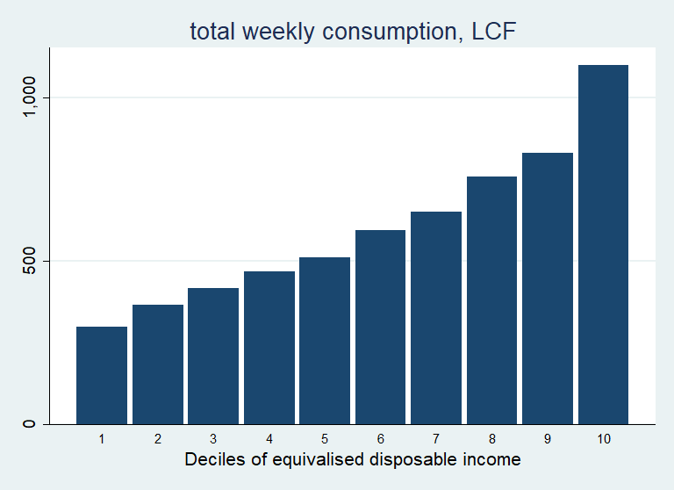
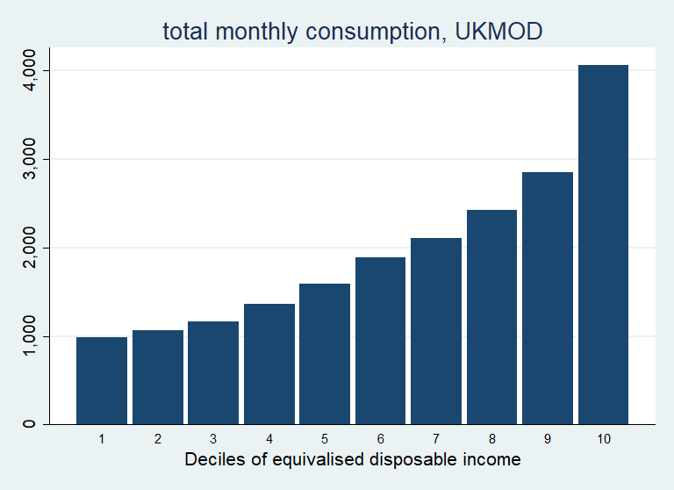
Consumption expenditure by income deciles, LCF and UKMOD, 2019

Slide 8
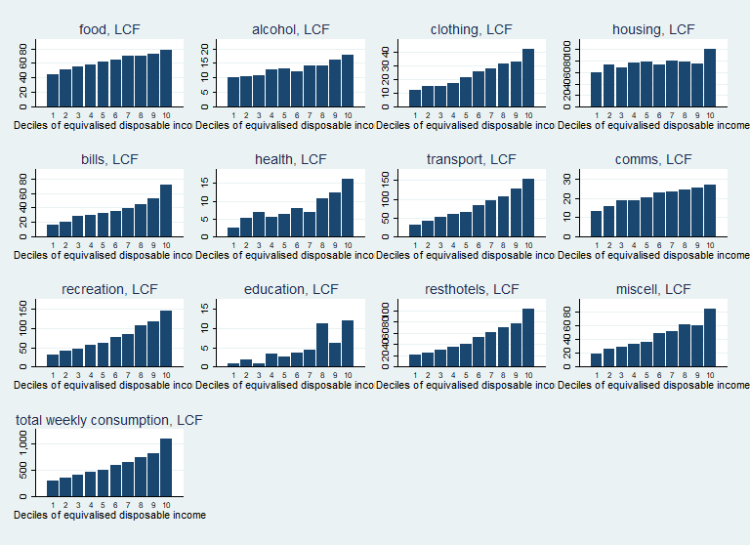
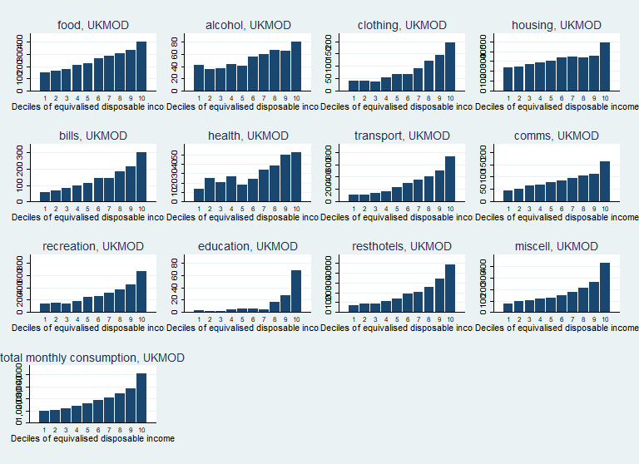
Consumption expenditure by income deciles, LCF and UKMOD, 2019

Slide 9
Income Concepts and Assumptions
Market Income
State pension and occupational pensions are treated as direct transfers; compulsory pension contributions are subtracted from market income.
Economic rather than statutory tax and benefit incidence is computed.
PIT and NIC are assumed to be borne by labour.
Consumption taxes are fully shifted forward to consumers.
The main welfare indicator used is equivalised post-fiscal/consumable income.
However, income deciles and poverty thresholds are defined using equivalised disposable income, to be in line with official statistics.
Currently only direct cash transfers are included in UKMOD.
+ direct transfers – direct taxes and (employee, self-employed and employer) NICs
Disposable Income
– indirect taxes (VAT, excises)
Post-fiscal or Consumable Income

Slide 10
Measuring redistribution
Redistributive effect of taxes and transfers is measured by the Reynolds–Smolensky index (RS)
𝑅𝑆=Wpre−Wpost
Wpre​ : Welfare indicator before taxes/transfers
Wpost​ : Welfare indicator after taxes/transfers
RS > 0 → Taxes/transfers reduce inequality
RS < 0 → Taxes/transfers increase inequality

Slide 11
Measuring progressivity
Progressivity captures how tax burdens or benefit entitlements vary with income. It is summarised by the Kakwani index (K).
For Taxes: 𝐾=𝐶t−𝐺pre, where
𝐶t is Concentration index of the tax
𝐺pre is Gini coefficient of pre-tax income
For Transfers: 𝐾=𝐺pre−𝐶b, where
𝐶b is Concentration index of the the transfer
𝐺pre is Gini coefficient of pre-transfer income
𝐾>0 → Progressive — burden increases with income/transfer decreases with income
𝐾=0 → Proportional — same relative burden/transfer across incomes
𝐾<0 → Regressive — burden falls with incomes/transfer increases with income

Slide 12
Impact of tax-benefit policy changes, 2019 vs 2023
Effect | Fixed Elements | Varying Elements
Total Policy Effect (TPE)= Overall policy impact of 2019–2023 changes |  | Market incomes (y) Policies (p)
Market Income Effect (ME) = Impact of changes in population composition and market incomes (including automatic stabilizers) | Policies (p) | Market incomes (y)
Policy Effect (PE) = Impact of discretionary policy and uprating changes | Market incomes (y) | Policies (p)
Decomposition framework by Paulus A and Tasseva IV. (2020)
S(y; p) is summary statistic of consumable income when applying:
Policies p to
Market incomes y.
2023 policies and market incomes are in 2019 prices, but this counterfactual differs from simply CPI-scaling 2023 results because we re-run the entire 2023 tax-benefit system in 2019 prices.
Counterfactual for PE is the 2023 policies divided by α (CPI or MII)
Results expressed as % changes relative to the 2019 baseline.

Slide 13
Impact of tax-benefit policy changes, 2019 vs 2023
Policy Effect (PE) measures how much tax-benefit system has changed in generosity between 2019 and 2023, holding market incomes constant (at 2019 level). It compares actual 2023 policies to a counterfactual where policies are uprated mechanically — either by prices (CPI) or by earnings (MII).
CPI-based counterfactual ➔ Change in real terms (are people better off after inflation?).
MII-based counterfactual ➔ Change in relative terms (did their income grow faster or slower than the mean?).
Real protection (keeping up with inflation) vs relative generosity (keeping up with rising wages).
Interpretation
If PE-CPI > 0 and PE-MII < 0, policies protected real incomes but lagged behind wage growth ➔ redistributive generosity weakened.
If PE-CPI < 0 and PE-MII > 0, policies failed to keep up with inflation (real losses), but declined less than earnings ➔ redistributive generosity strengthened.
If both > 0, discretionary policy increases exceeded both inflation and earnings ➔ strong expansion in support.
If both < 0, policy changes reduced generosity in both real and relative terms.

Slide 14
Findings

Slide 15
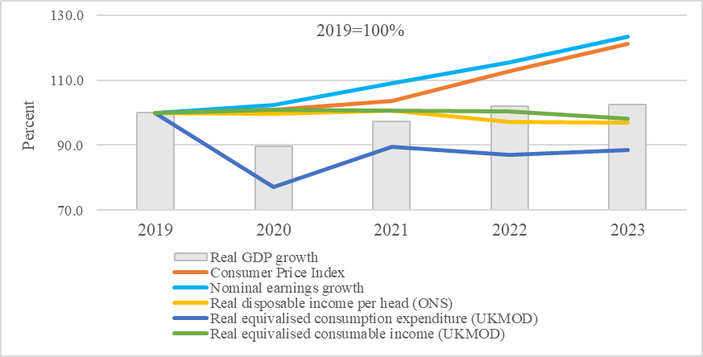
GDP growth, inflation and real incomes, 2019-2023

Slide 16
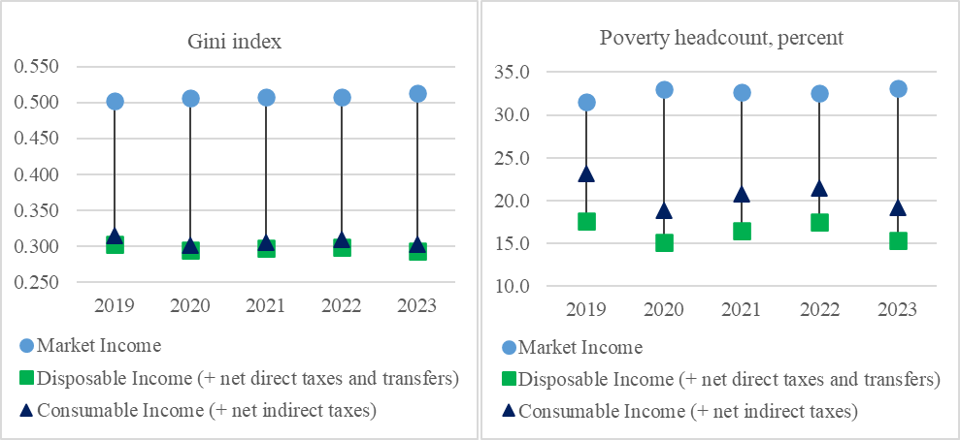
Fiscal Policy, Inequality & Poverty, 2019-2023

Slide 17
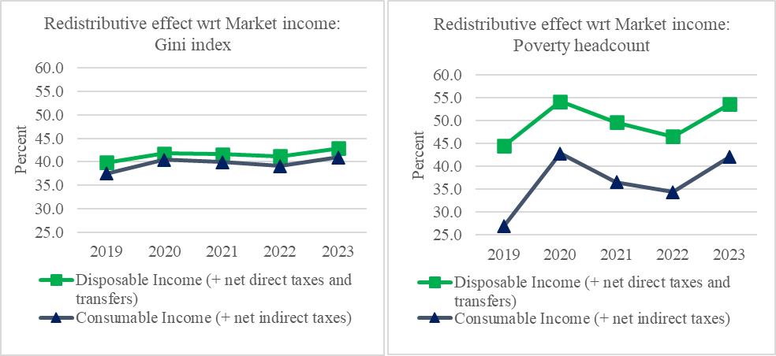
Changes in Redistribution, 2019-2023

Slide 18
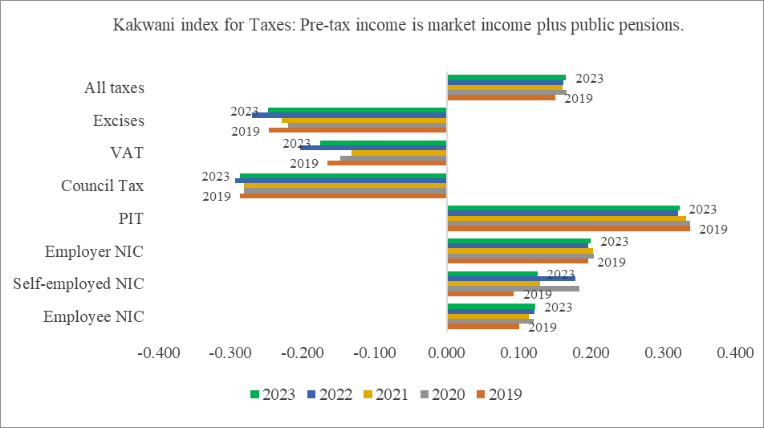
Changes in progressivity: Kakwani indices for Taxes, 2019-2023

Slide 19
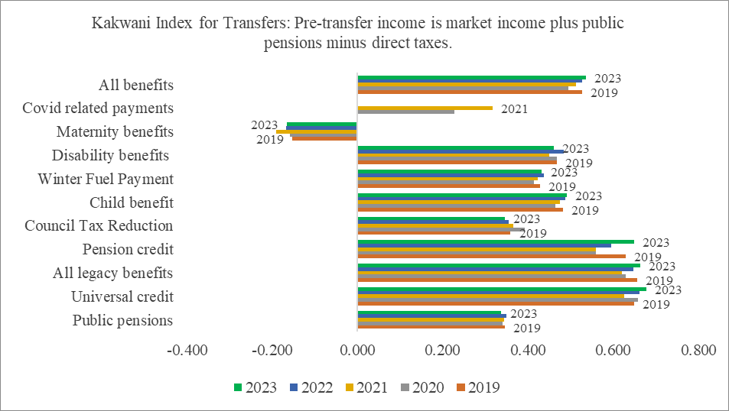
Changes in progressivity: Kakwani indices for Transfers, 2019-2023

Slide 20
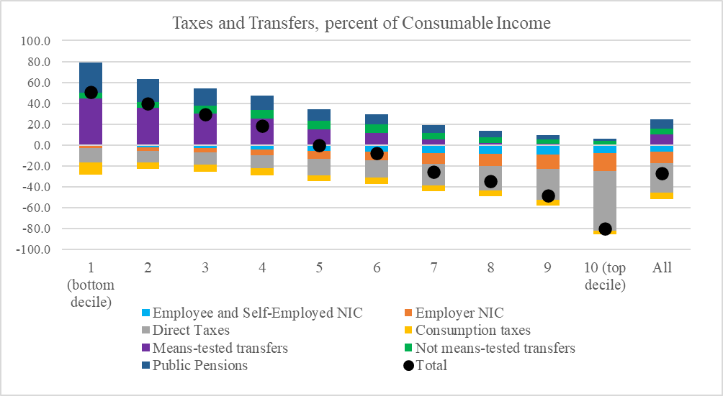
Net gain/loss from Taxes and Transfers by Decile, percent of Consumable Income, 2023

Slide 21
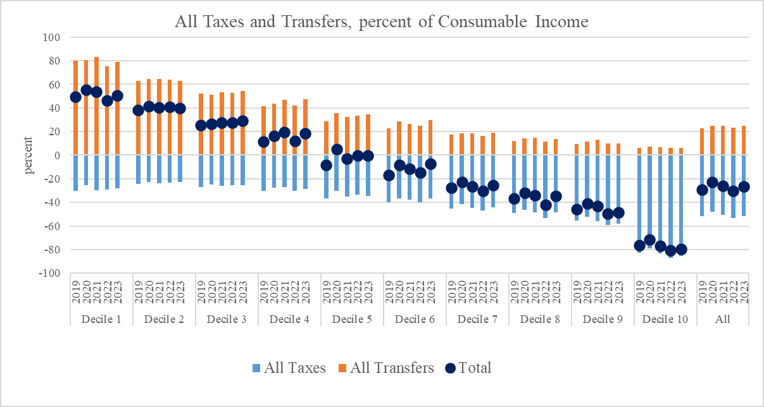
Net gain/loss from Taxes and Transfers by Income Deciles, percent of Consumable Income, 2019-2023

Slide 22
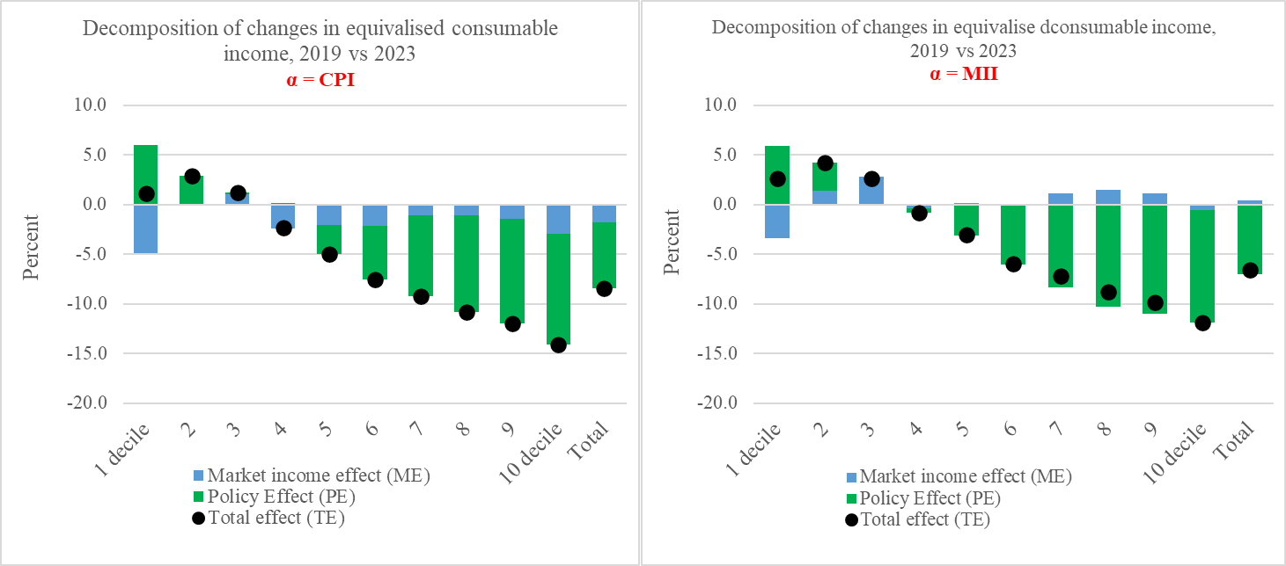
Impact of tax-benefit policy changes, 2019 vs 2023

Slide 23
Key insights and discussion
During 2020–2021, extra COVID-related transfers boosted support for lower deciles, increasing redistribution.
2022 saw higher tax burdens (especially for upper deciles) and the phasing-out of emergency benefits.
By 2023, both benefit progressivity and net gains/losses by decile had stabilised close to their pre-pandemic (2019) levels.
The real-term policy changes between 2019 and 2023 were progressive but fiscally tightening overall.
Lower deciles gained slightly (protection via means-tested transfers).
Middle and higher deciles lost, largely due to real-term erosion of thresholds, i.e. fiscal drag.
The total changes in consumable income between 2019-2023 are negative, reflecting both lower market incomes and a contractionary policy stance in real terms.

Slide 24
Thank you for your attention!
Dpopova@essex.ac.uk

