Slide 1
Estimates of benefit take-up and their evolution over time
Melchior Vella, Daria Popova, Lavinia Mitton, Matteo Richiardi
CEMPA
UKMOD Fest, 20 October 2025

Slide 2
Motivation
Not all eligible individuals claim social benefits
A recent study surveying take-up rates in 20 high-income countries found that less than one-fifth of welfare programmes had a take-up of 80% or higher, while nearly one-quarter had take-up rates of 40% or less (Ko and Moffitt, 2024)
Prior studies show considerable variation in take-up across countries, with limited recent UK-specific analysis:
Why it Matters?
→ Take-up gaps affect policy effectiveness and equity
→ Understanding who does not claim benefits helps improve delivery and design
Gaps in Literature
→ Most UK evidence is dated (e.g. Blundell et al., 1988).
→ Limited evidence on how take-up has evolved in the era of Universal Credit and HICBC

Slide 3
Objectives
Estimate take-up rates for Child Benefit, Legacy Benefits combined with Universal Credit, and Pension Credit
Unpack these rates: to explore how take-up varies by age, income, family type
Rational Choice Theory: the level and duration of expected benefits and transaction costs of applying for social benefits
Other factors: information costs, uncertainty, time-inconsistent preferences, cognitive, and non-cognitive barriers
Document how increased means-testing (e.g.High Income Child Benefit Charge) and stricter conditionality under Universal Credit have changed take-up of social benefits in the UK

Slide 4
Benefits Considered
 | Child Benefits | Legacy Benefits/Universal Credit
Type | universal until means-tested charge at high income, as from 2013 (High Income Child Benefit Charge) | means-tested benefits (income and asset-dependent)
Complexity | near-universal for families with children simple application, few updates | complex and fragmented eligibility rules across multiple programmes, frequent reassessments and onerous reporting requirements for changes in income, work status, or household composition
Payment regularity | predictable, stable | amount depends on assessment, LB paid on different schedules depending on the benefit, UC paid monthly in arrears, with a single lump-sum covering all entitlements
Work | does not vary with employment | strongly interacts with earnings and hours worked

Slide 5
Benefits Considered
 | Pension Credit
Type | means-tested benefit (income and capital thresholds for pensioners)
Complexity | complex income/asset rules, application process can be complex for older adults
Payment regularity | predictable, stable
Work | not related to employment, designed for those above State Pension age

Slide 6


Analytical Strategy
To simulate take-up rates for various benefits, we use UKMOD by applying existing eligibility rules for each year between 2008 and 2023.
It compares simulated take-up (how many individuals would take up benefits if they were aware and able to claim) with observed take-up (actual claims reported in the FRS).
The model then estimates gaps between potential and actual take-up, accounting for eligibility, awareness, and barriers to claiming.
claimants observed recipients
Take-up rate = --------------- = ---------------------------
eligible simulated eligibility

Slide 7
Types of Measurement Error in Take-Up
Numerator
If someone is eligible but does not report receiving the benefit (a false negative), they will be wrongly counted as not taking up the benefit, understating take-up.
If someone reports receiving the benefit but did not actually get it (a false positive), for example due to confusion about timing, and they are simulated as eligible, this will overstate take-up.
Denominator
Errors can also occur when estimating who is eligible.
If eligibility is overestimated, the denominator is too large, which lowers the take-up rate.
If eligibility is underestimated, the denominator is too small, which raises the take-up rate.

Slide 8
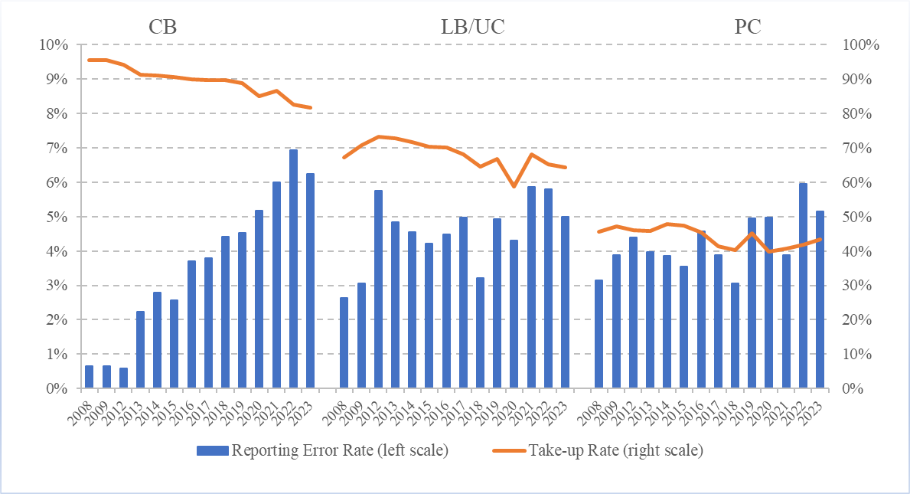
“Error” rate
# Not eligible reporting the benefits = --------------------------------------------------------------- # eligible (whether reporting recipiency or not)

Slide 9
Data
Using data from the Family Resources Survey (FRS) and UKMOD
cross-sectional household survey
several adjustment procedures take place after the data collection, including taking into account interviewers’ notes, checking fixed-amount benefits, disentangling multiple benefit receipts, investigating outliers and zero amounts
Take-up rate estimated at the head of the tax unit.

Slide 10
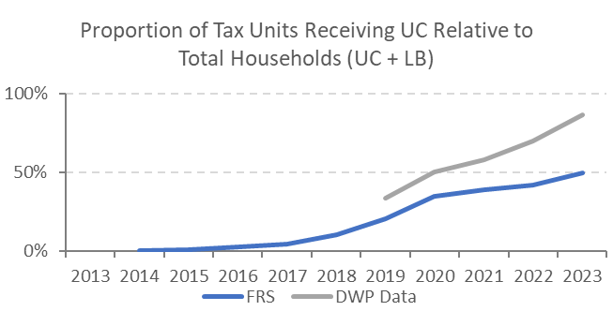
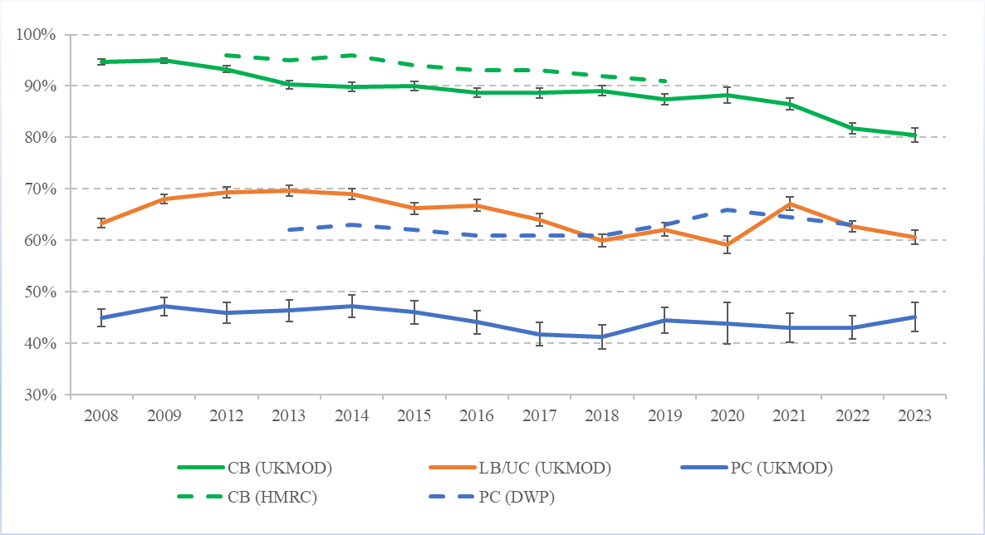
Overall Take-Up Rates

Slide 11
Child Benefit – Income & Benefit Amount

Slide 12
Child Benefit – SES & Demographics

Slide 13
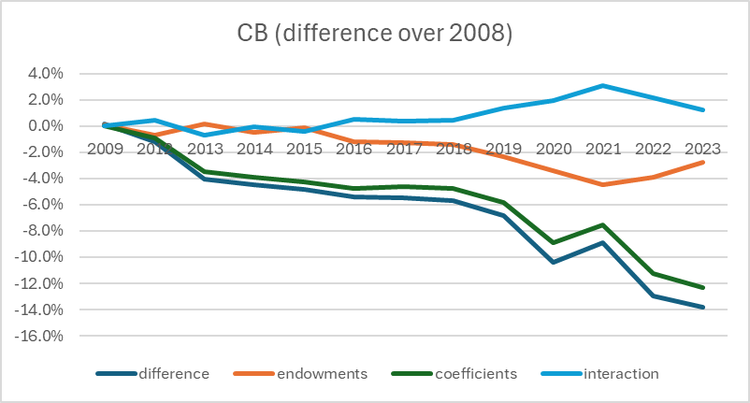
Child Benefit – Oaxaca decomposition

Slide 14
Legacy Benefit / Universal Credit - Income

Slide 15
LB/UC – SES & Demographics

Slide 16
LB/UC – SES & Demographics

Slide 17
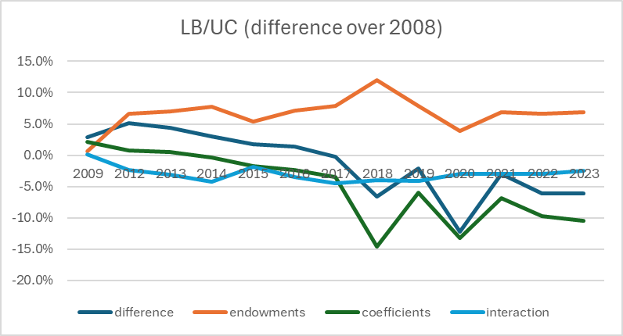
LB/UC – Oaxaca decomposition

Slide 18
Pension Credit

Slide 19
Conclusion
Results indicate the benefit amounts and income of tax-units are most important predictors of take-up in the UK. These confirm the results of Vella and Richiardi (2024) using longitudinal UKHLS data
the presence of significant dynamics of genuine state dependence once the initial condition and the contribution of unobserved heterogeneity have been accounted for
unobserved heterogeneity plays an important role for take-up behaviour for certain social benefits
Future research:
How is non-take-up of social benefits associated with social outcomes
How has the transition from LB to UC affected the take-up

