Slide 1
HBAI data in UKMOD
Matteo Richiardi, Daria Popova and Justin van de Ven
University of Essex

Slide 2
Overview
FRS and HBAI
Choosing between HBAI and FRS data
Integration of HBAI data
Comparative statistics

Slide 3
FRS and HBAI
Family Resources Survey (FRS)
Data available from 1993/94
Administered by DWP
Finer detail concerning income sources than most other UK studies
Substantial sample size (approx. 3 times the LCF)
LCF income top-coded from 2006
Default data source for UKMOD
Packaged for UKMOD from 2003/04, 2008/9, 2009/10, 2012/13+
Households Below Average Income (HBAI) data
HBAI based on the FRS (from 1996)
Adjustments to survey weights and income definitions for high income households evaluated using data from the Survey of Personal Incomes (SPI, administrative HMRC)
Slight differences in sample

Slide 4
FRS and HBAI

Slide 5
Choosing between HBAI and FRS data
General rule is to use HBAI data if focus is on equivalised disposable household incomes, especially for distributional analyses
HBAI data is the basis for the DWP’s HBAI publication
Considered more appropriate for identifying distributional metrics for equivalised disposable income than FRS
Complications with respect to UKMOD
HBAI focus is disposable income
Measures of original (private) income are imputed in HBAI
used as input to UKMOD
Slight differences in variable definitions (complicating comparisons)
HBAI has slightly smaller sample size

Slide 6
How have HBAI data been integrated?
New variables from HBAI integrated into input data sets:
2018(a4), 2019(a2), 2020(a2), 2021(a1, b1), 2022(a1,b1)
A new policy over-writes FRS variables with HBAI variables
The new policy is activated via a new model switch

Slide 7
Variable mapping from HBAI to FRS
hbai_gs_pp dwt (weight)
hbai_ypp_ind ypp (pension)
hbai_yot_ind yot01 (other)
hbai_yem_ind yem (employee)
hbai_yse_ind yse (self-emp)
hbai_yds_ind yds (disp inc)
hbai_ypt_ind yptot, yptmp (private transfers)
hbai_yiy_ind yiy, yiynt, yiytx,
yittx, ydvtx
(investment inc)
+ ypr, yprnt, yprtx
(property inc)

Slide 8
The “UseHBAI_uk” policy
Over-writes default model inputs reported by the FRS with values reported by HBAI

Slide 9
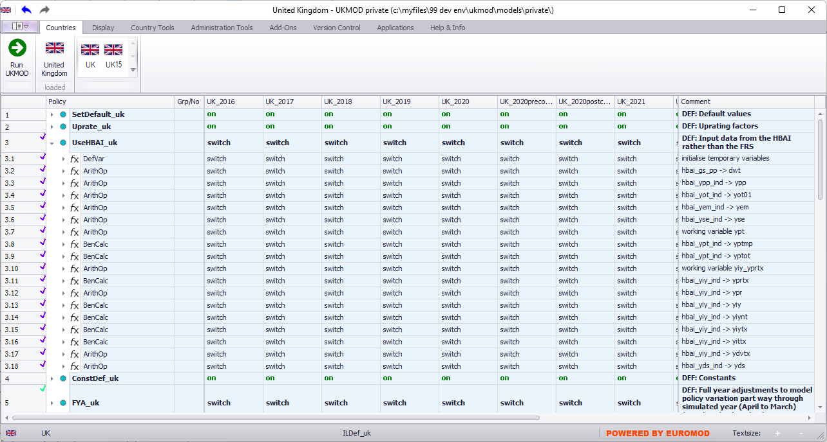

Slide 10
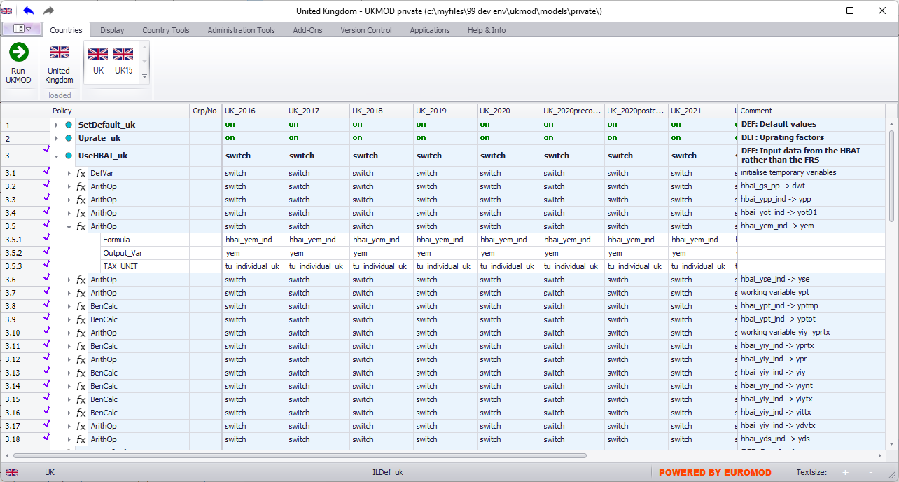

Slide 11
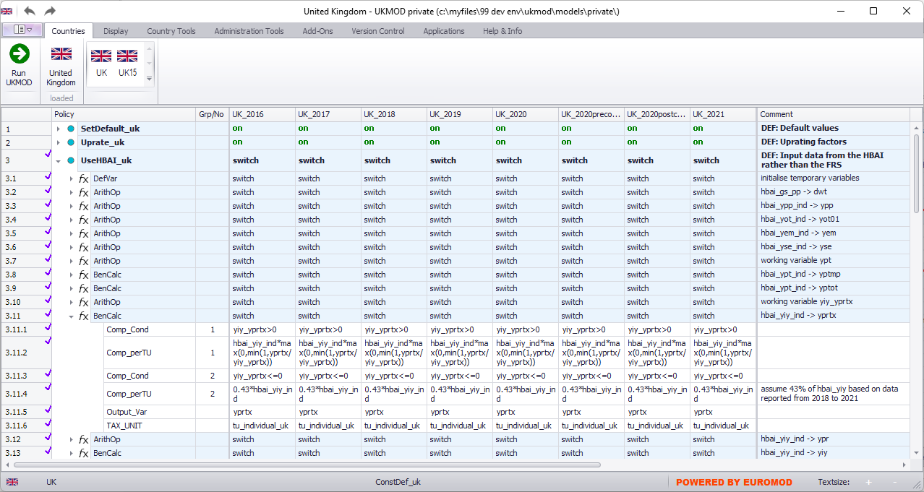

Slide 12
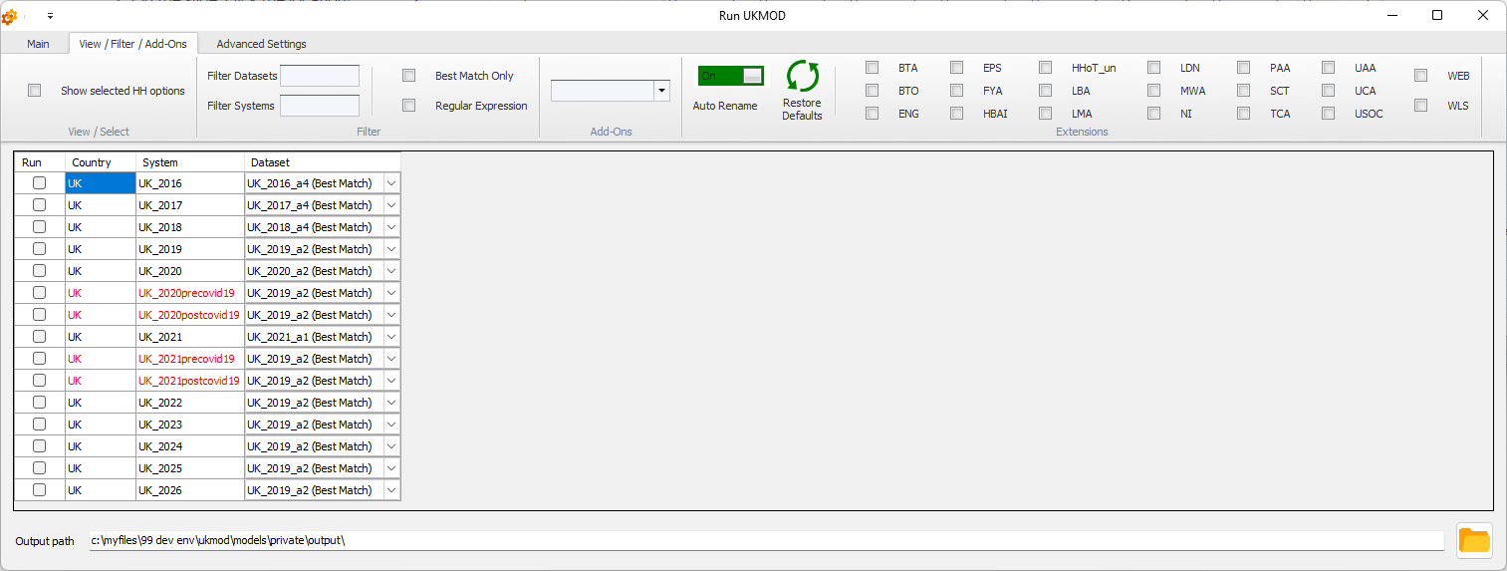
The “HBAI” extension

Slide 13
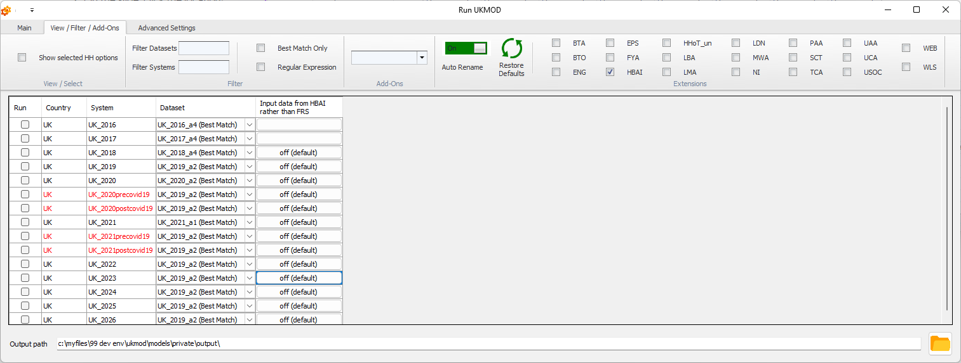
The “HBAI” extension

Slide 14
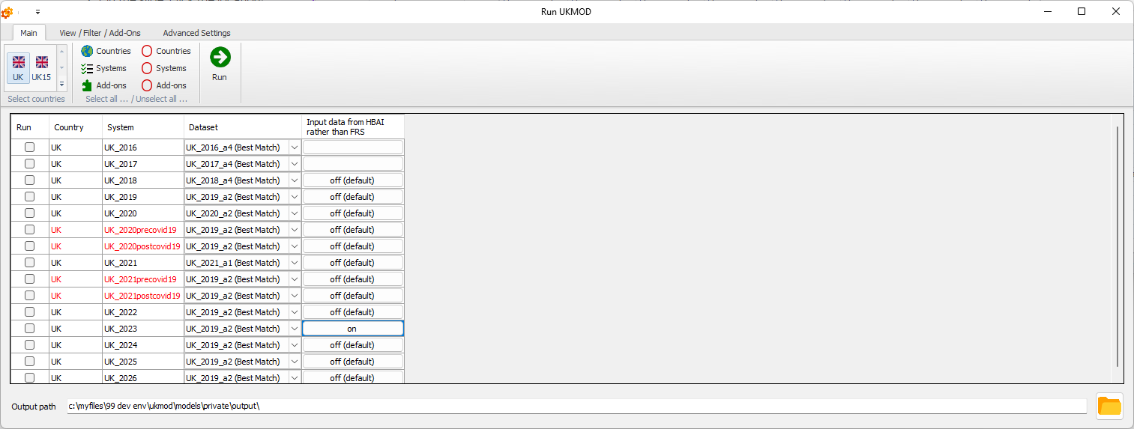
The “HBAI” extension

Slide 15
HBAI vs FRS: earnings (2021)
Ratios of earnings of UKMOD by data source to ASHE
 | ASHE | UKMOD (HBAI) | UKMOD (FRS)
all | 2584.4 | 1.12 | 1.06
male | 3049.8 | 1.15 | 1.06
female | 2120.3 | 1.06 | 1.04

Slide 16
HBAI vs FRS: earnings (2021)

Slide 17
HBAI vs FRS: exogenous expenditure (2021)
 | case loads |  | expenditure
 | FRS | HBAI | FRS | HBAI
Contributory ESA | 0.96 | 0.98 | 0.51 | 0.53
new/basic State Pension | 0.91 | 0.91 | 0.90 | 0.90
Second State Pension | 0.99 | 0.99 | 1.09 | 1.07
Bereavement Benefits | 1.89 | 1.84 | 2.36 | 2.32
Attendance Allowance | 0.65 | 0.64 | 0.63 | 0.62
Disability Living Allowance | 0.69 | 0.67 | 0.67 | 0.65
Severe Disablement Allowance | 0.62 | 0.77 | 0.54 | 0.72
Carer's Allowance | 1.04 | 1.01 | 1.01 | 0.98
Industrial Injuries Disablement Allow. | 0.59 | 0.54 | 0.57 | 0.54
Maternity allowances | 0.29 | 0.24 | 0.29 | 0.25
Statutory Maternity Pay | 0.61 | 0.59 | 0.43 | 0.41
Personal Independence Payment | 0.99 | 0.96 | 0.94 | 0.91

Slide 18
HBAI vs FRS: endogenous expenditure (2021)
 | case loads |  | expenditure
 | FRS | HBAI | FRS | HBAI
Child Benefit | 1.00 | 1.00 | 1.01 | 1.00
Child and Working Tax Credits | 0.71 | 0.68 | 0.59 | 0.56
Housing Benefit | 0.83 | 0.81 | 0.65 | 0.63
Pension Credit | 0.92 | 0.97 | 0.90 | 0.95
Universal Credit | 1.02 | 1.01 | 0.93 | 0.93
Social Contributions | na | na | 0.96 | 1.02
Income Taxes | na | na | 0.74 | 0.91

Slide 19
HBAI vs FRS: distribution (2021)
 |  | UKMOD
 | HBAI | HBAI | FRS
Gini | 34 | 33 | 30
Poverty - all
below 50% of median | 10 | 9 | 8
below 60% of median | 17 | 15 | 14
below 70% of median | 25 | 24 | 23
Poverty - children
below 50% of median | 11 | 8 | 8
below 60% of median | 20 | 18 | 17
below 70% of median | 31 | 30 | 29
Poverty - pensioners
below 50% of median | 10 | 11 | 9
below 60% of median | 18 | 19 | 17
below 70% of median | 28 | 31 | 28

