Slide 1
Recent UKMOD Developments
Matteo Richiardi, Daria Popova and Justin van de Ven
University of Essex

Slide 2
Overview
Development of a behavioural add-on (BVR)
Development of an indirect tax add-on (TCO)
HBAI integration
UKMOD Explore
EUROMOD Engine
Github repository
Development and release calendar

Slide 3
Behavioural Add-on (BVR)
Seek to distinguish between “impact” and “behavioural” effects
Impact effects are standard in UKMOD
Behavioural effects consider likely responses to policy reform
Method based on standard approach adopted by UK Government (HMT, DWP, Scottish Fiscal Commission)
New add-on BVR projects output data distinguishing between impact and behavioural effects
New statistics presenter template reports summary statistics to assist analysis of behavioural responses
Documentation: “BVR add-on.pdf”

Slide 4
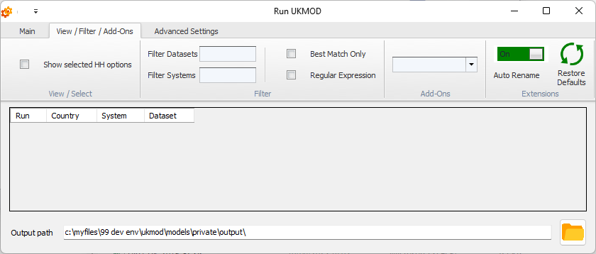
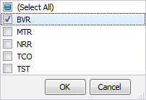
Using Add-ons

Slide 5
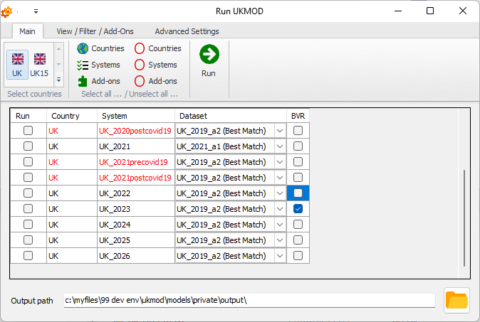
Using Add-ons

Slide 6
Indirect Tax add-on (TCO)
Designed to project specific and ad valorem excise, and value added taxes
Three new UKMOD features:
New data – currently for 2018, 2019, 2020, and 2021 (2022 delayed due to delay in publishing of LCFS)
New add-on: TCO
New statistics reported in Statistics Presenter “Default” and “Baseline/Reform” templates
Three behavioural variants:
Constant income shares
Constant expenditure shares
Constant quantities
Documentation: “TCO add-on.pdf” to be issued with the end-of-year model release

Slide 7
HBAI Integration
Current default: Family Resources Survey (FRS)
Alternative: Households Below Average Income (HBAI) data
Integration:
New variables from HBAI integrated into input data sets:
2018(a4), 2019(a2), 2020(a2), 2021(a1, b1), 2022(a1, b1)
A new policy over-writes FRS variables with HBAI variables
The new policy is activated via a model switch, using the “HBAI” model extension

Slide 8
UKMOD Explore
UKMOD Explore / UKMOD Light
Targeted for people with general policy interest (e.g. journalists, general public)
Requires no application process
Available online: https://www.microsimulation.ac.uk/ukmod/ukmod-explore
Updating of policy contexts and improvements to the user interface
Idea is to provide an easily accessible tool for quick policy analyses and to check results from direct model manipulation (self-training)

Slide 9
EUROMOD Engine
Substantially improved computation efficiency with version 3.7.5
More than twice as fast as previous versions in our tests for UKMOD
New connectors for running EUROMOD models from other programming environments:
Stata
Python

Slide 10
UKMOD Version Control
UKMOD is now maintained on Github
Public repository:
https://github.com/centreformicrosimulation/UKMOD-PUBLIC
Private repository:
Access limited to Premium User Group members, by request
https://github.com/centreformicrosimulation/UKMOD-PRIVATE

Slide 11
Development and Release Calendar
Spring Statement
Data release
FRS and HBAI
LCFS
Autumn Budget
Country Report (end of calendar year)

