Slide 1

Behavioural effects of income tax changes in Scotland
Maike Waldmann
Scottish Parliament Information Centre (SPICe)
maike.waldmann@parliament.scot

Slide 2
Behavioural analysis in SPICe
How we use the UKMOD behavioural add-on
How we know the results are ‘right’
How we talk about them

Slide 3
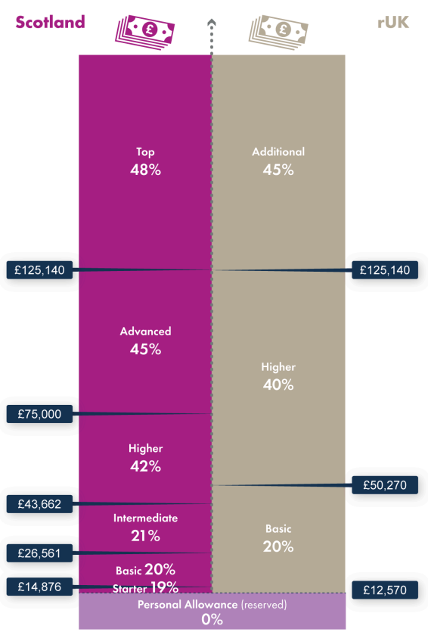
Scottish rates of income tax
 | Baseline* |  | Scottish Budget bill Dec 2023 proposal (now implemented) | SC 2024-25
Starter | 12,571 – 14,876 | 19%
Basic | 14,877 – 26,561 | 20%
Intermediate | 26,562 – 43,662 | 21%
Higher | 43,663 – 125,140 | 42% | Higher | 43,663 – 75,000 | 42%
 |  |  | Advanced | 75,001 – 125,140 | 45%
Top | 125,141+ | 47% | Top | 125,141 + | 48%
*SFC baseline; bands uprated from previous year

Slide 4
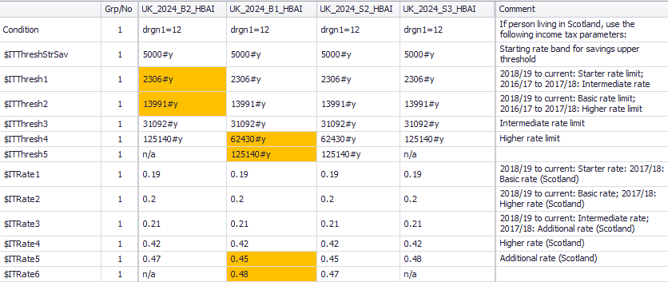
UKMOD DEF: Constants
Baseline
Full proposal
Advanced band
Top rate +1p

Slide 5
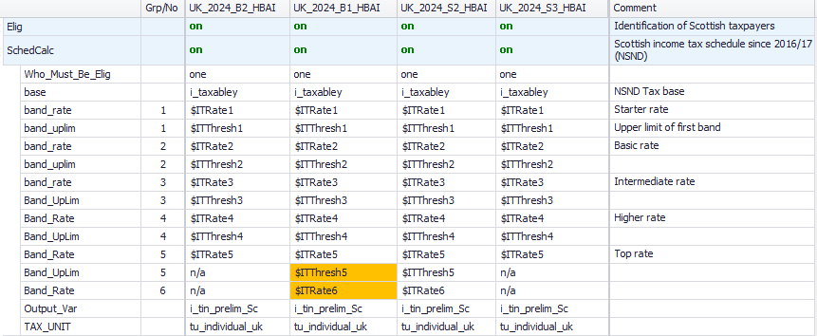
UKMOD TAX: Personal income tax
Baseline
Full proposal
Advanced band
Top rate +1p

Slide 6
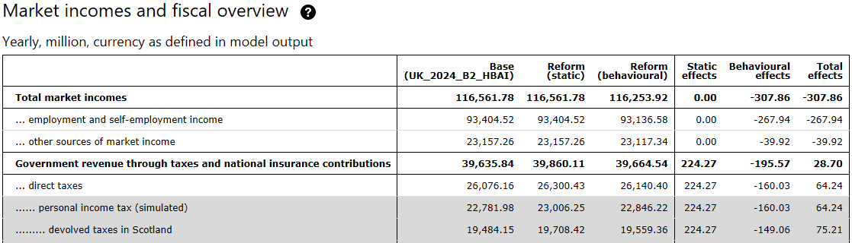
UKMOD Statistics Presenter output
(Reform = full proposal, as implemented)

Slide 7
How we know results are ‘right’
All models are wrong …
Compare with others’ models of the same proposal (but note that we all tend to use the same assumptions)
Compare with SG ready reckoners
Regular catch-ups with other modelling teams in Scotland to discuss general methodology issues

Slide 8
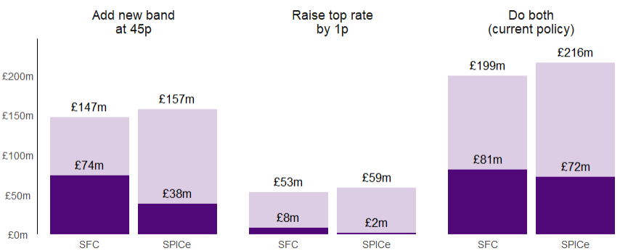
Comparison with SFC forecast
Expected additional income tax revenue in 2024-25 as forecast by SFC and SPICe
Static and post-behavioural effects
Note: SPICe estimates on this slide are unrounded to show the comparison. We would round any estimates prior to using them in any other way.
SFC forecasts: Scotland’s Economic and Fiscal Forecasts – December 2023 | Scottish Fiscal Commission; SPICe estimates calibrated to SFC baseline

Slide 9
Comparison with SG ready reckoners
Post-behavioural impact of small changes to income tax, in £ million
Scenario name | SG | UKMOD HBAI
Increase Starter rate by 1p | 65 | 61
Increase Basic rate by 1p | 239 | 239
Increase Intermediate rate by 1p | 172 | 175
Increase Higher rate by 1p | 80 | 81
Increase Advanced rate by 1p | 21 | 9
Increase Top rate by 1p | 6 | -1
Decrease Top rate by 1p | -8 | -2
Increase the Starter rate band by £100 | -3 | -2
Reduce the Starter rate band by £100 | 3 | 3
Increase the Basic rate band by £1,000 | -15 | -15
Reduce the Basic rate band by £1,000 | 16 | 16
Increase the Higher rate threshold by £1,000 | -114 | -125
Reduce the Higher rate threshold by £1,000 | 129 | 133
Increase the Advanced rate threshold by £1,000 | -3 | -3
Decrease the Advanced rate threshold by £1,000 | 3 | 3
Note: SPICe estimates on this slide are unrounded to show the comparison. We would round any estimates prior to using them in any other way.
Scottish tax ready reckoners: direct effects of illustrative tax changes for 2024 to 2025 - gov.scot (www.gov.scot); SPICe estimates not calibrated

Slide 10
How we talk about it
Lately, we have used behavioural analysis mainly when responding to MSP enquiries, and not so much in published outputs (blogs & briefings)
Estimates of behavioural effects are less certain than static effects and sensitive to underlying assumptions -> SPICe blog on behavioural effects and sensitivity to TIEs
Estimates are calibrated to SFC forecasts
Standard wording
Rigorous rounding

Slide 11
Thank you
Maike.Waldmann@parliament.scot

