Slide 1
Modelling a Minimum Income Guarantee in Scotland Spencer Thompson, October 2024

Slide 2
The contents of this presentation are unpublished and do not represent policy decisions

Slide 3

Background
In the 2021/22, the Scottish Government committed to “begin work on a Minimum Income Guarantee [MIG], which would make sure that everyone in Scotland has enough money to live with dignity.”
Since then, the MIG Steering Group was established, consisting of a cross-party Strategy Group and an independent Expert Group (EG) with representation from poverty and equality organisations, academia and think tanks.
Scottish Government analysts have provided analytical support ahead of the final report of the EG.

Slide 4
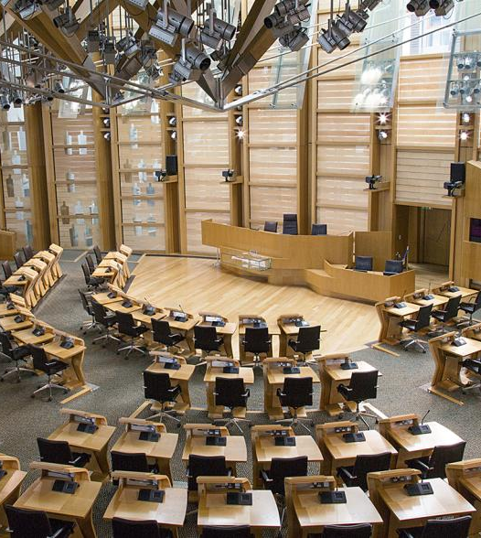
What is a MIG?
A MIG is a minimum level of income below which no citizen should fall.
This could be achieved in various ways, including through earnings, benefits, and even public services, depending on how the MIG was defined.
In Scotland, the landscape is complicated by partial devolution of powers: e.g. Universal Credit (UC) and Minimum Wage are reserved to UK Government.
Generally modelling steps towards a MIG, focusing on social security in this presentation.

Slide 5
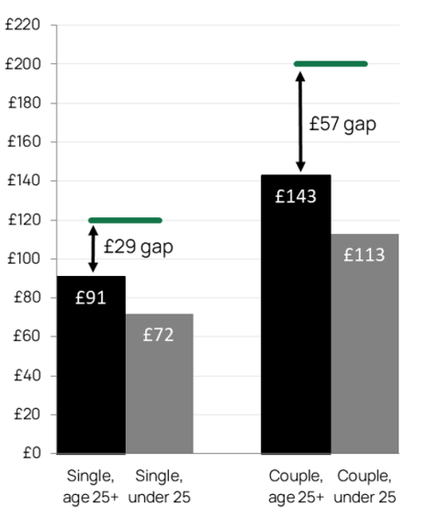
Potential options – near-term
We were asked by EG to model potential options for moving towards a MIG within current social security powers
This could involve either a top-up to UC or an increase in devolved benefits.
We modelled the first as a top-up to the UC standard allowances to bring them up to the level of JRF’s Essentials Guarantee.
We modelled the second as an increase to Scottish Child Payment to bring it up to a certain proportion of the average Minimum Income Standard for children, along with a taper to overcome the ‘cliff edge’.

Slide 6
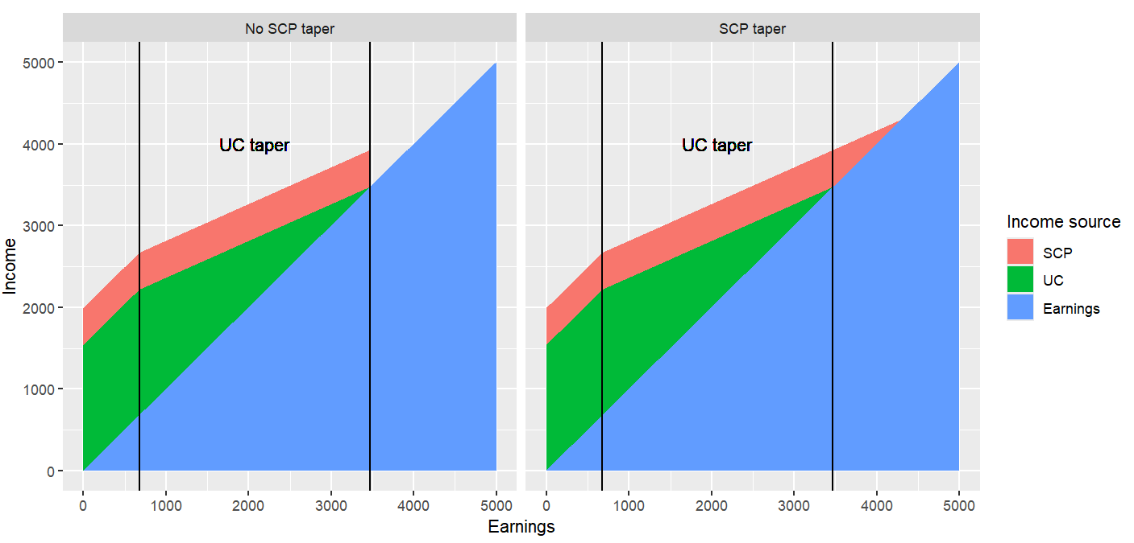
SCP taper (illustrative)
Single parent, <25, 3 children, Stirling
Notes:
Without an SCP taper, all SCP income is withdrawn as soon as the household’s earnings exceed the point at which UC tapers to zero
This becomes more significant if SCP is increased
SCP taper removes the cliff edge, but if the taper overlaps with the UC taper then you end up with very high combined taper rate
We therefore start the SCP taper at the point where UC tapers to zero – this is equivalent to including SCP within the UC award
Implemented in UKMOD through a bit of algebra to determine the point at which UC tapers to zero – treat that as the SCP work allowance and then use the withdraw parameters

Slide 7
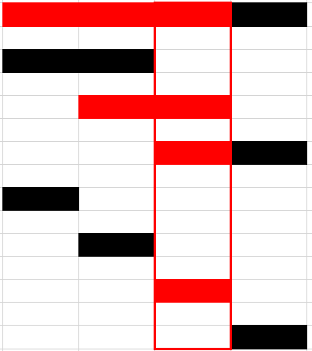
Potential option – medium-term
EG also wanted to explore a medium-term option for achieving the MIG, with more control over UC.
We model a ‘mid-MIG’ as an increase to UC standard allowances and the child element to bring households up to the after-housing-cost poverty line, replacing SCP, with the two-child limit and benefit cap also removed.
This pushes UC high up the earnings distribution, so we also drop the work allowance.
We also model the cost of a ‘time-limited’ variant of the mid-MIG using DWP data on UC spell lengths, adjusted for survivor bias (longer spells more likely to be sampled)
Notes:
Image shows illustration of survivor bias in spell length sampling – the shorter the spell length, the less likely it is to be sampled, and there’s another problem in that we only observe the spell length up to the point of sampling.
Adjust for survivor bias by weighting each observed spell by the inverse of its duration. Then assume we observe spells at the mid-point.
NB: no adjustment made to housing element of UC; if rents exceed the housing element a household can still be below the poverty line
But also lots of other reasons why recipients may be below or above the poverty line, including earnings

Slide 8
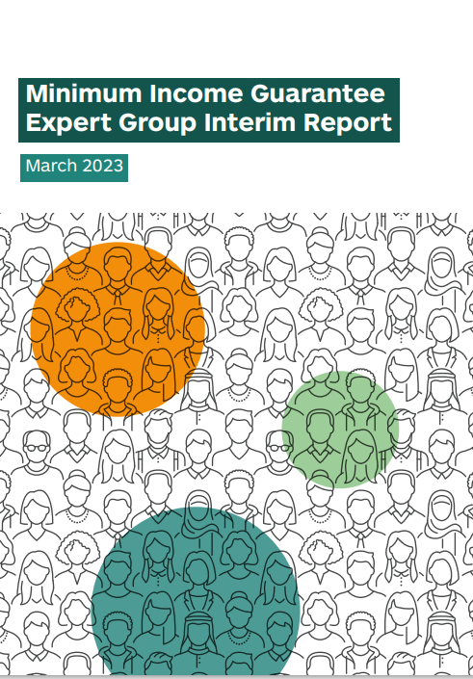
Read the interim report at https://www.gov.scot/publications/minimum-income-guarantee-expert-group-interim-report/

