Slide 1
Panel Session: Labour Supply Modelling
Stuart Maclachlan

Slide 2
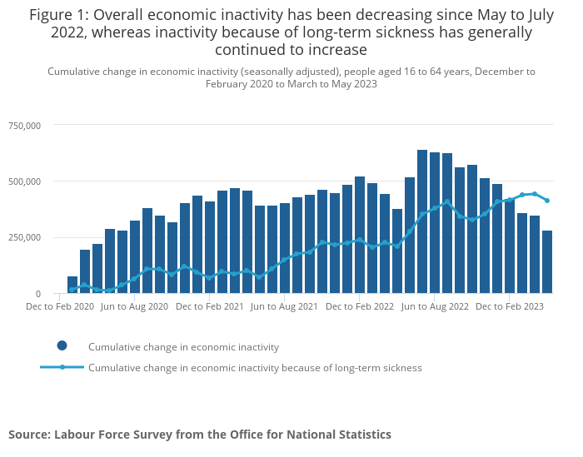
DWP & Labour Supply
DWP’s official priorities state that the department aims to:
  Maximize employment;
  Reduce economic inactivity;
  Enable disabled people and people with health conditions to start, stay and succeed in work.
Getting people back into work helps by:
  Cutting welfare spend, which reduces public debt;
  Loosening the labour market, which reduces wage inflationary pressure;
  Making the economy more productive, which boosts growth.
Labour supply modelling provides a framework for understanding which policies incentivize work, and to what extent they incentivize work.
The graph shows that economic inactivity has been on the rise, with long-term sickness the driving force. (ONS)

Slide 3
Current Modelling Framework
We were commissioned by policy analysts in the department to produce a behavioural model.
The key objective is to emulate the methodology currently in use by HMT, who own the indirect effects process. Our Ministers would like to have an indication of the policies the OBR may score the indirect effects of.
It is a partial equilibrium model in which labour supply elasticities are exogenously assumed. A write-up of the model is available here.

Slide 4
Future Modelling Framework
We are developing a random utility model of labour supply in collaboration with Patryk Bronka, UKRI Policy Fellow.
Its structure is very closely aligned with the SimPaths’ labour supply model.
In this set-up, we can update elasticities to reflect newly available data or population sub-groups of interest. This makes the model adaptable to the department’s future policy objectives.

