Slide 1
Using UKMOD to support MPs’ research
Matthew Keep – Senior Library Clerk. Economic Policy and Statistics

Slide 2
Introduction
What is the House of Commons Library? What do we do?
How have we been using UKMOD?

Slide 3
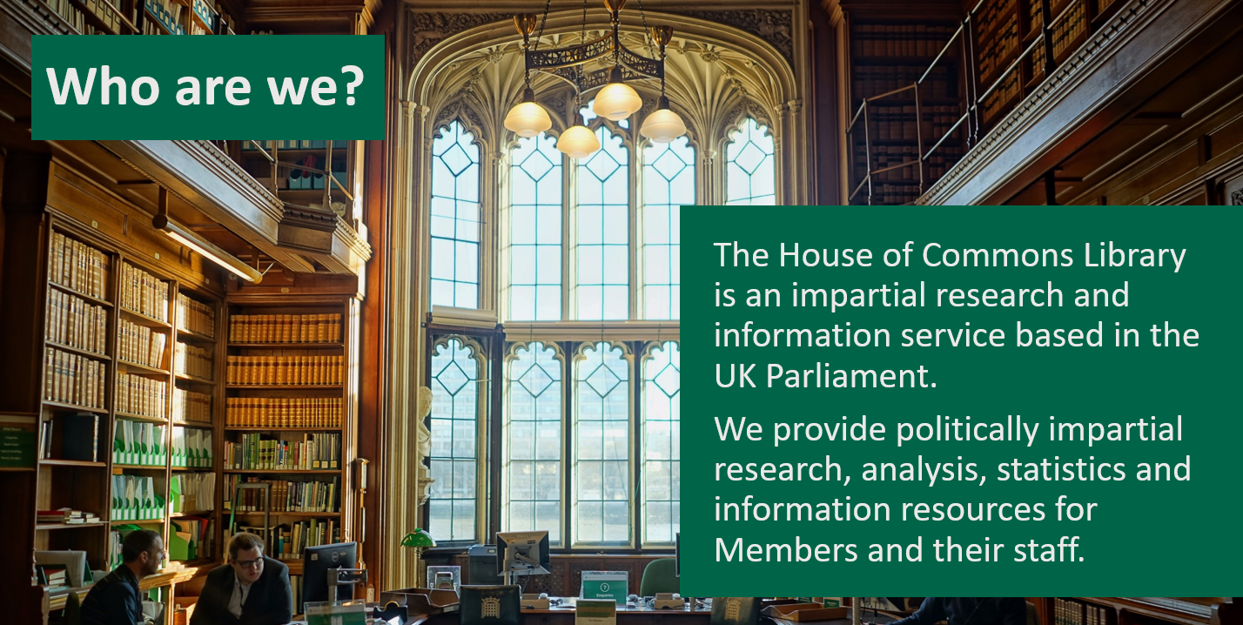
What is the House of Commons Library?

Slide 4
What is the House of Commons Library?
Research: Around 80 subject specialists

Slide 5
What is the House of Commons Library?
Research: Around 80 subject specialists – 4 do some work with UKMOD

Slide 6
What is the House of Commons Library?
Research: Around 80 subject specialists
We work largely for opposition MPs and backbench MPs

Slide 7
How do we support MPs?
We answer information requests and conduct bespoke analysis for MPs and their staff
We publish politically impartial research at https://commonslibrary.parliament.uk/
Help MPs and their staff in their roles:
  scrutinise legislation
  scrutinise government policy
  media
  develop policy
  support constituents

Slide 8
How do we use UKMOD?
Mainly for answering MPs requests
Largely for analysing and developing tax (and some benefit) policy
Sometimes to consider policies of the government (previous or current)
Sometimes to consider alternative policies
Modelling hypothetical households

Slide 9
How do we use UKMOD?
Generally, create a counterfactual policy spine to compare with existing policy

Slide 10
Examples: alternative policies

Slide 11
Examples: alternative policies
How much would it cost to increase the child element of Universal Credit by £26.70 per week, with the benefit cap and two-child limit also removed?
How many children would it lift out of poverty, by country?

Slide 12
Examples: alternative policies
How much would it cost to increase the child element of Universal Credit by £26.70 per week, with the benefit cap and two-child limit also removed?
How many children would it lift out of poverty, by country?
How would removing the benefit cap affect poverty?

Slide 13
Examples: alternative policies
How much would it cost to increase the child element of Universal Credit by £26.70 per week, with the benefit cap and two-child limit also removed?
How many children would it lift out of poverty, by country?
How would removing the benefit cap affect poverty?
How much it would cost to reform the High Income Child Benefit Charge (HICBC) so that it starts being paid when joint incomes exceed £100,000.

Slide 14
Examples: alternative policies
How much would it cost to increase the child element of Universal Credit by £26.70 per week, with the benefit cap and two-child limit also removed?
How many children would it lift out of poverty, by country?
How would removing the benefit cap affect poverty?
How much it would cost to reform the High Income Child Benefit Charge (HICBC) so that it starts being paid when joint incomes exceed £100,000.
How much might it cost to end the removal of the personal allowance for those with incomes over £100,000?

Slide 15
Examples: government policy

Slide 16
Examples: government policy
Lots of questions about income tax freezes

Slide 17

Examples: government policy
Lots of questions about income tax freezes

Slide 18
Examples: government policy
Lots of questions about income tax freezes
Often sub-UK estimates

Slide 19
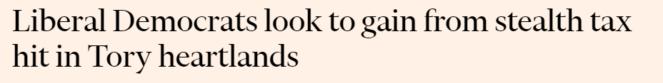
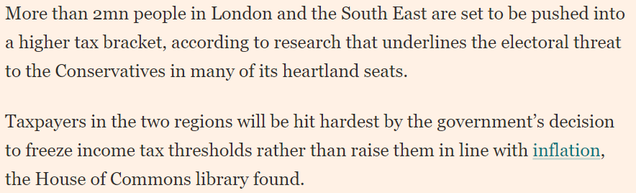
Examples: government policy
Lots of questions about income tax freezes

Slide 20
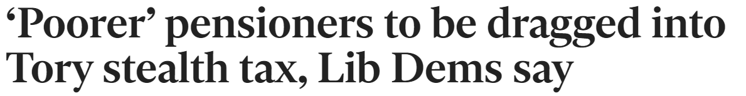
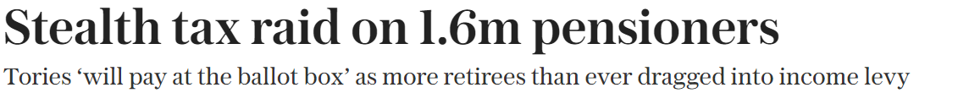
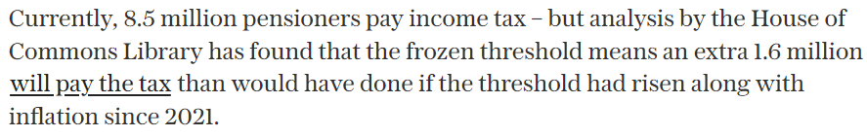
Examples: government policy
Lots of questions about income tax freezes

Slide 21
Examples: government policy
What is the effect of income tax and National Insurance contributions (NICs) changes on people in different industries in aggregate?

Slide 22
Examples: government policy
What is the effect of income tax and National Insurance contributions (NICs) changes on people in different industries in aggregate?
What is the effect of income tax and National Insurance contributions (NICs) changes on people in each region?

Slide 23
Examples: government policy
What is the effect of income tax and National Insurance contributions (NICs) changes on people in different industries in aggregate?
What is the effect of income tax and National Insurance contributions (NICs) changes on people in each region?
How much the freeze on income tax thresholds would be equivalent to if it was being compared to an income tax increase in each of the financial years?

Slide 24
Examples: Hypo. households

Slide 25
Examples: Hypo. households
Changes to net income for two types of households, with different wages, in each region of the country in 2009/10 and 2023/24
Based on various assumptions from the MP:
Regional wages: minimum wage, mean wage and median wage
Single person household (with two children)
Couple household (with two children)

Slide 26
What did we do before UKMOD?
Often, we couldn’t provide an answer.
Before we used UKMOD we were dependent on other sources of data:
Responses to Parliamentary Questions
Other research bodies/think tanks publishing similar research
Analysis of data from the Survey of Personal Incomes, FRS, HBAI etc.

Slide 27
Summary
UKMOD largely used to answer MPs questions about tax/benefits
  Analysing impacts of existing government policy
  Developing alternative policy

