Slide 1
UBI-eh? Strengthening minimum income guarantees, universality and unconditionality in the UK working-age welfare state
Joe Chrisp, Nick Pearce & Matteo Richiardi
Institute for Policy Research, University of Bath Centre for Microsimulation and Policy Analysis University of Essex

Slide 2
Motivation
To examine the distributional and cost implications of reforms that could be pitched as steps towards UBI (or alternatives depending on your perspective)
To design these reforms so that policymakers could use the analysis to evaluate the value of these steps

Slide 3
Political support for UBI
Beyond ‘cheap support’
Parties tend not to commit to UBI as a policy in manifestos but rather one of the following (Chrisp 2020):
Experiments
Government commissions
Steps
What kind of steps?

Slide 4
Reforms to Universal Credit
Age group / benefit | Step | Modelling implications
Working age population / Universal Credit | Auto-register all households/residents in UC system | Increase take-up to c. 100%
 | Remove job-seeking conditions from standard allowance in UC
 | Remove (or increase threshold of) wealth/savings from means test | Extend eligibility of UC standard allowance to those in households with higher savings/wealth
 | Reduce taper rate | Taper rate to 40%
 | Increase level of standard allowance in UC | Increase to £120/week for single households and £200/week for couples

Slide 5
Reforms to Family Benefits
Age group / benefit | Step | Modelling implications
Children / Child Benefit | Remove High Income Child Benefit Charge | Extend child benefit to higher earners
 | Scrap 2-child limit in UC | Extend eligibility to 3rd child and more
 | Increase Child Benefit level | Increase to £30/week

Slide 6
Modelled tax implications
For each policy or policy combinations we report the gross cost and then the distributional consequences if this was:
Externally financed (no changes to income tax)
Funded through progressive changes to income tax – i.e. pp increase on each tax band at a ratio of 1:2 wrt the basic rate vs. higher and top rate (with a minimum increase of 0.2pp) i.e. a 1% increase in the basic rate to 21% would mean the higher rate would be 42% and the top rate 47%

Slide 7
NB The first step modelled was increasing take-up to 100%. This would cost £12.802bn.
All subsequent calculations of cost and tax changes were done in reference to baseline of 100% take up
100% take up assumed to be consequence of:
Auto-registering all residents in UC and removing sanctions

Slide 8
Costs and tax implications for individual reforms
Individual policy reform | Estimated gross cost | Suggestive possible tax implications
Finish migration to UC | £1.272bn | <0.2pp
Remove wealth/savings from UC means test | £0.468bn | <0.2pp
Reduce taper rate to 40% | £9.221bn | Basic: +0.8pp; Higher: +1.6pp
Increase standard allowance (£120/week & £200/week) | £11.108bn | Basic: +1pp; Higher: +2pp
Remove High Income Child Benefit Charge | £3.521bn | Basic: +0.2pp; Higher: +0.4pp
Scrap 2-child limit in UC | £1.511bn | <0.2pp
Increase child benefit (£30/week) | £4.765bn | Basic: +0.4pp; Higher: +0.8pp

Slide 9
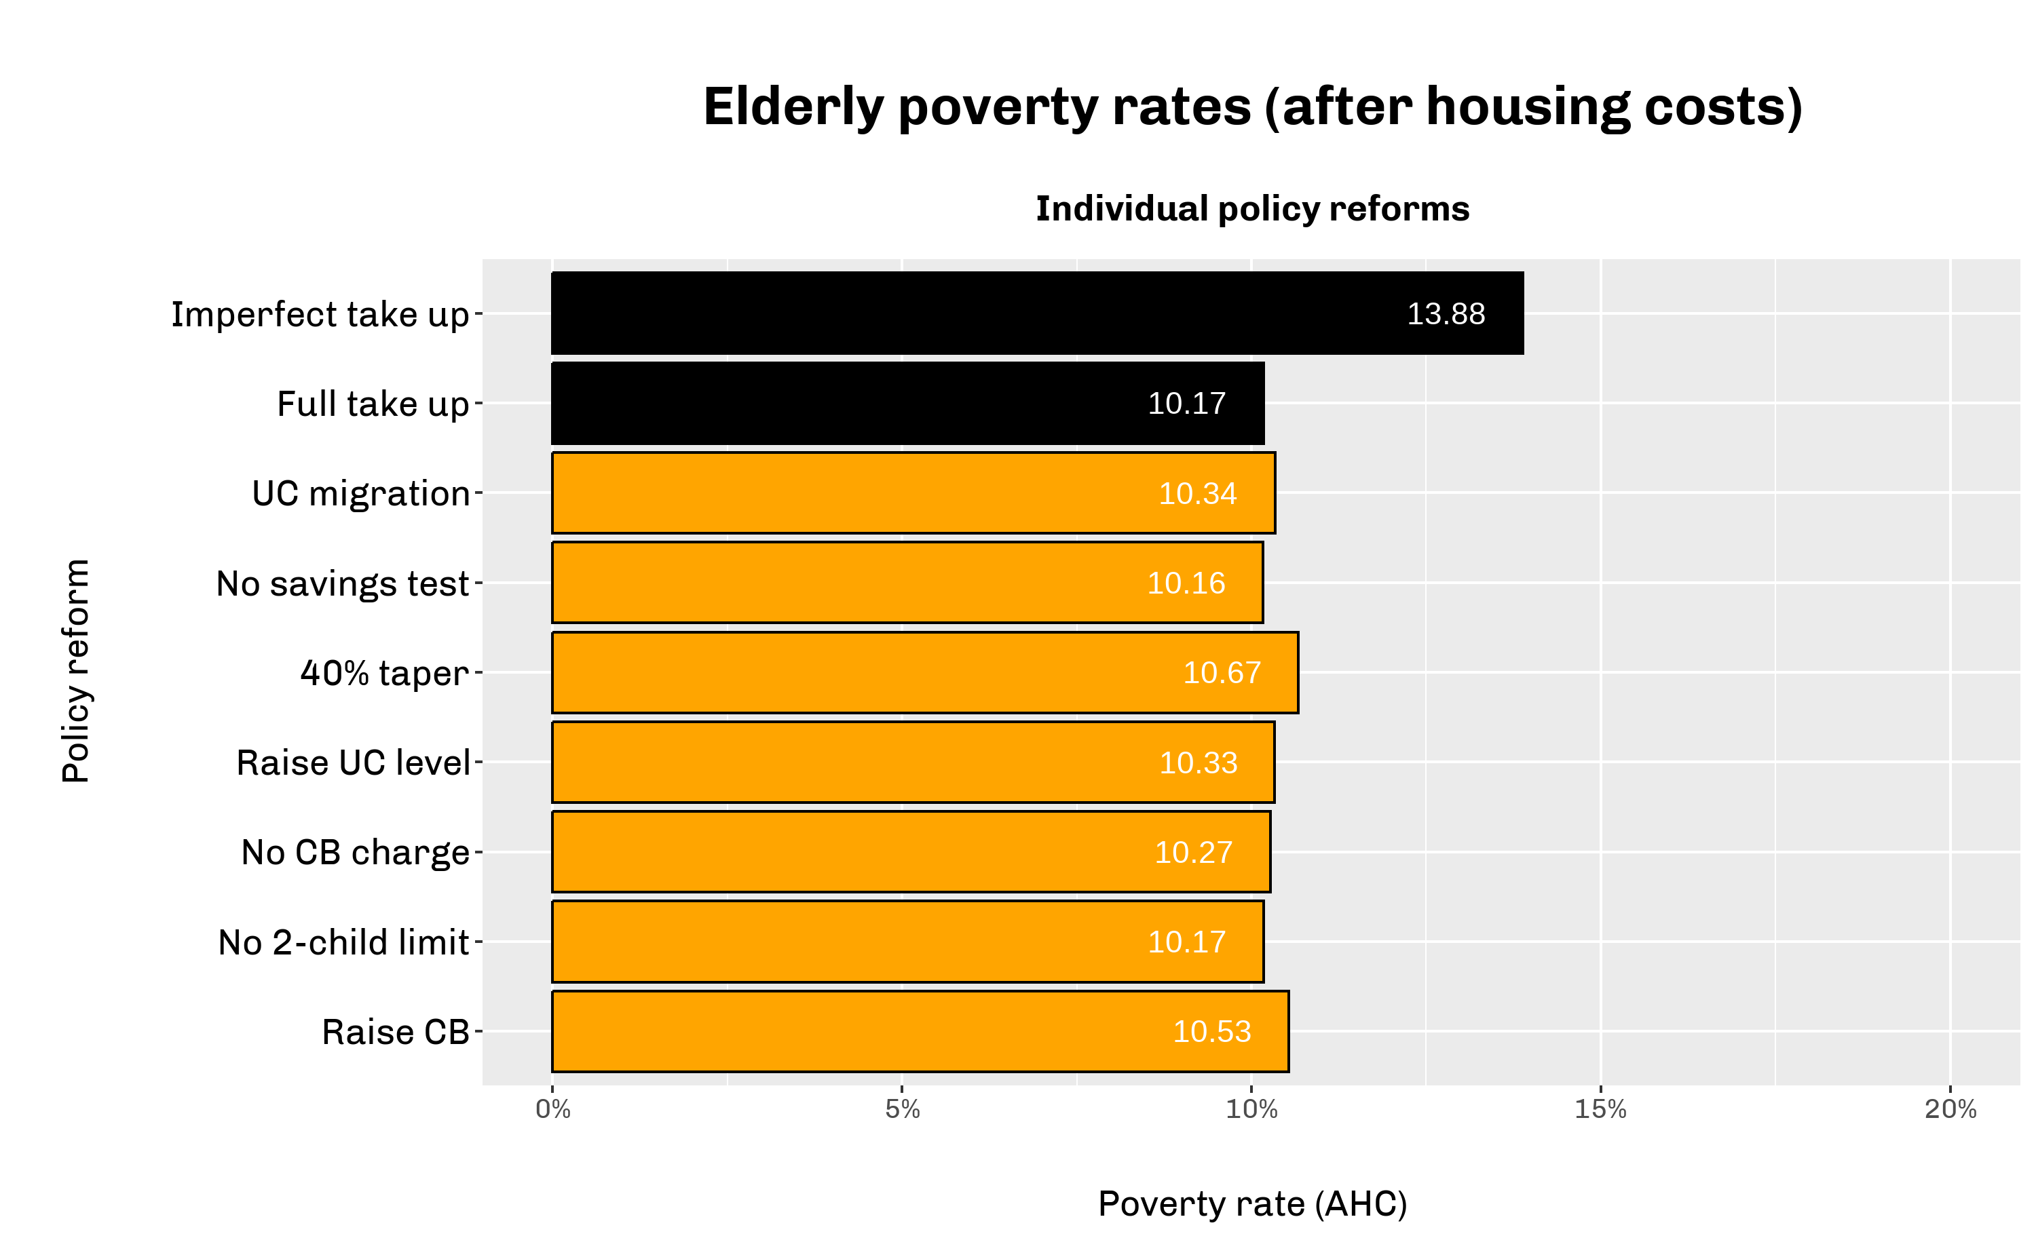
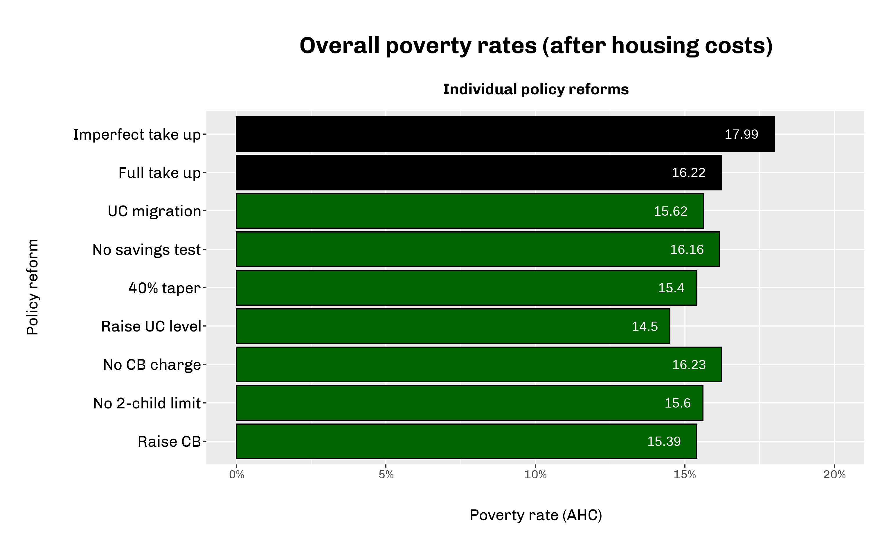
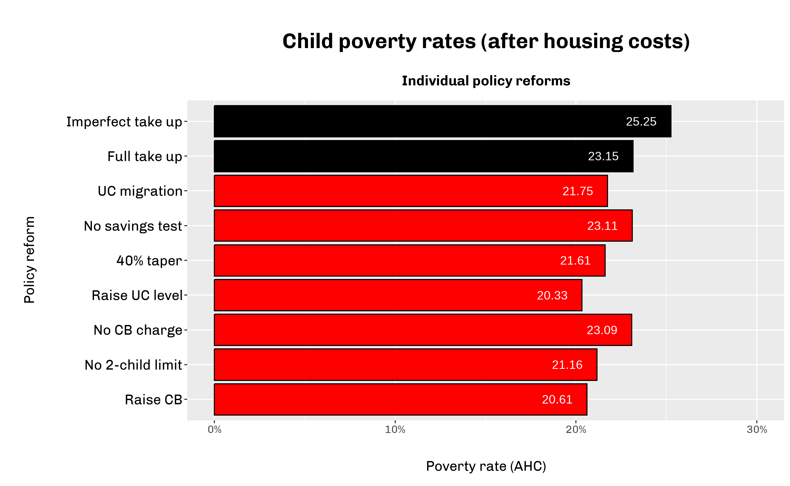

Slide 10
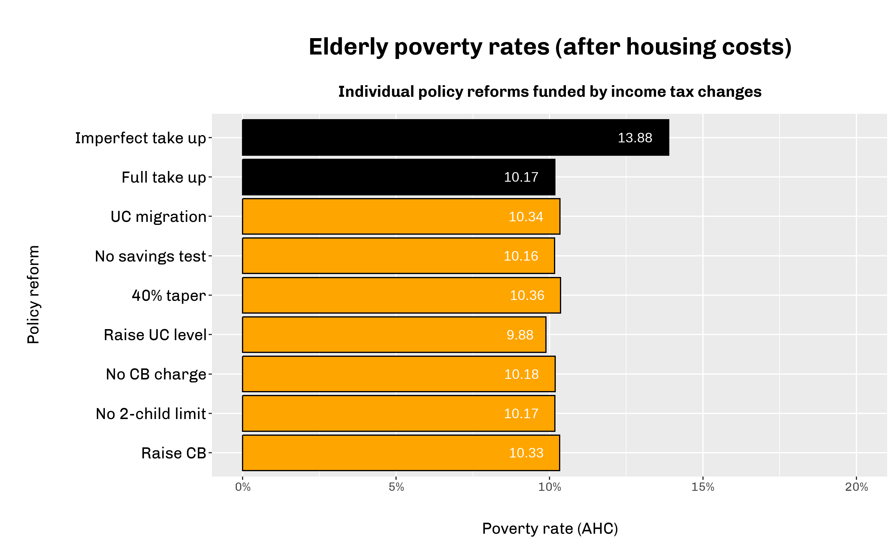
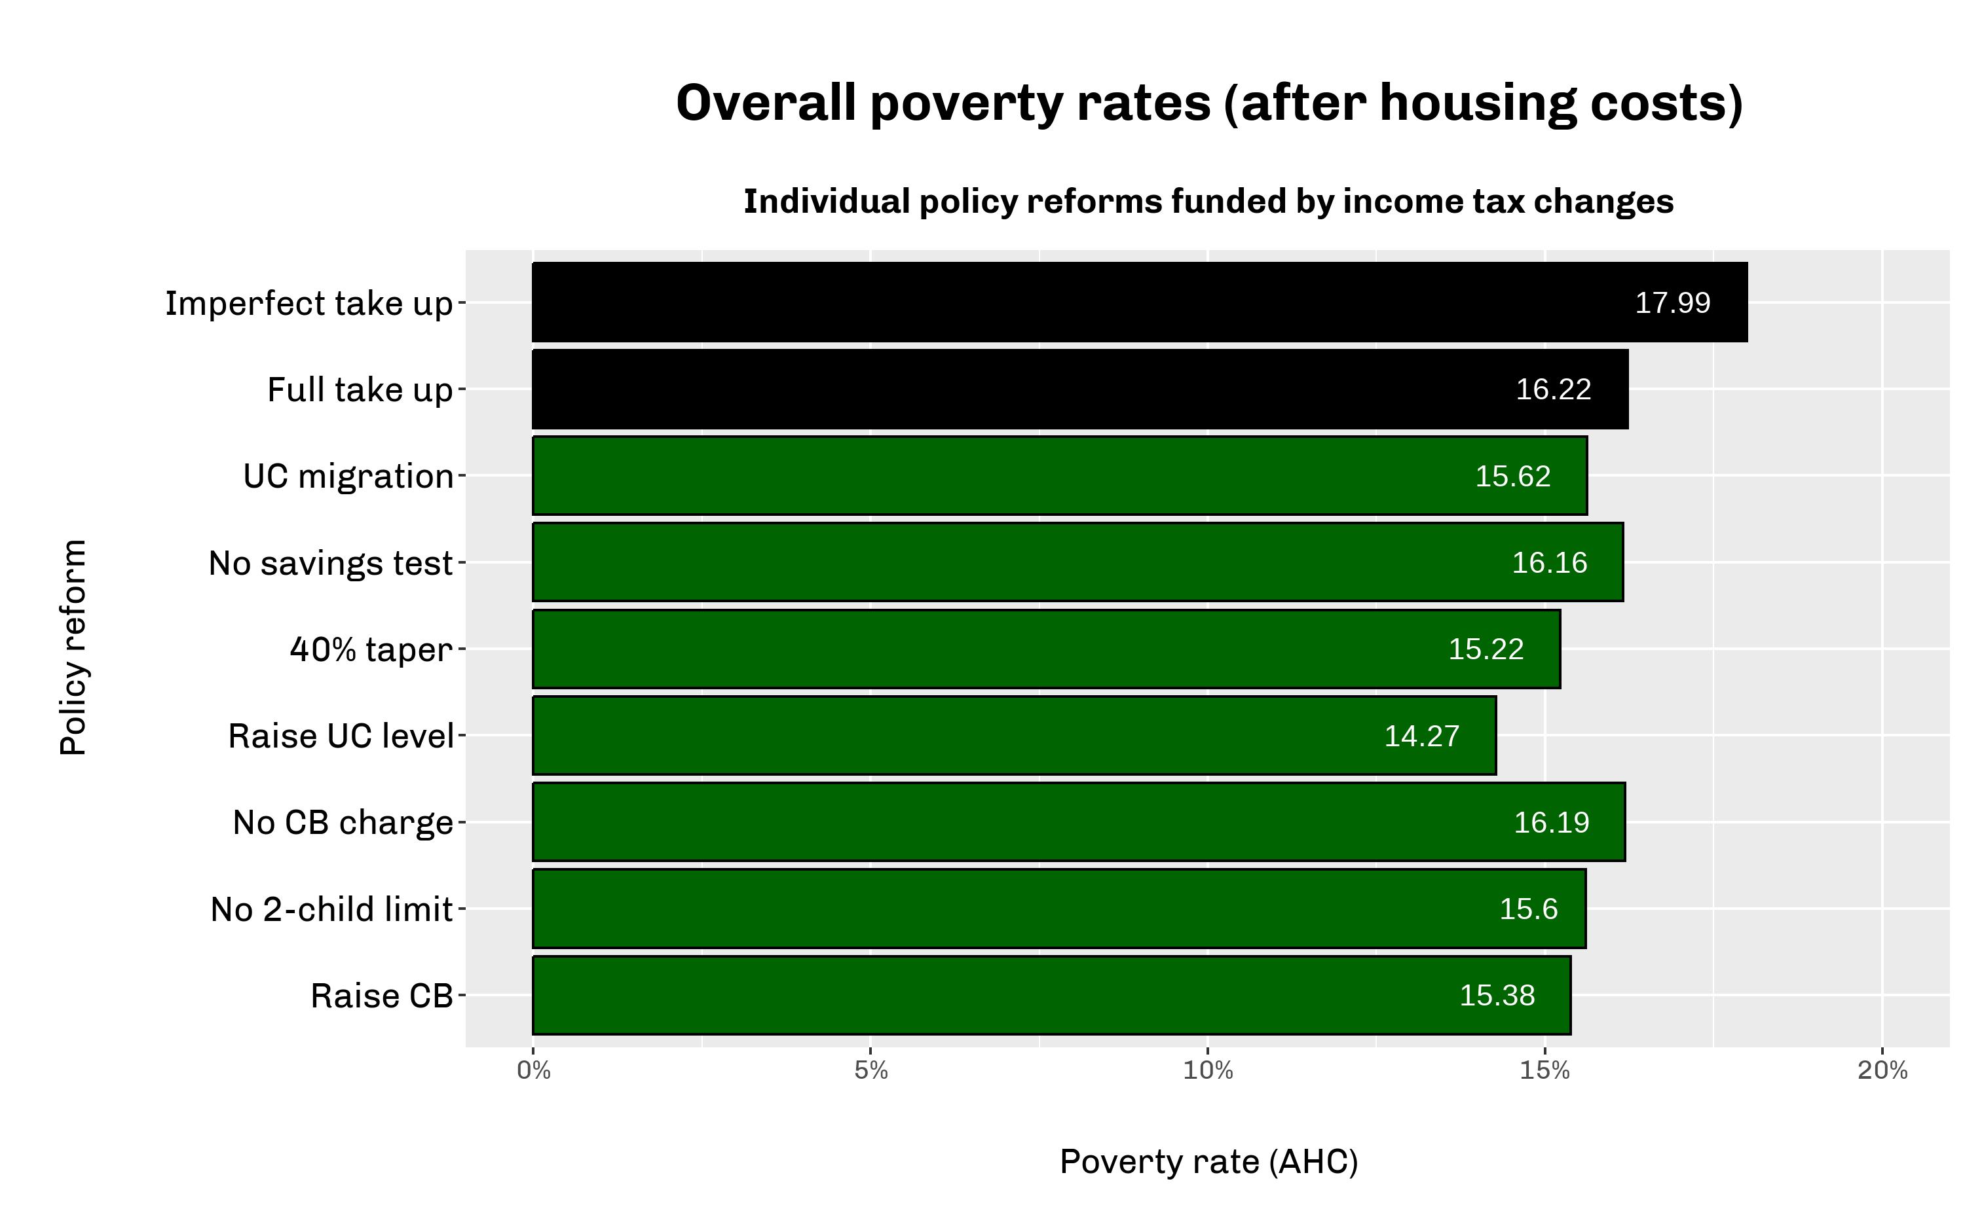


Slide 11
Costs and tax implications for cumulative reforms
Individual policy reform | Estimated gross cost | Suggestive possible tax implications
Finish migration to UC | £1.272bn | <0.2pp
Remove wealth/savings from UC means test | £1.897bn | Basic: +0.2pp; Higher: +0.4pp
Reduce taper rate to 40% | £14.403bn | Basic: +1.2pp; Higher: +2.4pp
Increase standard allowance (£120/week & £200/week) | £33.863bn | Basic: +3.2pp; Higher: +6.4pp
Remove High Income Child Benefit Charge | £37.383bn | Basic: +3.6pp; Higher: +7.2pp
Scrap 2-child limit in UC | £39.56bn | Basic: +3.8pp; Higher: +7.6pp
Increase child benefit (£30/week) | £46.124bn | Basic: +4.4pp; Higher: +8.8pp

Slide 12
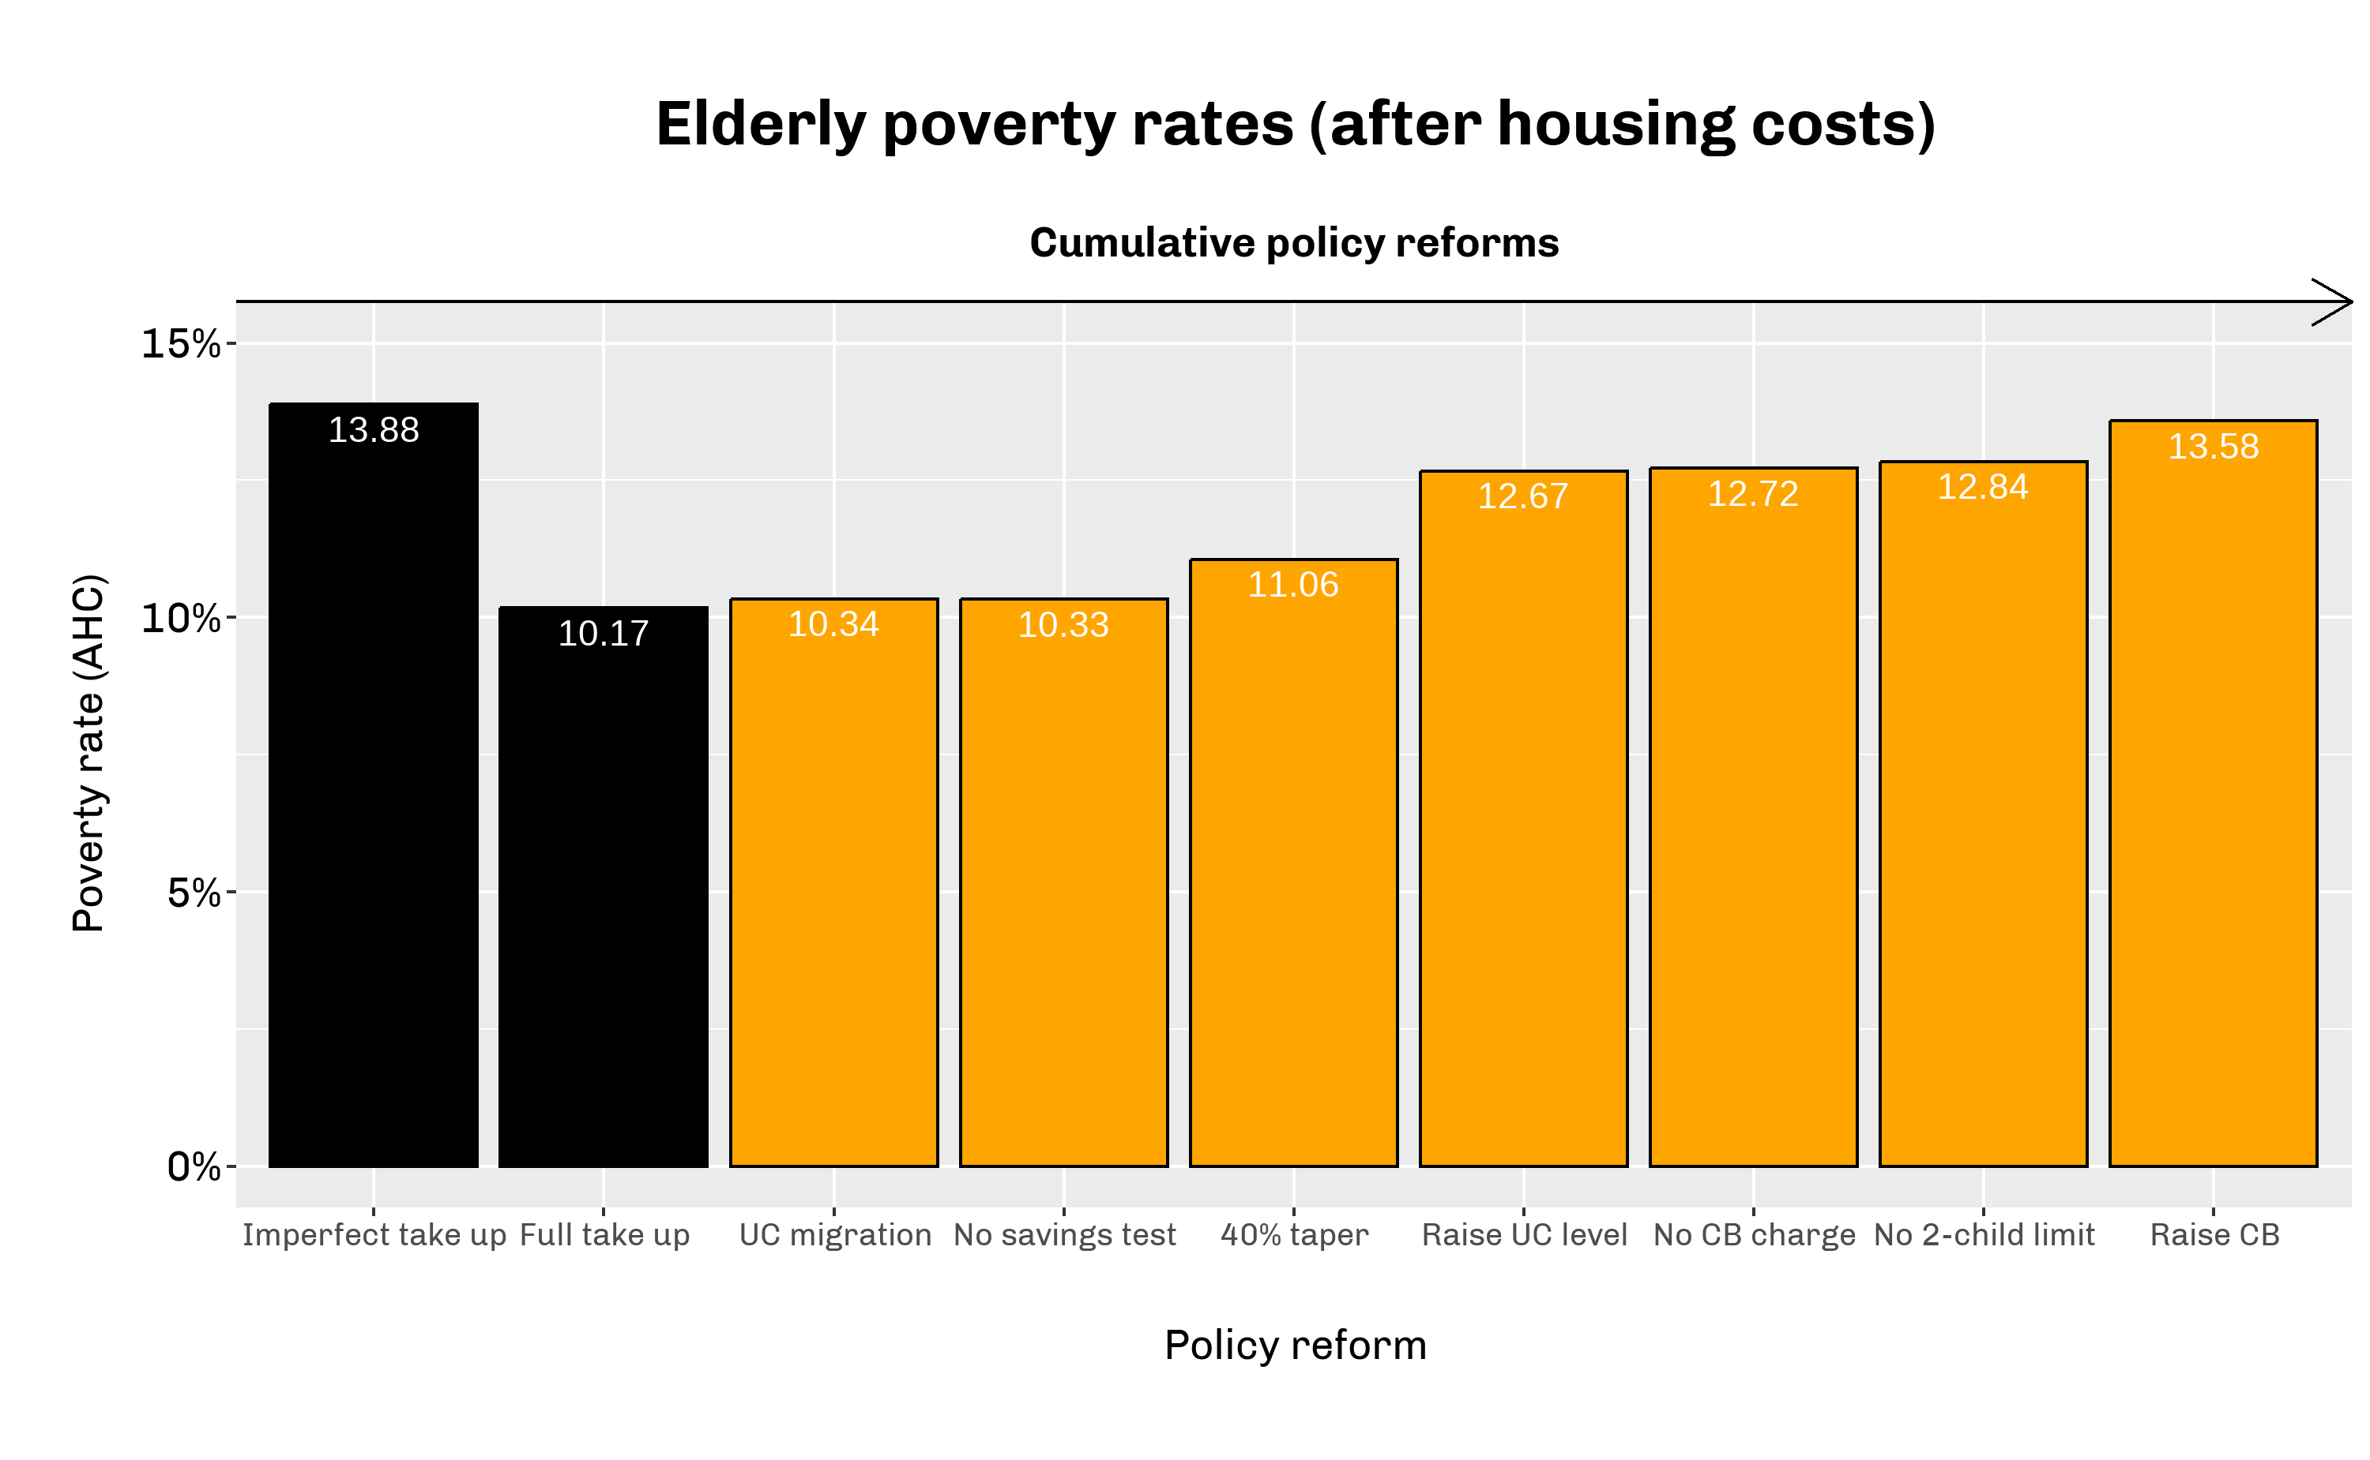
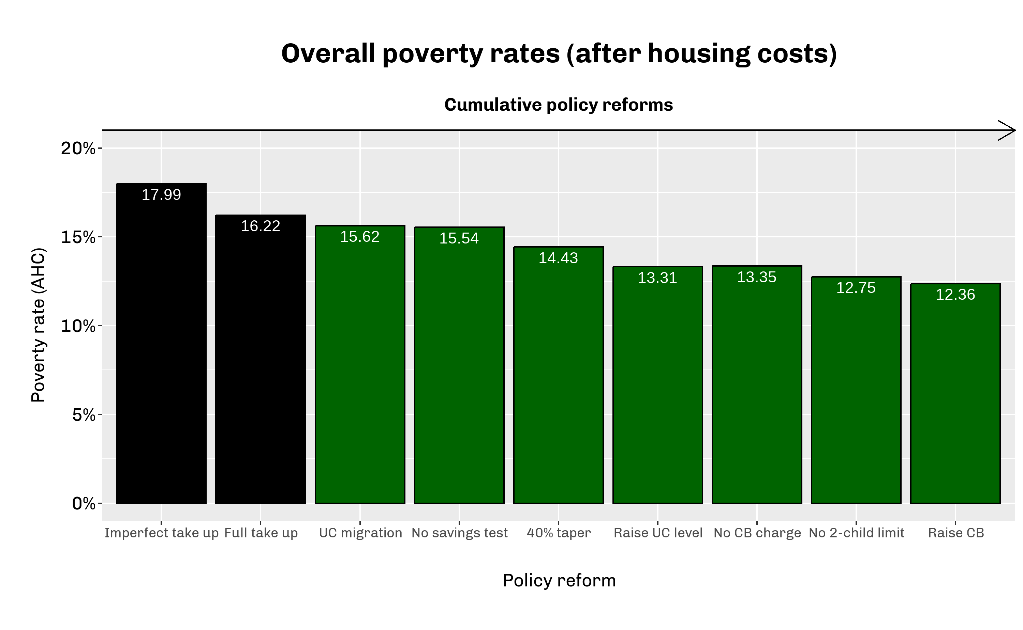
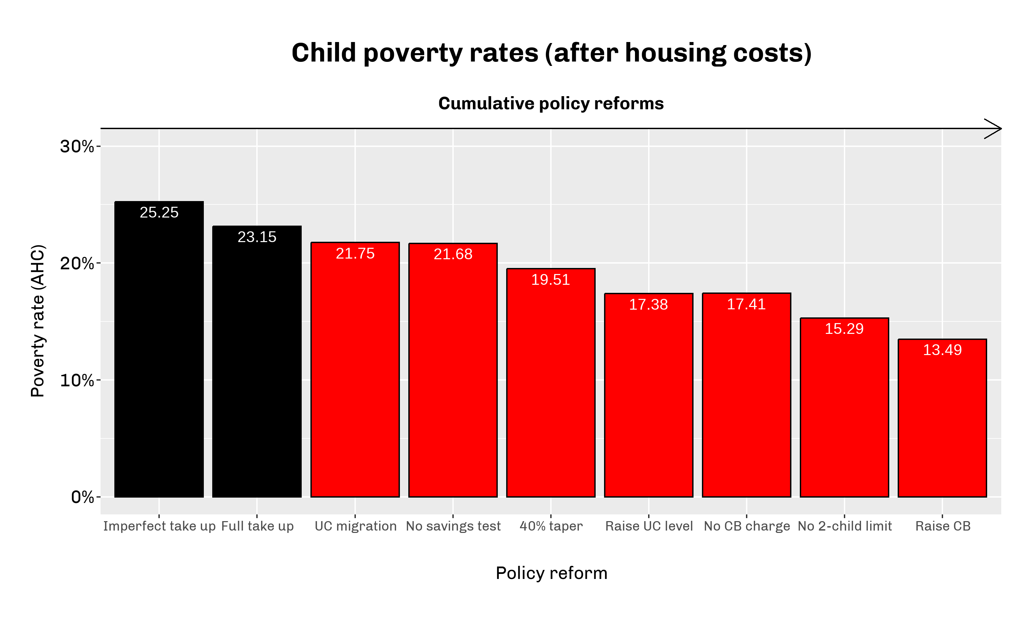

Slide 13
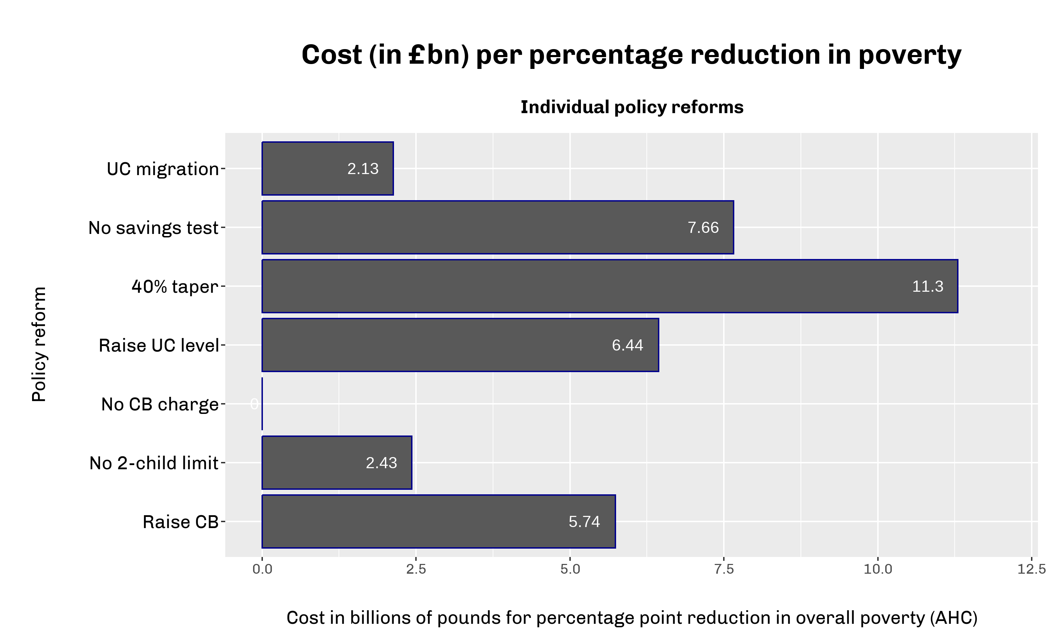
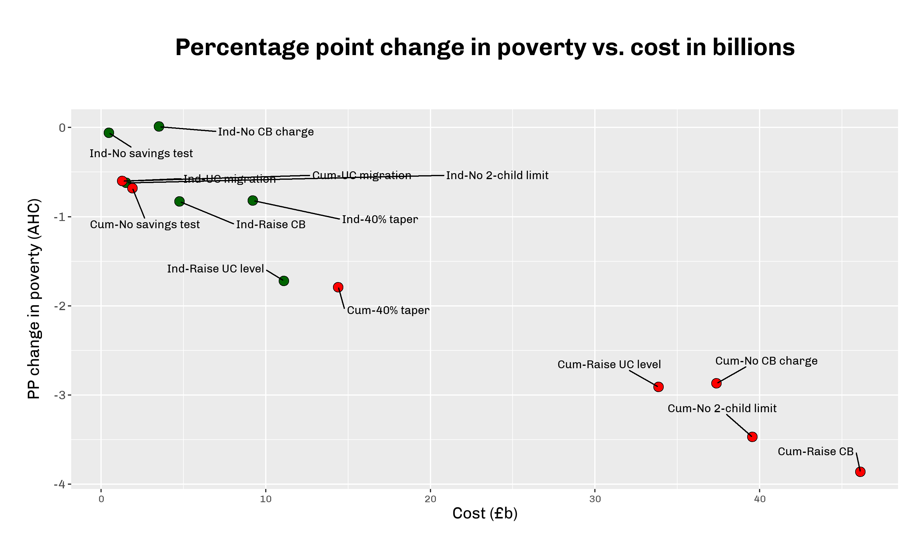

Slide 14
Illustrative trade-offs for METRs
The two main policies that aim to reduce marginal effective tax rates are:
- 40% taper rate
- Removing Child Benefit Income Tax charge
But all policies will affect METRs in some way – trilemma / ‘iron triangle’ (Blundell 2001)

Slide 15
Next steps
Incomplete take-up
Only increase higher and additional rates rather than basic, possibly VAT
Model and report METRs
Include dynamic labour responses

Slide 16
Thank you

