Slide 1
UKMOD Fest 2023
Matteo Richiardi, CeMPA

Slide 2

WELCOME!

Slide 3
Some numbers
119 access requests in 2022 (58 existing users, 61 new users):
Age UK, Bright Blue, Cardiff University, Centre for London, Centre for Social Justice, Child Poverty Action Group, Citizens Advice, CoLABOR, CPAG, Department for Levelling Up, Housing and Communities, department for work and pensions, Finnish Institute for Health and Welfare, Georgetown University School of Foreign Service (Qatar), Greater London Authority, House of Commons, House of Commons Library, ifo Institute, Institute for Social and Economic Research, Instituto de Investigaciones Económicas – UNAM, JRF, Jubilee Debt Campaign, King's College London, London School of Economics, Loughborough University, Ministry of Economy and Finance of Mozambique, National University Ireland Galway, NIESR, Nova School of Business and Economics, Policy Exchange, Prime Minister's Office, Public Health Scotland, Scottish Fiscal Commission, Scottish Government, SPICe, Statistics Finland, The Scottish Government, Tilastokeskus, Tony Blair Institute for Global Change, Transcendence, UK Parliament, Universidad de Alcalá, Universidad Nacional Autónoma de México, University College London, University of Antwerp, University of Bath, University of Chile, University of Edinburgh, University of Essex, University of Frankfurt, University of Freiburg, University of Glasgow, University of Hull, University of Nottingham, University of Sheffield, University of Strasbourg, University of Strathclyde, University of Valencia, Welsh Government, Women's Budget Group, World Bank
56 downloads of the B1 version so far
676 visits to the UKMOD Explore web page in the last 12 months
7,210 UKMOD-related page views (4,493 unique page views) in the last 12 months

Slide 4
In the past year…
Started a new, exciting project funded by the abrdn Financial Fairness Trust, aimed at making UKMOD more accessible to 3rd sector providers of advisory and advocacy services
Advisory Group includes Action for Children, Basic Income Earth Network (BIEN), Centre for Social Justice, Child Poverty Action Group, Citizens Advice, Greater London Authority, Health Foundation, Institute for Policy Research @ University of Bath, Joseph Rowntree Foundation, Social Market Foundation, Tony Blair Institute, Trade Union Congress, Women's Budget Group
Moved from a bi-annual model update to a continuous update, with major releases after the Budgets.

Slide 5
Forthcoming
  New extension to HBAI sample
  New UKHLS input data
  New extension to indirect taxes
  Major improvements to UKMOD Explore
  Revised training modules:
    1-hr “UKMOD Beginners” course – no coding required!
    2-hrs “UKMOD Basics” course – no knowledge of functions required!
    Revised content for our 2-days standard course, which will become “UKMOD Intermediate”
    New 2-days “UKMOD Advanced” course, to be run once a year
    Additional advanced courses for PUG members

Slide 6
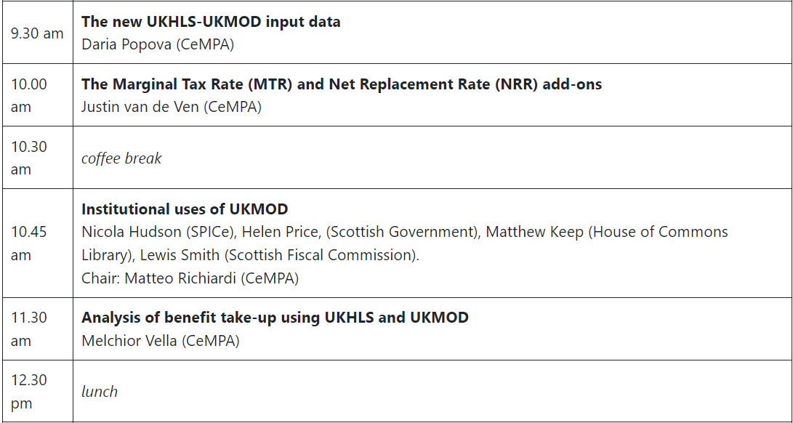
Program: AM

Slide 7
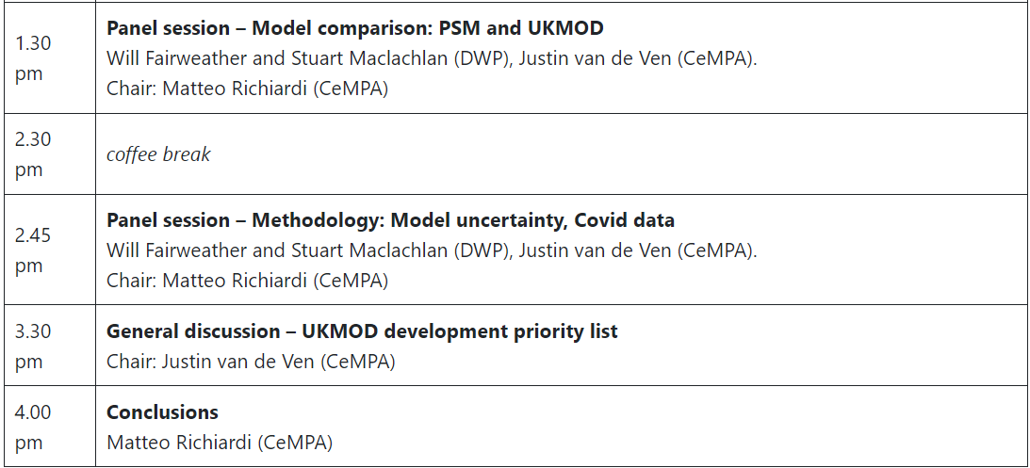
Program: PM

Slide 8
Housekeeping
Entering the building
WiFi access:
  Abrdn-guest
  Foh.Edinburgh@abrdn.com

