Slide 1
Tax and benefit incentives for employment
Matteo Richiardi, Daria Popova and Justin van de Ven
University of Essex

Slide 2
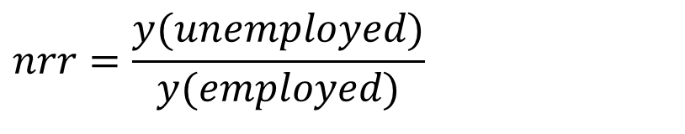

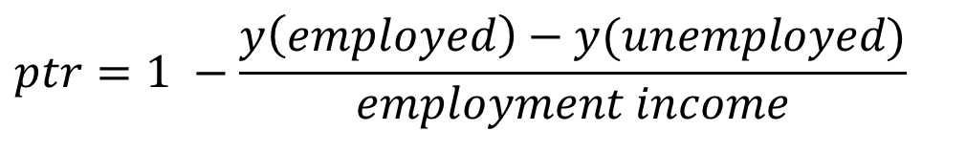
Metrics of employment incentives
$$mtr=1 −\frac{∆y}{∆x}$$
Marginal Tax Rates (MTR)
MTR add-on
Net Replacement Rates (NRR)
NRR add-on
Participation Tax Rates (PTR)
NRR add-on
$$nrr=\frac{y(unemployed)}{y(employed)}$$
$$ptr=1 −\frac{y\left(employed\right)−y(unemployed)}{employment income}$$

Slide 3
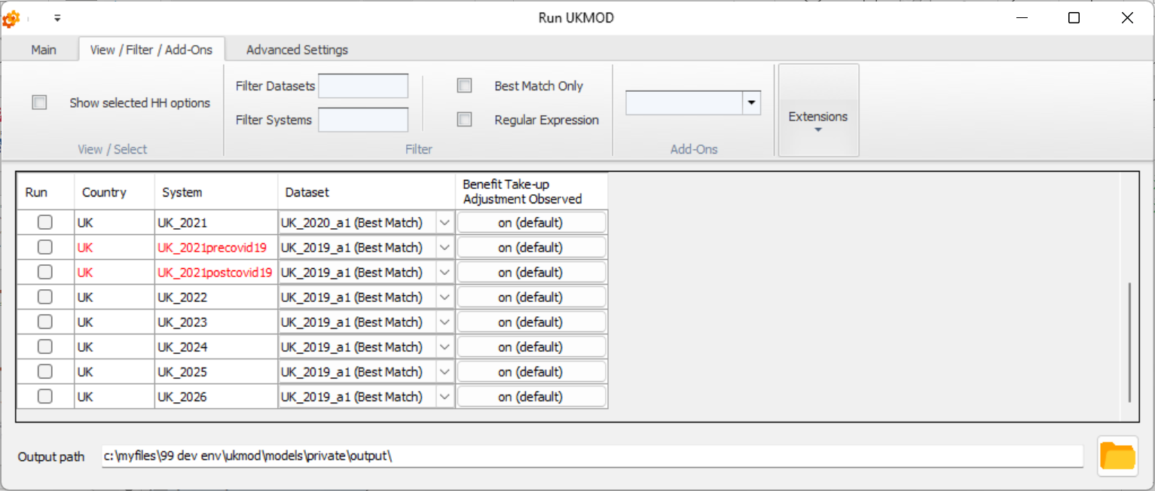
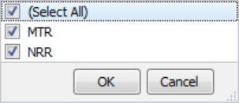
Running Add-ons

Slide 4
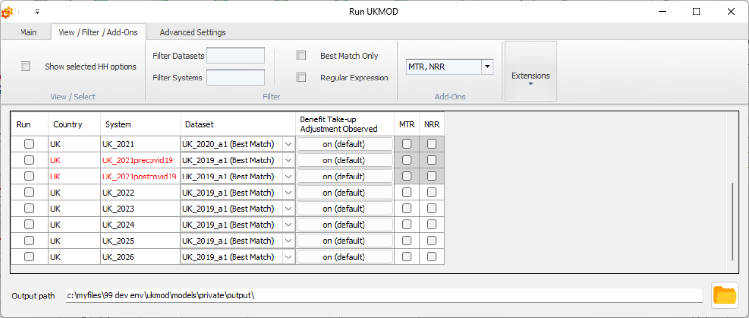
Running Add-ons

Slide 5
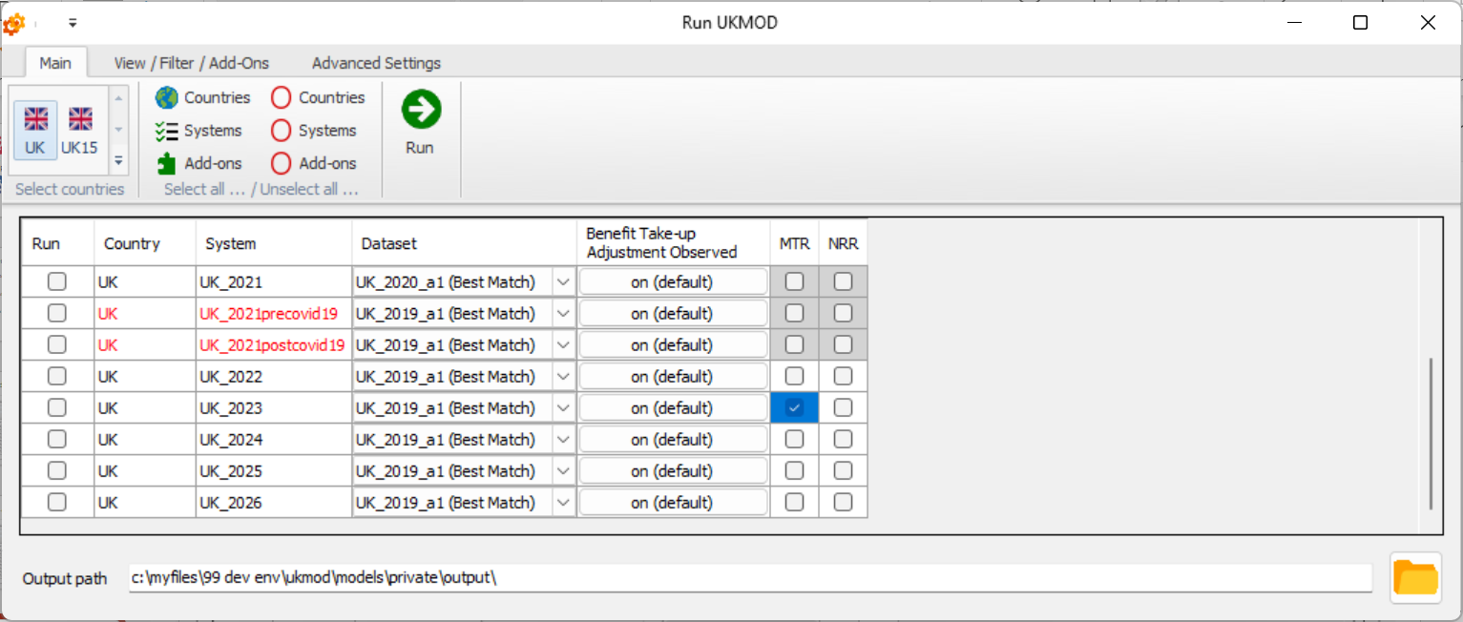
Running Add-ons

Slide 6
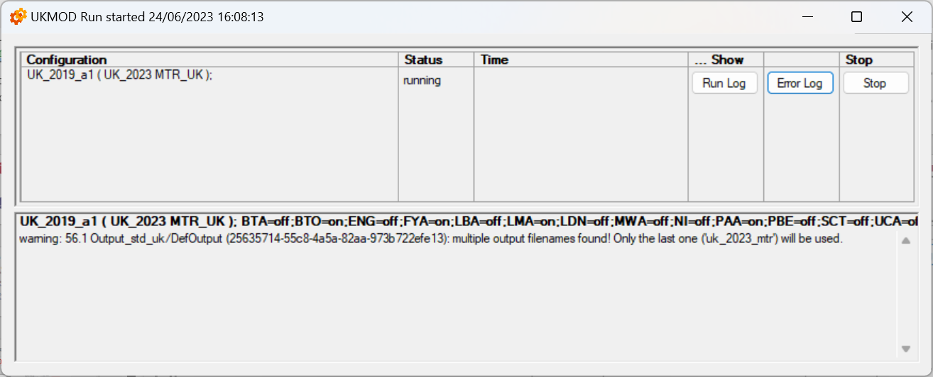
Running Add-ons

Slide 7
Project Implementation
Revised add-ons append results to standard model output
Assists post-simulation analysis
Permits analysis via standard Statistics Presenter
New page added to Default and Reform Statistics Presenter templates to report mtr, ptr, and nrr summary statistics where these are available
Templates have also been updated more generally
Note that add-ons turn off the take-up (BTO) extension

Slide 8
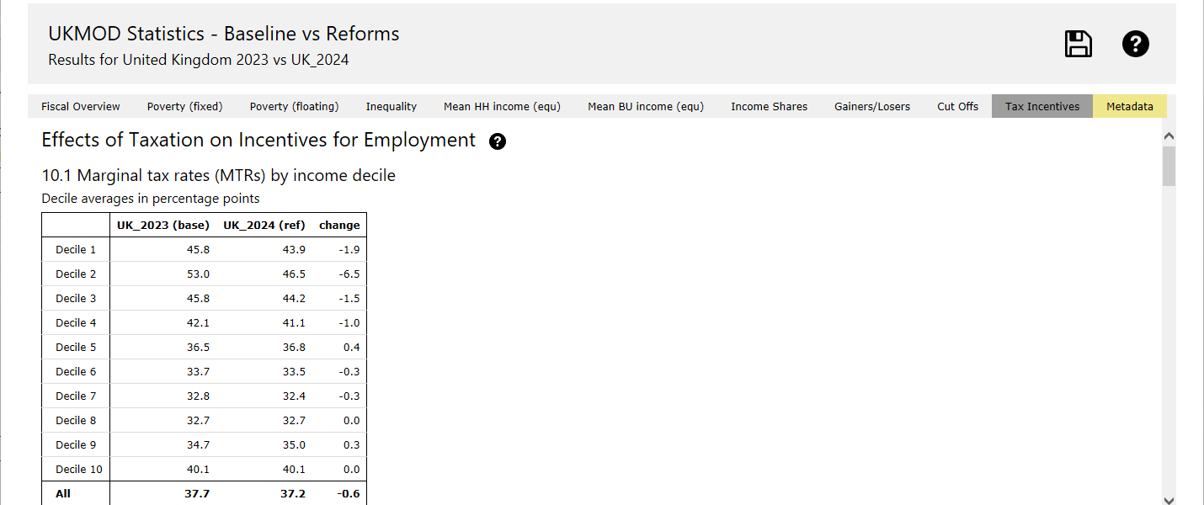
Example of statistics output
Notes:
Policy increases all rates of “Universal Social Charge” by 0.5%

Slide 9
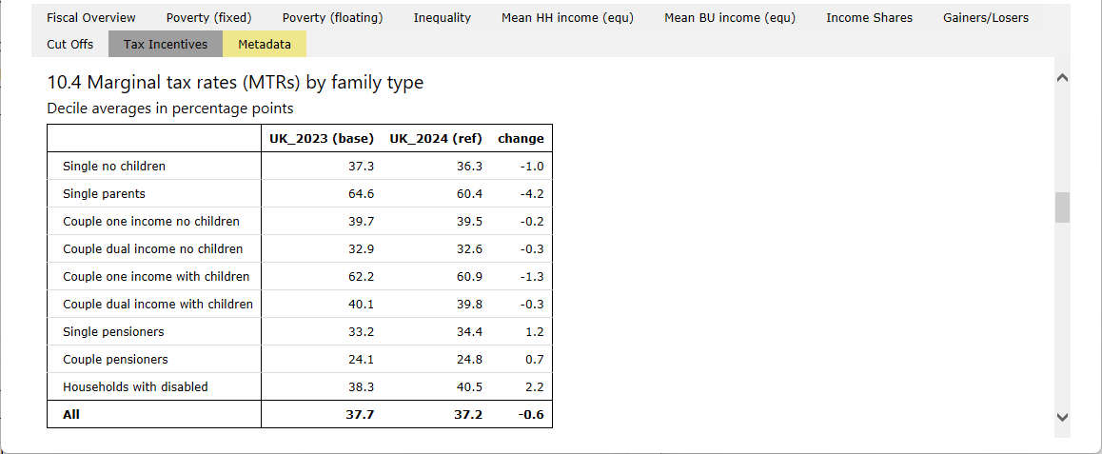
Example of statistics output
Notes:
Policy increases all rates of “Universal Social Charge” by 0.5%

Slide 10
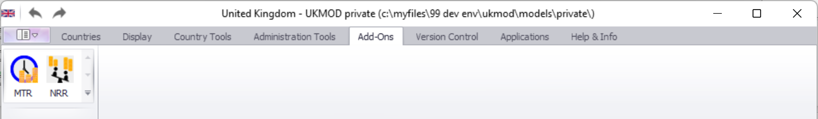
Editing Add-ons
Accessed via:
Advanced subject – training available if there is sufficient demand

Slide 11
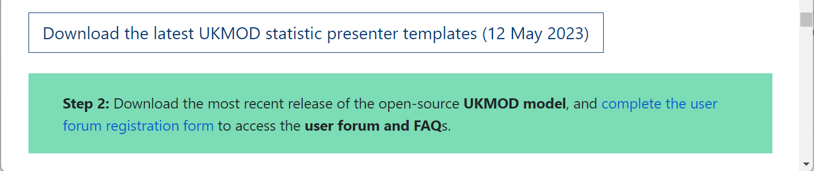
Summary
Revised add-ons provided with the next model update
New Statistics Presenter templates available from the CeMPA website:
https://www.microsimulation.ac.uk/ukmod/access

