Slide 1


UKMOD Fest 2023 SPICe and UKMOD Nicola Hudson June 2023

Slide 2
What is SPICe and what do we do?
Impartial research for MSPs and staff
Enquiries
Committee support
Published briefings and blogs
Mostly “under the radar”

Slide 3
SPICe: our UKMOD journey
Began in 2015 (?) with Euromod
Prompted by devolution of tax and benefit powers to Scottish Parliament after 2014 independence referendum
Has been widely used for policy analysis
Costings of new policies / amended policies
Distributional analysis
Poverty impact

Slide 4
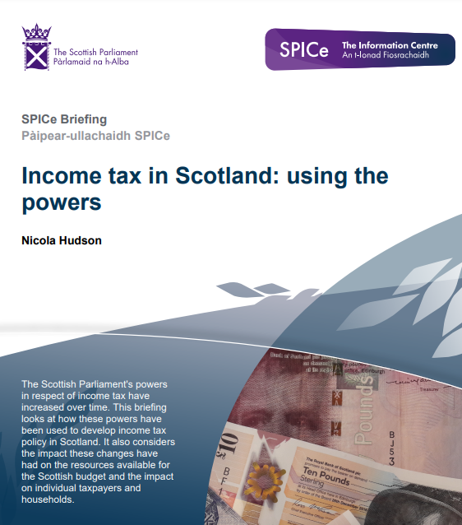
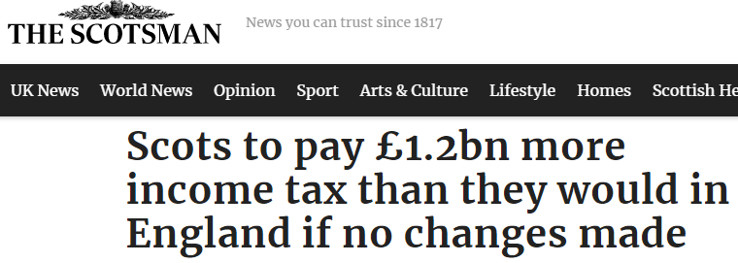
Income tax
Amending income tax policies – extra bands, different thresholds/rates
Shift to five-band policy in Scotland stimulated lots of interest
Calibrate to official Scottish Fiscal Commission forecasts
Static analysis

Slide 5
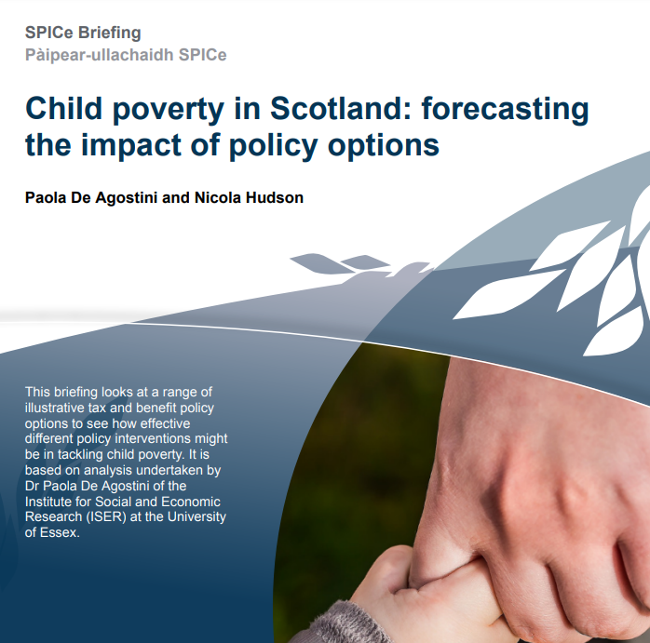
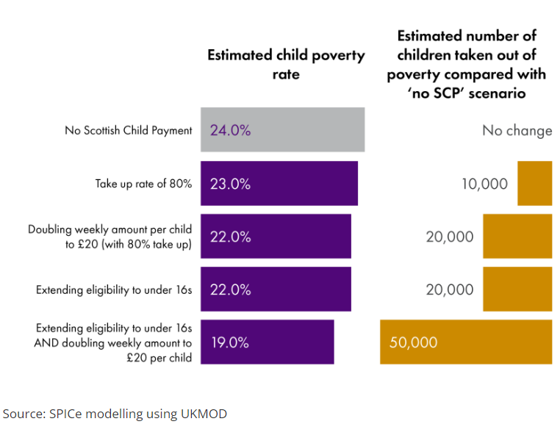
Scottish Child Payment
Initial work with UKMOD team prior to introduction of Scottish Child Payment
Extensive analysis of alternative policy options – costs and poverty impact
Alternative eligibility criteria
Calibrate to official data (Scottish Fiscal Commission, Scottish Government)

Slide 6
Other areas of interest for Scottish Parliament
Universal Credit
Changing parameters e.g. rates payable for young parents
Free School Meals
Alternative eligibility criteria
Housing costs

Slide 7
Benefits of UKMOD for SPICe
Adaptable by user
Allows for Scotland-specific analysis (with pooled dataset)
Range of users in similar policy environment e.g. Scottish Government, SFC, House of Commons Library
User forum
UKMOD team support
Existing and new tools e.g. statistics presenter, household tool
Continually developing with input from users

Slide 8
Limitations and opportunities…
Limitations (current)
My time and skills!
Limitations of FRS data, especially income data for higher earners
Static analysis
Opportunities
HBAI data
Understanding society data and longitudinal analysis
In-depth analysis tool
More users, further development

