Slide 1

Distributional Analysis in Scottish Government

Slide 2

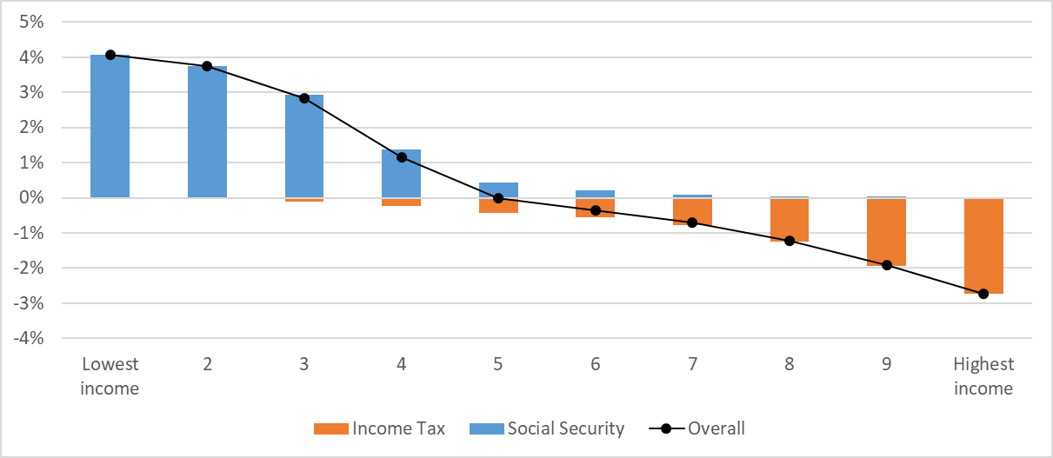
What is Distributional Analysis?
How do policy decisions impact incomes?
Cumulative impact of Scottish Income Tax and Social Security policy decisions on household incomes since 2016-17
Link to publication: The Scottish Government's Medium-Term Financial Strategy - gov.scot (www.gov.scot)

Slide 3
Modelling the 23/24 Income Tax policy
Impact of Income Tax policies on individual taxpayers
Impact of Income Tax policies on households, after housing costs
Link to publication: Scottish Income Tax: distributional analysis 2023-24 - gov.scot (www.gov.scot)

Slide 4
Modelling cumulative impact of Scottish Income Tax and Social Security policy decisions since 2016-17
Cumulative impact of Scottish Income Tax and Social Security policy decisions since 2016-17
Link to publication: The Scottish Government's Medium-Term Financial Strategy - gov.scot (www.gov.scot)

Slide 5
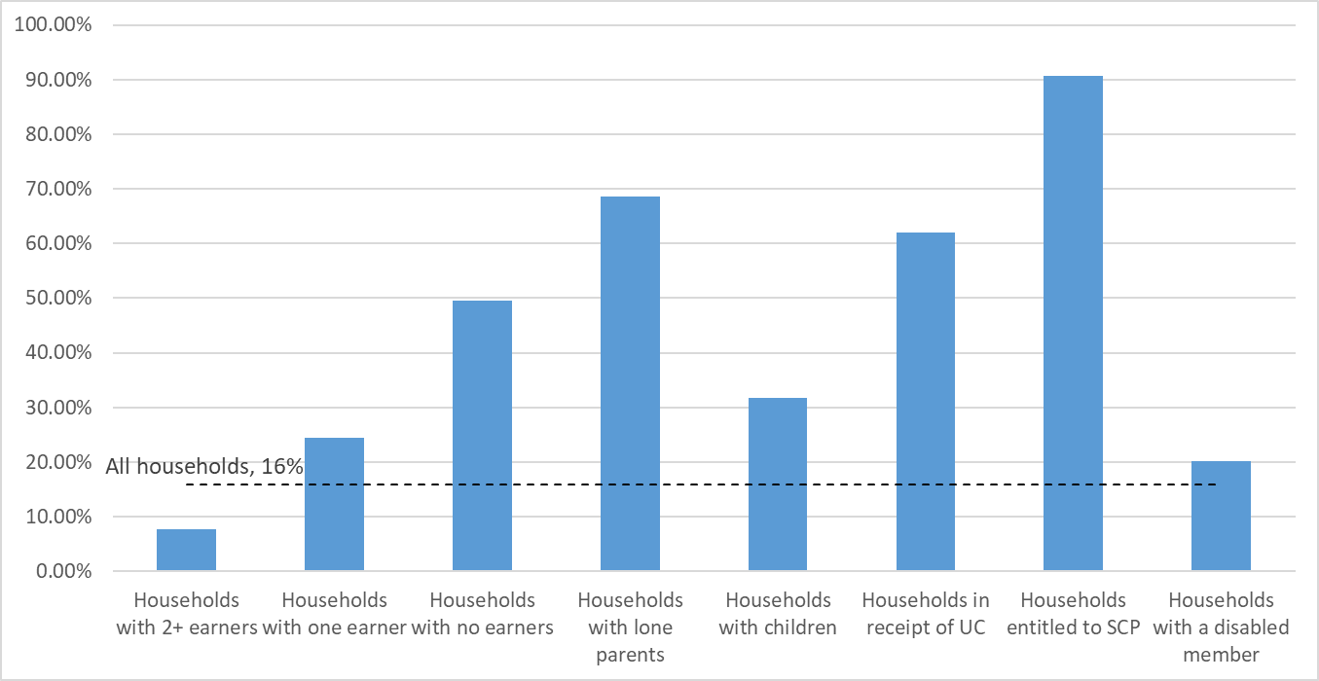
Modelling cumulative impact of Scottish Income Tax and Social Security policy decisions since 2016-17
Proportion of people in households with a more than 1% increase in income
Link to publication: Scottish Income Tax: distributional analysis 2023-24 - gov.scot (www.gov.scot)

Slide 6



How could this analysis be improved?
Behavioural responses not modelled
Input data limitations
Calibration

Slide 7
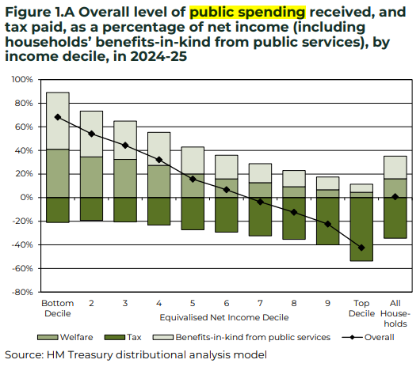
What other DA has been carried out?
Treasury
Includes changes to the benefits system
Includes public spending
Link to Treasury publication: FINAL_Impact_on_households_-_SB23.pdf (publishing.service.gov.uk)

Slide 8
How could our Distributional Analysis be improved?
Include other taxes e.g. council tax
Include public spending e.g. healthcare spending
Budget 2019 to 2020: feasibility of distributional analysis - study - gov.scot (www.gov.scot)

Slide 9
Thank you for listening

