Slide 1

microWELT
A modular, continuous-time, interacting population microsimulation platform for the comparative analysis of private and public welfare transfers over the life course and between generations.
martin.spielauer@wifo.ac.at
Winter Microsimulation Workshop
University of Torino - Feb 2023

Slide 2
Organization
What
How
Application examples

Slide 3
What? - General
Initially developed along the JPI H2020 WELTRANSIM project: Comparative study of welfare transfers captured in disaggregated National Transfer Account data
Comparison of 4 welfare state regimes
Focus on education and family types
A modular, continuous-time, interacting population microsimulation platform implemented in Modgen/openM++

Slide 4
What? - Focus
Comparative analysis of private and public welfare transfers over the life course and between generations
Integration of detailed socio-demographic projections with individual accounting of welfare transfers captured in disaggregated National Transfer Account data
Internationally portable, based on standardized data
Modeling platform used / extended / adapted for various comparative and national (Austrian) projects
Model extensions: health, labor & employment, retirement
Model refinements: detailed Austrian model

Slide 5
What? - Projects & Funding
International
H2020
Weltransim: NTA by educ. & family
WellCare: Care need & supply
SustainWell: distributional NTA, wealth
Bertelsmann Foundation
Comparative labor force projections focus health and education
NBER / US Social Security Administration
EU-US comparison labor force
Labor force projections, ethnicity
Austria
Austrian National Bank
Economic integration immigrants (education, labor) & onward migration
Austrian Social Insurance Institutions
Public health costs by education
Austrian Social Partners
Elderly labor force, health, employment
Related:
Statistics Austria: population projections
Slovenian Inst. Econ. Research: Pensions
Worldbank: Dynamis-Pop

Slide 6
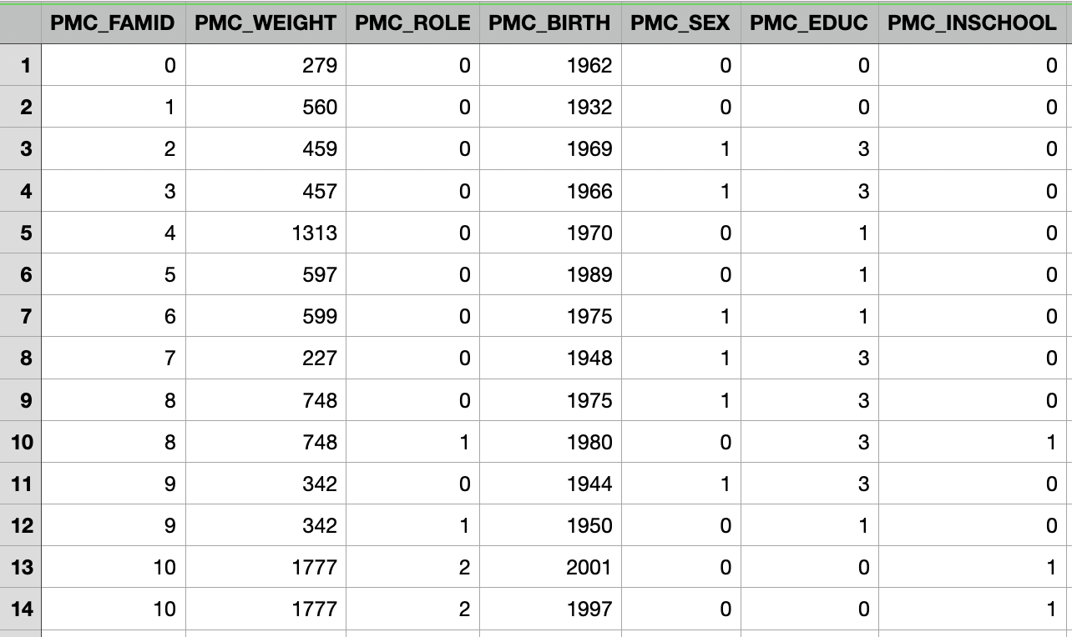
Starting Population
Taken from cross-sectional population database (e.g., EU-SILC).
MicroWELT automatically de-weights observations into identical weight simulation actors.
The simulation size is a parameter.
Most simple version: Family ID (nuclear family), Sample Weight, Role in Family, YOB, Sex, Education Level, Current School Attendance

Slide 7
Mortality
General goal: reproduce Eurostat projections but include mortality differentials by education
﻿﻿Base: life table of period mortality rates by age and sex
﻿﻿Calibrated: period life expectancies at age 30 and age 65 by education used to calibrate mortality for meeting targets by education.
﻿﻿Aligned: rates are aligned to produce the same aggregate mortality as in the base model, but keeping the relative mortality risks by education

Slide 8
Fertility
Goal is simultaneously reproducing births by age (as Eurostat) while having a realistic model of the timing at first births and childlessness by education.
﻿﻿Focus on childlessness as key component of concentration of reproduction by education.
Parameters:
﻿﻿Age-specific period fertility rates (Eurostat; as in Ageing Report).
﻿﻿First births by education: first births are modelled using cohort first birth rates by education. The base model is still used to decide the number of births by age, but babies are distributed to be consistent with first births.

Slide 9
Migration
Most simple version: Reproduce age- and sex-specific net migration targets (Eurostat net migration projections.
Emigrants are removed from population, immigrants are ‘cloned’ from existing population members of same age and sex.
Refinements
Immigration pools, e.g., foreign students
Immigration and emigration; by country/region of origin
Origin, duration of residence, 2nd generation immigrant status used in education, labor force behaviors, emigration

Slide 10
Partnerships
Goal: capture patterns found in welfare state regimes by a ‘photo approach’ - partnership status by age, education, motherhood and age of youngest child (e.g. lone parenthood)
﻿﻿Female driven. (some rules for males, minimum proportions single by education)
﻿﻿Status change by periodic alignment to target rates
﻿﻿Children: Proportion by education, age at last birth; age youngest child
No Children: Proportion in a partnership by education and age
Partner matches by distribution of education; filling distribution by age
Longitudinal consistency for cohorts by education and parenthood

Slide 11
Education – Base Version
Goals: We try to capture (1) intergenerational transmission patterns typical for welfare state regime while (2) being able to reproduce aggregate education projections.
﻿﻿Education levels: various implementations; minimum: low, medium, high.
﻿﻿Fate model: projection scenarios of aggregate education outcomes by sex and year of birth.
﻿﻿Transmission model: Highest education by parents highest education
﻿﻿Alignment mechanisms: Adjusting the transmission model to reproduce fate model on aggregate (for a start year only or for all years).
Sampling of education career paths for give outcome

Slide 12
NTA Groups
Groups:
﻿﻿Children 0-16: age, parents education
﻿﻿Students 17-25: age, parents educ
﻿﻿Non-students 17-25: age, sex, own education, family type A
﻿﻿Adults 26-59: age, sex, own education, family type A
﻿﻿Adults 60+: age, sex, own education, family type B
Family types:
﻿﻿ A: 6 types by union status and living with children (><3)
﻿﻿ B: 4 types by union status and childlessness

Slide 13
NTA Variables
Private Consumption: Educ (CFE), Health (CFH), Other (CFX)
﻿﻿Public Consumption: Educ (CGE), Health (CGH), Other (CGX)
﻿﻿Public Transfers Inflows: Pensions (TGSOAI), Other Cash (TGXCI), Other In-Kind (TGXII), Education (TGEI), Health (TGHI)
﻿﻿Public Transfers Outflows (TGO)
﻿﻿Net Interhousehold Transfers (TFB)
﻿ Intrahousehold Transfers (TFW)
﻿﻿ Private Saving (SF)
﻿﻿ Public Saving (SG)
﻿﻿ Labor Income (LY)
﻿﻿ Private Asset Income (YAF)
﻿﻿ Public Asset Income (YAG)

Slide 14
NTA Profiles (1)

Slide 15
NTA Profiles (2)

Slide 16
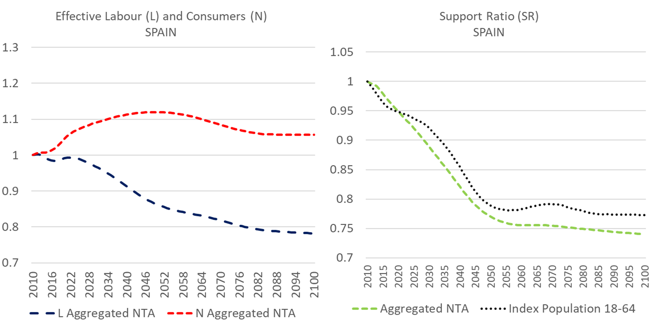
Support Ratios

Slide 17
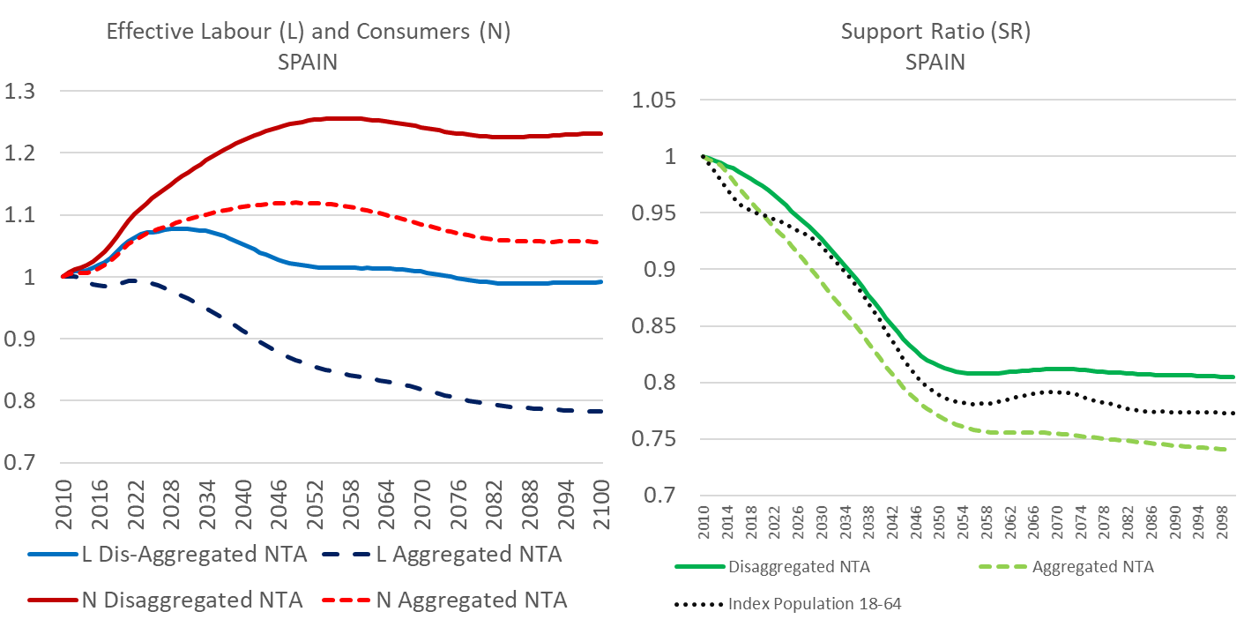
Support Ratios

Slide 18
Generational accounting
Net present value of private and public transfers in relation to the present value of employment income
Scenario: 1.5% Growth, Discount factor 3%, balanced budgets

Slide 19
LFP rates Italy – Ageing Report vs. microWELT

Slide 20
Decomposition labor force Italy 2080 vs. 2016

Slide 21
Activity transitions AT

Slide 22



Martin Spielauer
martin.spielauer@wifo.ac.at
+43 1 798 26 01 - 246
https://www.wifo.ac.at/martin_spielauer

