Slide 1
LABSim: An open-source framework for life-course analysis
Patryk Bronka, Matteo Richiardi, Justin van de Ven
University of Essex

Slide 2
Motivation
A framework for life course analysis
Observed trajectories are complemented by simulations
(Tax-benefit) policies modelled in details
Applications (work in progress):
Effects of population ageing in Italy
Effects of COVID-19 on mental health (UK)
Demand and supply of care over the life course (UK)
Impact of indirect taxes on health (UK)
Intergenerational fairness (UK and IT)

Slide 3
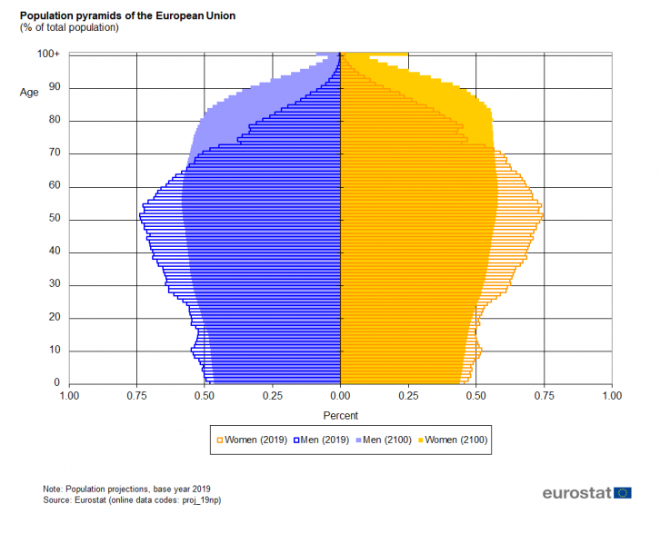


Population ageing
Low birth rates and increasing life expectancy transform the shape on the age pyramid. Transition to much older population structure underway.
Older population has implications for policy:
Different needs (health, care)
Different behaviour (labour supply)
Pressure on the budget sustainability

Slide 4
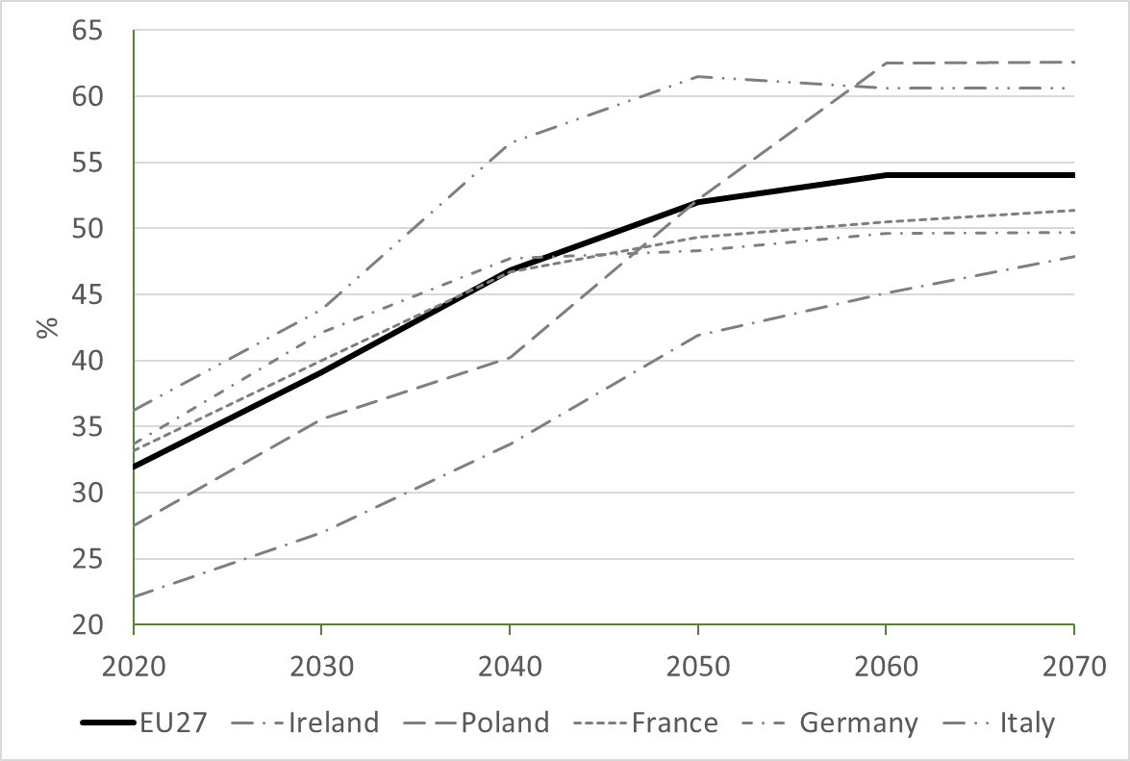
Old-age dependency ratio
ratio of individuals aged 65+ to the 15-64 years old population
Notes:
REPLACE WITH GRAPH FOR OECD COUNTRIES

Slide 5
Projections: Simple extrapolations
Population is divided in cells (e.g. by age, sex, region)
Outcomes (e.g. activity or employment rates) are computed for each cell
The weight of each cell in the population is evolved according to demographic projections
NO COHORT EFFECTS: Methodology implies younger cohorts will behave as older cohorts, when they will become old.
Ad-hoc modifications introduced to deal with planned pension reforms and other exogenous information (e.g. productivity growth, improvements in health systems, scenario assumptions).
LIMITED ROLE OF POLICIES

Slide 6
Projections: Cohort approach
Methodology used by EC (Carone, 2005) and OECD (Scherer,2002; Burniaux et al.,2003)
Bypasses the age-cohort issue by focussing on flows, rather than stocks.
Cohort effects are allowed to influence the initial level (stocks) of labour market participation / employment, but then movements in and out of the labour force (flows) are assumed to depend only on age and not on cohorts.
HYBRID COHORT EFFECTS: When applied to cohort-specific stocks, they produce participation / employment rates that differ by age and cohort.
NO FURTHER DYNAMICS: Cohorts below working age in the data are supposed to follow the labour supply behaviour of the youngest cohort of working age observed in the data.
LIMITED ROLE OF POLICIES

Slide 7
Projections: Dynamic approach
Individual determinants of participation / employment rates are estimated on longitudinal data, allowing for cohort effects.
All the estimated trends interact in determining the future evolution of age-cohort profiles.
However, most economic studies of heterogeneous households
abstract from demographic detail, and
adopt a stylised description of fiscal policy.
Demographic heterogeneity and fiscal policy influence behavioural incentives on both the labour/leisure and consumption/saving margins.

Slide 8
Microsimulation: Why
To reconstruct things we do not observe:
Missing variables
Future states
Counterfactuals
With respect to other modelling exercises:
Focus on micro-units, and micro-rules
Flexibility brought about by the computational approach: everything that can be algorithmically described can be simulated.

Slide 9
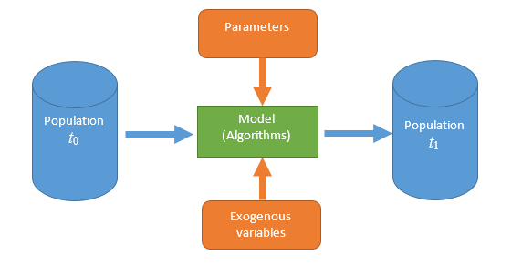
Microsimulation
Microsimulation models operate at the level of individual units, applying rules to simulated changes in state or behaviour of these units and estimating distributional outcomes after applying these rules on the micro level.
Two main types:
Static: “morning-after” effect, individual characteristics are used passively for tax-benefit accounting. Based on historical data, with time typically not present (or population reweighted at each time step).
Dynamic: modelling individuals over time, individuals make choices about education, work, union formation, childbirth, retirement etc. Typically forward-looking, with time explicitly modelled.
(Agent-based models very similar to dynamic microsimulation, but usually driven more by theory than data and focused on interactions between individual units).

Slide 10
Types of tax-benefit microsimulation model
 | Static | Dynamic
Non-Behavioural | Individual characteristics are fixed Behaviour is fixed Short-term analysis (“morning after”) Focus on direct effects of policies
Behavioural | Individual characteristics are fixed Behaviour react to incentives Medium-term analysis (“a few months”) Focus on direct and indirect effects of policies | Individual characteristics change over time Behaviour explicitly modelled Longer-term analysis (“a few years/decades”) Focus on direct and indirect effects of policies and population change

Slide 11
Combining static and dynamic models
Most economic studies of heterogeneous households abstract from demographic detail (adopting stylised descriptions of fiscal policy)
Demographic heterogeneity and fiscal policy influence behavioural incentives on both the labour/leisure and consumption/saving margins
Reflecting fiscal policy remains challenging, even where sufficient demographic detail is included for analysis
Notes:
Most economic studies of heterogeneous households abstract from demographic detail
=> Motivates adoption of stylised descriptions for fiscal policy
Demographic heterogeneity and fiscal policy influence behavioural incentives for both labour/leisure and consumption/saving
=> Motivates increasingly detailed analytical specifications
Reflecting fiscal policy remains challenging, even where sufficient demographic detail is included for analysis

Slide 12
LABSim
LABSim: a rich, dynamic microsimulation model of individual life course events, designed to jointly model the demographic and socioeconomic characteristics and health status.
Links dynamic microsimulation with a static tax-benefit model (EUROMOD / UKMOD), which allows ex-post evaluation of policies, as well as ex-ante evaluation of hypothetical policies.
The model takes a representative sample of the population as input and evolves it through time, potentially many decades, according to estimated processes.
To account for tax-benefit policies, gross incomes are transformed to disposable incomes by statistically matching simulated households with best fitting donor households, for which EUROMOD / UKMOD calculates the gross-to-net ratio for a specific tax-benefit regime (van de Ven et al., 2022).

Slide 13

Data sources
Initial population
Based on cross-sectional data from UKHLS for the UK and EU-SILC for Italy. Multiple initial populations to allow starting in the past and validation of the model.
Estimates
Model the probability of events / value of continuous variables at the individual level. Obtained from longitudinal data, currently UKHLS / longitudinal EU-SILC
Donor population
UKMOD / EUROMOD output data, which contains the population used by UKMOD / EUROMOD and values of policy-dependent variables under various tax-benefit schedules. Benefit units from the initial population are matched to the donors.

Slide 14
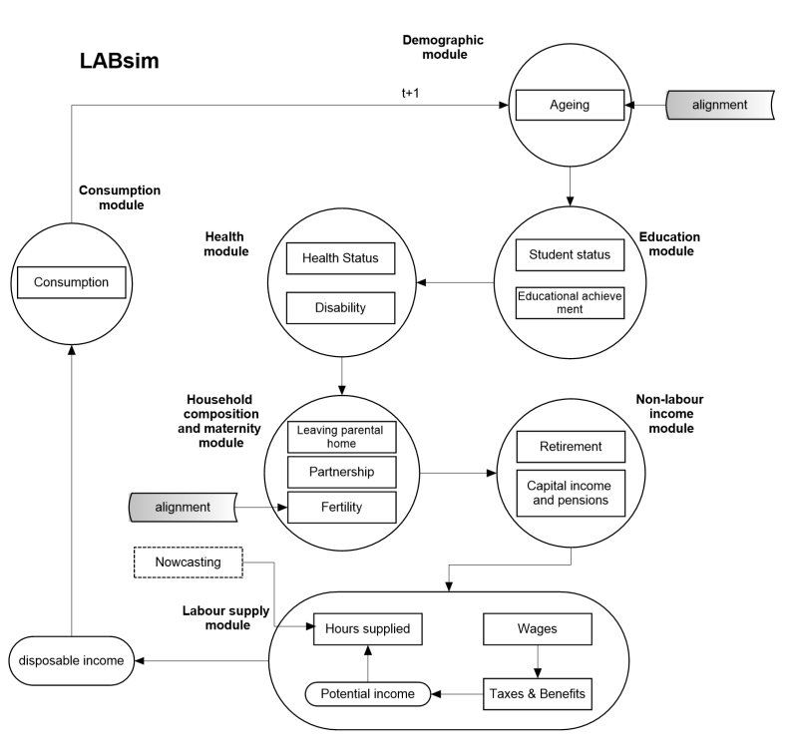
Model structure
7 core modules:
Demography
Education
Health
Household composition
Non-labour income
Labour supply
Consumption

Slide 15
Individuals – Benefit Units - Households
The structure of the simulation is based on
Individuals
Benefit Units: can contain one or more individuals. A benefit unit consists of an individual, and their partner and dependent children, if present.
Households: can contain one or more benefit units, for example adult children living at home

Slide 16
Demography
Ageing
Each period, age of individuals is incremented by 1
Individuals who reach maximum age for which population projections are supplied are removed from the simulation
Number of individuals in each country-gender-region-age cell is aligned to official projections. To achieve that, individuals in each cell are removed / cloned in the simulation. Random individual of most similar age is cloned (population alignment)
Cloned individuals enter as singles; however, we recreate the original household structure by finding partners for such individuals, and assigning cloned children to cloned mothers, up to the original number of children they had.
Leaving parental home

Slide 17
Education
Student status
Probability of being a student determined by probit models
for individuals aged 16 – 29 who have always been in education
for individuals aged 16 – 45 not in continuous education
Educational attainment
Level of education of individuals who stop being students is determined using a multinomial probit model

Slide 18
Health
Health
Health status predicted using a linear model. Continuous score from 1 to 5.
Disability
Individuals above 16 who are not in continuous education can become disabled with the probability determined by a probit model.

Slide 19
Household composition
Union formation
Individuals above the age to become responsible (18) who don’t have a partner follow a probit model to determine if they will look for a partner
Union dissolution
Modelled at the benefit unit level with a probit model
Fertility
Model of differential fertility: women aged 18 – 44 who have a partner give birth to a child with the probability determined by a probit model. The probabilities are adjusted to match the number of newborns predicted by the population projections.
Sex of the child is randomly drawn with equal probability

Slide 20
Union matching
Individuals looking for a partner are matched using either a parametric or non-parametric approach.
In the parametric approach, individuals draw a desired age and wage differential from a bivariate normal distribution parametrized using the input data. Matching score is calculated as an equally-weighted function of the age and wage difference, and acts as a weight when randomly selecting the partner from the set of potential partners.
In the non-parametric matching, the frequency of matches between individuals of different types (defined on observables, such as gender, region, education, age) is obtained from the data and adjusted to the number of simulated individuals of each type using an iterative proportional fitting procedure. Individuals within each combination of types are then matched randomly.

Slide 21
Non-labour income
Captures income from other sources than the gross employment income and tax and benefit system. Modelled using a set of probit (for the probability of receiving income) and linear models (for the amount) for different sources of income:
Capital returns (investment and property income)
Pensions

Slide 22
Labour supply
Wages
Wages estimated using a Heckman-corrected wage equation, separately for each gender. Because wages are observed only for those who work (non-random sample of the population), in the first stage the probability of working is modelled based on observable characteristics such as age, age² ,education, region, marital status, number of children.
In the 2nd stage, the selection bias is corrected by including an additional covariate, the inverse Mills ratio in the wage equation.

Slide 23
Labour supply
Random Utility Model:
For each possible combination of discretized hours of labour supply per week (0, 20, 30, 36, 40, 50 hours) in the household, the potential income of the household corresponding to that choice is calculated using the previously obtained estimates of hourly wages.
Disposable income corresponding to each potential choice is calculated using a net-to-gross ratio obtained from the best-matching EUROMOD donor household or imputed directly for low-income households
Net-to-gross ratio each year depends on the tax and benefit policy schedule

Slide 24
Consumption
Non-retired individuals consume (1-savings rate) of their equivalised disposable income
Savings rate affects the amount of capital income received (the higher the savings rate, the higher the capital income multiplier)

Slide 25
Uncertainty in the model
Uncertainty regarding model projections can arise because of:
Input data (for example sampling errors in the initial population)
Model structure (“methodological uncertainty”, the validity of the general modelling approach)
Model specification (choice of the covariates and the functional form used; the assumption that any regularity observed in the data will not break up in the future)
Model parameters (imprecision of the estimates)
Montecarlo variation
To address parameters uncertainty, the simulation is run multiple times using a different set of coefficients in each run, obtained by bootstrapping the coefficients of the estimated equations from their estimated distribution with mean equal to the point estimate, and variance-covariance matrix equal to the estimated variance-covariance.
Notes:
Generally speaking, source (i) should be limited, due to the use of appropriate input data and sampling weights. Sources (ii)-(iii) are often left unexplored, by making the common assumption that the model is well specified (measures of fit should be reported for each estimated equation to corroborate this hypothesis). Montecarlo variation of the model outcome (source v) can be brought down to negligible by appropriately scaling up simulated population size. The remaining source of uncertainty that needs to be addressed is therefore parameters uncertainty, stemming from sampling errors in estimation (source iv).

Slide 26
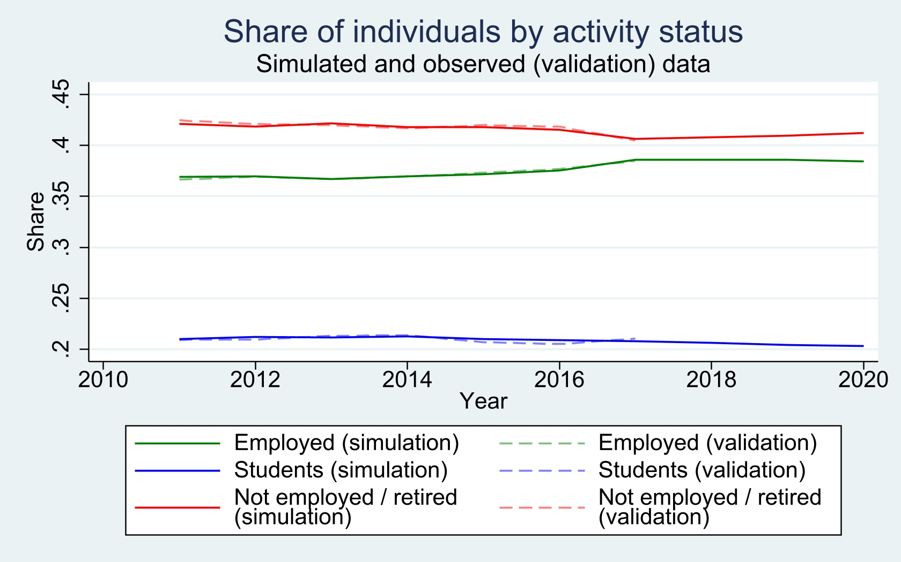
Validation: Activity status

Slide 27
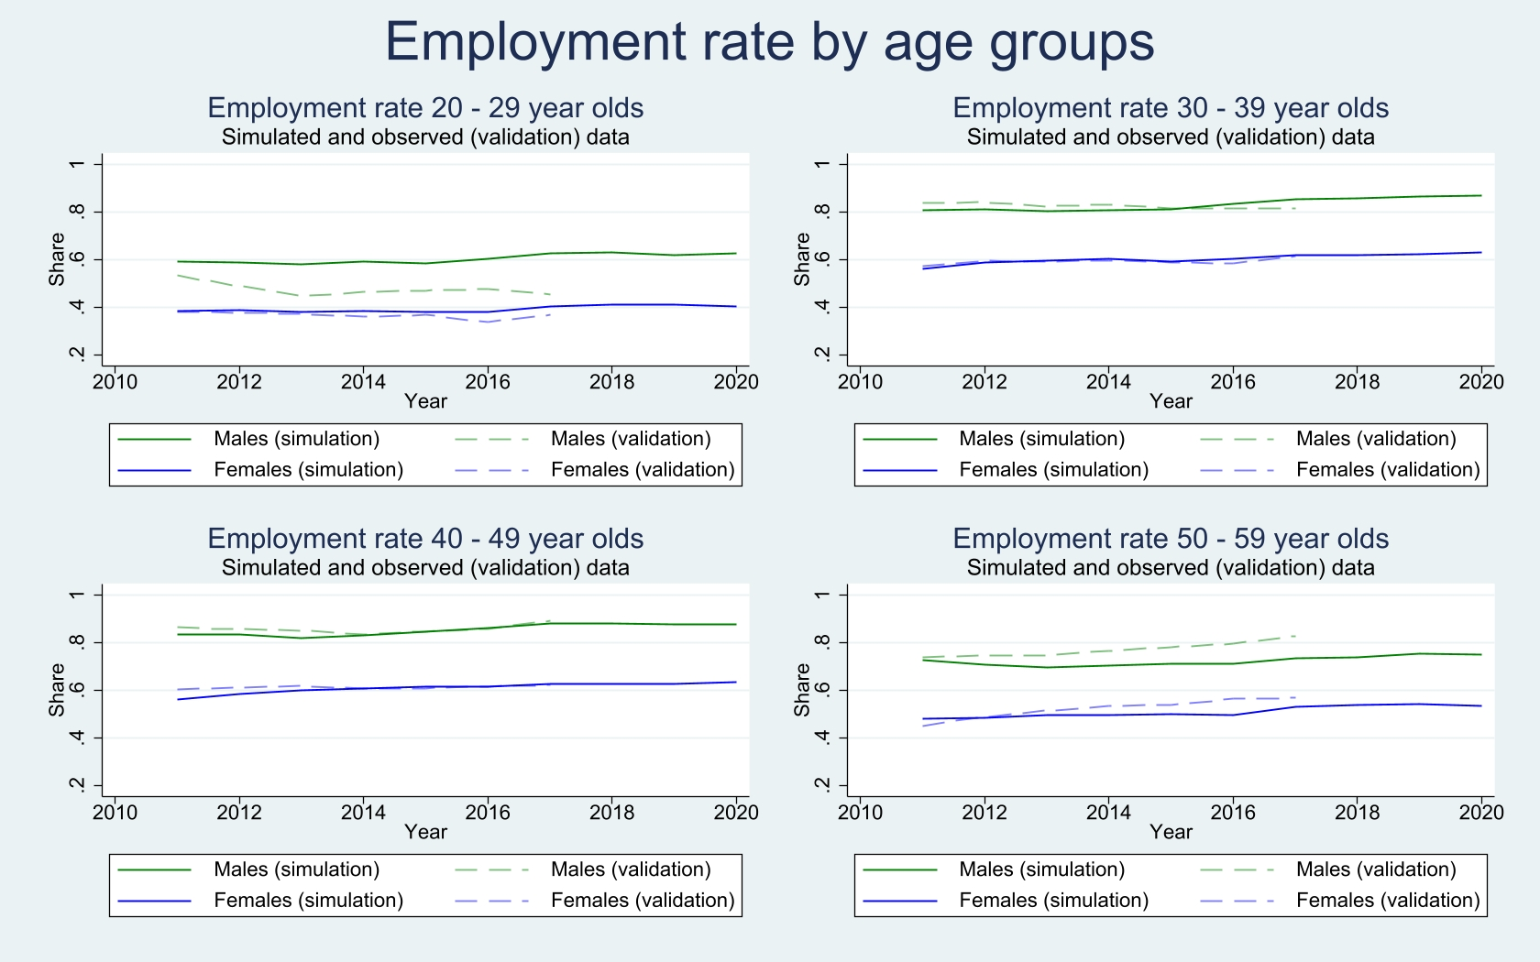
Validation: Employment

Slide 28
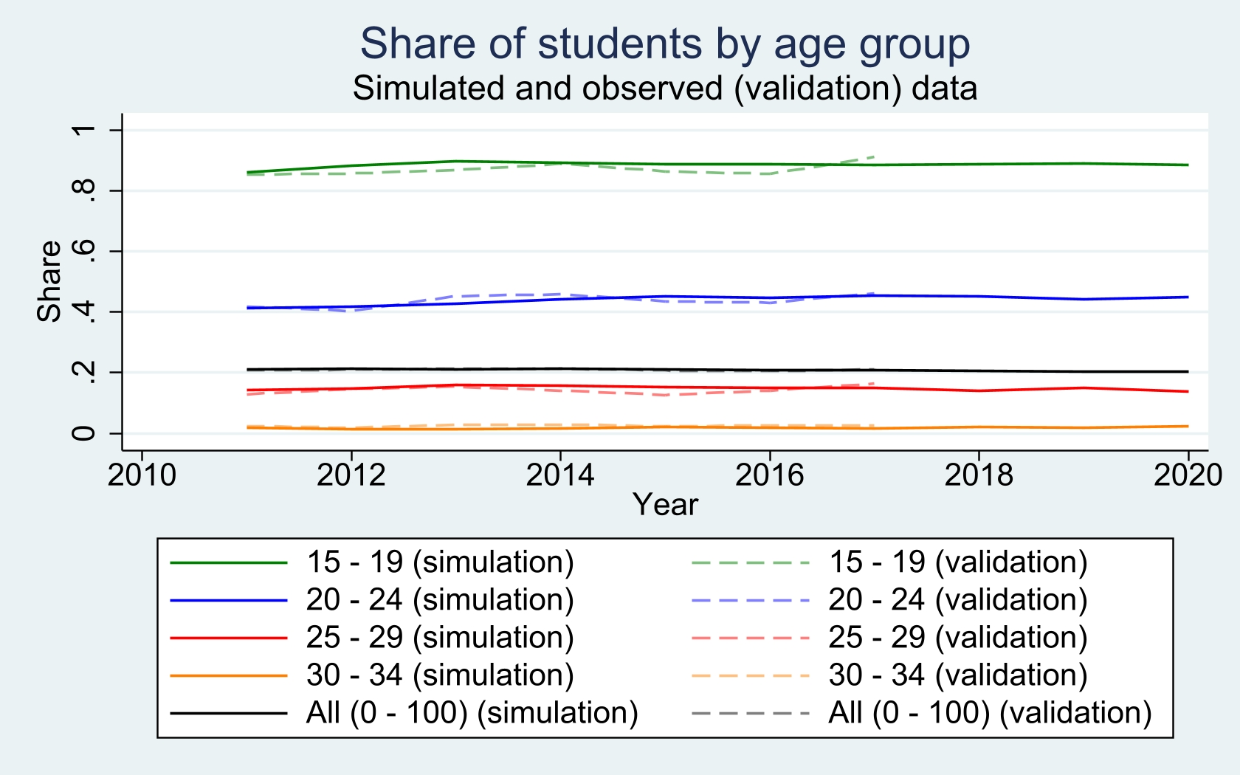
Validation: Enrolment in education

Slide 29
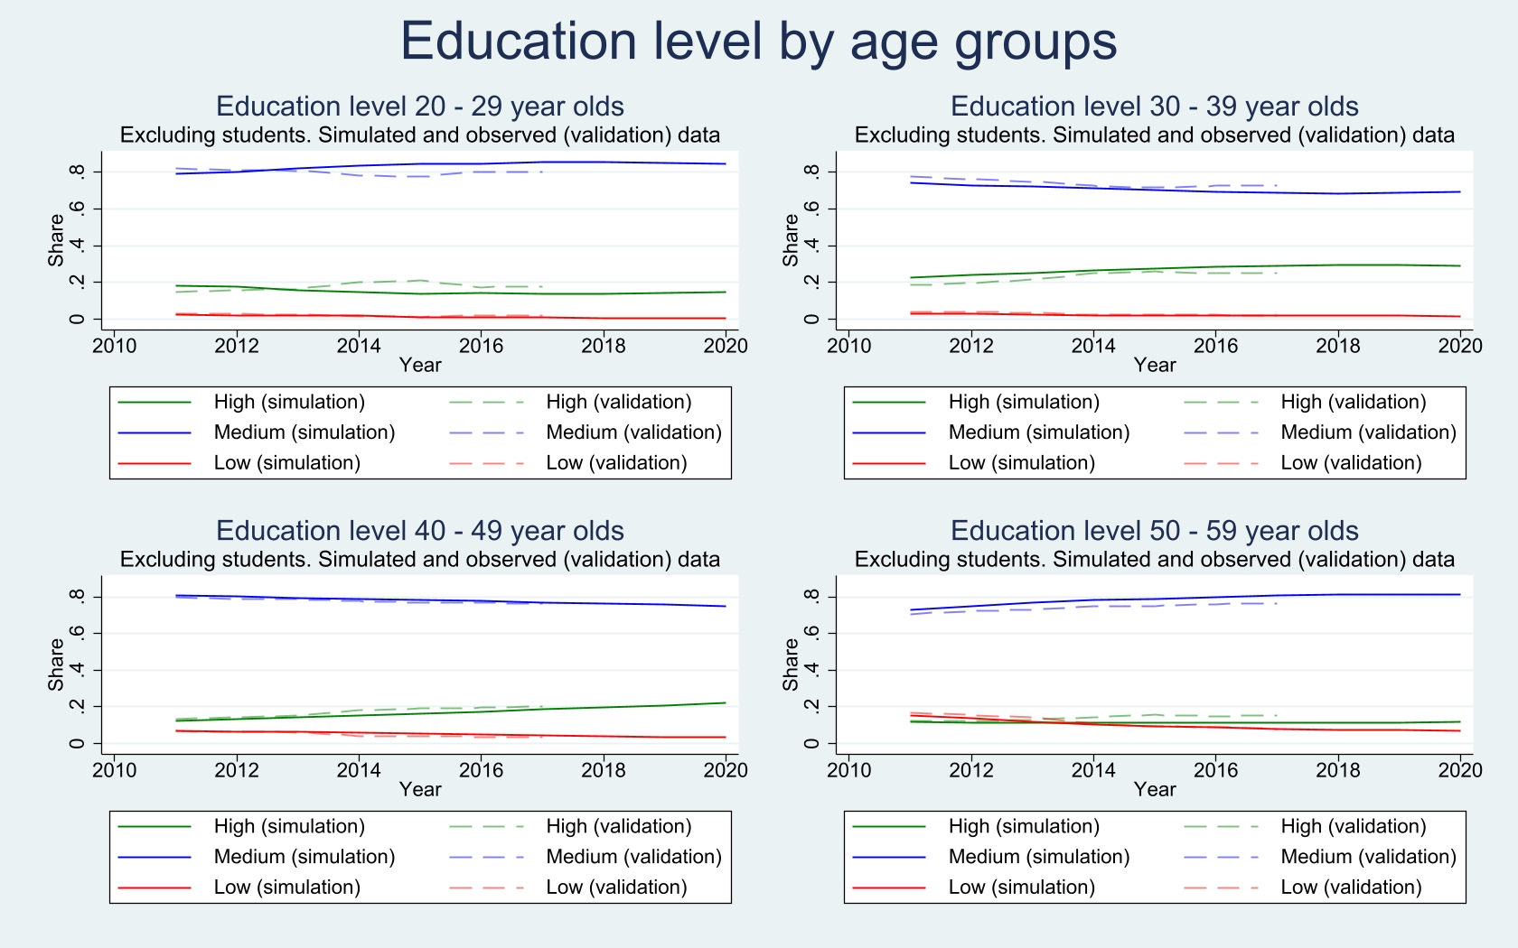
Validation: Education level

Slide 30
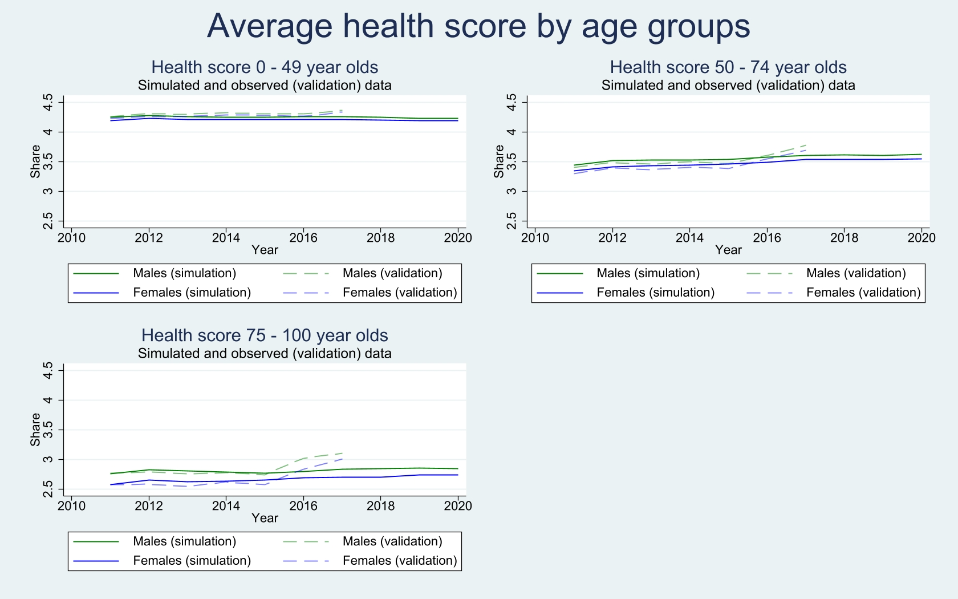
Validation: Health

Slide 31
Debunking the “demo doom” narrative
“Models should be as simple as possible, but not simpler than that”
This presentation: Comparing LABSim with cell-based projections.

Slide 32
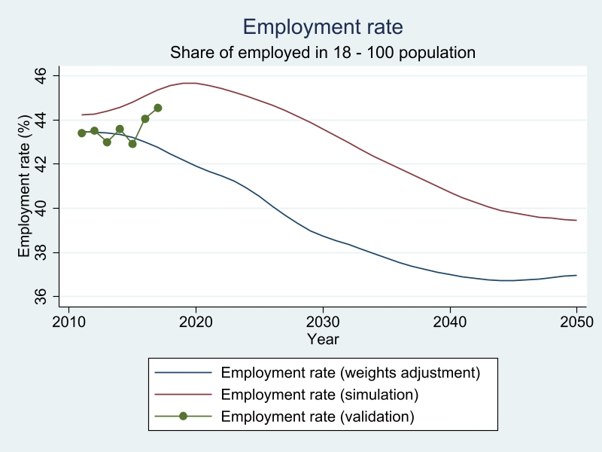
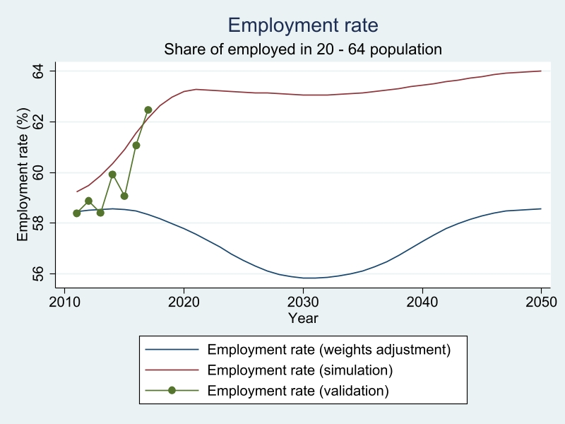
Model comparison

Slide 33
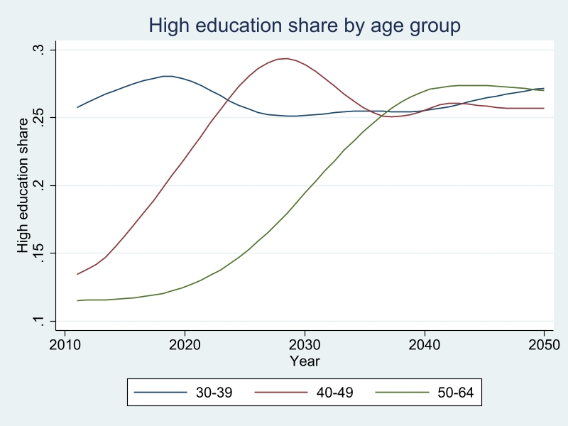
Determinants: Education
Large increase in the share of labour force with high education.

Slide 34
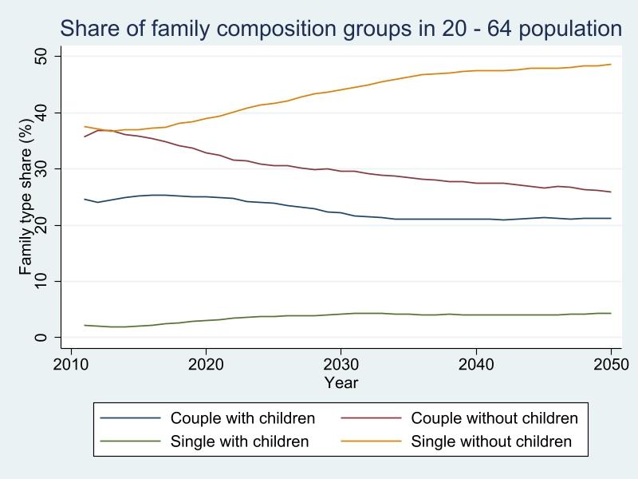
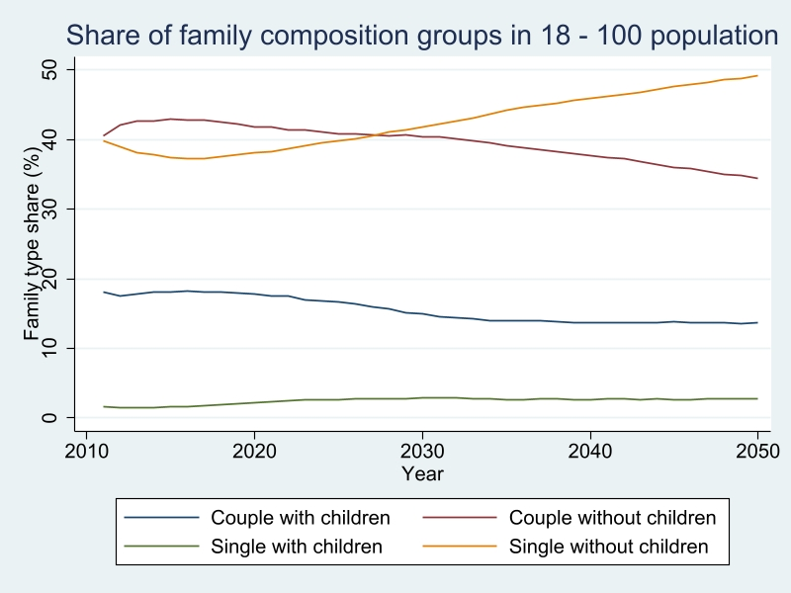
Determinants: HH composition

Slide 35
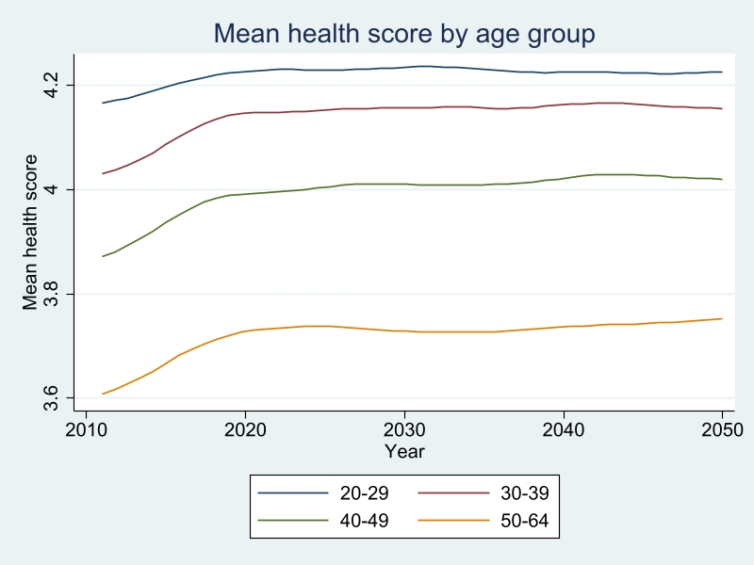
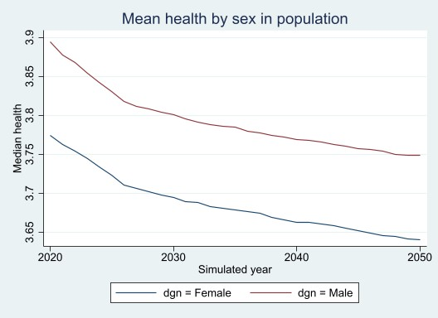
Determinants: Health

Slide 36
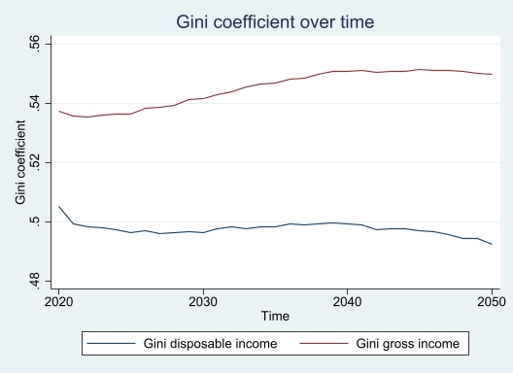
Effects: Income inequality
Inequality in gross incomes projected to increase over time.
However, a slight decrease in inequality when measured in terms of disposable incomes.

Slide 37
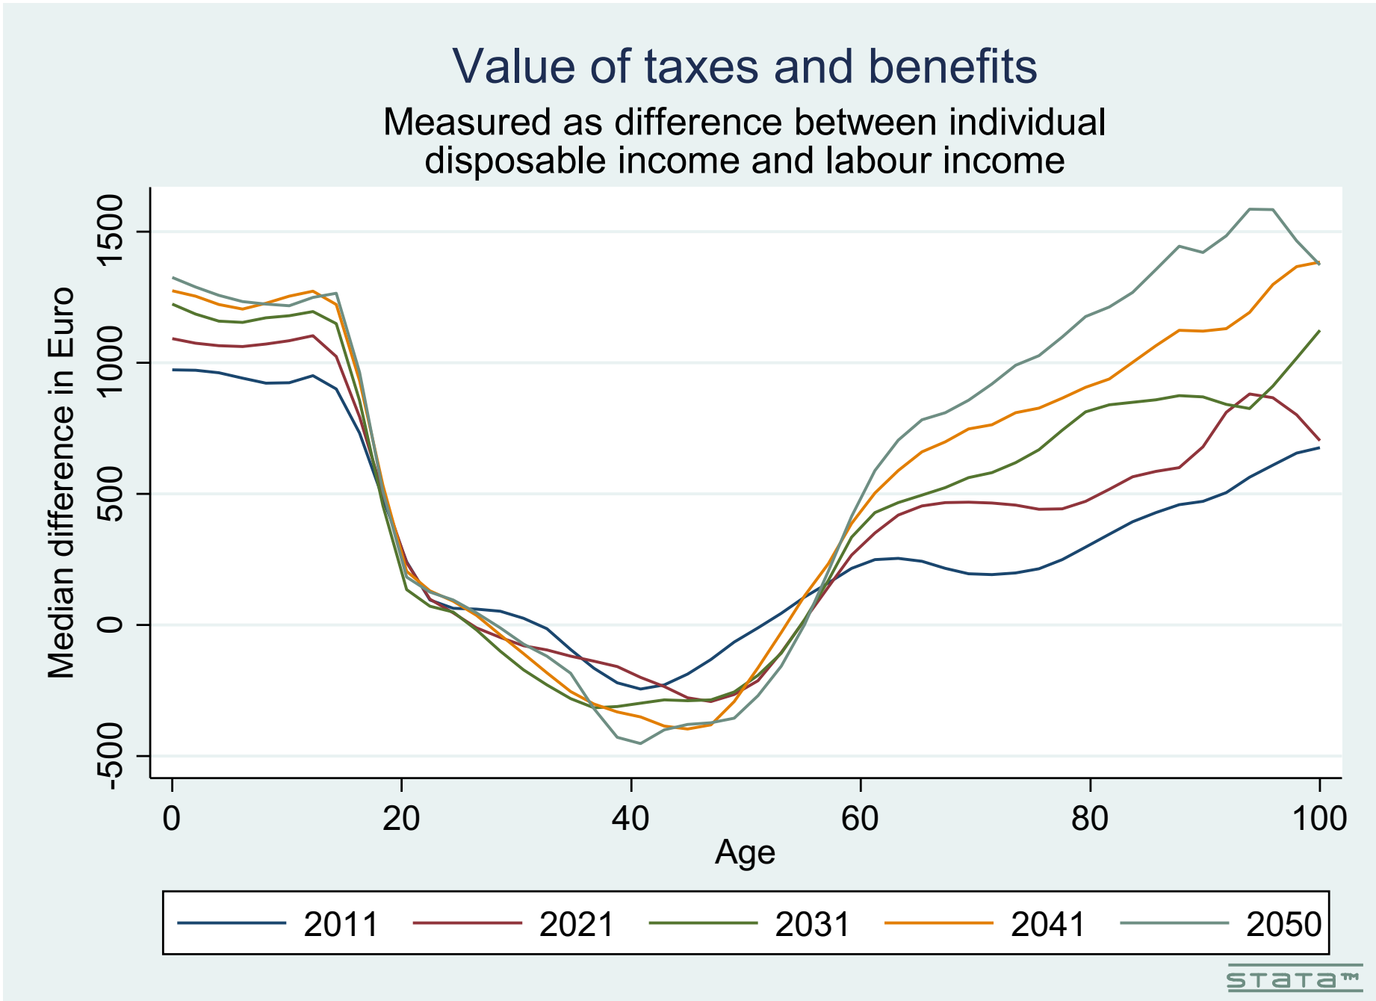
Effects: Sustainability and intergenerational fairness
Increasing pressure on gov’t budgets
Beneficiaries: younger and older cohorts
(Also those more at risk of budget squeezes)

Slide 38
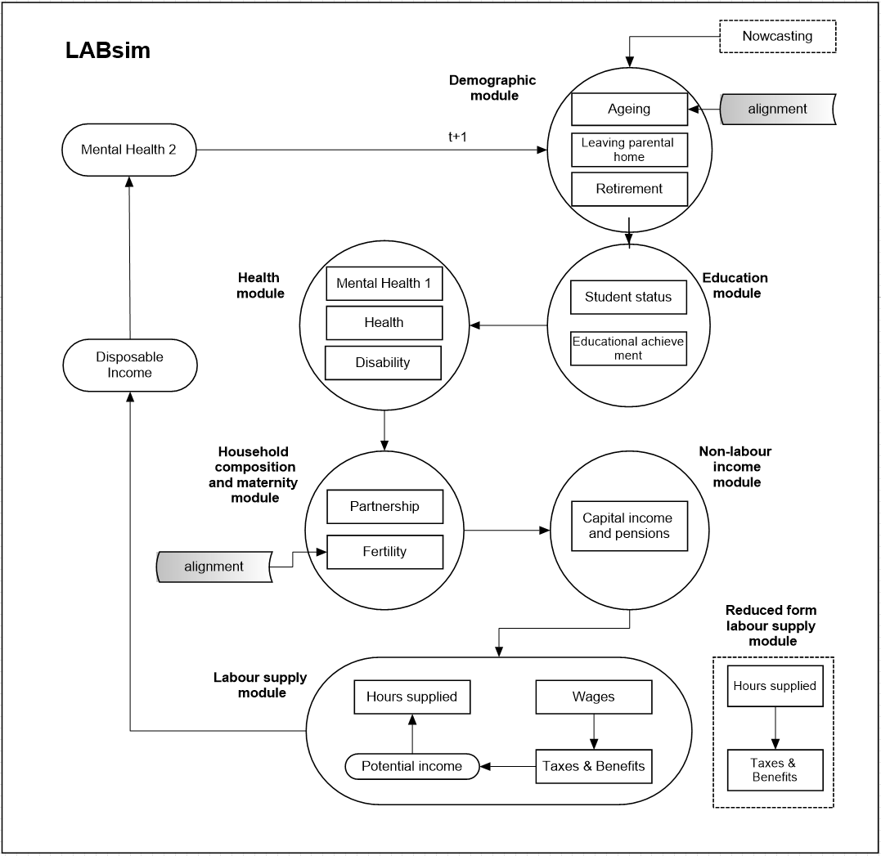
Model refinements /1
Modified to introduce new modules:
Mental Health 1
Mental Health 2
Covid-19 labour supply transitions

