Slide 1

Modelling the economic impact of precision medicine on childhood cancer management – a microsimulation approach
Owen Tan¹, Deborah Schofield¹, Rupendra Shrestha¹
¹GenIMPACT: Centre for Economic Impacts of Genomic Medicine, Macquarie Business School, Macquarie University, Australia.
Presenting at:
5 December 2021
Notes:
The project I am presenting today is part of the PhD project. Modelling the economomic impact of NGS and precision medicine in childhood cancer management.

Slide 2
Cancer in children
Cancer is the most common cause of death by disease among children.
Survival rates for certain cancer types have significantly improved over the last 50 years.
Improvement in rate of survival has reached plateau for these cancers since the early 2000s
Australian Childhood Cancer Statistics Online
Notes:
Cancer is the most common cause of death by disease for children.
We achieved significant improvement in survival outcome with the use of chemotherapy (in fact, the first application of chemotherapy was on a child with acute leukemia)
However, current treatment regime has reached plateau in terms of effectiveness.
Due to significant improvement in genetic sequencing technology, a more sophisticated treatment approach become feasible.

Slide 3
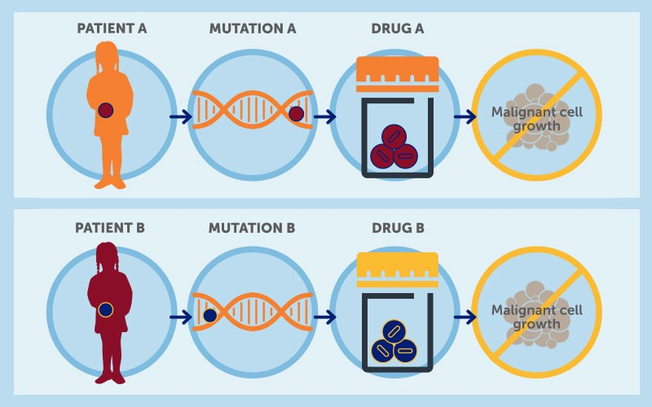
Genomic guided precision medicine: paradigm shift from current treatment approach
The genomics allows better understanding of what is driving cancer growth at an individual patient level.
It informs better matching of drug to target – i.e so specific target drugs are given to matching patient at the right time.
It opens up a plethora of new targeted drugs – most of which are designed to hone in on a growth pathway as opposed to chemotherapy that kills all rapidly dividing cells (good and bad) – hence the side effect profiles, particularly in a growing child should be better.
Collecting these steps are why precision medicine is a potential disrupter or paradigm shift in how we treat cancers.
Notes:
Thanks to covid19, most people are familiar with the idea of genes and genomic sequencing.
The technology that enable us to mass screen for covid, was already being trialled at other diseases care before the emergence of covid19.
Using the same technology, clinicians are able to prescribed drugs specific to patients mutation. This could be a potential paradigm shift in how we treat disease. The individualized characteristics of this treatment approach, makes microsimulation a nice fit for modelling the impact of this treatment.

Slide 4
Cost-effectiveness analysis is required for public funding Previous cost-effectiveness studies of precision medicine (selected)
Type of studies | Author | Conclusion
Research article | Li et al. 2015 | Disease: Metastatic melanoma. Target sequencing vs. single site BRAF V600 mutation test. Outcome: Target sequencing is the dominant strategy. ICER= -US$526,058
Research article | Gallego et al., 2015 | Disease: colorectal cancer. Comparisons between panels constitute of various oncogenes. Outcome: 2 of the panels (with wider genes coverage) resulted in ICER<US$100,000/QALY gained.
Research article | Doble et al 2016 | Disease: metastatic lung adenocarcinoma. Target sequencing is not cost-effective. ICER=AU$489,338/QALY gained.
Research article | Bennette et al 2015 | cost-effectiveness of returning incidental findings. returning incidental findings to healthy individual and cardiomyopathy patients achieve ICER<US$100,000/QALY gained. ICER for colorectal cancer patient is US$115,020/QALY gained.
Review | Verbelen et al 2017 | reviewed economic evaluations for pharmagogenetic guided treatment. Outcome: 57% of studies (not limited to cancer) were cost-effective.
Review | Phillips et al 2013 | 72% of identified personalised medicine studies were cost-effective.
Review | Kasztura et al 2019 | majority of studies concluded that the PM intervention was at least cost-effective compared to usual care.
Notes:
These are some selected precision medicine studies. Overall, most studies found the use of precision medicine to be cost-effective.

Slide 5
Current evidence
No study examines the cost-effectiveness of precision medicine in childhood cancer. (Tan et al., 2018)
Multiple prospective clinical sequencing studies in pediatric oncology have been reported in the last 2 years. These studies demonstrated feasibility of sequencing in the clinic and revealed a rate of actionable variants that justifies the development of precision trials for childhood cancer. (Forrest et al., 2018)
The primary results of the first round of pediatric precision oncology clinical trials will provide us with a greater understanding of the clinical impact of linking tumor profiling to selection of targeted therapies. (Forrest et al., 2018)
Tan et al., 2018 Application of next‐generation sequencing to improve cancer management: A review of the clinical effectiveness and cost‐effectiveness, Clinical Genetics 93:3
Forrest et al., 2018, Precision medicine in pediatric oncology, Current opinion in pediatrics.
Notes:
However, there is no cost-effectiveness study of precision medicine in childhood cancer. There’s multiple ongoing trials demonstrated the feasibility of using NGS in the clinical settings. We hope results from these trial will allow us to gain better understanding of the precision medicine in childhood cancer care.

Slide 6

Aim
To develop a microsimulation model to evaluate the cost and benefit of implementing precision medicine program in the management of childhood cancer as last line of treatment
$Incremental cost per QALY gained=\frac{mean cost ofprecision medicine−mean cost of standard care}{mean QALYs from precision medicine−mean QALYs from standard care}$
Notes:
The aim of the project was to develop a microsim model to evaluate the cost and benefit of implementing precision medicine as last line of treatment.

Slide 7
Approach
NSW Cancer registry (N=2966)
Using the existing state-wide data from the cancer registry—a population study
Payer perspectives
Base population of model: cancer patients that have been registered as death-proxy for high risk patients.
Precision medicine likely to be trialed in high risk patients.
Notes:
Our base populatin was obtained from NSW Cancer Registry for all cancer patients under the age of 18. We identified patients that were registered as death as a proxy for high-risk patients, and model the cost-effectiveness of applying precision medicine as their last line of treatment.

Slide 8
PeCanMOD: Structure of the model and relationships between key data items O. Tan, D. J Schofield, T. O’Brien, T. Trahair, R. N Shrestha; 2021; Modelling the Economic Impact of Next Generation Sequencing and Precision Medicine on Childhood Cancer Management—a Microsimulation Approach; International Journal of Microsimulation; 14(1); 73-91. DOI: 10.34196/IJM.00230
Deceased patients (<18 years old) on NSW Central Cancer Registry (N=541)
Variables: Linkage ID, timing of cancer diagnosis, cancer types, and cancer stages at diagnosis
Childhood cancer in Australia by AIHW, impute person weight to reflect Australia childhood cancer population, by age group, sex, and cancer types
Genomic variants distribution:
Foundation Medicine Pediatric Portal
Individuals imputed with genomic variants (N=364)
PeCanMOD
Simulated counterfactuals
Simulated outcome
Cost of precision medicine intervention
Life years gain from precision medicine intervention
Cost per life years gain from precision medicine intervention
Cost per QALYs gain from precision medicine intervention
Potential life year gain, duration of response, probability of response, probability of cure, health utility

Slide 9
Results

Slide 10
Sample characteristics
 | %
Sex
Male | 54.95
Female | 45.05
Age at diagnosis
0-4 | 40.93
5-9 | 20.6
10-14 | 20.05
15-17 | 18.41
Cancer types#
Acute lymphoblastic leukaemia | 14.01
Neuroblastoma | 10.99
Glioma | 8.79
Precursor B-cell lymphoblastic leukaemia | 7.69
Medulloblastoma NOS | 6.32
Ewing sarcoma | 6.04
Glioblastoma NOS | 6.04
All other cancer types** | 40.12
Notes:
Majority of patients are at younger age group. And leukemia and nervous system cancers accounted for majority of the cancer types.

Slide 11
Heat map shows frequency of mutations (normalised and represented as Z-scores) in each gene in (A) reference population, i.e. Foundation Medicine dataset, and (B) model base population simulation output. Pearson correlation coefficients=0.73, p<0.01.
Reference population
Model population
genes
genes
Notes:
A comparison of the genetic distribution in reference population versus the model population indicating both distributions were highly correlated.

Slide 12
Average annual costs of running the precision medicine program—AU$12,253 per person
19% of individuals were estimated to be eligible for precision medicine treatment.
About 27% of treated patients would have achieved a clinical response to the precision medicine treatment.
Overall incremental costs per quality-of-life adjusted life year (QALY) gained was AU$337,155 (CI: AU$106,061-1,548,216)
Overall incremental costs per life year (LY) gained was AU$245,562 (CI: AU$87,160-976,972).
Notes:
Average annual costs of running the program was 12,000 per person. In our model, 19% of sequenced individual were estimated to be eligible for precision medicine. Among them, 27% would achieved a clinical response. Overall ICER was 337k. Usually, the general acceptable threshold for cost-effective treatment was $100,000 per QALYs, and anything above that value are generally not eligible for public funding.

Slide 13
One-way sensitivity analysis
Notes:
One way sensitivity analysis showed that the model outcome is significantly sensitive to changes in duration of response, probability of being cured, probability of responding to treatment, and cost of sequencing, and discount rate apply to life year gain.

Slide 14
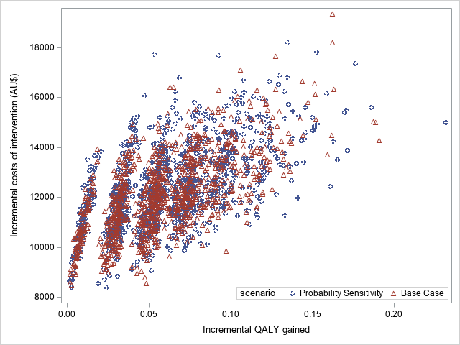
Distribution of incremental costs of intervention and QALY gained from base case and probabilistic sensitivity analysis. ICER _{probabilistic sensitivity} = AU$325,327 (CI: AU$99,547-1,419,645)
Notes:
I have also run a probabilistic sensitivity analysis, and the outcome of each simulation are represented as the triangle here.

Slide 15
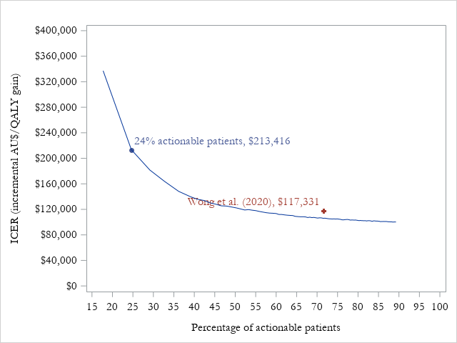
Scenario analysis

Slide 16
Discussion
“When assessed, relatively few patients in these initial studies (3–18% of the study populations) received targeted therapy matched to an identified actionable variant.”—Forrest et al 2018
NCI-COG Pediatric MATCH trial is finding targetable genetic changes in 24–29% of patients (Allen et al., 2017), which was closely align with our model output (19%)
The model suggested that this simulated precision medicine program is unlikely to be cost-effective based on current evidence and main scenario study parameters (as last line of treatment).
Scenario analysis shows that precision medicine program could be cost-effective by increasing the probability of individuals with targetable mutation.
Notes:
In a systematic review by Forrest, the authors found 3-18% of individual to be actionable. In another report by NCI-COG MATCH, they found 24-29% of their patients are actionable. These are closely align to our model output.
The model suggested that this simulated PM program is unlikely to be cost-effective based on the current scenario, where precision medicine was introduced as last line of treatment.

Slide 17
Limitations and future direction
Limitations
Model outcome is affected by the “heterogeneity” of population, i.e. genetic marker distribution among the population
Assume all patients meeting eligibility criteria (such as physical conditions etc. ) and accepted change in treatment
Require reliable data as input for parameter estimations
The model assesses precision medicine when applied at end stage for cancer patients, which is likely to be different from practice where precision medicine treatment could begin at an earlier stage of cancer progression. Longer-term follow-up data will improve the accuracy of longer-term projection.
Did not consider costs beyond the health system, i.e. patients/families perspectives
Future work
Perform simulation using Australian precision medicine clinical trial data
Notes:
There’s a number of limitations in this study. The model is very much affected by the genomic distribution, hence the quality of reference dataset will have significant impact on proportion of individuals been actionable.
We assume all patients with the right genomic mutation to accept change in treatment and meeting other eligibility criteria, e.g reasonable physical conditions with no other comorbidities etc.
The input parameters used was based on adult clinical trial data.
Model assume precision medicine applied as final line. Could be different in future.
The model did not consider costs beyond the health system. Which could be incorporated in future update and report cost effectiveness from multiple perspectives

Slide 18
Acknowledgement
GenIMPACT team:
Deborah Schofield
Rupendra Shrestha
Heidi Worsely
Philippa Smith
Dr. Hannah Carter, Professor Tracey O’Brien, Dr Toby Trahair
NSW Ministry of Health and NSW Cancer Institute—Access to cancer registry and hospital records

