Slide 1



Assessing the role of tax-benefit policies in mitigating the distributional effects of COVID-19 in the Andean region
H. Xavier Jara, Andrés Avellaneda, Rodrigo Chang, Diego Collado, Andrés Miderose, Lourdes Montesdeoca, David Rodríguez, Javier Torres, Omar Vanegas
Centre for Microsimulation and Policy Analysis
ISER, U. of Essex

Slide 2
Introduction
This paper assesses the role of tax-benefit policies in mitigating the effects of the COVID-19 crisis on the distribution of household disposable incomes in Colombia, Ecuador and Peru.
Before the crisis, these countries had low levels of social spending. Thus, it was likely that their benefit systems could not offer much protection.
The pandemic brought a significant deterioration of labour market in 2020: unemployment climbed 3 pp, while the participation rates decreased by 10 pp (ECLAC, 2021). This was projected to increase poverty from 30% to 35% (ECLAC, 2020).
A few studies have focused on the effect of expanded social assistance programmes in mitigating the distributional impact of COVID (Cuesta and Pico 2020; Lustig et al. 2020; Brum and de Rosa 2021; Huesca et al. 2021; Jara et al. 2021). They find:
A large increase in poverty and inequality
A limited effect of expanded social assistance, except in few countries (e.g. Brazil and Argentina).
We focus on the role of tax-benefit systems as a whole

Slide 3
Earners relative to the working age population

Slide 4
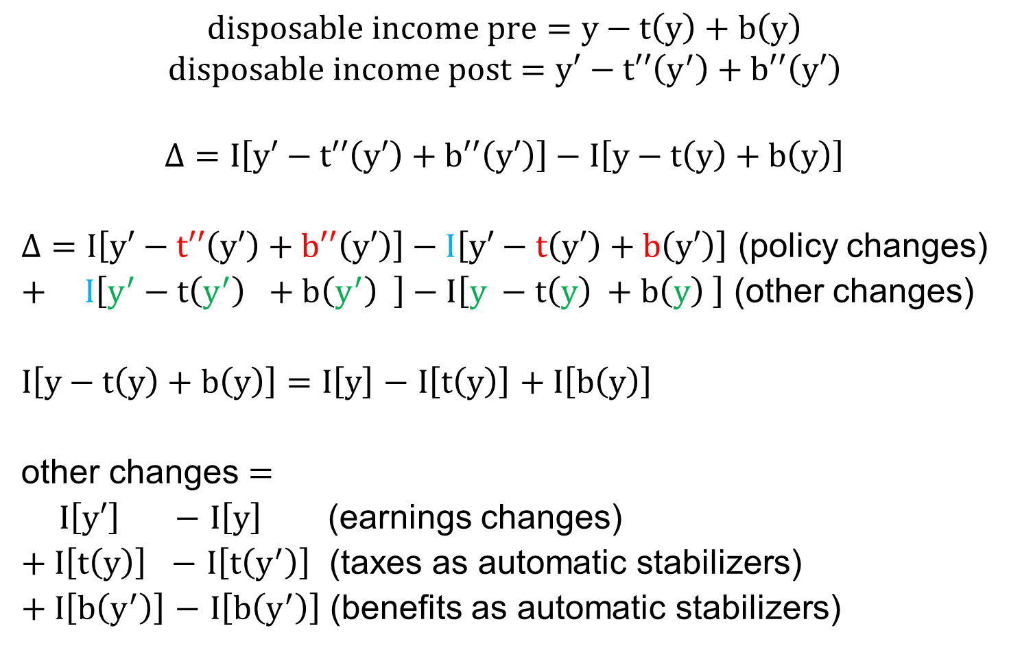
Methodology – Decomposition of changes in household disposable income
$$disposable income pre=y−t\left(y\right)+b\left(y\right)$$
$$disposable income post=y′−t′′\left(y^{′}\right)+b′′\left(y′\right)$$
$$Δ=I\left[y′−t′′\left(y′\right)+b′′\left(y′\right)\right]−I\left[y−t\left(y\right)+b\left(y\right)\right]$$
$Δ=I\left[y′−t′′\left(y′\right)+b′′\left(y′\right)\right]−I\left[y′−t\left(y′\right)+b\left(y′\right)\right]$ (policy changes)
$+ I\left[y^{′}−t\left(y^{′}\right) +b\left(y^{′}\right) \right]−I\left[y −t\left(y\right) +b\left(y\right) \right]$ (other changes)
$I\left[y−t\left(y\right)+b\left(y\right)\right]=$ $I\left[y\right]$ $−$ $I\left[t\left(y\right)\right]$ $+ I\left[b\left(y\right)\right]$
other changes $=$
$I\left[y′\right]$ $−$ $I\left[y\right]$ (earnings changes)
$+ I\left[t\left(y\right)\right]$ $−$ $I\left[t\left(y^{′}\right)\right]$ (taxes as automatic stabilizers)
$+ I\left[b\left(y^{′}\right)\right]$ $−$ $I\left[b\left(y^{′}\right)\right]$ (benefits as automatic stabilizers)
Bargain and Callan (2010)
Tasseva and Paulus (2020)

Slide 5
Data and tax-benefit simulations
We start from representative household survey data covering the pre-pandemic period (Q4-2019)
And nowcast the earnings distribution during the pandemic based on official surveys collected during 2020 (Q2 and Q4)
We use the microsimulation models to simulate tax-benefit policies and household disposable income before and during the pandemic
Table 1. Data sources and microsimulation models
Country | Data source | Period of data collection | Number of individuals | Microsimulation model
Colombia | Gran Encuesta Integrada de Hogares (GEIH) | Q4 2019 | 186,727 | COLMOD
 |  | May 2020 | 65,481
 |  | Q4 2020 | 184,790
Ecuador | Encuesta Nacional de Empleo, Desempleo y Subempleo de Hogares Urbanos y Rurales (ENEMDU) | Dec. 2019 | 59,183 | ECUAMOD
 |  | May/June 2020 | 37,406
 |  | Dec. 2020 | 30,636
Peru | Encuesta Nacional de Hogares (ENAHO) | Q4 2019 | 28,599 | PERUMOD
 |  | Q2 2020 | 27,614
 |  | Q4 2020 | 27,191
Source: Own elaboration based on household surveys.

Slide 6
Methodology: Nowcasting
The pandemic reduced the questionnaires and, in some cases, forced telephonic interviews. Data for 2020 in most cases only contains demographics and earnings. To overcome, we nowcast: modify 2019 information on earnings and labour market status to match 2020 information.
Extensive margin: probability model to determine if a working individual in the 2019 database is predicted to have positive earnings in 2020.
P(Earnings=1)=Φ(β+ϕCharacteristics+θd2020+δCharacteristics∙d2020)
Prediction: characteristics multiplied by the coefficients plus a random component
We move ranked individuals to match earners by industry and formality status
Intensive margin: conditional on having predicted positive earnings, apply a percentage change in earnings between 2019 and 2020.
We carry out this process for employees and self-employed workers independently.
We calculate percent changes by industry and formality status (“Δ% per cell”)

Slide 7
Nowcasting results
Table B2. Comparison of earners in original 2020 and nowcasted 2020 data based on 2019
Colombia
 | Observed-Q2 | Nowcast-Q2 | Observed-Q4 | Nowcast-Q4
Share of male | 0.632 | 0.657 | 0.610 | 0.629
Share of Self-employment | 0.428 | 0.427 | 0.485 | 0.463
Share of Skilled | 0.312 | 0.312 | 0.289 | 0.280
Ecuador
 | Observed-Q2 | Nowcast-Q2 | Observed-Q4 | Nowcast-Q4
Share of male | 0.659 | 0.693 | 0.639 | 0.658
Share of Self-employment | 0.360 | 0.364 | 0.440 | 0.397
Share of Skilled | 0.247 | 0.270 | 0.194 | 0.205
Peru
 | Observed-Q2 | Nowcast-Q2 | Observed-Q4 | Nowcast-Q4
Share of male | 0.635 | 0.622 | 0.572 | 0.568
Share of Self-employment | 0.452 | 0.451 | 0.451 | 0.434
Share of Skilled | 0.253 | 0.230 | 0.225 | 0.218
Note: Skilled is defined as having education above secondary level. Source: Authors’ elaboration based on household surveys.

Slide 8
Covid-19 policies
Colombia | Perú | Ecuador
Social assistance (monthly) Familias en Acción (56% of median income) Jóvenes en Acción (39%) Colombia Mayor (19%) Ingreso Solidario (7%) Un. subsidy (<4 min. wages→2 min. wages 3 months) VAT return Tax on High pensions and High earners in Government Reduction in pension contribution from 16% to 3% for self-employed, 4% to 0.75% for employed. | Social assistance (once) Bono independiente, Bono rural and Bono familiar universal (124%) Bono Yo me quedo en casa (62% of median) Not simulated: Extension of the annual declaration and payment of income tax for 2019, and the automatic refund of payments in excess of 2019. Partial early withdrawal from (compulsory) private pension funds (+3MM workers withdrew 25% of stock) | Bono de Protección Familiar (42% in 2 payments)

Slide 9
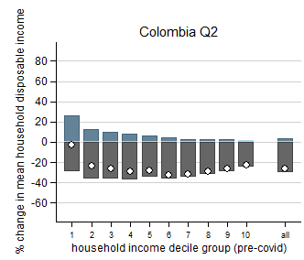
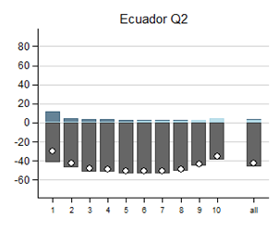
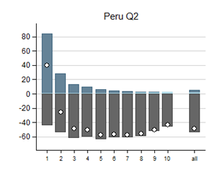
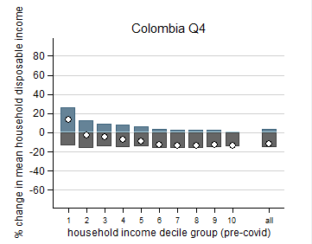
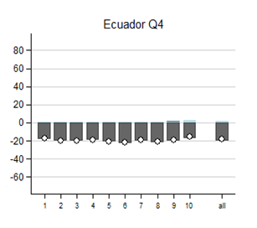
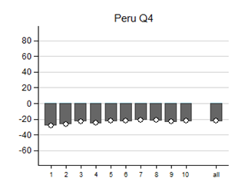

Results – Decomposition of changes in household disposable income

Slide 10
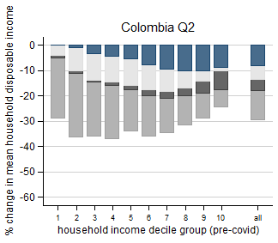
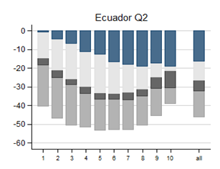
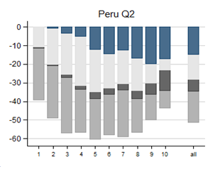
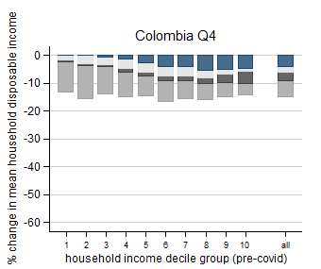
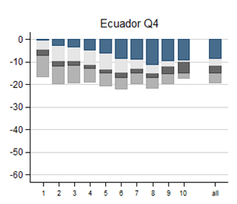
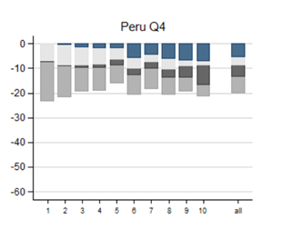

Results - Contributions to income changes by employment type

Slide 11
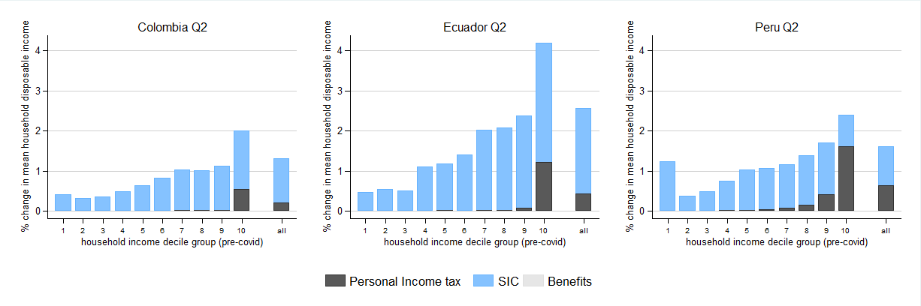
Results - Change in disposable income due to automatic stabilisers

Slide 12
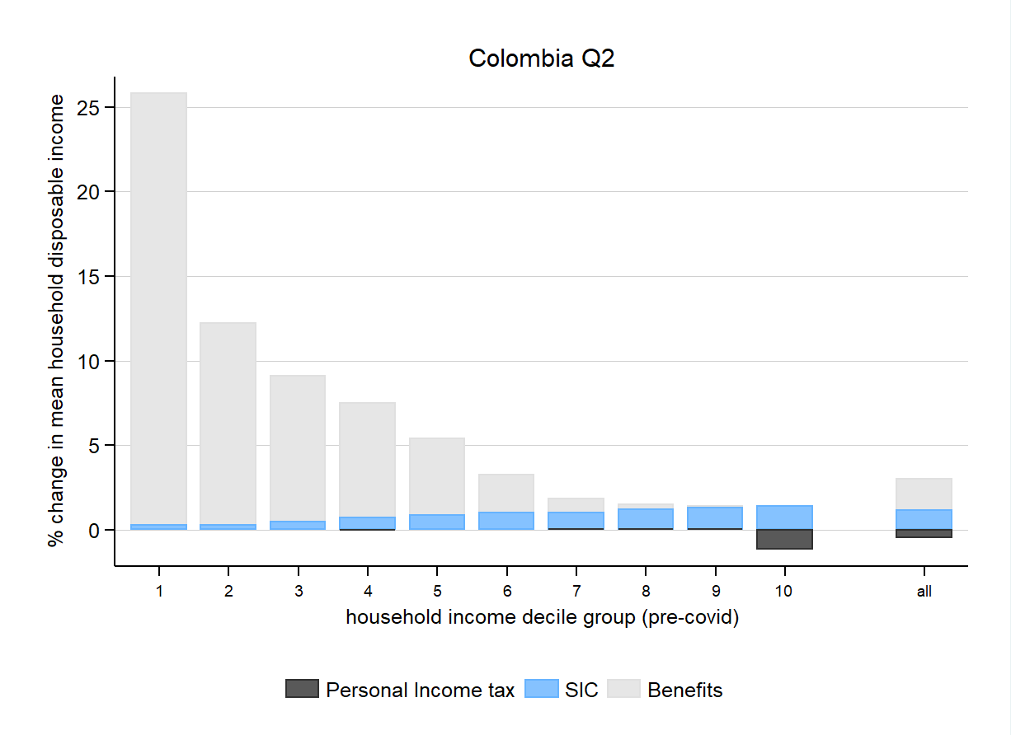
Results - Change in income due to COVID policies in Colombia

Slide 13
Conclusions
Average household disposable income fell dramatically in the second quarter of 2020: 25.7% in Colombia, 43% in Ecuador and 49.3% in Peru. Gini increased by 0.07, 0.133 and 0.126, while the poverty headcount by 19.3, 34.5pp and 36.5pp, respectively.
As lockdowns relaxed, smaller drops in household income of 11.8% in Colombia, 18.2% in Ecuador and 21.9% in Peru.
Shock larger at the middle (U-shaped)
COVID-related policies mitigated the impact at the bottom to different extents across countries
Increased mean disposable income of the first decile group by 26.1% in Colombia, 11.3% in Ecuador and 83% in Peru, during the second quarter of 2020.
By contrast, automatic stabilizers cushion the income shock at the top (taxes and SIC). While social assistance programmes did not react automatically due to their design as proxy means-tested benefits.
These results highlight the unpreparedness of current tax-benefit systems, the partial success of some countries and the lack of fiscal capacity of others​

Slide 14
Future steps
Adding AR, BO, CL, MX and UR to another paper
Using 2020 Q4 and some 2020 Q2 surveys instead of nowcasting

Slide 15
Thank you

Slide 16
Results - The effect of the COVID-19 pandemic on income inequality and poverty
The effect of the COVID-19 pandemic on income inequality and poverty
 | Colombia |  |  |  | Ecuador |  |  |  | Peru
 | Pre-COVID | Total | Total |  | Pre-COVID | Total | Total |  | Pre-COVID | Total | Total
 | scenario | change | change |  | scenario | change | change |  | scenario | change | change
 |  | Q2 | Q4 |  |  | Q2 | Q4 |  |  | Q2 | Q4
Inequality
Gini | 0.497 | 0.070 | 0.010 |  | 0.461 | 0.133 | 0.038 |  | 0.460 | 0.126 | 0.042
Theil | 0.481 | 0.115 | 0.013 |  | 0.395 | 0.225 | 0.058 |  | 0.379 | 0.241 | 0.069
Poverty
FGT0 (%) | 26.6 | 19.3 | 5.8 |  | 25.7 | 34.5 | 12.3 |  | 28.2 | 36.5 | 11.9
FGT1 (%) | 10.0 | 13.2 | 3.1 |  | 9.6 | 25.5 | 7.2 |  | 13.1 | 25.6 | 8.9
Extreme poverty
FGT0 (%) | 6.9 | 14.1 | 2.7 |  | 9.2 | 31.3 | 8.5 |  | 13.6 | 29.6 | 9.9
FGT1 (%) | 2.4 | 7.9 | 1.5 |  | 3.6 | 19.1 | 4.5 |  | 6.4 | 17.9 | 6.8
Note: poverty and inequality indicators are based on per capita household disposable income. The 2019 national poverty and extreme poverty lines are used in each country. Poverty changes are expressed in percentage points. Source: own calculations

Slide 17
Results - Decomposing the change in income inequality and poverty
Decomposing the change in income inequality and poverty
 | Colombia Q2 | Colombia Q2 |  |  | Ecuador Q2 |  |  | Peru Q2 |  |  | Colombia Q4
 | Total | Total | COVID-related | Other | Total | COVID-related | Other | Total | COVID-related | Other | Total | COVID-related | Other
 | change | change | policies effects | effects | change | policies effects | effects | change | policies effects | effects | change | policies effects | effects
Inequality
Gini | 0.070 | 0.070 | -0.023 | 0.092 | 0.133 | -0.012 | 0.144 | 0.126 | -0.046 | 0.172 | 0.010 | -0.019 | 0.029
Theil | 0.115 | 0.115 | -0.034 | 0.149 | 0.225 | -0.013 | 0.238 | 0.241 | -0.070 | 0.311 | 0.013 | -0.036 | 0.049
Poverty
FGT0 (%) | 19.3 | 19.3 | -3.0 | 22.3 | 34.5 | -0.7 | 35.2 | 36.5 | -3.4 | 39.9 | 5.8 | -3.4 | 9.2
FGT1 (%) | 13.2 | 13.2 | -3.5 | 16.7 | 25.5 | -1.6 | 27.1 | 25.6 | -6.3 | 31.9 | 3.1 | -2.7 | 5.7
Extreme poverty
FGT0 (%) |  | 14.1 | -3.9 | 18.0 | 31.3 | -1.2 | 32.5 | 29.6 | -7.0 | 36.6 | 2.7 | -3.0 | 5.7
FGT1 (%) |  | 7.9 | -3.4 | 11.3 | 19.1 | -2.0 | 21.2 | 17.9 | -7.4 | 25.4 | 1.5 | -1.7 | 3.2
Note: poverty and inequality indicators are based on per capita household disposable income. The 2019 national poverty and extreme poverty lines are used in each country. Poverty changes are expressed in percentage points. Source: own calculations

