Slide 1
The mitigating role of tax and benefit rescue packages for poverty and inequality in Africa amid the COVID-19 pandemic
Jesse Lastunen
Research Associate
UNU-WIDER
International Microsimulation Association
8th World Congress, CeMPA, ISER, Univ of Essex
2nd December 2021

Slide 2
SOUTHMOD COVID-19 study
Large research project on the distributional effects of COVID-19
Africa: Zambia, Mozambique, Uganda, Tanzania & Ghana
South Africa & Ecuador (working papers out on short-run effects) + Viet Nam
Main objectives:
Estimate the effects of the pandemic on poverty and inequality
Assess the contributions of pre-crisis tax-benefit systems and discretionary tax and benefit policies during crisis in mitigating the adverse impacts of the pandemic

Slide 3
Steps of the analysis
Develop counterfactual “pre-crisis“ datasets for 2020
We reweight the underlying annual datasets used in standard models (from 2014–2018) so that they match with population estimates from early 2020
Develop “crisis“ datasets that account for the effect of COVID in 2020
Modelling of tax-benefit policies during COVID
Study the effects of the pandemic and COVID-related policies via microsimulation and decomposition techniques

Slide 4
Steps of the analysis
Develop counterfactual “pre-crisis“ datasets for 2020
We reweight the underlying annual datasets used in standard models (from 2014–2018) so that they match with population estimates from early 2020
Develop “crisis“ datasets that account for the effect of COVID in 2020
Modelling of tax-benefit policies during COVID
Study the effects of the pandemic and COVID-related policies via microsimulation and decomposition techniques

Slide 5
2. Crisis datasets: From macro to micro shocks
1. Estimate GDP shocks: deviation of 2020 GDP from 2017–19 trend by industry
2. Allocate shocks to the micro level data used in the models:
2a. Random allocation method (all countries):
Randomly selected workers in each industry are assigned to unemployment with zero income so that…
…total labour income in the industry is reduced in proportion to the respective GDP shock
2b. Imputation method (alternative method for Uganda and soon Ethiopia):
Total labour income losses are still proportionate to the GDP shocks across industries…
…but losses for individual workers within industries are imputed from microdata from the World Bank High-Frequency Phone Surveys for Uganda

Slide 6
Steps of the analysis
Develop counterfactual “pre-crisis“ datasets for 2020
We reweight the underlying annual datasets used in standard models (from 2014–2018) so that they match with population estimates from early 2020
Develop “crisis“ datasets that account for the effect of COVID in 2020
Modelling of tax-benefit policies during COVID
Study the effects of the pandemic and COVID-related policies via microsimulation and decomposition techniques

Slide 7
Steps of the analysis
Develop counterfactual “pre-crisis“ datasets for 2020
We reweight the underlying annual datasets used in standard models (from 2014–2018) so that they match with population estimates from early 2020
Develop “crisis“ datasets that account for the effect of COVID in 2020
Modelling of tax-benefit policies during COVID
Study the effects of the pandemic and COVID-related policies via microsimulation and decomposition techniques

Slide 8
3. Tax-benefit policies during COVID
In Africa, tax-benefit measures at the household level in response to COVID-19 have been limited – especially in 2020
Some examples:
In Mozambique and Ghana, utility fees were reduced or waived for consumers for the rest of 2020
Zambia enacted an Emergency Social Cash Transfer
Ghana paused a large school feeding program during lockdown thus limiting it to 3 months (= “unintentional COVID-19 policy”)

Slide 9
Steps of the analysis
Develop counterfactual “pre-crisis“ datasets for 2020
We reweight the underlying annual datasets used in standard models (from 2014–2018) so that they match with population estimates from early 2020
Develop “crisis“ datasets that account for the effect of COVID in 2020
Modelling of tax-benefit policies during COVID
Study the effects of the pandemic and COVID-related policies via microsimulation and decomposition techniques

Slide 10
Steps of the analysis
Develop counterfactual “pre-crisis“ datasets for 2020
We reweight the underlying annual datasets used in standard models (from 2014–2018) so that they match with population estimates from early 2020
Develop “crisis“ datasets that account for the effect of COVID in 2020
Modelling of tax-benefit policies during COVID
Study the effects of the pandemic and COVID-related policies via microsimulation and decomposition techniques

Slide 11
Data set used
Scenarios
Policy systems
Pre-crisis data set
No COVID-19 shocks
Standard data re-weighted to match with population in early 2020
Baseline T₀
Pre-crisis
Only policies unrelated to COVID
Scenario C
Counterfactual: Crisis under no COVID-related tax-benefit policies
Crisis data set
COVID-19 shocks
All policies in place throughout 2020, including those related to COVID
Baseline T₁
Crisis
* Following Paulus and Tasseva (2020)

Slide 12
Data set used
Scenarios
Policy systems
Pre-crisis dataset
No COVID-19 shocks
Standard data re-weighted to match with population in early 2020
Baseline T₀
Pre-crisis
Only policies
unrelated to COVID-19
Scenario C
Counterfactual: Crisis under no COVID-related tax-benefit policies
Crisis dataset
COVID-19 shocks
All policies in place throughout 2020, including policies
related to COVID-19
Baseline T₁
Crisis
* Following Paulus and Tasseva (2020)

Slide 13
Comparative results: Mean disposable income

Slide 14
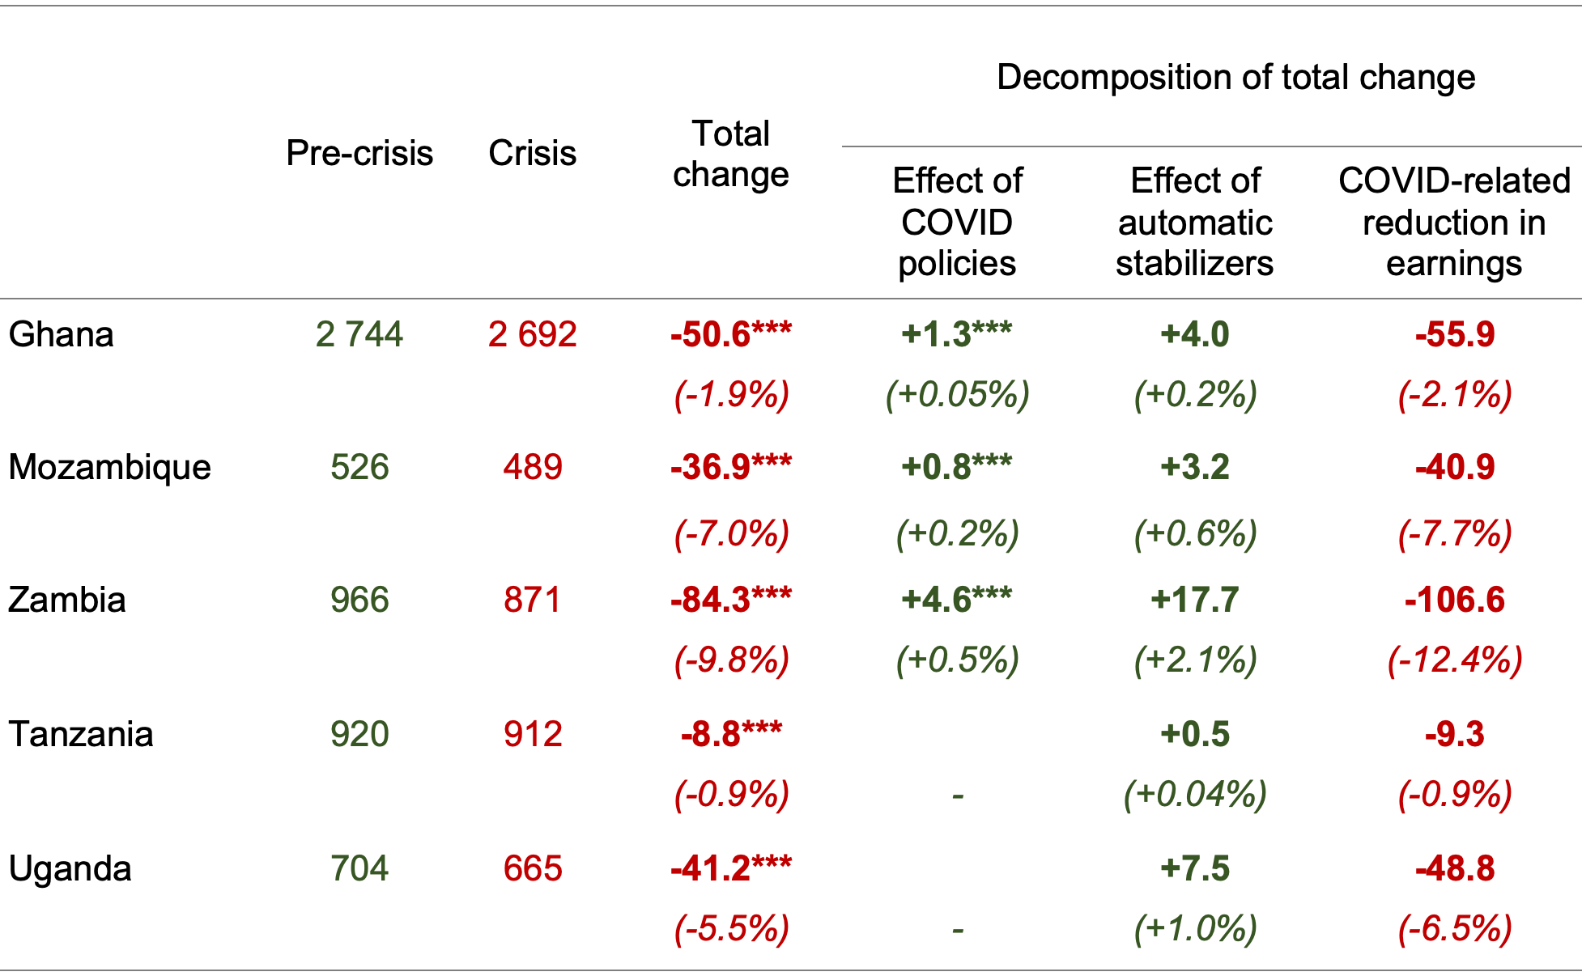
Comparative results: Mean disposable income

Slide 15
Comparative results: Mean disposable income

Slide 16
Comparative results: Poverty and inequality

Slide 17
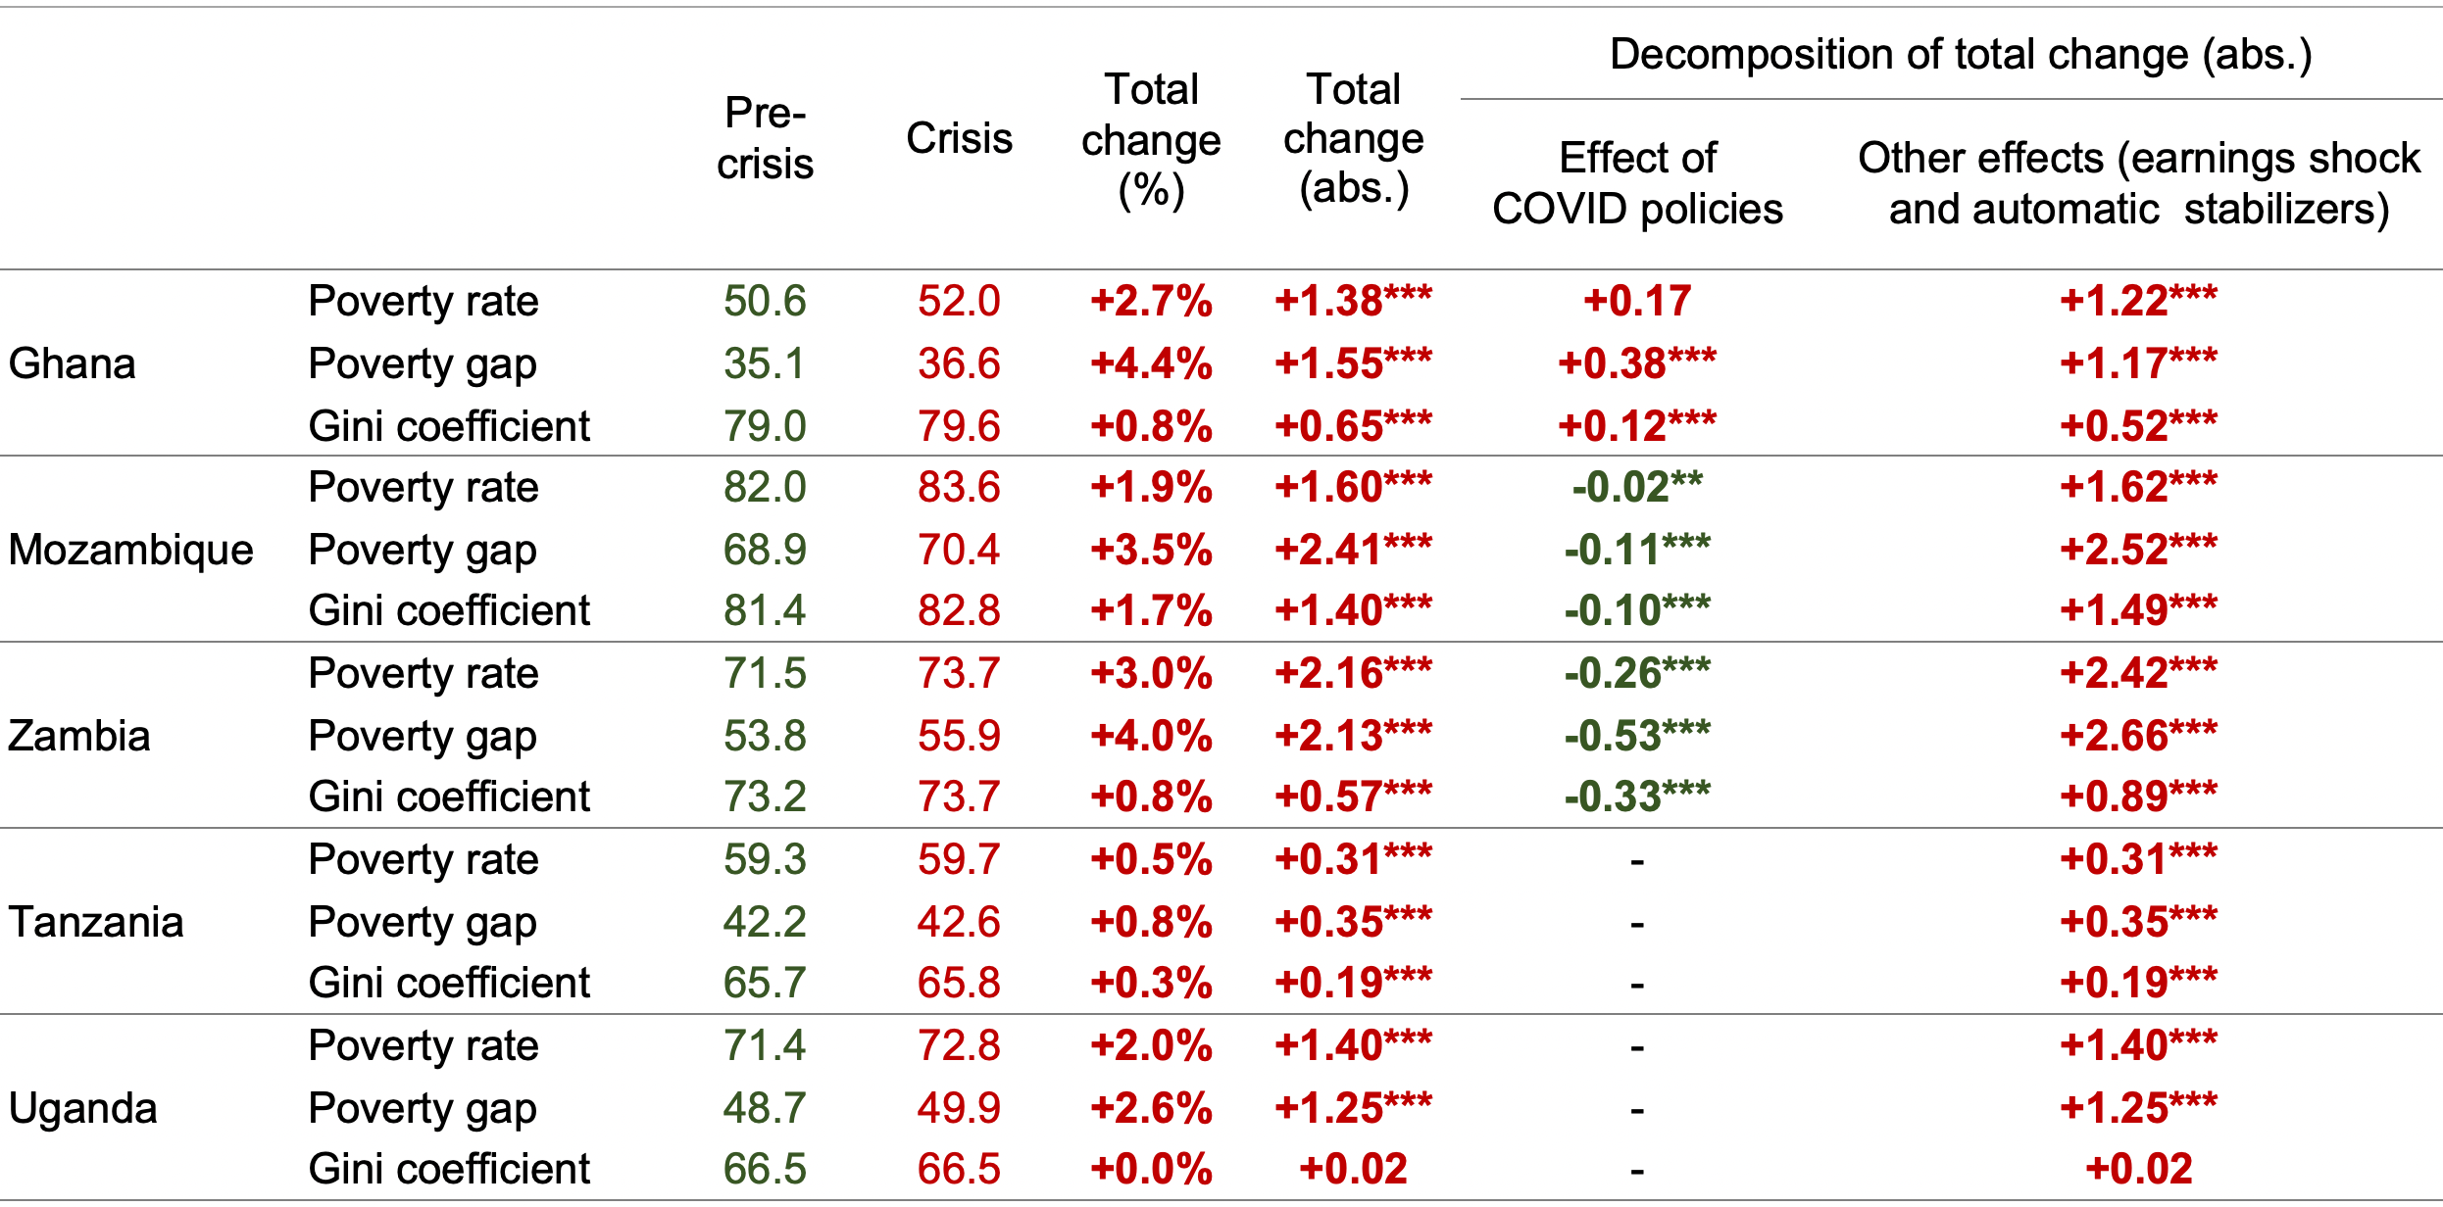
Comparative results: Poverty and inequality
Share of population with disposable income under $1.9/day (%)

Slide 18
Comparative results: Poverty and inequality
Share of population with disposable income under $1.9/day (%)

Slide 19
Comparative results: Poverty and inequality

Slide 20
Comparative results: Poverty and inequality

Slide 21
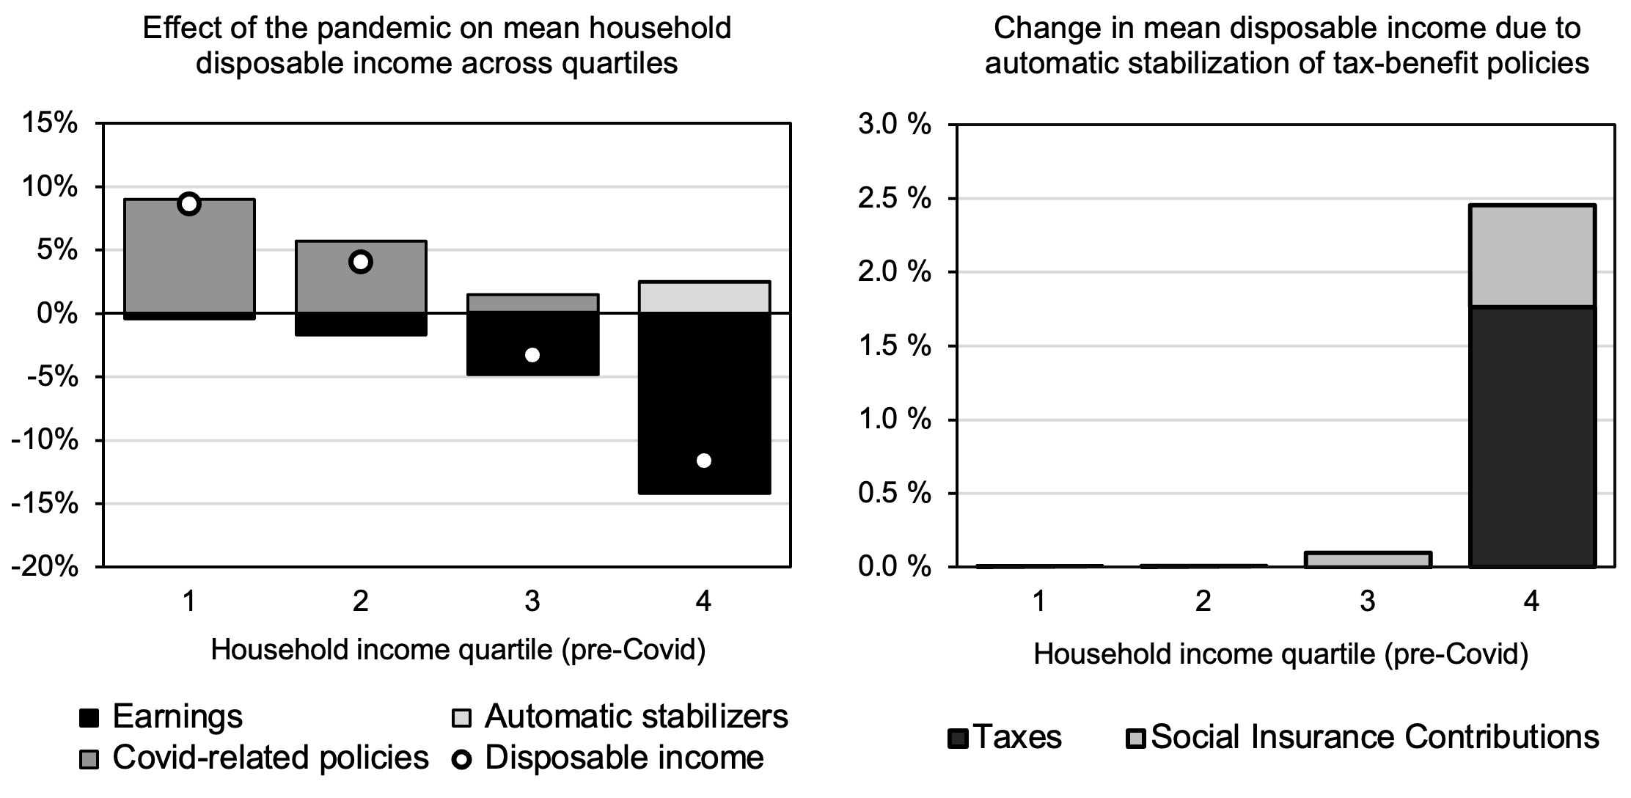
Zambia
Emergency Social Cash Transfer (over-)compensated for income losses among the poorest households

Slide 22
Zambia
Very limited automatic income stabilization by the general tax-benefit system

Slide 23
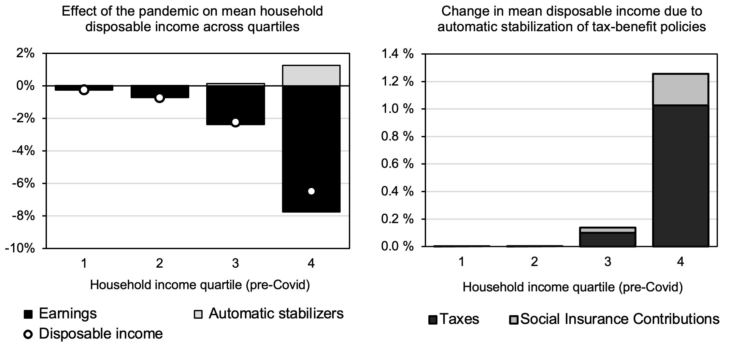
Uganda
We can also examine how earnings shocks are distributed between different types of workers

Slide 24
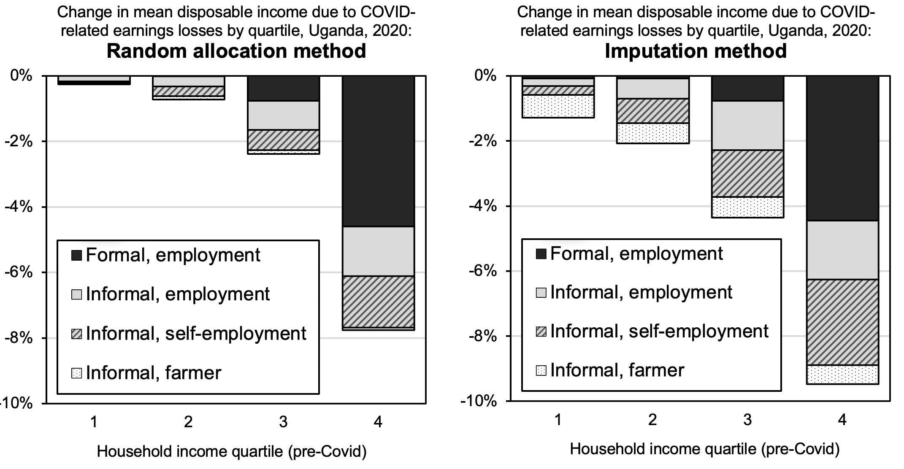
Uganda
Imputing losses from World Bank survey data allows us to look at effects within industries in greater detail
Notes:
Micro data points to larger income reductions among informal workers

Slide 25
Uganda
Notes:
Micro data points to larger income reductions among informal workers

Slide 26
Main findings
Modest increases in income inequality and poverty across countries studied
Effects vary across countries; high-income households were also affected
Agriculture has been the least affected sector, serving as a buffer
Automatic stabilizers had a very limited effect in mitigating income losses
High informality
Lack of income means-tested benefits
The Emergency Social Cash Transfer in Zambia was likely quite effective in reducing income reductions at the bottom of the income distribution
Tax-benefit policies in most countries were of smaller scale
In Ghana, limiting the school feeding program to 3 months increased poverty and inequality

Slide 27

Links – copied to the chat
Press release on the paper and related policy briefs: www.wider.unu.edu/news/press-release-new-un-study-reveals-limited-impact-tax-and-social-protection-policies-early
Main study: www.wider.unu.edu/publication/mitigating-role-tax-and-benefit-rescue-packages-poverty-and-inequality-africa-amid-covid
Working paper on the short-run effects of COVID in Ecuador… www.wider.unu.edu/publication/role-automatic-stabilizers-and-emergency-tax%E2%80%93benefit-policies-during-covid-19-pandemic …and South Africa: https://sa-tied.wider.unu.edu/article/analysis-distributional-effects-covid-19-and-state-led-remedial-measures-south-africa
SOUTHMOD at WIDER: www.wider.unu.edu/project/southmod-simulating-tax-and-benefit-policies-development-phase-2
Accessing SOUTHMOD tax-benefit microsimulation models: www.wider.unu.edu/about/accessing-southmod-models
Contact
lastunen@wider.unu.edu

