Slide 1

Dynamic Microsimulation of tax and benefit payments by Database Imputation
8th World Congress of the International Microsimulation Association
Patryk Bronka, Matteo Richiardi and Justin van de Ven

Slide 2
Outline
Motivation and objectives
Proposed methodology
Reference database
Matching methods
Imputation of transfer payments
Practical example
Implementation
Policy counterfactual
Results

Slide 3
Motivation and objectives
Motivation:
Modern tax and benefits systems are complex and subject to constant reform
Poses significant challenges to static and dynamic modelling
Increasing numbers of well-supported static models of tax and benefits policy now exist
EUROMOD/UKMOD, IGOTM, PSM, TAXBEN…
Objectives:
Use an existing static microsimulation model to project taxes and benefits in a dynamic microsimulation model
Flexibility
Computational efficiency

Slide 4
Proposed methodology
Formal integration of alternative model structures
e.g. Liégeois (2021), InGRID
Computational burden of model communications
EUROMOD AND LIAM2
Reduced flexibility switching between alternative static models
Database approach
Use static model to generate a reference database
Use matching methods to identify observations from the database, which allows the database to be used as a look-up table
Imputation of tax and benefit payments

Slide 5
Proposed methodology
Specification of a reference database
Accommodate generic multi-level microdata
Typical output from static microsimulation models of taxes and benefits
Facilitates switching between alternative static models
Allows the method to draw directly from commonly available survey micro-data
Matching method: coarsened-exact matching followed by weighted nearest neighbour matching
Coarsened-exact matching:
over income and demographic characteristics
adapted to balance precision against completeness
Weighted nearest neighbour matching with respect to private income

Slide 6
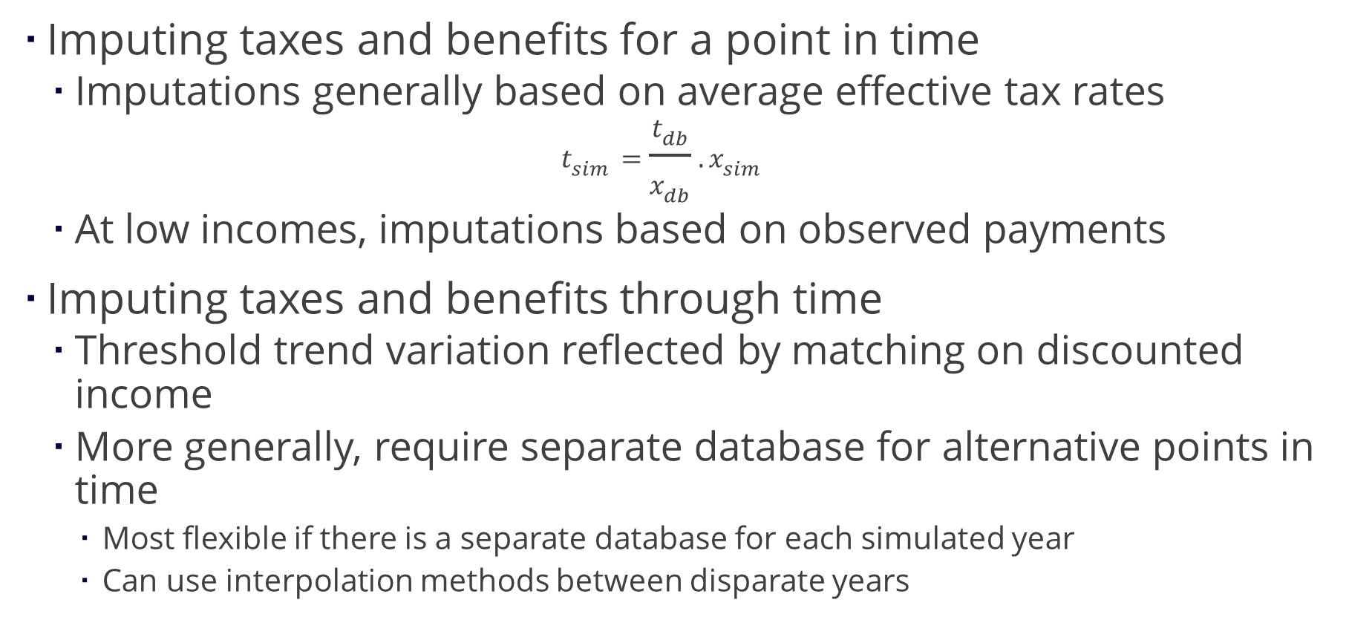
Proposed methodology
Imputing taxes and benefits for a point in time
Imputations generally based on average effective tax rates
$$t_{sim}=\frac{t_{db}}{x_{db}}.x_{sim}$$
At low incomes, imputations based on observed payments
Imputing taxes and benefits through time
Threshold trend variation reflected by matching on discounted income
More generally, require separate database for alternative points in time
Most flexible if there is a separate database for each simulated year
Can use interpolation methods between disparate years

Slide 7
Practical Example
LINDA and IGOTM
Matching method:
three age categories: under 45 (child-rearing), under 66 (pre-pension), and 66+ (post-pension);
relationship status of the benefit unit: single, couple;
number of children under 5 (schooling age) in the benefit unit (maximum 2);
number of children of aged 5+ in the benefit unit (maximum 3);
three labour categories for each adult in the benefit unit (not employed, part-time employed, full-time employed);
and, three private income categories: under £225 per week (low), under £710 per week (middle), £710+ per week (high).
Policy environment fixed in real terms (simple)
Counterfactual 10% increase in all income tax rates

Slide 8
Practical Example
Simulation run-times increased by 5-10% relative to functional projections
Simulation run-times by policy scenario and method of transfer payment imputation

Slide 9
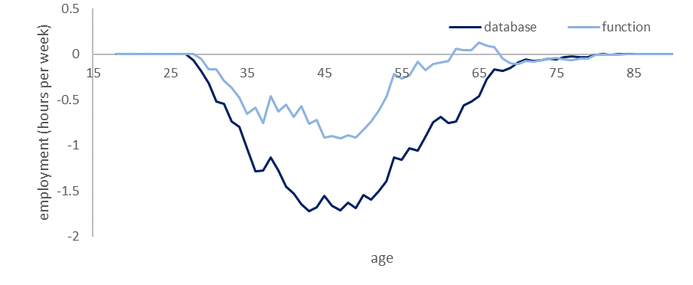
Practical Example
Labour supply responses to a 10 percentage point increase in income tax rates, by method of transfer payment imputation

Slide 10
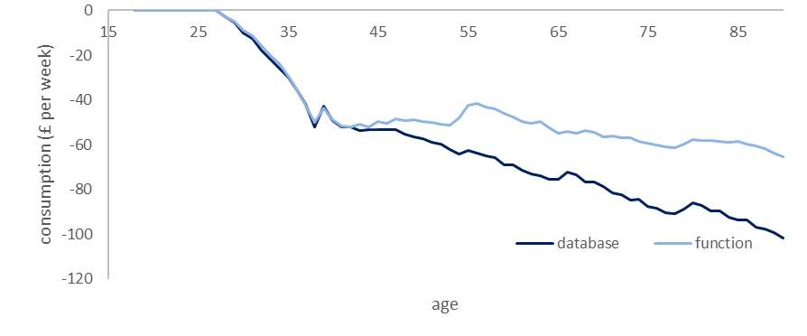
Practical Example
Consumption responses to a 10 percentage point increase in income tax rates, by method of transfer payment imputation

Slide 11
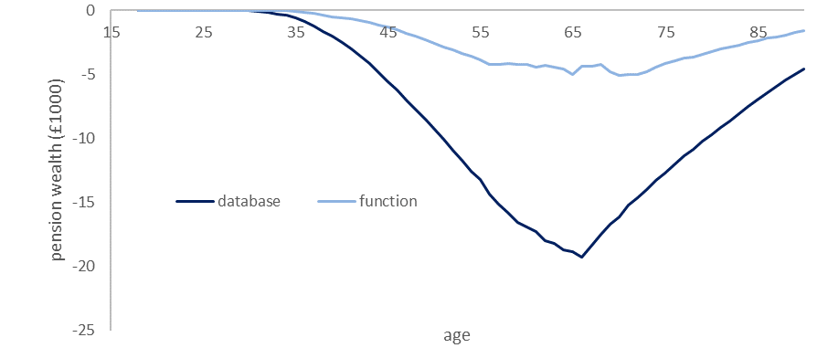
Practical Example
Private pension saving responses to a 10 percentage point increase in income tax rates, by method of transfer payment imputation

Slide 12
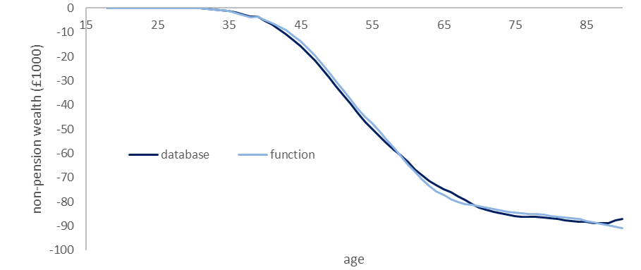
Practical Example
Non-pension saving responses to a 10 percentage point increase in income tax rates, by method of transfer payment imputation

Slide 13
Conclusions
Database methods for integrating static and dynamic microsimulation models work
Qualitatively similar projections
In similar computational time-frames
Caveats of approach
Matching methods endogenous to policy margins of interest
Consideration of health policy would require that health be included in matching routines
Results highlight endogeneity of the assumed policy context and model projections
Associated program code is available upon request

