Slide 1
Changes in female employment in Australia over two decades: understanding the drivers of change
Nicolas Herault
Joint work with Guyonne Kalb

Slide 2
Female labour force participation Aged 25-54 1990-2017
Source: OECD data

Slide 3
What can explain these large changes?
Numerous studies on women’s LFP, particularly coupled women and mothers
Largely US-based evidence on explaining the large increases since WWII (rather than the more recent decline/stabilisation seen since the late 1990s)
The literature emphasises the role of increases in wages and reductions in the gender wage gap as key drivers (Jones et al. 2015, Cardia and Gomme 2013, Eckstein and Lifshitz 2011, Attanasio et al. 2008, Olivetti 2006, Pencavel 1998, Juhn & Murphy 1997, Gustafsson and Jacobsson 1985)
Numerous other factors are mentioned in the literature

Slide 4
This paper
We use Australian data spanning 23 years (1994-2016) and a behavioural tax-benefit microsimulation model to decompose changes in the distribution of hours worked
Answers the call by Blundell et al. (2013) for an assessment of the effect of tax-transfer policy reforms on both margins of employment (extensive and intensive)
And we evaluate the effect of changes in labour supply preference parameters and the effect of changes in wages
How?
Apply the decomposition approach introduced by Bargain (2012)
Augmented to identify the effect of changes in labour supply preference parameters and in wages (extended Oaxaca-Blinder type approach)

Slide 5
Methodology

Slide 6
Methodology
(1) Effect of tax-transfer reforms
Base = 1994 population
Change from tax-transfer system of 1994 to that of 2016
(2) Effect of changes in preference parameters
Allow for labour supply to adjust
Replace wages by 2016 predicted real wages
(3) Effect of changes in real wages
Allow for labour supply responses to tax-policy changes
Change labour supply parameters to those of 2016
(4) Population composition changes
Change to 2016 population
=> 2016 distribution
Allow for labour supply to adjust
One decomposition path
Notes:
Say a few words about what each component is capturing

Slide 7
Labour supply modelling

Slide 8
Labour supply modelling: Data Sources and Methods
Use data from the various editions of a nationally representative survey, the Australian Survey of Income and Housing Costs (SIHC)
Pool 4 cross-sectional surveys from the mid to late 1990s (1994/95, 1995/96, 1996/97, and 1997/98) and 3 cross-sectional surveys from 2011 to 2016 (2011/12, 2013/14 and 2015/16)
Time and policy variations important to identify structural parameters
Use the Melbourne Institute Tax and Transfer Simulator (MITTS), to compute income tax liabilities and benefit entitlements, and to derive net income for a range of hours worked
Discrete choice approach with a quadratic utility function and random utility component (Keane and Moffitt 1998)
Estimated separately for 4 demographic groups: couples (joint decision), single men, single women and sole parents

Slide 9
Implied changes in wage elasticities

Slide 10
Policy context

Slide 11
Policy context
There were numerous key tax and transfer reforms between 1995 and 2016
Income tax decreased for all income levels with the tax-free income threshold more than doubling in real terms, and similarly, the top income threshold more than doubling in real terms
The effects on labour supply are a priori ambiguous (income vs. substitution effects)
Major changes have also occurred for allowances (paid in cases of unemployment) and pensions (paid in cases of disability or single parenthood)
Pensions increased with wages and allowances with prices
This led to an important wedge between these 2 types of payments
Withdrawal rates were reduced
Again, the effect on labour supply is ambiguous

Slide 12
Results

Slide 13
Table 3 Decomposition results for partnered women and single parents of working age (25-55 years old) – absolute (ppt or hrs/wk) and relative (%) contributions

Slide 14
Table 3 Decomposition results for partnered women and single parents of working age (25-55 years old) – absolute (ppt or hrs/wk) and relative (%) contributions

Slide 15
Table 3 Decomposition results for partnered women and single parents of working age (25-55 years old) – absolute (ppt or hrs/wk) and relative (%) contributions

Slide 16
Table 3 Decomposition results for partnered women and single parents of working age (25-55 years old) – absolute (ppt or hrs/wk) and relative (%) contributions

Slide 17
Discussion

Slide 18
Discussion
Large increases in labour force participation for women over the last 2 decades
Consistent with the stated goals of various policy reforms implemented by the Australian government
However, we find that these reforms have done relatively little to achieve these large increases. Lack of consistency or counteracting effects might be to blame.
The focus has largely been on improving incentives to work full-time, essentially through tax cuts
Part-time work for single parents, often the only desired option, has been discouraged
Most of the increase has come from changes in wages and changes preference parameters, that seem to be part of a global and continuing trend
This trend has been accompanied by reduced responsiveness (lower elasticities)
Policy implications

Slide 19
THANK YOU!

Slide 20
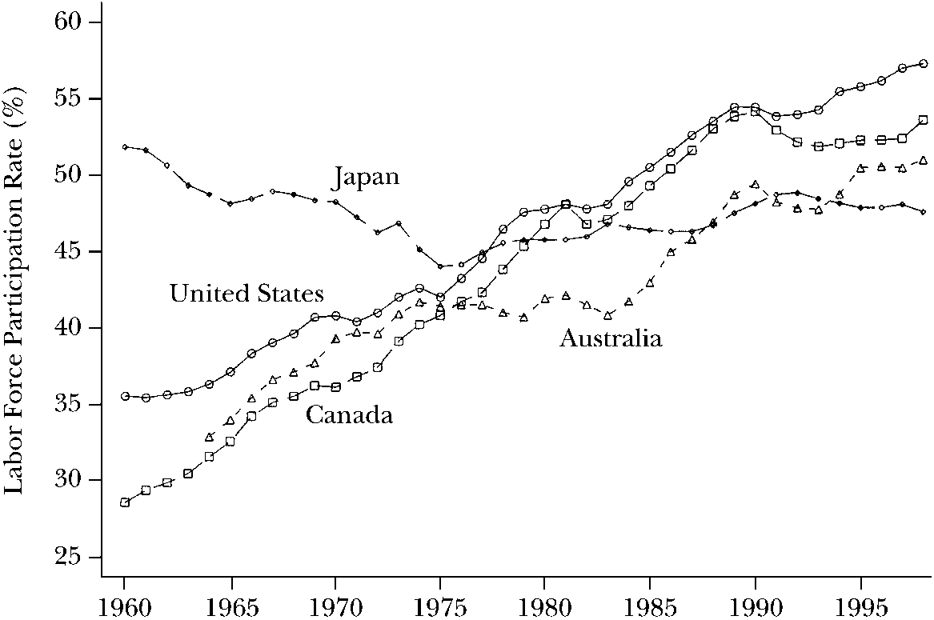
Female labour force participation Aged 15+ 1960-1998
Source: Costa, D.L. 2000. “From Mill Town to Board Room: The Rise of Women’s Paid Labor.” Journal of Economic Perspectives 14(4):101–122.

Slide 21
Labour force participation of persons aged 25-54 years (Australia, 1990-2017)
Source: OECD.stat

Slide 22
What can explain these large changes?
Observable demographic characteristics are generally found to explain very little
One exception is Eckstein and Lifshitz (2011): large direct effect of education for married women in the US
Numerous other factors are mentioned in the literature, including:
technological improvements in the household (Jones et al. 2015)
cohort (or time) effects (Goldin 1990) => preferences?
fertility (Erosa, Fuster and Restuccia 2005)
culture & social norms (Costa 2000, Fernandez et al. 2004, Fortin 2005, Fernandez 2013) => preferences?
improvements in medical technology (Albanesi and Olivetti 2009, Goldin and Katz, 2002)
reductions in the ‘cost’ of children (Attanasio et al. 2008, Olivetti 2006)
Still, a large portion of changes remains unexplained (Blau 1998)

Slide 23
What can explain these large changes?
To explain these changes, the (descriptive) paper by Blundell et al. (2013) call for “for a detailed analysis of effective incentives in the tax and benefit system, how they have changed over time, and how individuals and families have responded”
Separately, the literature on wage elasticities points to sharp declines in female wage elasticities in recent decades (Blundell and Macurdy 1999 and other more recent studies)
Again, changes in demographic characteristics appear to explain little, suggesting changes in the labour supply function (i.e., changes in preference parameters) played a major role (Pencavel 1998, Heim 2007, Blau and Kahn 2007, Eckstein and Lifshitz 2011)

Slide 24
Methodology
This new decomposition approach requires us to think carefully about what each term is capturing
Direct effect of tax-transfer reforms (through changes in financial incentives) => T
Direct effect of changes in (conditional) real wages through changes in financial incentives, excluding population composition effects => W

Slide 25
Methodology
But what goes into changes in preferences PR and in population changes P?
Changes in fertility (e.g., ↗ no. kids) => R (= a change in the population’s composition)
More generally, any change in explanatory variables (e.g., education, age, no. & age of kids, household structure) => R
↘ gender wage gap => W (for the part not due to composition changes; changes in returns only)
Child care changes (affordability & availability) => PR, through a reduction in the ‘cost’ of kids
Public transport policies => PR, through a reduction in the fixed cost of working
Changes in social norms towards working women => PR
Any policy or any factor directly affecting the ‘cost’ of working => PR
Any indirect effect of tax-transfer policies on social norms => PR
Notes:
Skip?

Slide 26
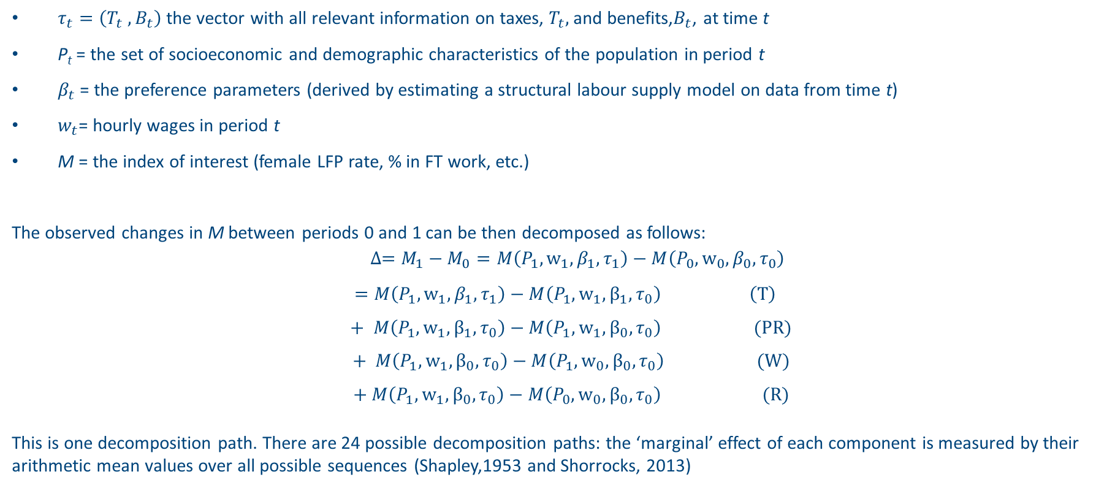
Methodology
$τ_{t}=\left(T_{t} , B_{t}\right)$the vector with all relevant information on taxes, $T_{t},$and benefits,$B_{t}$, at time t
P_{t} = the set of socioeconomic and demographic characteristics of the population in period t
$β_{t}$ = the preference parameters (derived by estimating a structural labour supply model on data from time t)
$w_{t}$= hourly wages in period t
M = the index of interest (female LFP rate, % in FT work, etc.)
The observed changes in M between periods 0 and 1 can be then decomposed as follows:
$$∆=M_{1}−M_{0}=M\left(P_{1},w_{1},β_{1},τ_{1}\right)−M\left(P_{0},{w_{0},β}_{0},τ_{0}\right)$$
$$=M\left(P_{1},{w_{1},β}_{1},τ_{1}\right)−M\left(P_{1},w_{1},β_{1},τ_{0}\right) \left(T\right)$$
$$+ M\left(P_{1},{w_{1},β}_{1},τ_{0}\right)−M\left(P_{1},{w_{1},β}_{0},τ_{0}\right) (PR)$$
$$+ M\left(P_{1},{w_{1},β}_{0},τ_{0}\right)−M\left(P_{1},{w_{0},β}_{0},τ_{0}\right) (W)$$
$$+ M\left(P_{1},{w_{1},β}_{0},τ_{0}\right)−M\left(P_{0},{w_{0},β}_{0},τ_{0}\right) (R)$$
This is one decomposition path. There are 24 possible decomposition paths: the ‘marginal’ effect of each component is measured by their arithmetic mean values over all possible sequences (Shapley,1953 and Shorrocks, 2013)
Notes:
Just focus on M can be different indices, and we take Shapley value

Slide 27
Summary statistics – Labour market

Slide 28
Labour Market Summary Statistics for Couples (25-55-Year-Old)
Notes: a) the 1994/95 male wage is $30.46 in 2016 dollars.
b) the 1994/95 female wage is $23.10 in 2016 dollars.
Sources: Authors’ calculations based on the weighted Survey of Income and Housing.

Slide 29
Labour Market Summary Statistics for 25-55-Year-Old Single Persons
Notes: b) the 1994/95 wage for single women is $25.55 in 2016 dollars.
c) the 1994/95 wage for single parents is $19.62 in 2016 dollars.

Slide 32
 | 1994/98 |  | 2011/16
 | Coef. | SE | Coef. | SE
Quadratic terms
Income squared/100,000 | -0.0142 | 0.0041 | -0.00005 | 0.0006
Hrs head squared/100 | -0.6398 | 0.0102 | -0.5013 | 0.0078
Hrs spouse squared/100 | -0.2023 | 0.0091 | -0.2191 | 0.0068
Cross products
Inc. x hrs. (head) /10,000 | -0.3493 | 0.0273 | -0.0690 | 0.0065
Inc. x hrs. (spouse) /10,000 | -0.1462 | 0.0166 | -0.0746 | 0.0058
Hrs head x hrs spouse/100 | -0.0444 | 0.0057 | -0.0330 | 0.0040
Linear term in income /100
Income – Constant | 0.6207 | 0.0188 | 0.2726 | 0.0069
Income - Number of children | -0.0078 | 0.0023 | -0.0065 | 0.0010
Linear term in men's hours worked
constant | 0.3586 | 0.0132 | 0.2781 | 0.0110
Children 0-2 years old | 0.0033 | 0.0026 | -0.0031 | 0.0023
Children 3-4 years old | 0.0010 | 0.0032 | -0.0049 | 0.0030
Children 5-9 years old | 0.0002 | 0.0026 | 0.0001 | 0.0025
Number of children | 0.0004 | 0.0010 | 0.0007 | 0.0009
Age/10 | 0.0653 | 0.0052 | 0.0694 | 0.0045
Age squared/100 | -0.0087 | 0.0006 | -0.0092 | 0.0005
Vocational education | 0.0083 | 0.0015 | 0.0082 | 0.0014
University degree | 0.0119 | 0.0025 | -0.0044 | 0.0018
Vocational education (spouse) | 0.0018 | 0.0017 | -0.0018 | 0.0014
University degree (spouse) | 0.0024 | 0.0027 | -0.0069 | 0.0017
Linear term in women's hours worked
constant | 0.0506 | 0.0127 | 0.0517 | 0.0096
Children 0-2 years old | -0.0608 | 0.0024 | -0.0472 | 0.0019
Children 3-4 yrs old | -0.0416 | 0.0030 | -0.0363 | 0.0025
Children 5-9 yrs old | -0.0226 | 0.0023 | -0.0214 | 0.0020
Number of children | -0.0093 | 0.0008 | -0.0082 | 0.0007
Age/10 | 0.0481 | 0.0058 | 0.0473 | 0.0042
Age squared/100 | -0.0081 | 0.0007 | -0.0070 | 0.0005
Vocational education | -0.0003 | 0.0015 | 0.0004 | 0.0013
University degree | -0.0050 | 0.0022 | -0.0096 | 0.0016
Vocational education (spouse) | 0.0129 | 0.0016 | 0.0132 | 0.0013
University degree (spouse) | 0.0330 | 0.0023 | 0.0272 | 0.0015
Fixed cost of working
Head | 18.2360 | 0.6532 | 33.3883 | 1.0459
Spouse | 6.8911 | 0.2783 | 14.6089 | 0.5161
Labour supply parameters for couple families

Slide 33
Figure F.1 Observed and predicted weekly hours of work (1994/95)
Notes: The estimation sample only includes 25-55 years old who are not full-time students, self employed or receiving a disability support payment.
Sources: Authors’ estimates based on MITTS and the 1994/95 Survey of Income and Housing.

Slide 34
Figure F.2 Observed and predicted weekly hours of work (2015/16)
Notes: The estimation sample only includes 25-55 years old who are not full-time students, self employed or receiving a disability support payment.
Sources: Authors’ estimates based on MITTS and the 2015/16 Survey of Income and Housing.

