Slide 1
Using dynamic microsimulation to project cognitive function in the elderly population
IMA 2021 | December 3rd, 2021
Yifan Wei, Hanke Heun-Johnson, Bryan Tysinger
University of Southern California, Leonard D. Schaeffer Center for Health Policy and Economics

Slide 2
Introduction
Alzheimer’s disease and other dementias (ADOD) impose an increasing burden on the United States society and health care system. [1]
The first disease-modifying treatment (DMT) for ADOD was approved by the US FDA in June 2021, with more potential DMTs in pipeline. [2, 3]
Need ADOD economic evaluation models to answer questions of budget impact and value of treatment. [4, 5]
Existing US-based models for ADOD economic evaluation [6-11]:
  None based on nationally-representative data;
  Not all models tracked individuals across all stages of cognitive decline;
  Most models lacked validation.
Notes:
Alzheimer’s disease and other dementias (ADOD) impose an increasing burden on the United States society and health care system. According to the Alzheimer’s Association, the number of Americans 65 and older living with Alzheimer’s dementia is estimated to grow from 5.8 million in 2019 to 13.8 million by 2050, as the baby boom generation ages.
The good new is, the US Food and Drug Administration recently approved Aduhelm (Aducanumab), the first disease-modifying treatment (DMT) for ADOD, with more potential DMTs in the pipeline.
As these novel treatments are costly and often require expensive examinations before, questions of budget impact and value of treatment arises. ADOD economic evaluation models are needed to answer these questions.
We identified six existing US-based models for ADOD economic evaluation. We found that none of these models was based on nationally representative data, which should be a favorable feature if the aim is to make projection and evaluation for the US population. And three models did not track individuals across all stages of cognitive decline, while as treatments of ADOD shifts in focus from dementia to earlier disease phases like mild cognitive impairment, models should also cover all stages. Finally, most models were not validated, which makes it harder to evaluate the quality of findings based on these models.
In this study, we developed and validated a microsimulation model for cognition that aim to improve on these aspects.

Slide 3
Method
The Future Elderly Model (FEM) [12]
  Black: impact TICS27; red: impacted by TICS27.
Data: the Health and Retirement Study (HRS), 2006 – 2016
  Biennial nationally-representative longitudinal survey with more than 37,000 respondents over age 50 in the US [13]
  Simulation sample: HRS respondents age 53 or older in 2006
Economic Outcomes | Health Outcomes | Other Outcomes
Employment Earnings Demographics Wealth Health Insurance Disability Insurance Claim Defined Benefit Claim SSI Claim Social Security Claim | Heart Stroke Cancer Hypertension Diabetes Lung Disease BMI Smoking Status ADL Limitations IADL Limitations Nursing Home Death | Income Tax Revenue Social Security Revenue Medicare Revenue Medical Expenses Medicare Part A Expenses Medicare Part B Expenses Medicare Part B Enrollment Medicare Part D Enrollment OASI Enrollment DI Enrollment SSI Enrollment Medicaid Enrollment Medicaid Expenditures
Notes:
The Future Elderly Model (FEM) is a microsimulation model of health and economics outcomes for the US population aged 51 and older. FEM uses first-order Markov transition models to simulate individuals’ aging progress. Here we listed the large set of outcomes FEM tracks; among all outcomes, those feeding into our target of today, the TICS27 model, are in black, and those impacted by TICS27, are in red.
Here is a diagram detailing this process. Demographics variables, lag of TICS27 score, age, chronic disease indicators, employment, widowhood and BMI, and ever smoked and ever had AD or MCI feed into TICS27 model. TICS27 will directly impact ADL, IADL and living in nursing home models. And through ADL and IADL, it will indirectly impact mortality.
The FEM is based on the Health and Retirement Study, which is a biennial nationally-representative longitudinal survey with more than 37,000 respondents over age 50 in the US. For this study, we use HRS data from 2006 to 2016 and our simulation sample includes HRS respondents age 53 or older in 2006.

Slide 4
Demographics:
Gender
Race and ethnicity
Education
ADL
IADL
Mortality
Lag variables:
TICS27 score
Age
Chronic disease indicators
Employment
Widowhood
BMI
…
TICS27
Ever variables:
Ever smoked
AD/MCI ever
Nursing home
Notes:
Here is a diagram detailing this process. Demographics variables, lag of TICS27 score, age, chronic disease indicators, employment, widowhood and BMI, and ever smoked and ever had AD or MCI feed into TICS27 model. TICS27 will directly impact ADL, IADL and living in nursing home models. And through ADL and IADL, it will indirectly impact mortality.

Slide 5
Method (cont’d)
Cognition measurement: the Telephone Interview for Cognitive Status (TICS) [14]
  Test includes three components
    immediate and delayed word recall
    counting back from 100 by 7’s
    counting back from 20
  Total score ranging from 0 – 27 [15, 16]
    Dementia: 0 – 6
    Mild cognitive impairment: 7 – 11
    Cognitively normal: 12 – 27
  A 3-point decline in TICS27 indicates significant decline [17, 18, 19]
Transition model for TICS27
  Model: ordered probit model
  Predictors: TICS27 score from two and four years prior, cognitive status, demographic variables (age, gender, race and ethnicity, education), chronic disease indicators, employment, widowhood, smoking status and body mass index
Notes:
HRS assess the respondents’ cognitive function with the Telephone Interview for Cognitive Status, or TICS test. This test includes three components: immediate and delayed word recall, counting back from 100 by 7’s and counting back from 20. It has a total score ranging from 0 to 27, respondents with score from 0 to 6 are classified as having dementia, from 7 to 11 as having mild cognitive impairment and from 12 to 27 as being cognitively normal. Since in later slides we will talk about the model’s performance for predicting significant decline for people with mild cognitive impairment, a three point decline in TICS27 is considered as a significant decline for people with MCI.
The transition model for TICS27 is an ordered probit model, with predictors mentioned in the last slide.

Slide 6
Method (cont’d)
Model validation approach
  Five-fold cross validation approach
  We compared the projection of TICS27 in FEM to the observed TICS27 distribution for the same individuals in the HRS after 10 years, 2006 to 2016.
  Population-level
    Distribution comparison between simulated and observed data
    Uses all 2006 HRS respondents
  Individual-level: evaluating prediction accuracy using area under the receiver operating characteristics curves (AUROC)
    Predicting dementia in 10 years
    Predicting significant decline (greater than or equal to 3 points) in TICS27 in two years
    Uses 2006 HRS respondents with a full 10-year follow-up (responded every wave until 2016 or death)
Notes:
For model validation, we took a five-fold cross validation approach in order to have separate datasets for estimation and simulation to evaluate model’s performance in an independent dataset. We compared the projection of TICS27 in FEM to the observed TICS27 distribution for the same individuals in the HRS after 10 years, from 2006 to 2016.
We evaluated the model’s performance from both the population and individual levels. On the population-level, we compared the TICS27 distribution between the simulated and observed data. For this, we used all 2006 HRS respondents. For the individual-level validation, we evaluated model’s prediction accuracy using area under the receiver operating characteristics curves (AUROC), for the outcomes of predicting dementia in 10 years and predicting a significant decline in TICS27 in two years for people with MCI. For individual-level analysis, unlike the population-level, we only included respondents who responded every wave from 2006 until 2016 or their death, since this analysis requires follow-up every wave.
AUROC is a performance metric that can be used to evaluate classification models, it ranges from 0 to 1, while an AUROC of 0.5 just means random prediction. And the higher AUROC is, more accurate the model can predict.

Slide 7
Full follow-up validation sample requiring survival is older and sicker
 | 2006 HRS | 2006 HRS w/ full 10-year follow-up | P>|t|
Characteristics | Mean
N | 15,764 | 13,106
Age | 66.91 | 67.34 | 0.000***
Race and Ethnicity
Non-Hispanic White | 0.811 | 0.814 | 0.041*
Non-Hispanic Black | 0.091 | 0.093 | 0.056
Hispanic | 0.073 | 0.071 | 0.031*
Education
Less than high school | 0.181 | 0.183 | 0.168
High School | 0.347 | 0.348 | 0.654
Some college and above | 0.472 | 0.469 | 0.165
TICS score | 15.57 | 15.54 | 0.205
Verified cognitive status
Dementia | 0.012 | 0.013 | 0.203
Mild Cognitive Impairment | 0.089 | 0.090 | 0.203
Normal | 0.900 | 0.898 | 0.203
Disease status
Heart disease ever | 0.215 | 0.223 | 0.000***
Stroke ever | 0.075 | 0.080 | 0.000***
Cancer ever | 0.131 | 0.139 | 0.000***
Hypertension ever | 0.517 | 0.525 | 0.001***
Diabetes ever | 0.179 | 0.186 | 0.000***
Lung disease ever | 0.083 | 0.089 | 0.000***
Heart attack | 0.017 | 0.016 | 0.493
Work for pay | 0.429 | 0.417 | 0.000***
Widowed | 0.177 | 0.186 | 0.000***
Smoking ever | 0.571 | 0.577 | 0.006**
Table 1. Characteristics of the 2006 Health and Retirement Study (HRS) respondents.
Notes:
I just mentioned we used two difference samples for the population and individual level validation. Here shows the sample characteristics of the two samples, as can be seen in Table 1, since the full follow-up validation sample requires survival, it is older and sicker than the 2006 HRS sample.

Slide 8
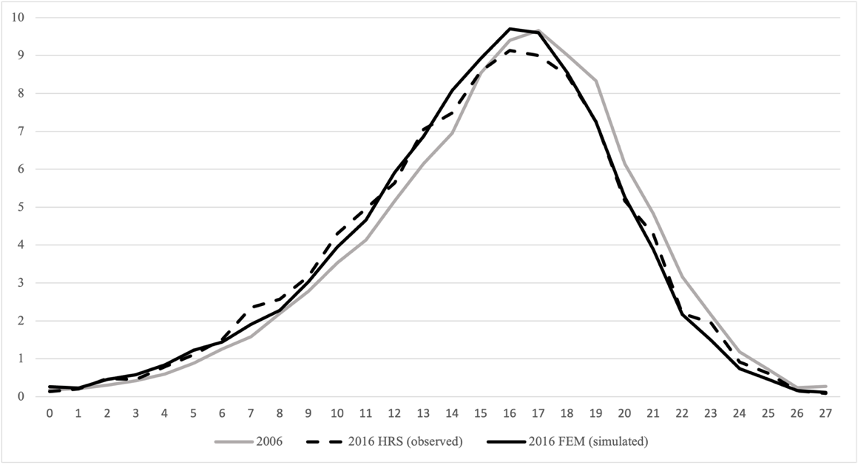
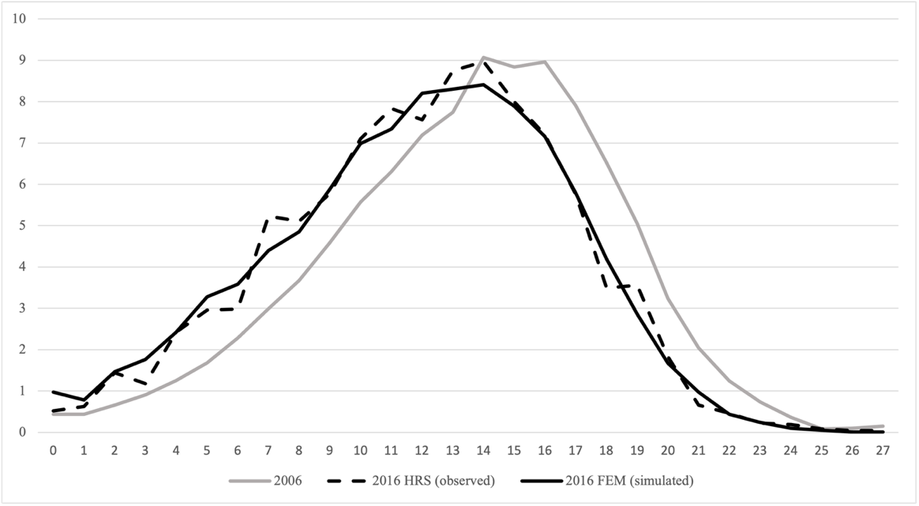
FEM simulated TICS27 distribution matches HRS observed one well, both at mean and at specific points
Figure 1. Distribution comparison between HRS and FEM, 2006 – 2016.
Panel a. Population ages 53 and above in 2006
Panel b. Population ages 70 and above in 2006
Table 2. 10-year change in mean TICS27 score, comparison between HRS and FEM
 | Ages 53+ in 2006 | Ages 70+ in 2006
HRS (observed) | -0.62 | -1.51
FEM (simulated) | -0.64 | -1.67
Notes:
Now I will present model validation results. For the population-level distribution comparison, here is shown the TICS27 simulated and observed distribution in 2016, for two different age groups. The simulated 2016 distribution is in solid line and the observed 2016 distribution is in dashed line, with the 2006 starting distribution shown in grey. In the table below, we show the 10-year change in mean TICS27 score for two different age groups. Based on these results, we concluded that the FEM simulated TICS27 distribution matches HRS observed one well, both at mean and at specific points.

Slide 9
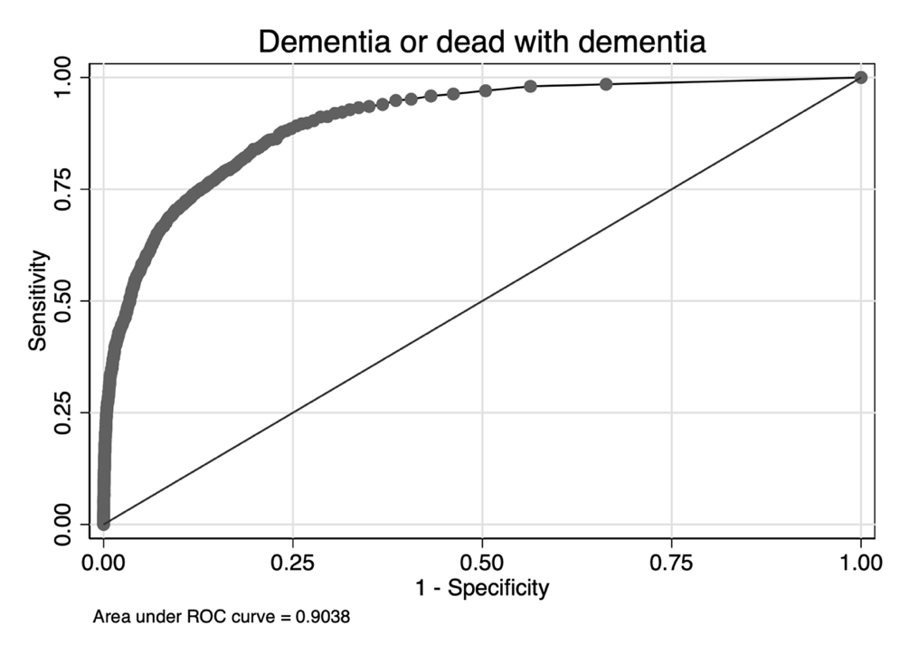
FEM TICS27 achieved AUROC of 0.9038 for predicting dementia or dead with dementia in 10 years
10-year Full follow-up sample
Figure 2. Receiver operating characteristics curve for predicting dementia or dead with dementia in 10 years.
Mild cognitive impairment sample
Table 3. Model performance for people with mild cognitive impairment in 2006.
Outcomes | AUROC
10 years, dementia or dead with dementia | 0.720
2 years, significant decline (greater than or equal to 3 points) in TICS27 | 0.722
Notes:
Now I will show the individual-level validation results. In the 10-year full follow-up sample, we used AUROC to evaluate the model’s performance for predicting dementia or dead with dementia in 10 years. FEM TICS27 achieved high accuracy with AUROC of 0.9038 for this outcome. And we look more closely at the mild cognitive impairment sample, since these are the patients that are the most heterogeneous and most difficult to project their cognitive trajectory. For this group of patients, when predicting dementia or dead with dementia in 10 years, FEM TICS27 achieved AUROC of 0.720. And when predicting significant decline in TICS27 in two years, the AUROC is 0.722. FEM TICS27’s performance in MCI patient group is also reasonable.

Slide 10
FEM TICS27 demonstrated excellent internal validity at both population and individual level outcomes.
FEM TICS27 does a good job at both the population (distribution) and individual (concordance) levels for 10-year outcomes.
Improvement over existing US-based ADOD economics evaluation models:
  Based on nationally representative survey data;
  Models all stages of cognitive decline (cognitively normal, mild cognitive impairment, dementia);
  Validated with an unbiased approach and demonstrated excellent internal validity;
  Tracks other relevant outcomes: functional limitations, physical health, medical resource utilization and costs.
Notes:
We showed that FEM TICS27 does a good job at both the population and individual levels for 10-year outcomes. It has several improvement over existing models: first, it is based on nationally representative data, which is more suitable for population-level evaluation; second, it models all stages of cognitive decline; third, it is validated with an unbiased approach and demonstrated excellent internal validity; finally, FEM also tracks other outcomes relevant to ADOD besides cognition, which could provide a more comprehensive view when conducting economic evaluation.

Slide 11
FEM TICS27 can be applied to evaluate long-term impact of ADOD treatment.
Application of FEM TICS27
  Evaluate scenarios where TICS27 is changed (e.g. by novel ADOD treatment);
  Assess impact on functional limitations, physical health, and medical utilization/expenditures.
Limitation and future development
  FEM TICS27 is based on data collected in a phone interview;
  Include genotype and biomarker variables as predictor to improve model’s performance.
Notes:
We showed that our model can predict cognitive function very well. We could apply this model for evaluation by considering the counterfactuals, where TICS27 is changed, potentially by novel treatment, and we can use this model to assess the impacts on functional limitations, physical health, and medical utilization or expenditures.
FEM TICS27 model also has its limitation. It is based on survey data that is collected in a phone interview, not requiring medical specialists, biomarkers or genetic testing. A future development is to include genotype and biomarker variables in this model, which are available from the data source HRS, and to improve the model’s performance.

Slide 12
Reference
[1] 2019 Alzheimer's disease facts and figures. Alzheimer's & Dementia. 2019; 15(3):321-87.
[2] Cummings J, Lee G, Ritter A, Sabbagh M, Zhong K. Alzheimer's disease drug development pipeline: 2019. Alzheimer's & Dementia: Translational Research & Clinical Interventions. 2019; 5:272-93.
[3] Dunn B, Stein P, Cavazzoni P. Approval of Aducanumab for Alzheimer Disease - the FDA’s Perspective. JAMA Internal Medicine. 2021.
[4] Wimo A. The End of the Beginning of the Alzheimer's Disease Nightmare: A Devil's Advocate's View. Journal of Alzheimer's disease: JAD. 2018; 64(s1):S41-S6.
[5] Lin P-J, Cohen JT, Neumann PJ. Preparing the health-care system to pay for new Alzheimer's drugs. Alzheimer's & Dementia. 2020; 16(11):1568-70.
[6] Spackman DE, Kadiyala S, Neumann PJ, Veenstra DL, Sullivan SD. Measuring Alzheimer Disease Progression with Transition Probabilities: Estimates from NACC-UDS. Current Alzheimer research. 2012; 9(9):1050-8.
[7] Kansal AR, Tafazzoli A, Ishak KJ, Krotneva S. Alzheimer's disease Archimedes condition-event simulator: Development and validation. Alzheimer's & Dementia: Translational Research & Clinical Interventions. 2018; 4:76-88.
[8] Jutkowitz E, MacLehose RF, Gaugler JE, Dowd B, Kuntz KM, Kane RL. Risk Factors Associated With Cognitive, Functional, and Behavioral Trajectories of Newly Diagnosed Dementia Patients. The Journals of Gerontology: Series A. 2017; 72(2):251-8.
[9] Herring W, Keenan A, Mauskopf J, Michael T, Wiegand F. The potential economic value of disease-modifying treatments in Alzheimer's disease: patient-level simulation of predementia symptom trajectories. Value in Health. 2017; 20(5):A12.
[10] Green C, Zhang S. Predicting the progression of Alzheimer's disease dementia: A multidomain health policy model. Alzheimer's & Dementia. 2016; 12(7):776-85.
[11] Davis M, O'Connell T, Johnson S, Cline S, Merikle E, Martenyi F, et al. Estimating Alzheimer's Disease Progression Rates from Normal Cognition Through Mild Cognitive Impairment and Stages of Dementia. Current Alzheimer Research. 2018; 15(8):777-88.
[12] Goldman DP, Leaf DE, Sullivan J, Tysinger B. The Future Elderly Model: Technical Documentation: Univeristy of Southern California; 2018.
[13] Sonnega A, Faul JD, Ofstedal MB, Langa KM, Phillips JW, Weir DR. Cohort Profile: the Health and Retirement Study (HRS). International Journal of Epidemiology. 2014; 43(2):576-85.
[14] Ofstedal MB, Fisher GG, Herzog AR. Documentation of Cognitive Functioning Measures in the Health and Retirement Study. Ann Arbor, Michigan: Institute for Social Research, University of Michigan; 2005.
[15] Crimmins EM, Kim JK, Langa KM, Weir DR. Assessment of Cognition Using Surveys and Neuropsychological Assessment: The Health and Retirement Study and the Aging, Demographics, and Memory Study. The Journals of Gerontology Series B: Psychological Sciences and Social Sciences. 2011; 66B(Suppl 1):i162-i71.
[16] Langa KM, Kabeto M, Weir D. Report on race and cognitive impairment using HRS in 2010 Alzheimer’s disease facts and figures. Retrieved July. 2010; 12:2010.
[17] Hensel Anke MCA, Steffi G. Riedel-Heller. Measuring cognitive change in older adults: reliable change indices for the Mini-Mental State Examination. Journal of Neurology, Neurosurgery & Psychiatry. 2007; 78:1298-303.
[18] Stein J. LM, Wagner M., Wolfsgruber S., Scherer M., Kohler M., Eisele M., Weyerer S., Werle J., Bickel H., Mosch E., Wiese B., Prokein J., Pentzek M., Fuchs A., Leicht H., Konig H.-H., Riedel-Heller S.G. . Assessing cognitive changes in the elderly: Reliable Change Indices for the Mini-Mental State Examination. Acta Psychiatrica Scandinavica. 2012; 126.3:208-18.
[19] Jakub P. Hlavka, Jeffrey C. Yu, Darius N. Lakdawalla. Crosswalk between the Mini-Mental State Examination and the Telephone Interview for Cognitive Status (TICS-27/30/40). University of Southern California 2021.

Slide 14
Appendix
Appendix Table 1. Marginal effect from FEM TICS27 and mortality transition model.
Variables | TICS27 Coefficient (Std. Err) | Mortality Coefficient (Std.Err)
Two-year lag TICS score | 0.0915 (0.0015)***
Four-year lag TICS score | 0.0955 (0.0017)***
Non-Hispanic Black | -0.2343 (0.0116)*** | 0.0028 (0.0023)
Hispanic | -0.1502 (0.0144)*** | -0.0094 (0.0031)**
Did not graduate high school | -0.1361 (0.0131)*** | -0.0002 (0.0022)
At least some college | 0.1967 (0.0092)*** | -0.0072 (0.0019)***
Male | -0.0884 (0.0086)*** | 0.0177 (0.0019)***
Slope of age spline before age 65 | -0.0009 (0.0013) | 0.0025 (0.0004)***
Slope of age spline ages 65-74 | -0.0173 (0.0015)*** | 0.0029 (0.0003)***
Slope of age spline ages 75 and older | -0.0353 (0.0013)***
Slope of age spline ages 75-84 |  | 0.0040 (0.0003)***
Slope of age spline ages 85 and older |  | 0.0067 (0.0004)***
Ever diagnosed with heart problems | -0.0126 (0.0108) | 0.0131 (0.0020)***
Ever diagnosed with stroke | -0.1288 (0.0165)*** | 0.0110 (0.0023)***
Ever diagnosed with cancer | 0.0008 (0.0117) | 0.0334 (0.0020)***
Ever diagnosed with hypertension | -0.0355 (0.0088)*** | 0.0097 (0.0019)***
Ever diagnosed with diabetes | -0.0693 (0.0105)*** | 0.0155 (0.0020)***
Ever diagnosed with lung disease | -0.0430 (0.0147)** | 0.0294 (0.0023)***
Heart attack in past 2 years | -0.0750 (0.0334)* | 0.0049 (0.0047)
Working for pay | 0.0943 (0.0100)***
Widowed | -0.0298 (0.0121)* | 0.0055 (0.0022)*
Ever smoked | -0.0426 (0.0083)***
Verified ADOD/MCI ever | -0.7105 (0.0155)***
Delta age | -0.1374 (0.0208)***
Lag log BMI below 30 | 0.1314 (0.0350)***
Lag log BMI above 30 | -0.0090 (0.0441)
(Cont’d)
Variable | TICS27 Coefficient (Std. Err) | Mortality Coefficient (Std. Err)
Difficulty with one IADL |  | 0.0162 (0.0028)***
Difficulty with two or more IADLs |  | 0.0483 (0.0031)***
Difficulty with one ADL |  | 0.0222 (0.0025)***
Difficulty with two ADLSs |  | 0.0342 (0.0033)***
Difficulty with three or more ADLs |  | 0.0603 (0.0028)***
Current smoker |  | 0.0187 (0.0027)***
Diagnosed with heart problems by age 50 |  | 0.0051 (0.0067)
Diagnosed with stroke by age 50 |  | -0.0107 (0.0167)
Diagnosed with cancer by age 50 |  | -0.0083 (0.0057)
Diagnosed with hypertension by age 50 |  | 0.0027 (0.0042)
Diagnosed with diabetes by age 50 |  | 0.0142 (0.0034)***
Diagnosed with lung disease by age 50 |  | -0.0278 (0.148)
Ever smoked at age 50 |  | 0.0061 (0.0022)**
Current smoker at age 50 |  | 0.0174 (0.0024)***
Ever diagnosed with congestive heart failure |  | 0.0259 (0.0028)***
Notes: *, significant at α=0.05; **, significant at α=0.01; ***, significant at α=0.001.

Slide 15
Appendix
Missingness in TICS27 due to HRS respondents using a proxy
Missing not at random: missingness of TICS27 among respondents using a proxy correlated with respondents’ cognitive functioning, depending on reason for using a proxy.
We adopted a multiple imputation strategy based on HRS’ approach for missing TICS27 among self-respondents. We used a combination of relevant demographic, health, and economic variables, as well as prior wave cognitive variables to perform the imputation using the sequential regression method.
Appendix Table 2. Proxy interview cognitive impairment rating from Health and Retirement Study, 2006 – 2016.
 | 2006 | 2008 | 2010 | 2012 | 2014 | 2016
No reason to think the respondent has any cognitive limitations | 608 | 522 | 636 | 480 | 429 | 394
The respondent may have some cognitive limitations but could probably do the interview | 92 | 90 | 91 | 81 | 73 | 58
The respondent has cognitive limitations that prevent him/her from being interviewed | 560 | 528 | 655 | 584 | 547 | 489

