Slide 1

‘Build It and They Will Come’: Exploring Spatial Microsimulation of Bicycle Demand During and After the COVID-19 Pandemic in Metro Manila
Noriel Christopher C. Tiglao, Mark Angelo Y. Tacderas and Niki Jon Y. Tolentino
National College of Public Administration and Governance (NCPAG), University of the Philippines Diliman

Slide 2
Background
Disruptions of all public transport services except shuttle services for essential workers during Enhanced Community Quarantine (lockdown) in March 2020
Government issued guidelines on the use and promotion of active transport during and after the COVID-19 Pandemic in Aug 2020
Mandates national agencies and local government units to provide bicycle network and support infrastructure including bike share system
Encourages the use of bicycles while observing minimum health standards to mitigate the spread of the virus
In Nov 2020, DOTr gets P1.3-billing funding for the installation of a bike lane network in Metro Manila, Cebu and Davao as part of its pandemic recovery plan
Budget came from the P9.5-billion funding alloted by Congress to the DOTr under the “Bayanihan to Recover As One Act”
Weak planning and data systems on urban commuting in Metro Manila; Bicycle trip-making is not given due attention

Slide 3
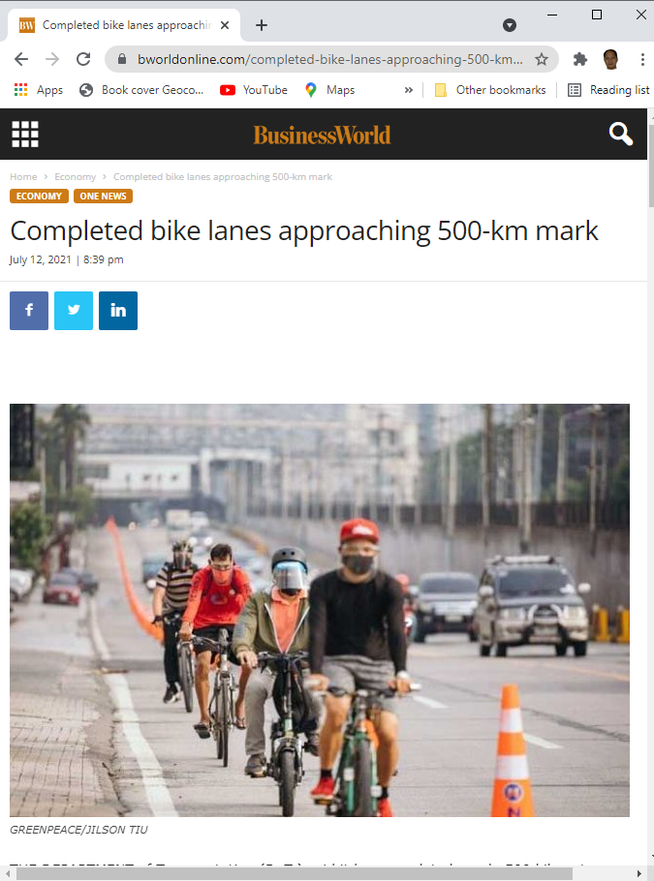
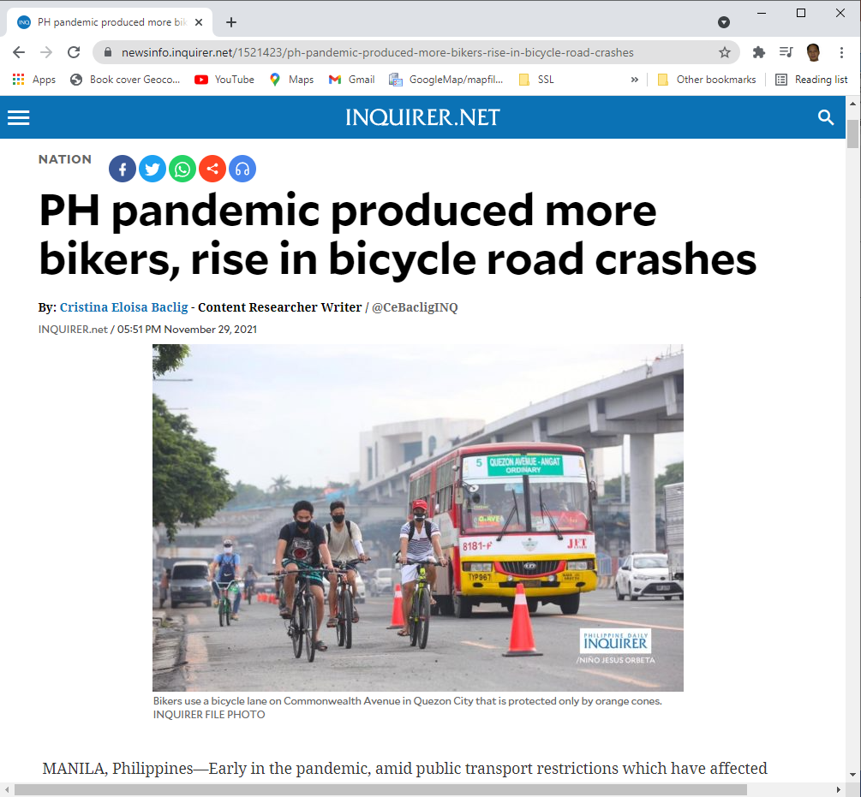
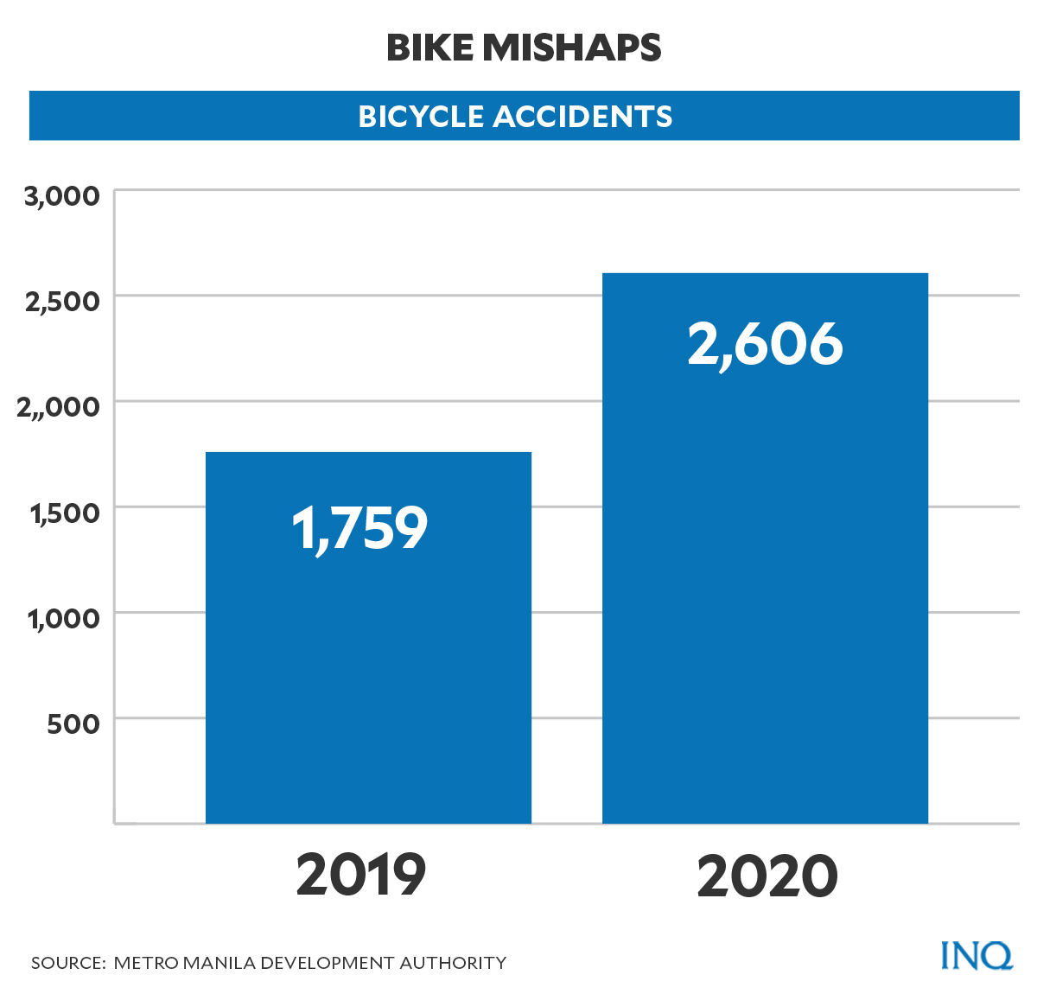
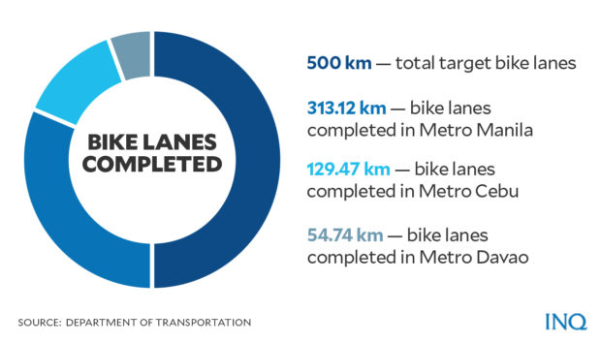

Slide 4
Bike-to-Work
In Sep 2020, DOLE conducted the survey in line with their Bike-to-Work Project, which aims to assist workers in this time of pandemic by providing bicycles as a transport option or a livelihood opportunity
The survey yielded a total of 1,119 respondents, with the majority of them coming from the National Capital Region (NCR).
Majority of the workers are in favor of having more bike lanes on paved roads, bike paths, and more secured bike parking.
Respondents said that what prevents them from using the bike is because of the following reasons: 1) they do not feel safe traveling in the road; 2) poor road conditions; 3) lack of secured bike parking or storage facility and facilities (ex. shower or change rooms).
Despite these concerns, 78% of the total respondents answered that they would still use bicycles in going to work, even if there were other accessible forms of transportation
According to the respondents, the significant health benefits of bicycling is the primary reason for them getting into bicycling (85%). This is followed by biking as a mode of transport to get to work (82%) concerning the pandemic and limited transportation.
For those who have used a bicycle for the last 6 months (813 respondents), more than half or 58% said that their bike trips were for traveling to and from work. It was also noted that those who have used a bike to work increased after the imposition of the Enhanced Community Quarantine (ECQ).
Source: Tacadao, Miraluna S. and Ivan Cassidy F. Villena (2020). “Bike to Work: A Survey on Use of Bike in Time of COVID-19 Pandemic”, ILS Discussion Paper Series 2020.

Slide 5
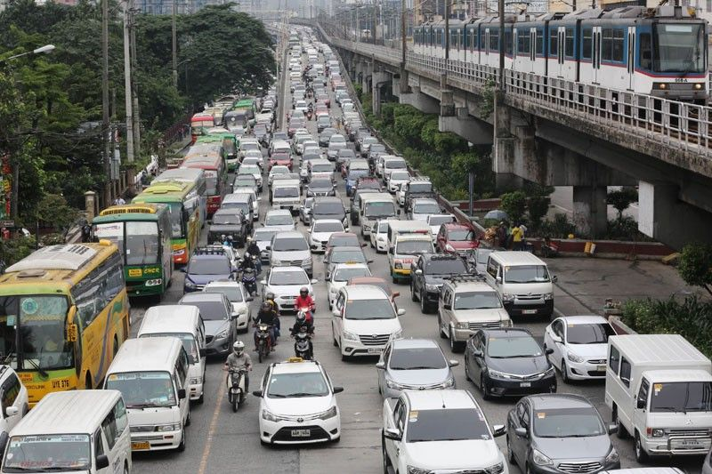
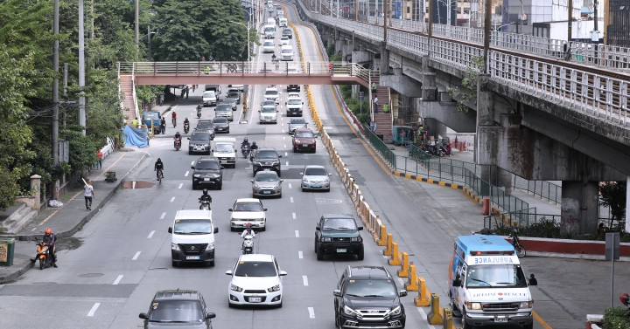
Motivation
Old Normal
Government’s priority to promote alternative, sustainable, and inclusive mobility for the New Normal
Pursue the potential of cycling for low-carbon city development
Weak institutional capacities for comprehensive transport planning and policy-making
No central authority on top of metropolitan-wide issues, which include traffic
Overlapping agency mandates
Lack of highly technical staff and over-dependence on outside consultants
Discontinuity of projects due to political cycle
Development of a spatial planning and collaborative decision framework for active and public transport for Metro Manila
2020 Community-Based Monitoring System (CBMS) Act
The law enables the Philippines’ adoption of a community-based monitoring system which generates updated disaggregated data necessary in targeting beneficiaries, conducting more comprehensive poverty analysis and needs prioritization, designing appropriate policies and interventions and monitoring impact over time.
New Normal

Slide 6
Research Objectives
Develop behavioral models in describing bicycle demand
Specify computational modules for integrating bicycle demand estimation in a spatial microsimulation model
InformalSim is a spatial microsimulation model for estimating household characteristics of informal settlements in Metro Manila
Explore spatial microsimulation approach in evaluating the future scenarios and distributional impacts of bicycle commuting in Metro Manila and other key cities
Source: Tiglao, N. C. (2002) ‘Small Area Estimation and Spatial Microsimulation of Household Characteristics in Developing Counties with Focus on Informal Settlements in Metro Manila’, Unpublished Ph.D. Dissertation, University of Tokyo.

Slide 7
Urban Modelling Considerations
McGee (1971)
Urbanization in the third world is happening at a compressed time-scale, greater magnitude and complex socio-economic conditions.
Urbanization studies in the third world should be undertaken in the broader investigation of the ‘forces influencing the society and country as a whole’
Lakshmanan (1981)
The modeler must be in touch with the policy maker and the policy maker should understand the attributes of the models
A mistake to make isomorphic transfers of urban development models from developed cities to the developing world
Mohan (1979)
Attention should be given to the particular institutional structure of the country concerned
Clear and reliable information is required in areas such as transport, housing, and the informal sector in developing countries
Tiglao and Tsutsumi (2003)
Highlighted key modeling issues that need to be tackled in the development of urban models for developing countries
Rapid growth in population is also coupled by the presence of severe economic inequality among individuals and households. The large gap between the rich and the poor is very much evident in the housing and labor sectors of the urban economy.
Need to effectively distinguish the various income and social groups. The current modeling practice of defining ‘representative households’ needs to be refined in order to capture the household structure in developing countries at a disaggregated level

Slide 8
Spatial Analysis Framework

Slide 9
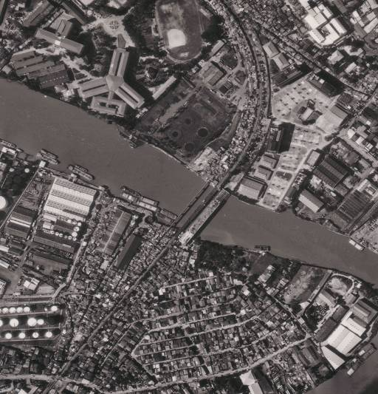
Attribute of household microdata in Spatial Microsimulation
HOUSEHOLD
Variables
Province-ID
District-ID
Barangay-ID
Household-ID
Household size
Age of hh head
Sex of hh head
Marital status of hh head
Education of hh head
(Economic activity of hh head)
(Occupation of hh head)
(Employment sector of hh head)
(Employment status of hh head)
Members [Vector]
Building type
Roof type
Wall type
State of repair
Year built
(Household income)
(Housing status)
(Housing value)
Methods
GetEconomicActivityofHead
GetOccupationofHead
GetEmploymentSectorofHead
GetEmploymentStatusofHead
GetHouseholdIncome
GetHousingStatus
GetHousingValue
...

Slide 10
Object representation of household microdata
MEMBER
HOUSEHOLD
Variables
Variables
Province-ID
Province-ID
District-ID
District-ID
Barangay-ID
Barangay-ID
Household-ID
Household-ID
Baseline
Member-ID
Household size
Characteristics
Relation to hh head
Age of hh head
Age
Sex of hh head
Sex
Marital status of hh head
Marital status
Education of hh head
Education
(Economic activity of hh head)
Unobserved
(Occupation)
(Occupation of hh head)
Characteristics
(Employment sector)
(Employment sector of hh head)
(Income)
(Employment status of hh head)
Methods
Members [Vector]
GetEconomictActivity
Building type
Computational
GetOccupation
Roof type
Objects/ Models
GetEmploymentSector
Wall type
GetIncome
State of repair
...
Year built
(Household income)
(Housing status)
(Housing value)
Methods
GetEconomicActivityofHead
Target of spatial microsimulation
GetOccupationofHead
GetEmploymentSectorofHead
GetEmploymentStatusofHead
GetHouseholdIncome
GetHousingStatus
GetHousingValue
...

Slide 11
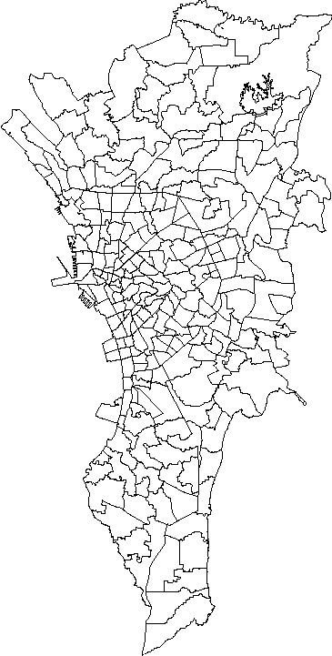
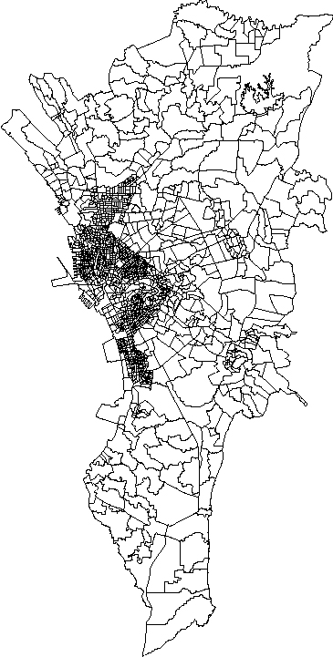
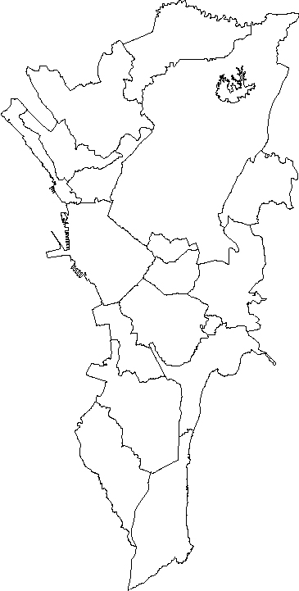
Disparate data sets, Different zoning systems
Traffic Zone
Barangay
City
Households

Slide 12
Available data sets
Zone
Zone
Data Set
Data Set
Description/ Coverage
Description/ Coverage
System
System
City
City
1997
1997
Family Income and
Family Income and
•
•
Household demographics, some
Household demographics, some
Expenditure Survey (FIES)
Expenditure Survey (FIES)
housing variables
housing variables
•
•
Detailed household incomes and
Detailed household incomes and
expenditures
expenditures
•
•
4,030 samples for Metro Manila
4,030 samples for Metro Manila
Traffic Zone
2015 MMUTIS Updating and Capacity Enhancement Project (MUCEP)
Traffic Zone
1996
1996
Metro Manila Urban
Metro Manila Urban
•
•
Selected household demographics
Selected household demographics
Transportation Integration
Transportation Integration
•
•
Member/ household income
Member/ household income
Study (MMUTIS)
Study (MMUTIS)
•
•
50,000 samples for Metro Manila
50,000 samples for Metro Manila
Barangay
2015 Census of Population and Housing
Barangay
1990
1990
Census of Population
Census of Population
•
•
Detailed household and housing
Detailed household and housing
and Housing (CPH)
and Housing (CPH)
characteristics
characteristics
•
•
No income/employment variable
No income/employment variable
•
•
Non
Non
-
-
response on housing variables
response on housing variables
•
•
All households in 1990 (1,567,665
All households in 1990 (1,567,665
households)
households)
GIS
GIS
1996
1996
MMUTIS Land Use GIS
MMUTIS Land Use GIS
•
•
Urban land use zoning map for
Urban land use zoning map for
entire Metro Manila
1997 Building Footprint Data
entire Metro Manila
1997 Building Footprint Data
•
•
Building footprints for most cities
Building footprints for most cities

Slide 13
InformalSim - Spatial Microsimulation Model for Estimating Household Characteristics
Initialize base households
using 1990 CPH data
(age, sex, marital status,
and education of household
head, household size)
Compute economic activity
Compute occupation
rate of household head
probabilities from
Occupation Choice Model
Assign occupation of
household head based
on Monte Carlo sampling
Compute employment
probabilities from
Employment Choice Model
Assign employment sector
of household head based
on Monte Carlo sampling
Compute employment
status probabilities and
assign employment status
by Monte Carlo sampling
Compute bias-adjusted
household income function
based on employment status
Estimate household income
based on characteristics
of household head
Estimate permanent
Income of household
Compute housing tenure
status probabilities and
assign housing tenure status
by Monte Carlo sampling
Compute bias-adjusted
housing value function
based on tenure status
Estimate housing tenure
and housing value
Source: Tiglao, N. C. (2002) ‘Small Area Estimation and Spatial Microsimulation of Household Characteristics in Developing Counties with Focus on Informal Settlements in Metro Manila’, Unpublished Ph.D. Dissertation, University of Tokyo.

Slide 14
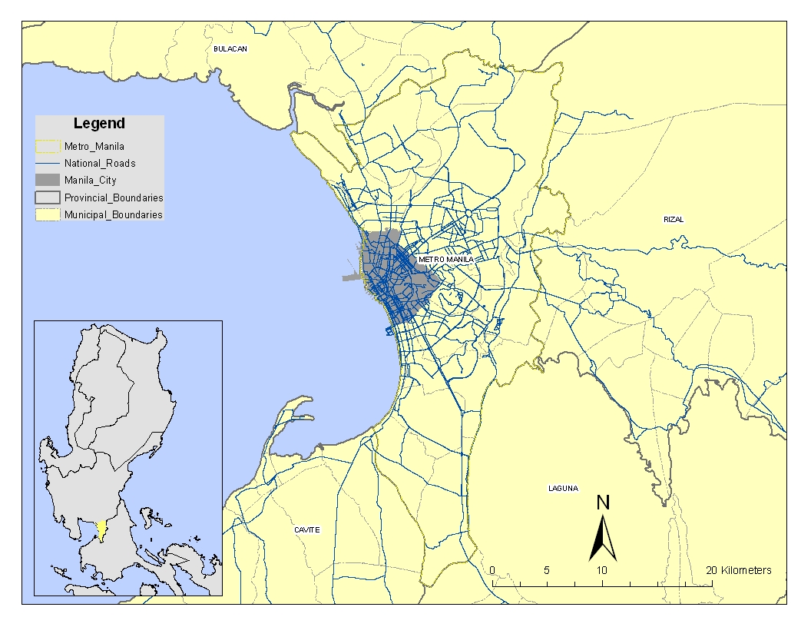
Metro Manila

Slide 15
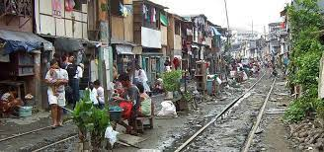
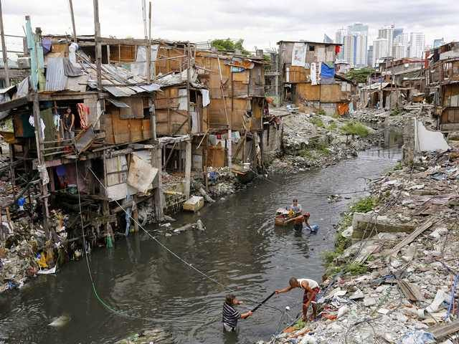
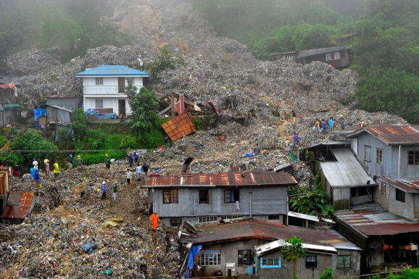
Official Census Definition
Squatter (or informal dwellers) - one who settles on the land of another without title or right or without the owner’s consent whether in urban or rural areas
Tenure Status of the Housing Unit - the housing may be:
Owned/Being Amortized - the household is the owner and has legal possession of the housing unit, or the household claims to own it. Includes also housing units which are being amortized or on mortgage;
Rented - the occupant actually pays rent either in cash or in kind;
Being occupied for free with consent of owner - the household occupies the housing unit with owner's permission and without paying any rent in cash or in kind to the owner, tenant/lessee or subtenant/sublessee. These are usually the households of farm tenants or lessees who occupy rent-free houses belonging to the owner of the land they farm; also those employees given free housing as part of fringe benefits but must vacate the housing unit upon separation from work; and
Being occupied for free without consent of owner - the household occupies the housing unit without the consent or knowledge of the owner. Examples are squatters who occupy public and private buildings.
Source: https://psa.gov.ph/sites/default/files/Annex-BR-11-2003-1.pdf

Slide 16
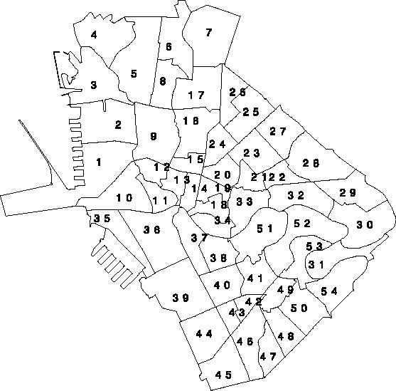
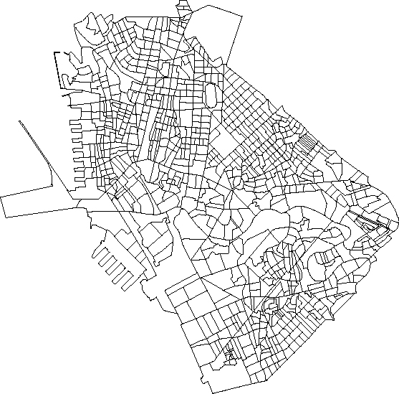
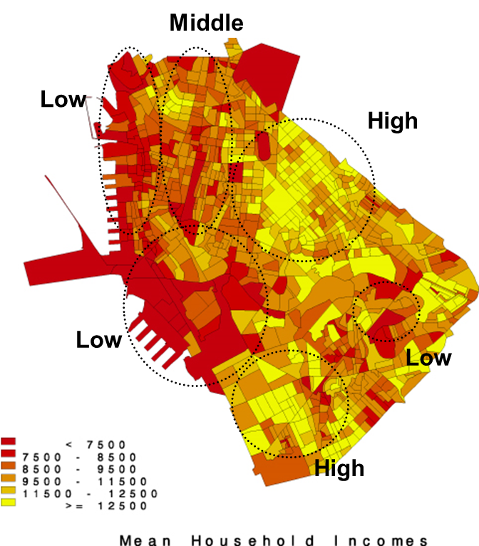
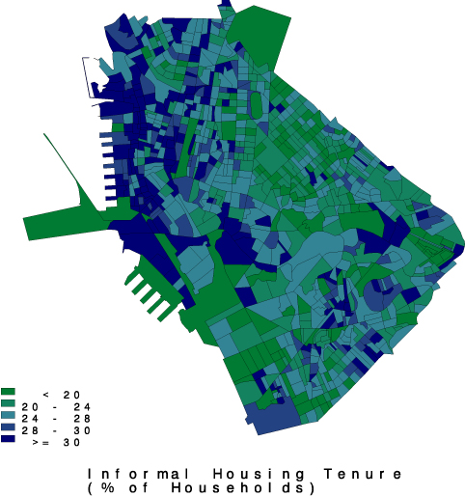
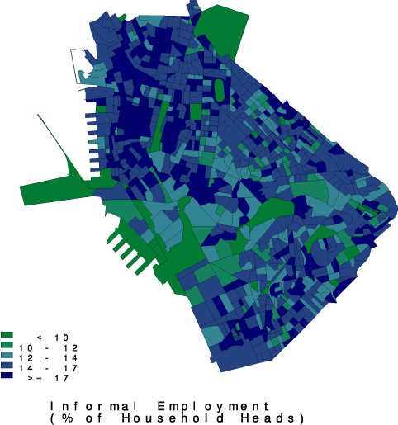
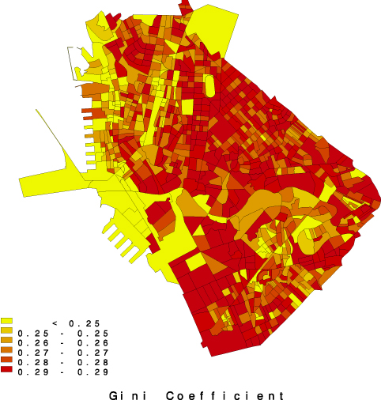
Microsimulation Results
Traffic Zones
Barangay Zones
Manila City (54 traffic zones, 900 barangays, 1.59 million pop. in 1990, 308,874 households)

Slide 17
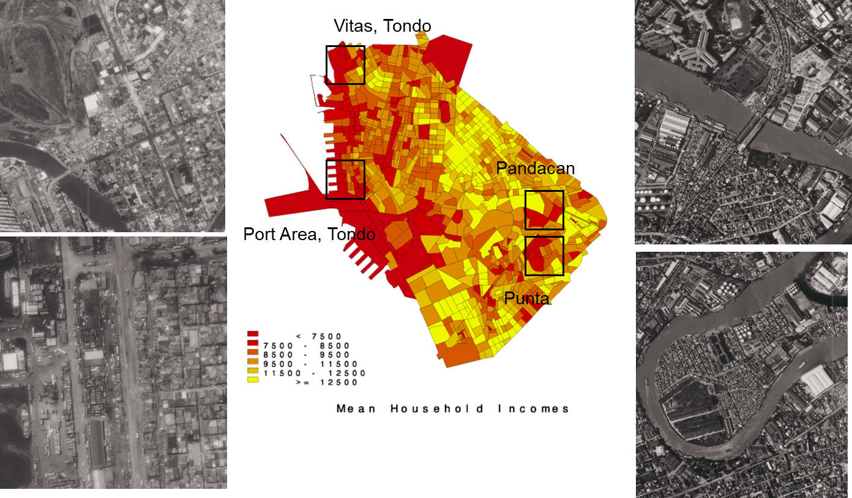
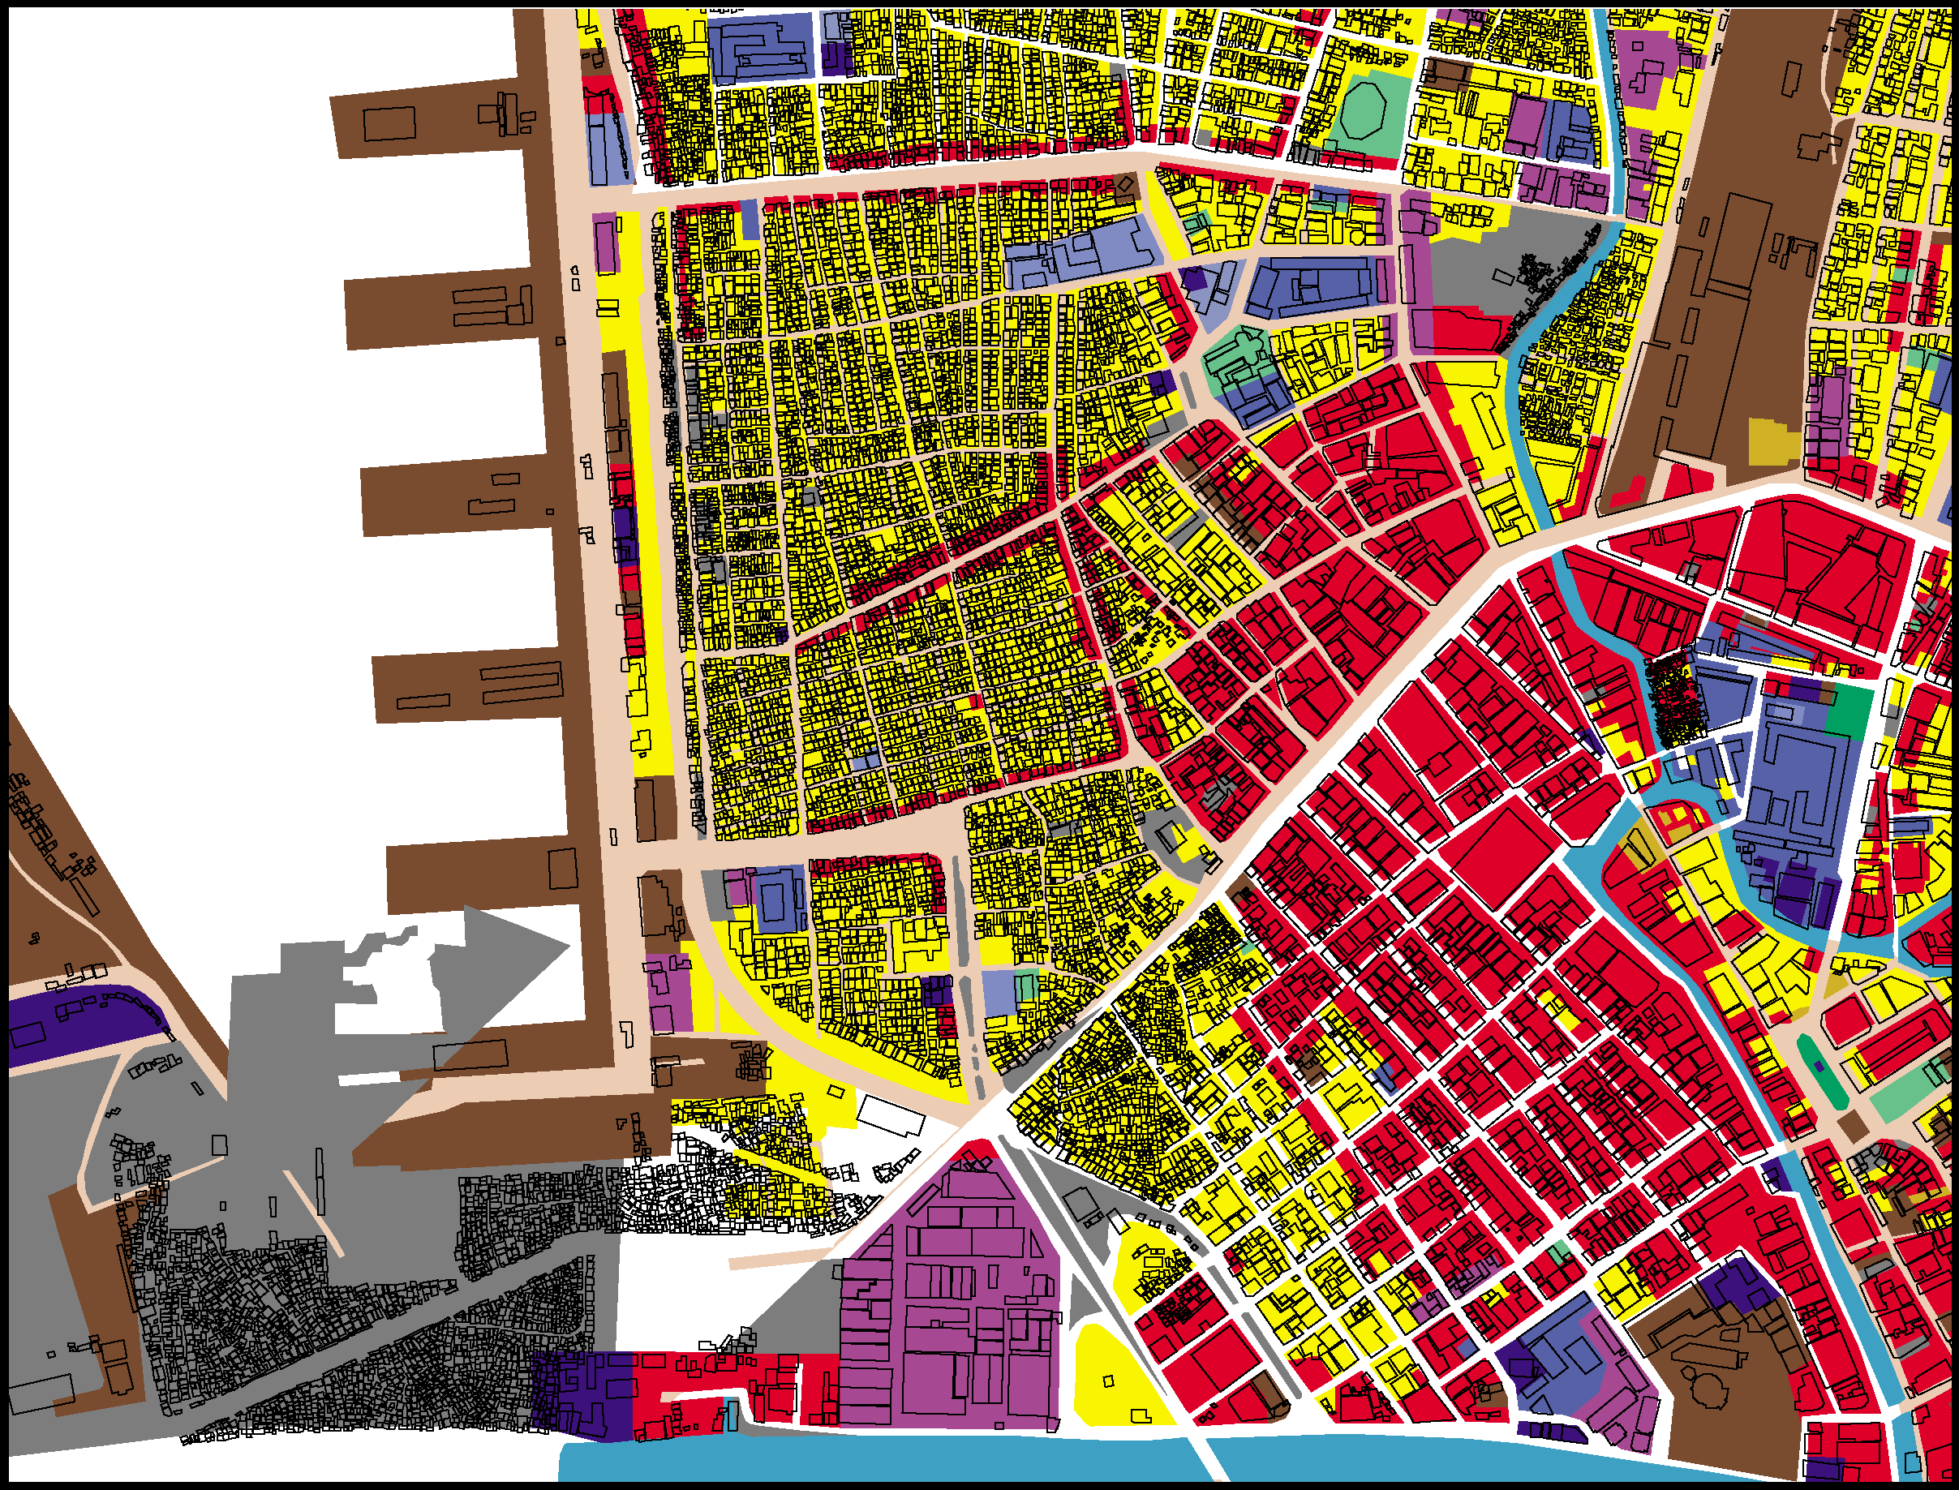
Model Validation
Use of small area income estimation to validate spatial microsimulation income results
Ground truth data
Average dwelling unit size from building footprint data used as covariate for mean household income

Slide 18
Spatial Microsimulation Modules (1/3)
Economic Activity Module. Economic activity rates are computed as conditional probability of an individual being economically active given age, sex and location using the 1996 MMUTIS data. The estimated rates for each zone are applied to all households in the barangays that are located with each particular zone. The assignment of whether a particular household head or member is economically active or not is determined using Monte Carlo sampling. The process involves drawings of random numbers and comparing it with the conditional probabilities.
Occupational Choice Module. The occupational choice is formulated as a multinomial logit model with the actual occupation type as observed choices of the household head. The model includes education level and age (proxy for experience) as explanatory variables. Separate models are estimated for male and female household heads. There are seven occupation groups, namely: Professional, Administrative, Clerical, Sales, Services, Agriculture, and Production.
Employment Sector Choice Module. The employment sector choice is also formulated as a multinomial logit model. It includes education level and age as explanatory variables for observed employment sector. Similarly, separate models are estimated for male and female household heads. There are six employment sectors, namely: Agriculture, Manufacturing, Wholesale & Retail, Transportation, Financing, and Community Services.
Employment Status Module. The employment status model determines whether the household head works in the formal or informal sector. The household head works in the formal sector when he/she is employed by a firm, whether government or in the private sector. On the other hand, a household head who is self-employed or works for another household is also considered to be in the informal sector. Employment status is formulated as a probit model with the following explanatory variables: sex, age, age squared, marital status, education level, household size, occupation type, and employment sector. This model provides a reduced-form probit equation in a three-stage model of household income with selectivity on employment status.

Slide 19
Spatial Microsimulation Modules (2/3)
Household Income Module. The household income model estimates the household income for a household head and taking into account the employment status of that particular head. Rather than simply calibrating regression models by ordinary least squares (OLS), the household income models incorporate bias corrections for selectivity. Separate household income functions were estimated for the formal and informal sector. Moreover, correction terms were found to be statistically different from zero.
Permanent Income Module. The permanent income model estimates the permanent income of the household given human and non-human wealth characteristics of the household. The explanatory variables include age, age squared, education level, education level squared, household type, and household income.
Housing Tenure Module. The housing tenure sub-model determines whether the household belongs to the formal or informal housing. Formal tenure consists of owners, renters, and those who own land while informal tenure refers to those who may own house but does not own the land. Housing tenure status is formulated as a probit model with the following explanatory variables: education level of household head, household size, and permanent income. This model provides a reduced-form probit equation in a three-stage model of housing value with selectivity on housing tenure status.
Housing Value Module. The housing value model estimates the imputed value of housing for each household which incorporates bias corrections for selectivity on housing tenure status. Separate housing value functions were estimated for the formal and informal housing tenures. Correction terms were found to be statistically different from zero.
Inequality Measures Module. The module takes the full array of incomes in the household microdata and generates three measures of inequality, namely: Gini coefficient, Theil index, and Coefficient of Variation (CV). It is possible to incorporate other measures on inequality based on human capital.
Mapping and Visualization Module. The mapping and visualization module provides the graphical interface for the internal data in the modeling system.

Slide 20
Spatial Microsimulation Modules (3/3)
Residential Location Choice Module
Pursued a sampling-of-alternatives approach in estimating a logit model of residential location choice
A total of 5,000 samples were randomly selected from the household microdata with formal and informal tenure, respectively. Then, the bid functions were used to generate estimates of the consumer surplus of each alternative. A total of 10 alternative residential zones, including the observed choice, were sampled
Bid prices are considered to be the successful bids that households make that match the market price for the alternative. The bid functions are a function of dwelling attributes and zone of neighborhood attributes
Employment Location Choice Module [under development]
The aim of the module is to assign the workplace zone for each of the household head in the microdata. Once the workplace zones for each household head has been assigned, a sampling-of-alternatives approach can be done in order to generate a set of alternatives for which the employment location choice model can be estimated.
The employment location choice model may be specified as a multinomial logit model that includes the accessibility variables (e.g. access to population areas, distance or travel time to the CBD), agglomeration variables in the sense that similar employment tend to cluster in a zone (e.g. percent of employment or occupation type), and land use characteristics.
Bicycle Demand Module [under development]

Slide 21
Bicycle Demand Estimation Module
Bicycle Ownership Model (Handy, et al., 2010)
Dependent variable: Bicycle ownership and regular use
Demographic predictors: Age, gender, education, household size, income, car ownership, house ownership
Other predictors: Individual attitudes/preferences, physical/environmental factors, social factors
Bicycle Use Model [on-going]
Bicycle Route Choice Model [on-going]

Slide 22
Initial Bike Ownership Model (1)
Data set - 177,489 individual household members, 16 variables; 51,330 households, 41 variables; 266,078 total number of trips, 44 variables
Model specification
Model estimates
Variable | Variable Name | Variable Type and Description
house ownership type | House_ownership | Categorical (1 = owned, 2 = rented)
Income of household head | HH_Head_Income | Continuous. This is the median of the ranges per income category used in the MUCEP model. This variable was taken from the household member database.
Household size | hhsize | Discrete count. This is the number of household members for each household.

Slide 23
Initial Bike Ownership Model (2)
Odds Ratio
Interpretations
The resulting coefficient of a categorical variable is the difference between the levels compared to a reference level, “house_ownership2” pertains to renting a house compared to owning a house.
In this case, the coefficient means that renting a house, as opposed to owning a house, changes the log odds of the household owning a bike by -0.02129. In terms of the odds ratio, because the odds is less than 1, renting a house has a lower odds of bike ownership. This means from the households in the MUCEP sample, a house owner was more likely to own a bike than a renter.
As household head income increases, the log odds of the household owning a bike decreases by 4.315 x 10-6. In terms of the odds ratio, as the household head’s income increases, the odds of owning a bike increases by a factor of 0.99. Household heads with larger income prefer to own cars (greater disposable income).
Lastly, as household size increases, the odds of the household owning a bike increases by a factor of 1.18. Larger households seem to have increased odds of owning a bike.
Model Component | OR | Lower 95% CI | Upper 95% CI
Intercept | 0.074536 | 3 0.06684415 | 0.08310781
Renting versus owning a house | 0.8082331 | 0.72611686 | 0.89761075
Household head income | 0.9999957 | 0.99999141 | 0.99999948
Household Size | 1.1809592 | 1.15062850 | 1.21193376

Slide 24
Concluding Remarks
Spatial Microsimulation methods can overcome data problems in ‘data-poor’ environments
Resulting microdata enables analyst to make full use of existing but disparate data sets and produce reliable and spatially-disaggregate information
Further research work should be pursued in developing the methods as practical policy tools for mobility and sustainable commuting studies (Lovelace, et al., 2014; Philips, et al., 2016; Philips, et al., 2022)

Slide 25
References
Ballas, D. and G. Clarke (2000) ‘GIS and microsimulation for local labour market analysis’, Computers, Environment and Urban Systems, 24, 305-330.
Ballas, D. and G. Clarke (2001) ‘The local implications of major job transformation in the city: a spatial microsimulation approach’, Geographical Analysis, 33(4), 291-311.
Clarke, M. (1996) Microsimulation for Urban and Regional Policy Analysis, Pion Ltd., London.
Clarke, M. and E. Holm (1987) ‘Microsimulation methods in spatial analysis and planning’, Geografiska Annaler B, 69(2), 145-164.
Handy, S. L., Xing, Y., & Buehler, T. J. (2010). Factors associated with bicycle ownership and use: A study of six small U.S. cities. Transportation, 37(6), 967-985. https://doi.org/10.1007/s11116-010-9269-x
Lovelace, R., Ballas, D., & Watson, M. (2014). A spatial microsimulation approach for the analysis of commuter patterns: From individual to regional levels. Journal of Transport Geography, 34, 282-296. https://doi.org/10.1016/j.jtrangeo.2013.07.008
McGee, T. G. (1971) The Urbanization process in the third world: explorations in search of a theory, G. Bell and Sons Ltd., London.
Mitra, R., Khachatryan, A., & Hess, P. M. (2021). Do new urban and suburban cycling facilities encourage more bicycling? Transportation Research Part D: Transport and Environment, 97, 102915. https://doi.org/10.1016/j.trd.2021.102915
Mohan, R. (1979) Urban economic and planning models: assessing the potential for cities in developing countries, John Hopkins University Press, The World Bank.
Orcutt G (1957) ‘A new type of socio-economic system’, Review of Economics and Statistics, 39(2), 116-123.
Philips, I., Clarke, G., & Watling, D. (2016). A fine grained hybrid spatial Microsimulation technique for generating detailed synthetic individuals from multiple data sources: An application to walking and cycling. International Journal of Microsimulation, 10(1), 167-200. https://doi.org/10.34196/ijm.00153
Philips, I., Anable, J., & Chatterton, T. (2022). E-bikes and their capability to reduce car CO2 emissions. Transport Policy, 116, 11-23. https://doi.org/10.1016/j.tranpol.2021.11.019
Tiglao, N. C. (2002) ‘Small area estimation and spatial microsimulation of household characteristics in developing counties with focus on informal settlements in metro manila’, Unpublished Ph.D. Dissertation, University of Tokyo.
Tiglao, N.C. and M. Tsutsumi (2003a) ‘Towards the development of empirical urban development models for large metropolitan regions in developing countries’, Selected Proceedings of the 9th World Conference on Transport Research, July 22-27, 2001, Seoul, Korea, edited by Change-Ho Park, et. al., CD-ROM, ISBN: 0-08-044274-9.
Tiglao, N.C. (2006) ‘Improving social policy through spatial information: application of small area estimation and spatial microsimulation methods in geographical targeting’, 69-84, in Jos P. van Leeuwen and Harry J.P. Timmermans (eds.) Progress in Design & Decision Support Systems in Architecture and Urban Planning, ISBN-10: 90-386-1756-9/ ISBN-13: 978-386-1756-5.

Slide 26
Thank you!
Noriel Christopher C. Tiglao, nctiglao@up.edu.ph

