Slide 1
How to identify consumers with high environmental awareness on a precise regional basis
Innovative segmentation using microgeography:

Slide 2
Content
Relevance and research question
Theory: Small Area Estimation
Survey: CASA Monitor
CASA Dataset
MeThod & Analysis
Conclusion

Slide 3


Relevance & Research Question

Slide 4
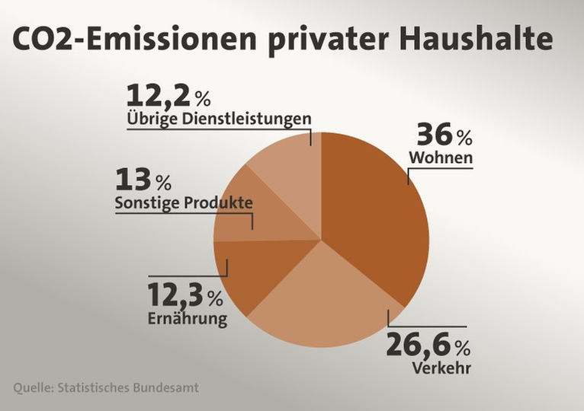
Relevance: The need to know more about sustainable people
Climate change is one of the most important issues of our time
17% of CO² emissions in Germany are caused by private households (tagesschau.de)
36% of private households’ emissions are due to living (e. g. heating)
To know more about how people live helps to identify suitable policy measures
CO2-Emissions of private households
Other services
Living
Other products
Nutrition
Verkehr

Slide 5

Research questions: finding out WHO is prone to sustainability
Who are the people prone to a sustainable lifestyle?
How can they be described socio-economically?
How do they live?
Where do they live?
All these questions can be answered by a Segmentation combined with Small Area Estimations

Slide 6

Theory: Small Area Estimation

Slide 7

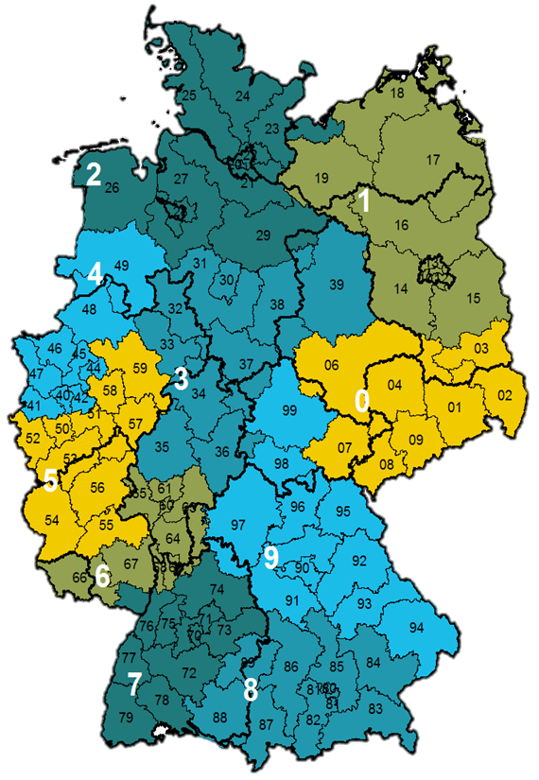
Small Area Estimation
APPLICATION
Estimation of small-scale data in regions where only very few or no (survey) data are available.
PRINCIPLE
Indirect estimation procedures using additional auxiliary information, e.g.:
Values from neighboring/superordinate levels
Values from previous surveys
Prerequisite: Data are hierarchically structured!
ADVANTAGES
Reliable results despite low/missing case numbers
Applicable to almost any subject area
Estimation down to the individual address and all higher levels

Slide 8
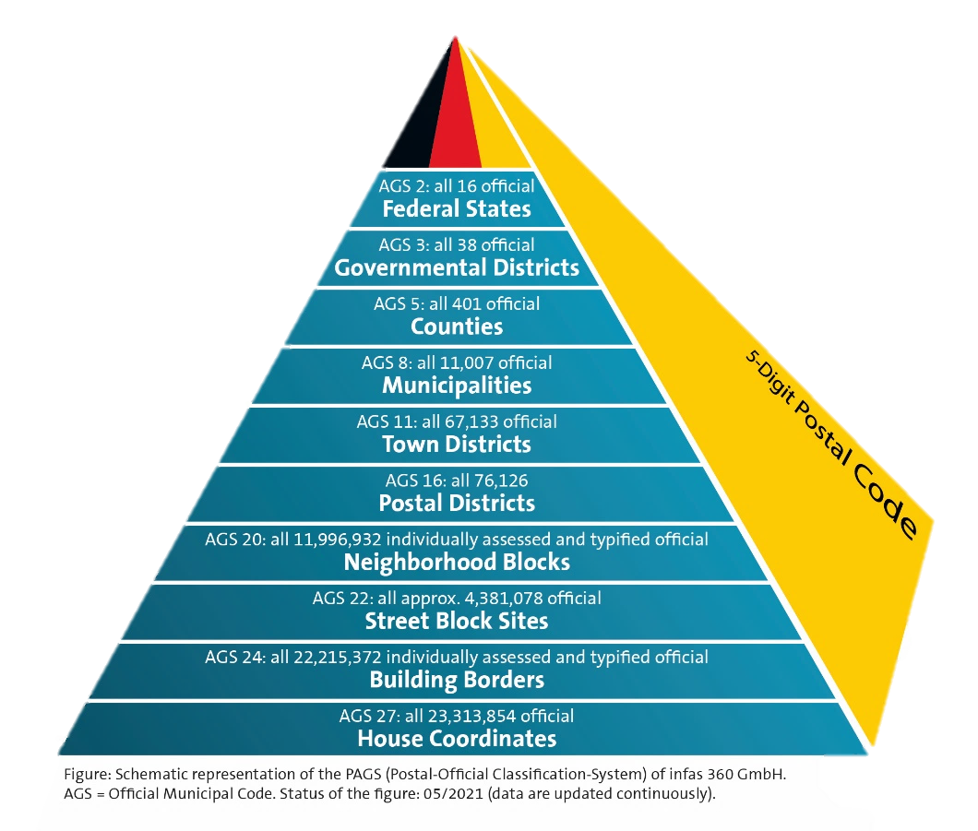
Geocoding and the postal-official classification system (PAGS)
PAGS is an overlap-free spatial planning system based on official structures in Germany
PAGS is standardized, highly precise.
Any specific structure can be integrated
By enriching the addresses with PAGS keys (geocoding), Small Area Estimation can be used in classical statistical programs (e.g. R, SAS, STATA).
PAGS enables spatial aggregations

Slide 9

Survey: CASA MONITOR

Slide 10




The idea: Innovative segmentation using multiple data sources
A survey allows for topic-specific research questions
Microgeographic data are combined with answers from the survey
Multidimensional segments are built and localized - up to address-level
Survey
+
Geodata
Market data
Segment 1
Segment 2
Segment 3
local determination of segments

Slide 11


Survey of over 10,000 people on sustainability
The CASA Monitor
(Online Survey)
Data from survey
(Sample respondent)
Survey method:
Sample size:
Survey duration:
Survey period:
Service provider:
Quotes:
Special feature:
Online access panel
10,303
Approx. 15 min.
Summer 2019
Panel: respondi (ISO 26262 certified)
Age, gender and postcode
Voluntary indication
of address
Age:
Gender Respondent(s):
Household size:
Age of children:
HH income:
Need to buy
sustainable products:
Turn off technical devices:
Willingness not to use
a car for short journeys:
38 years
Female
4 pers.
7 and 10
3,900 € (net)
Very high
Often
High
+ more questions
=
Sustainability sum score

Slide 12

CASA DATASET

Slide 13
The infas 360 database: CASa
CASA contains microgeographic information on inhabitants, households and buildings on different spatial levels nationwide
Geodata
Official data
Open data
Private company data
municipality and county level
address level
address level

Slide 14
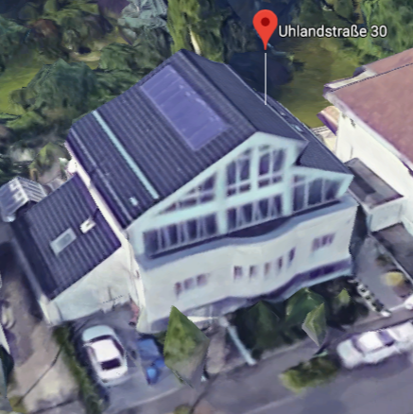
Our database contains information on all 23 million addresses
Year of construction
Living space
Building type
Building use
Garden size
Heating type
Roof orientation
Residential area
Public transport index
Households/Inhabitants
HH with children
Infrastructure
Ø Age structure
Distance to the closest supermarket
Ø Income
…and many more

Slide 15

Method & Analysis

Slide 16
Method: cluster analysis
Building characteristics
Infrastructure
Socio-demography of living environment
Attitudes towards sustainability (sum score)
Survey data
Variables from the
CASA dataset
2 clusters with tendency towards sustainability
n=8.429

Slide 17
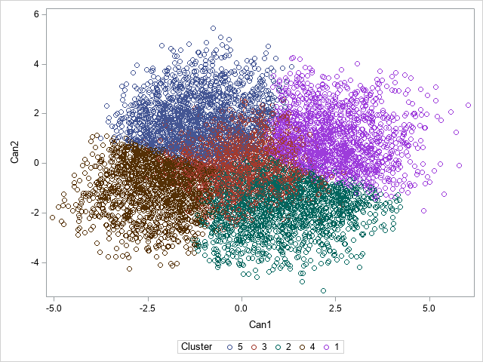
Quality of clusters
Determination of the number of clusters: With 5 clusters R² = 0.43 (relatively high)
Descriptive analyses of different amount of clusters show clear separation for 5 clusters
Highly significant variables
Validation of the results by discriminant analysis: Testing the model‘s performance results in a hit ratio of 80%

Slide 18
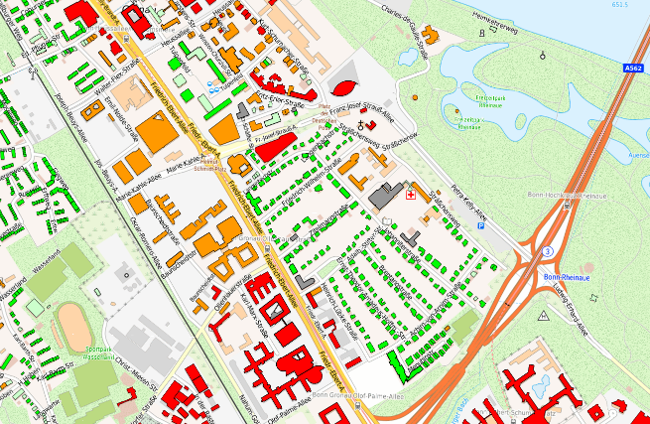


Method: Discriminant analysis
Cluster 1
Cluster 2
Cluster 3
Cluster 4
Cluster 5
n = 8.429 respondents
Which variables separate the groups from each other? (e.g. building characteristics, infrastructure, etc.)
Transfer to unknown cases on address level
Cluster 3
Cluster 5
N = 41 Million households

Slide 19

Results & Conclusion

Slide 20









Description of 2 sustainability types
Sustainability type 3
Sustainability type 5
Microgeography
Microgeography
Rural communities and smaller middle towns
Single family home with solar system
Married couples with children
Multi-party house, old building
Singles
Big city
Sociodemographics
Sociodemographics
Ø 51 years
Ø 46 years
Income 2.500 – 3.500€
Income 1.500 – 2.500€
> Ø Students & Interns

Slide 21

Segmentations based on survey data AND Microgeography offer many advantages.
Comprehensive description of clusters
High separability of clusters
Can be updated
Can be used in a variety of ways for science, marketing & sales due to transfer to the overall population
  Targeted policy measures
  Location and sales territory planning
  Transfer to customer relationship management
  and much more.

Slide 22

Limitations
Microgeographic analyses are only possible if address data are available
Values and attitudes are time sensitive and can change rapidly
Results are estimates, e.g. clusters‘ hit ratio is „only“ 80%
Survey data only represents online population
  → „Blended calibration“

Slide 23


Contact
Erika Ritz
Dep. Head
Data & Analytics
Tel. 0228/74887-371
E-Mail e.ritz@infas360.de
infas 360 GmbH
Ollenhauerstraße 1
53113 Bonn
www.infas360.de
Franziska Kern
Consultant
Data Science
Tel. 0228/74887-384
E-Mail f.kern@infas360.de
infas 360 GmbH
Ollenhauerstraße 1
53113 Bonn
www.infas360.de

