Slide 1




Distributional Impact of Carbon taxes and mitigation options in Five EU countries
Prepared by Jules Linden, Cathal O’Donoghue, Denisa M. Sologon
3rd December 2021
IMA 2021 World Congress
Research Funded by
Fond National de la Recherche, Aide au formation recherche (AFR), Luxembourg

Slide 2
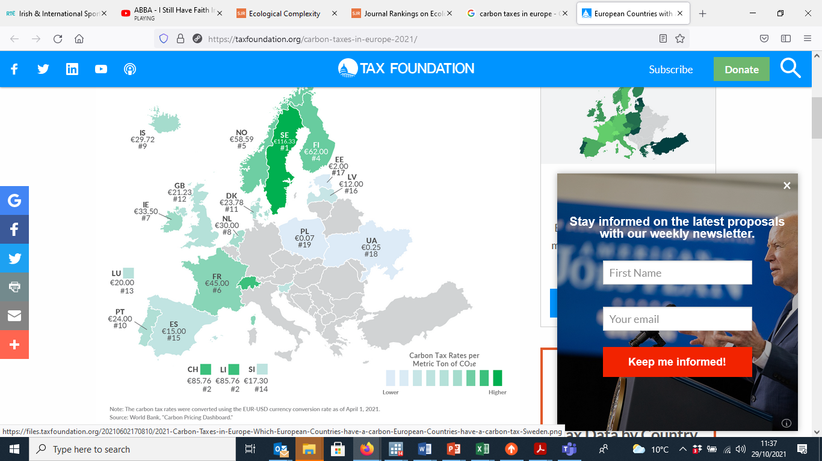
Context: Carbon Tax
European Commission’s Fit for 55 package extends carbon pricing to transportation and residential sector
Carbon tax is a popular tool with governments and economists
Efficient, easy to administer, cheap to collect and difficult to avoid ( Metcalf, 2019)
Advantage of revenue recycling
However they can be unpopular with the population due to distributional issues resulting from taxes on necessities, e.g. home heating and transportation
https://taxfoundation.org/carbon-taxes-in-europe-2021/
Notes:
Goulder, L. H. (1995). Environmental taxation and the double dividend: A reader’s guide. Int Tax Public Finan, 2, 157–183. https://doi.org/10.1007/BF00877495

Slide 3
Purpose
Understand the distributional impact to better compensate the losers
We will compare the distributional impact of a common €15/TCO2 tax across five countries and explore different revenue recycling options
Hungary
Portugal
Ireland
Finland
Luxembourg

Slide 4
Literature Review
Microsimulation studies
focus on one country (Berry (2019) in France; O’Donoghue (1997), O‘Malley et al (2020) in Ireland; Andersen and Etkinson (2020) for Sweden; Rausch et al (2011) in the US ; Creedy (2001) in Australia; Büchs (2021) in the UK. , Edenhoffer et al (2021) in Germany
Generally find regressive impacts of Carbon taxes
Cross-country studies
Frequently use macroeconomic models (Ekins et al, 2011; Barker and Köhler, 1998; Leipprand et al, 2007; Sager et al, 2019)
Few microsimulation studies – no mitigation strategy or only simple per flat rate transfer because no data on income source or tax payments (Feindt et al, 2021; Flues and Thomas, 2015)
Revenue recycling option/Mitigation Strategies
Double dividend: reduction of distortionary taxation and improving labour market (Nordhaus, 1993; Bovenberg and Goulder, 1996; Klenert et al 2018; Callan et al, 2009)
Redistribution: Universal basic incomes (Berry, 2019), fuel subsidies (Farrell, 2017), increase in social transfers (O’Malley, 2020)
Socioeconomic characteristics
play an important role in determining the carbon tax incidence (Farrell, 2017; Ekins et al, 2011)
Notes:
Goulder, L. H. (1995). Environmental taxation and the double dividend: A reader’s guide. Int Tax Public Finan, 2, 157–183. https://doi.org/10.1007/BF00877495
Expost evaluations (Andersson 2019 and Elbaum 2021

Slide 5
Method: Microsimulation model and Data
Data
EU-SILC
HBS
Input-Output Model
Step 1: Euromod: EU-SILC
Total benefits, taxes and disposable income
Step 2: Input-Output model
CO2 emissions – Compute direct and Indirect emissions
Step 3: Linear Expenditure System: Household Bugdet Survey
Budget elasticities and price elasticities (Cornwell and Creedy, 1995)
Step 4: Imputation of Co2 emissions in Euromod data
per equivalized disposable income decile and household size
Step 5: Simulation of revenue neutral mitigation strategies
Euromod
Consumption Model
Model
- Disposable Income
- Taxes and Benefits
- GHG emission change
- Carbon tax payments
Output
Spatial
Euromod data with Carbon tax payments
Imputation
Mitigation Strategies
Net Impact of Carbon tax
Notes:
Stone, R. (1954). Linear Expenditure Systems and Demand Analysis: An Application to the Pattern of British Demand. The Economic Journal, 64(255), 511. https://doi.org/10.2307/2227743
Creedy, J. (1998). Measuring the welfare effects of price changes: A convenient parametric approach. AUSTRALIAN ECONOMIC PAPERS, 16.

Slide 6
Carbon Tax incidence

Slide 7
Distribution of Fuel Expenditure
Home fuel is a necessity
Necessities are relatively more important for poor people
Transport luxury good
Richer people spend more on transportation fuels
Expenditure on Home fuels is larger
Notes:
Transport fuel - > distribution of car ownership, car ownership is a luxary
Countries ranked by median household income

Slide 8
Distribution of Carbon Tax
Carbon Tax burden largest at the bottom of the distribution
More carbon intensive consumption baskets
Higher costs in Hungary and Ireland
Portugal relatively less polluting consumption basket

Slide 9
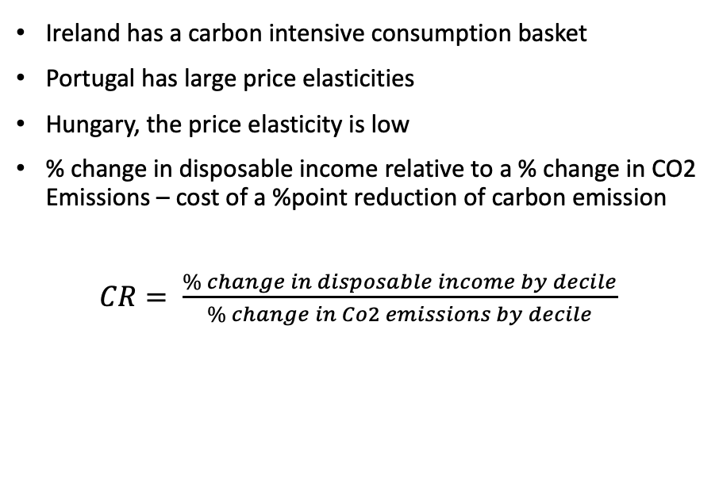
Carbon Emission Reductions
Notes:
Ireland consumes more carbon intensive home fuels

Slide 10
Mitigation Options
General Tax reduction
Payroll reduction
In-work benefit
Universal Basic Income

Slide 11
Impact of Carbon Tax – Reduce General Taxation
Overall tax reduction – equivalent to no mitigation measure, with revenue absorbed into general taxation
Return revenues under the form of tax cut
Overcompensates top earners
Global
System
Notes:
Offsetting other fiscal revenues – environmental fiscal reform

Slide 12
Impact of Mitigation Measures – Reduce Distortions
Double dividend: Payroll reduction
Reduces labour market distortions, affect labour demand
However net gain at the top, where most employment is
Similar pattern across countries
Global
System
Notes:
Offsetting other fiscal revenues – environmental fiscal reform

Slide 13
Impact of Mitigation Measures –Compensation and redistribution
In-Work Benefit
Support bottom and middle deciles
But, does nothing for non-workers
Universal Basic Income
Overcompensates bottom deciles
Due to Per Capita payment
Global
System

Slide 14
Impact on Inequality
Overall tax and payroll reduction increase inequality
In-Work Benefit and UBI reduce Gini Coefficients
In-Work Benefits exclude the non-earners, but transfers larger amounts to low earners
Global
System

Slide 15
Conclusion
Distributional Impact: Differences across countries
Difference in budget shares of fuel expenditures across countries
Differences in price elasticities
Mitigation: No one size fits all
Hard to achieve both reductions in distortions and to protect losers
Mitigation strategies differ in effect across countries, depending on population structure along the income distribution
Climate Justice challenges of a common EU carbon tax
Not only between EU citizens within countries
But between EU countries
Research necessary to find country specific solutions!

Slide 16



Thank you Jules.Linden@liser.lu Cathal.odonoghue@nuigalway.ie Denisa.Sologon@liser.lu

