Slide 1




A spatial microsimulation model for population health and health policy in Aotearoa New Zealand
IMA 8th World Congress (online), December 2021
Dr Jesse Wiki
Assoc. Professor Daniel Exeter
Epidemiology and Biostatistics
School of Population Health
Faculty of Medical and Health Sciences | Mātauranga Hauora
University of Auckland | Waipapa Taumata Rau

Slide 2

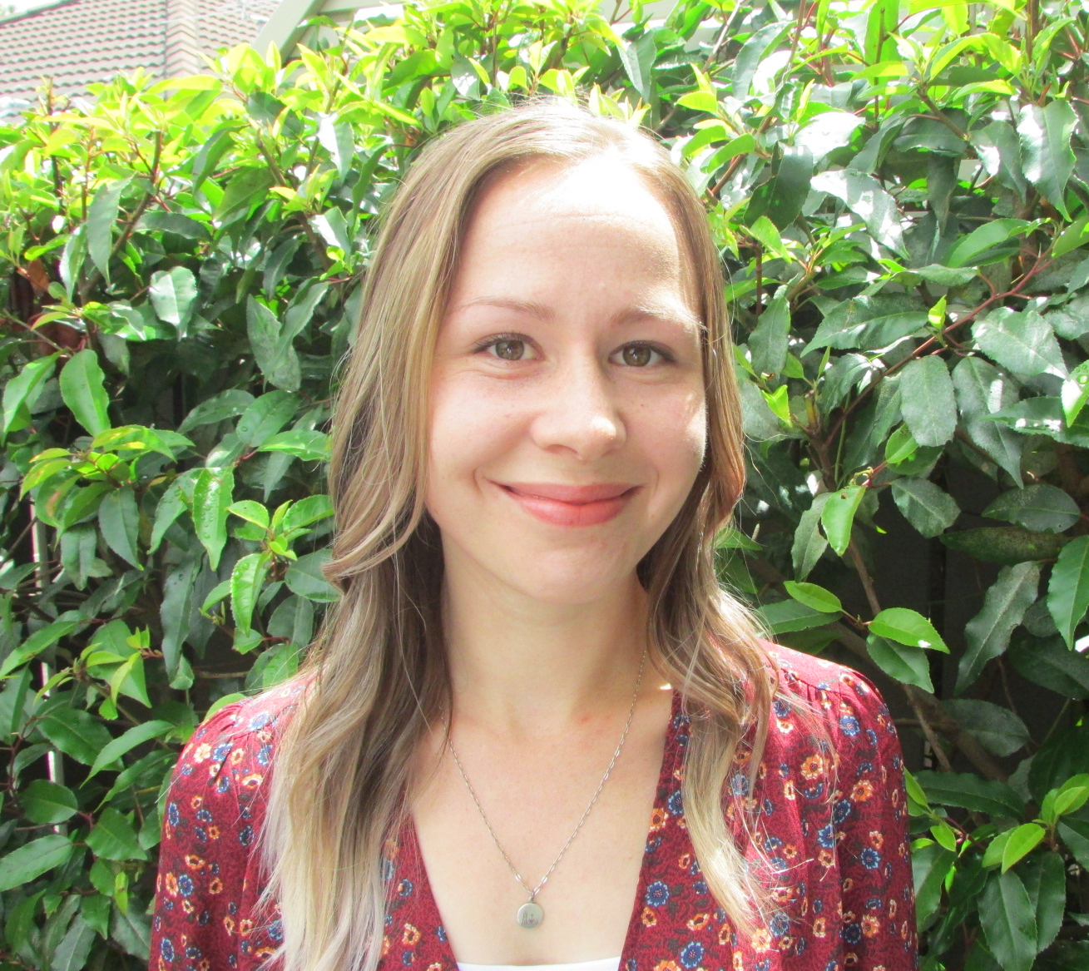
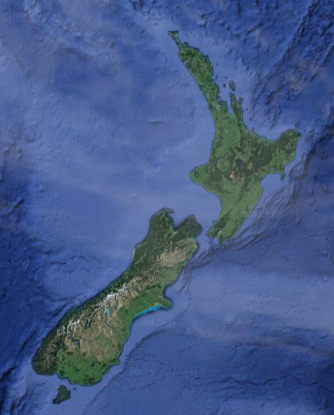

Background
Ph.D. in Geography
Research interests
Spatial epidemiology
Health geography
Spatial statistics
New to microsimulation
Interested in spatial microsimulation
Research funding until mid-2023
Initial stages, seeking feedback
1/6

Slide 3
Spatial Microsimulation… What?
Creation, analysis and modelling
Individual-level data allocated to geographic zones
Grouping variable = geographical
Inherent focus on how things vary over space
Geographically aggregated data
Spatial microdata
Spatial Microsimulation
Survey data
(individual-level)
Considerations
Constraint variables
Target variable(s)
Composite target variable(s)
Scale
Adapted from: Lovelace, R., Dumont, M., 2016. Spatial microsimulation with R. CRC Press
2/6

Slide 4
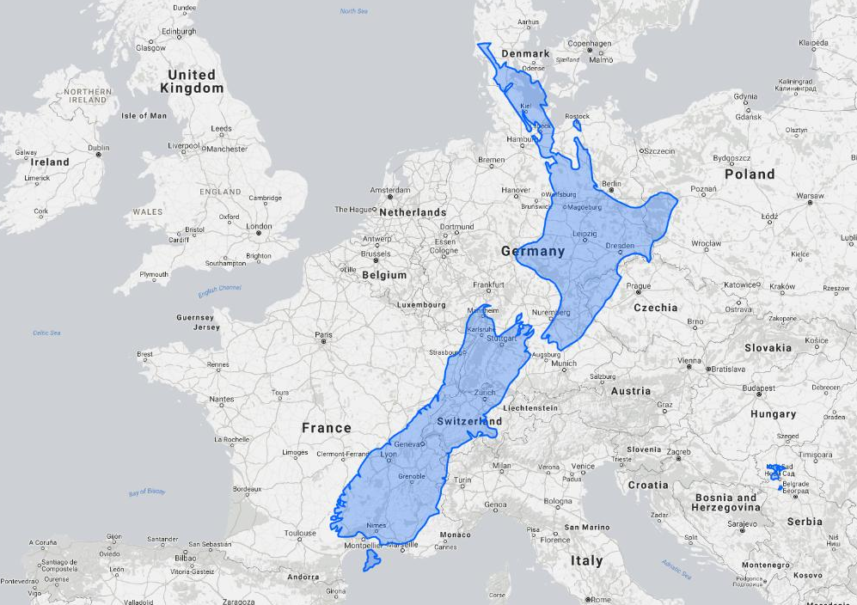
Spatial Microsimulation… Why?
Create model estimates of data that does not exist
Data is often available, but either
not at the geographic level of interest
not accessible due to privacy/confidentiality
Many variables reported in surveys,
but little information on how they vary from place to place
How does this relate to population health and health policy?
Contribute to improved policy implementation and evaluation
Support future planning
Enable resources to be allocated to areas where they are needed the most
Aid in achieving health equity
3/6

Slide 5



This Research
How long can we expect to live?
What is the quality of that life?
What is the cost to the healthcare system?
Not well understood within Aotearoa New Zealand, particularly at a small area scale
Research aim: To develop a spatial microsimulation model that examines health-adjusted
life expectancy, quality of life, and healthcare costs at a localised level in Aotearoa New Zealand
4/6

Slide 6

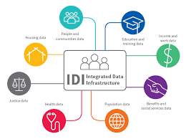


Data
Everything
Census*
Mortality*
Life event data*
Chronic conditions*
Disability survey*
Publicly funded hospital discharges*
Privately funded hospital discharges*
ACC injury claims*
Social housing*
Access to healthcare providers
Quality of environment
Subjective wellbeing
Interpersonal relations
Social inclusion
Health-adjusted life expectancy
Healthcare costs
Quality of life
*Linked data
5/6

Slide 7

Facts are stubborn things,
but statistics are more pliable
Contact: jesse.wiki@auckland.ac.nz
Faculty of Medical and Health Sciences | Mātauranga Hauora
University of Auckland | Waipapa Taumata Rau
Supported by a MBIE Science Whitinga Fellowship administered by Royal Society Te Apārangi on behalf of the New Zealand Government

