Slide 1
IMA 2021 World Congress Pensions microsimulation in the UK government Sam Mold and Ben Durcan
December 2021

Slide 2
Overview of pensions modelling in Department for Work and Pensions
UK Government’s Department for Work and Pensions (DWP) is responsible for welfare, pensions and child maintenance policy.
20 million customers
£200 billion spending per year ($265 billion / €235 billion)
Strong modelling community within DWP including a new Modelling and Forecasting profession.
DWP pension age microsimulation models:
PENSIM – long term pension accrual policy simulation model
PENFORM – medium term pensioner benefits forecasting model
PenPaC – static model of participation in workplace pensions

Slide 3
PENSIM: What is it?
PENSIM is a dynamic microsimulation model that simulates both private and state pension accumulation up to 2100.
Used by DWP policy analysts to improve understanding of long-term implications of current government policy, and alternative policy scenarios, enabling detailed analysis of different groups, income distributions and income sources over time.

Slide 4
PENSIM: Constructing the starting conditions
FRS
Statistical matching
USOC
Fused data
LLMDB
Merge fused and backward simulated data
Base data
Backward simulation
LLMDB
Backward simulated data

Slide 5
PENSIM: Running the model
DemographicsMortality, Migration, Fertility
Education & Training
Disability
Labour Market
Earnings
Private Pensions
Accrual & Receipt
State Pensions
Housing, savings
Tax & Benefits
Accrual & Receipt
Simulated Population contains all data from each simulation year
Model Input Parameters (Excel)
Simulation stage
2011-2100
characteristics of population simulated to change over time
(AnyLogic/Java)
Sample Population in a specific year e.g. 2011/12 (SAS)
Policy analysis
Carried out on simulated data (SAS)

Slide 6
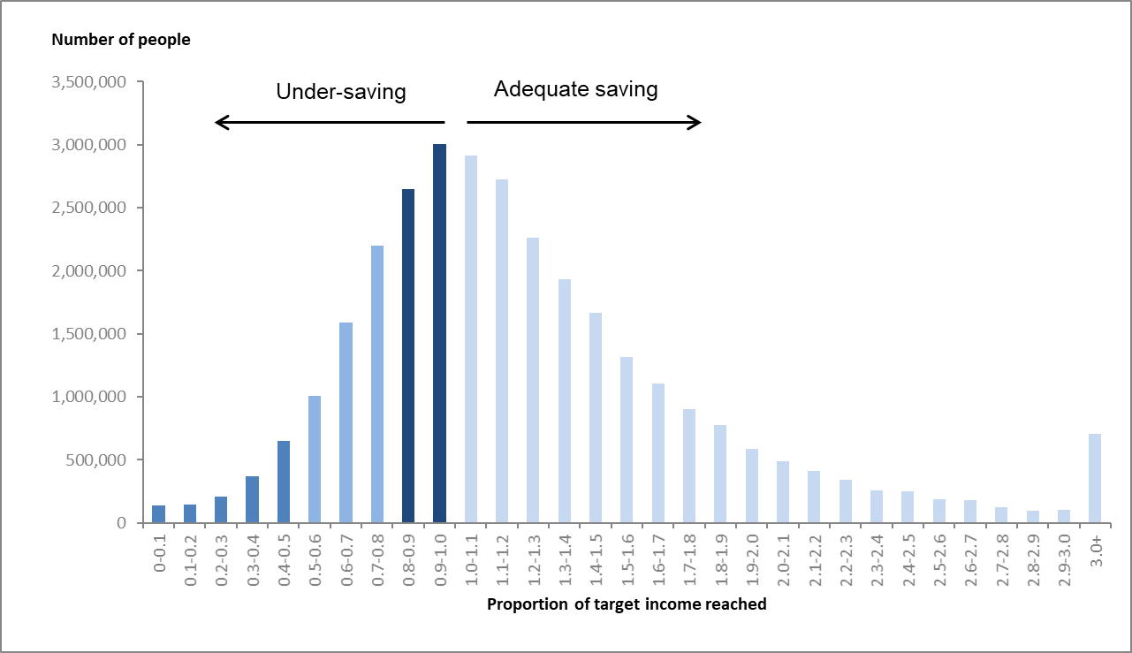
PENSIM: Use in policy simulation
PENSIM has provided the analysis to inform
every major UK pensions policy reform in the last 2 decades, including:
Automatic enrolment into workplace pension
Introduction of a new State Pension system
Uprating of State Pension
Source: Automatic enrolment review 2017

Slide 7
PENFORM: What is it?
PENFORM (PENsioner benefit FORcasting Model) is a dynamic microsimulation model to forecast the State Pension and other (including income related) pensioner benefits. It forecasts both the number of people receiving and the amounts received.
These forecasts are used by the UK’s independent fiscal watchdog, the Office for Budget Responsibility, to feed in to the twice annual Economic and Fiscal Outlook publications, which accompany the fiscal announcements in the UK Parliament.
PENFORM forecasts annual expenditure worth over £110 billion (2021/22 prices).

Slide 8
PENFORM: Constructing the starting conditions
Computer systems to administer DWP benefits
National Statistics database
– used to publish benefit claiming statistics
(Stat-Xplore - Log in (dwp.gov.uk))
PENFORM starting position
February 2019
State Pension
Attendance Allowance and other disability/ carer benefits
Pension Credit (income related)
Matching via anonymised National Insurance number
Model assumptions
Computer systems to locally administer Housing Benefit (rent assistance)

Slide 9
PenPaC: What is it?
PenPaC is the newest of our suite of models. It is a static microsimulation model using employee data to estimate participation in workplace pensions and how it is likely to change with changes in economic parameters and Government policies.
The PenPaC model contains a variety of technical aspects across SAS and Excel.
•PenPaC is primarily a policy simulation model for formal costing and other analysis of automatic enrolment policy changes.
•Secondarily, it is for scenario analysis/forecasting private-sector workplace pension participation and contributions and understanding the system.
Static model - rows in dataset are reweighted each time-step to account for population changes. In PenPaC: ASHE sampling weight reweighted each year of forecast.

Slide 10
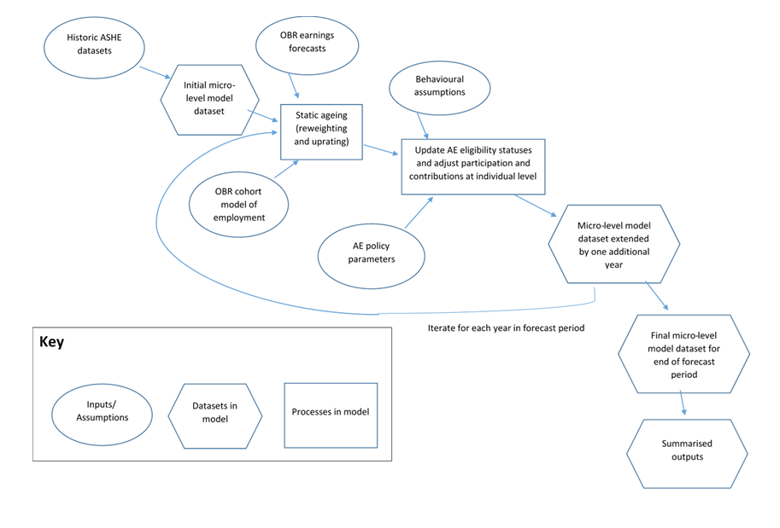
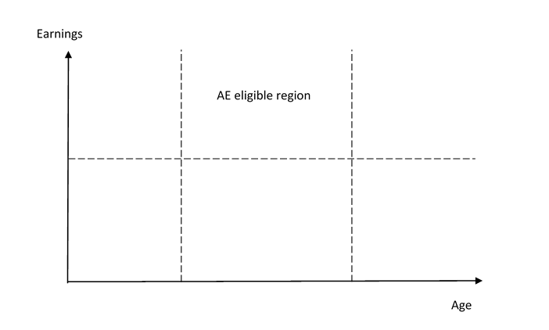

PenPac model process

Slide 11
Issues we're thinking about
Trade offs in modelling
Simplicity | vs | Accuracy
Easy to run and understand |  | Allows greater depth of analysis
Adding new functionality | vs | Keeping assumptions up to date
Demand for wealth modelling |  | Lots of assumptions quite old
Latest technology | vs | Familiar computing language
AnyLogic reduced run times from 8 hours to 15 minutes |  | New staff can get up to speed quicker if in language used elsewhere in department
Invest to gain | vs | Urgent priorities
Need dedicated resource for extended period to make improvements to model |  | Analysis for policy development

Slide 12
For further information, please contact: James Rees Head of Pensions Model Development and Forecasting James.Rees@dwp.gov.uk

